Slide 1
Device Drivers
B R Sahu

Slide 2
Need for Device Driver
For the new hardware device, for which driver is not available,
you are required to write device driver.
You may like to add additional capability to existing device
driver. (Filter Driver)

Slide 3
Device Drivers
They are distinct “black boxes” that make a particular piece
of hardware respond to a well-defined internal programming
interface ; they hide completely the details of how the device
works.
Linux kernel’s role is split into various tasks. The following slide
shows the position of device driver. For each type of device, the
device driver directly interacts with the kernel. A driver usually
implements at least the open, close, read and write systems calls.

Slide 4
A split view of the kernel
The System Call Interface
Process
management
Memory
management
File System
Device
control
Networking
Kernel
subsystems
Concurrency,
multitasking
Virtual
memory
Files and dirs:
the VFS
Ttys &
device access
Connectivity
Features
implemented
File system
Types
Character
devices
Network
subsystem
Software
support
Block devices
IF drivers
Hardware
Memory
Disks & CDs
Consoles,
etc.
Network
interfaces
CPU
features implemented as modules

Slide 5
Classes of Devices
There are mainly three classes of devices:
Character Devices (Console, serial ports, parallel port etc.)
Block Devices ( HDD, FDD, CD-ROM etc..)
Network Devices ( NIC etc)

Slide 6
The Driver and the filesystem
From the user’s side of view the driver looks like an ordinary file.
If you operate on this file via open, close, read or write requests the
kernel looks up the appropriate functions in your driver code.
All drivers provide a set of routines. Each device has a struct
char_fops that holds the pointers to this routine. At init time of the
driver this struct is hooked into another table where the kernel can
find it. The index that is used to dereference this set of routines is
called MAJOR number and is unique so that a definite distinction is
possible. The special inode file for the driver gets its MAJOR number
at creation time via the mknod command. The driver code gets its
MAJOR by the register_chrdev kernel routine.

Slide 7
Driver Processing – Write
The user process calls write(). This invokes the kernel through an INT
instruction where the write operation is conveyed as an index into the
syscall[] table. The filedes argument contains, among other things,
a major device number so that the kernel’s write function can access
the driver’s file_operations structure. The kernel calls the driver’s
write function, which copies the User Space buffer into Kernel Space.

Slide 8
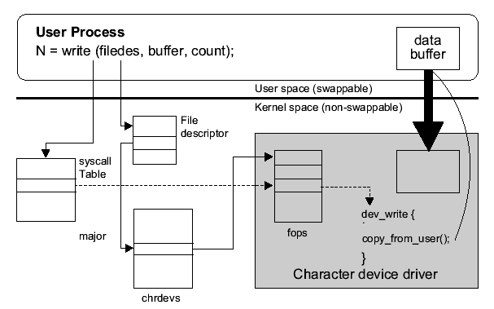
Driver Processing – Write

Slide 9
The general look of a Driver
The structure of a driver is similar for each peripheral device:
You have an init routine that is for initializing your hardware, perhaps
setting memory from the kernel and hooking your driver-routines into
the kernel.
You have a char_fops struct that is initialized with those routines that
you will provide for your device. This struct is the key to the kernel it
is ‘registered’ by the register_chrdev routine.
Mostly you have open and release routines that are called whenever
you perform a open or close on your special inode.
You can have routines for reading and writing data from or to your
driver, a ioctl routine that can perform special commands to your
driver like config requests or options.
You have the possibility to readout the kernel environment string to
configure your driver via lilo.
An interrupt routine can be registered if your hardware support this.

Slide 10
Compile your Driver into kernel code
The most drivers in Linux are linked to the kernel at compile time.
That means if you want to add a driver you have to put your .c and
.h files directly somewhere in the kernel source path and rebuild
the kernel.
Dynamically loaded drivers
The kernel module can be loaded into the kernel at runtime. That
means loaded and removed at any time after the boot process. The
only differences between a loadable Module and a kernel linked
driver are a special init() routine that is called when the module is
loaded into the kernel and a cleanup routine that is called when the
module is removed.

