Slide 1
H/W Interfacing
(I/O, Memory and Interrupts)

Slide 2
Hardware Basics
How to use the device’s control and status registers
What causes the device to generate interrupt
How the device transfers data
Whether the device uses any dedicated memory
Whether the device can be autoconfigured

Slide 3
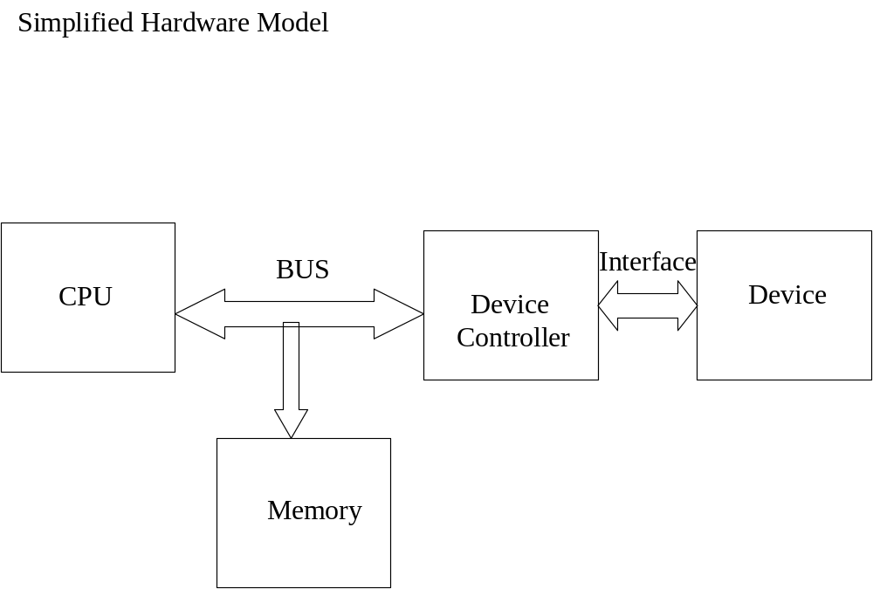

Slide 4
Device Registers: command, status and data buffer
Accessing device Registers: (i) address of the device’s first register (ii) address space where these registers live
I/O Space Registers: (i) inb() Read a single value from I/O Port (ii) outb() Write a single value to I/O Port
Memory-mapped registers: (i) readb() Read a single value from I/O register (ii) writeb() Write a single value to I/O register

Slide 5
Memory-mapped device registers and I/O space ports
Memory
Device
I/O Space
Register
Register
Register
CPU
LOAD/STORE
IN/OUT

Slide 6
Device Interrupts- device interrupts for (i)has completed I/O operation (ii) A buffer or FIFO is full (iii) encounters some kind of error
Interrupt priorities
Interrupt vectors
Signalling mechanism: edge triggered(or latched) interrupts and level-sensitive (or level triggered(level-triggered) interrupt
Processor affinity: multiprocessor platform contains special interrupt routing hardware

Slide 7
Data transfer mechanisms
Three basic options: Programmed I/O, Direct memory access, Shared buffers
PIO - need help of CPU for each byte transfer
DMA- special hardware DMA Controller, System DMA and Bus Master DMA
Device Dedicated Memory - such as video adapter board.

Slide 8
Paths followed by data in DMA and
programmed I/O transfers
DMA Controller
Memory
Count Register
Address Register
I/O
Device
Buffer
Data Register
CPU

Slide 9
Autoconfiguration
Ports, IRQs and DMA channel assignment
Device resource lists: Manufacturer id, device type id, I/O space, interrupt requirement, DMA channels, device memory
No jumpers or switches - change resource dynamically
Change Notification

Slide 10
Buses
Bus is a collection of data, address and control lines that allows a peripheral device to communicate with memory and CPU
ISA - Industry Standard Architecture
MCA - Micro Channel Architecture
EISA - Extended Industry Standard Architecture
PCI - Peripheral component Interconnect

Slide 11
The ISA Bus
The ISA bus is quite old in design and is a poor performer, but it still
holds a good part of the market for extension devices. If speed is not
important and you want to support old motherboards, an ISA
implementation is preferable.
An additional advantage of this old standard is that if you are an
electronic hobbyist, you can easily build your own ISA devices.
A great disadvantage of ISA is that it’s tightly bound to the PC
architecture.
The other great problem with the ISA design (inherited from the
original IBM PC) is the lack of geographical addressing, which has
led to many problems and lengthy unplug-rejumper-plug-test cycles
to add new devices.

Slide 12
Layout of an ISA system
Local Bus
Memory
CPU
PIC
System
DMAC
ISA Bus
ISA Card
ISA Card
ISA Card

Slide 13
The ISA bus clock rate is 16 MHz, the maximum transfer rate is
about 16MB/sec.
The I/O Address range is 0x0000 to 0x03FF.
ISA Bus supports 16 interrupts. Multiple cards can not share the
interrupt.
Upto 8 DMA channels, Can access below 16 MB of memory.
Any device dedicated memory must live with in 16 MB space.
No Auto-Configuration facility, set by DIP switches and jumpers

Slide 14
I/O Ports
Peripheral devices are controlled by writing and reading their registers.
They are accessed at consecutive addresses, either in the memory address
space or in the I/O address space.
Some CPU manufacturers implement a single address space in their chips.
Some processors (x86 etc) have separate ‘read’ and ‘write’ electrical lines for
I/O ports and special CPU instructions to access ports.
Linux implements the concept of I/O ports on all computer platforms it runs
on.
Even if the processor or peripheral bus has a separate address space for I/O
ports, not all devices map their registers to I / O ports.
Use of I / O ports is common for ISA peripheral boards.
Most PCI devices map registers into a memory address region.
Architecture that support memory mapped I/O registers fake port I/O by
mapping port addresses and the kernel hides the details from the driver.

Slide 15
Reading / Writing I/O Ports
Reading : unsigned inb ( unsigned port ) ;
unsigned inw ( unsigned port ) ;
unsigned inl ( unsigned port ) ;
Writing : void outb ( unsigned char byte, unsigned port ) ;
void outw ( unsigned short word, unsigned port ) ;
void outl ( unsigned long word, unsigned port ) ;
Most h/w differentiate between 8-bit , 16- bit & 32 bit ports.
Not to mix them like we do with system memory access.
64 – bit I/O operations are not defined .
Even on 64-bit architectures the port address space uses a 32-bit
maximum.
These functions can also be used from user space ( at least on
PC-class) provided the ioperm or iopl are used to obtain
permissions.

Slide 16
I/O Memory
It is the main mechanism used to communicate with
devices through memory-mapped registers and device
memory.
It is simply a region of RAM- like locations that the device
makes available to the processor over the bus.
According to the computer platform and bus being used,
I/O memory may or may not be accessed through page tables.
If no page tables are needed , then I/O memory locations
look pretty much like I/O Ports.
Direct use of pointers to I/O memory is not a good practice.

Slide 17
I/O Memory…
Devices live at well-known physical addresses, but the
CPU has no predefined virtual address to access them.
For software to access I/O memory, there must be a
way to assign a virtual address to the device.
Linux provides the following functions:
#include < asm/io.h >
void *ioremap ( unsigned long phys_addr, unsigned long size ) ;
void *iounmap ( void *addr ) ;

Slide 18
Registering an interrupt handler
#include < linux/sched.h >
int request_irq ( unsigned int irq,
void ( *handler ) ( int , void *),
unsigned long flags,
const char *dev_name ,
void *dev_id ) ;
irq -> Interrupt number
handler -> Pointer to the interrupt handler function.
flags -> IRQF_DISABLED - ‘fast’ interrupt handler
IRQF_SHARED - interrupt can be shared
dev_id -> It is a unique identifier that is used when the interrupt line is
freed and that may also be used by the driver.
when no sharing is in force , dev_id can be set to NULL.
Interrupt handler can be installed either at driver initialization or
when the device is first opened.
IMPORTANT FILES: /proc/ interrupts

Slide 19
Freeing an interrupt handler
When your driver unloads, you need to unregister your interrupt
handler and disable the interrupt line. To do this call
void free_irq(unsigned int irq, void *dev_id);
If the specified interrupt line is not shared, this function removes the
handler and disables the line.

Slide 20
Interrupt Service Routine
#include <linux/interrupt.h>
irqreturn_t my_isr(int irq, void *dev_id);
In interrupt handler:
If interrupt for someone else
return IRQ_NONE
otherwise
return IRQ_HANDLED

