Slide 1
Linux Network Implementation
Description

Slide 2
Linux: TCP/IP Implementation
The support of network communication is one of the basic needs of
an operating system. The range of network services, such as ftp
(file transfer), telnet and rlogin( remote login), facility to use file
systems on other computers (NFS) are provided in Linux.
An implementation of TCP/IP is provided which concentrates mainly
on Ethernet. Using SLIP (Serial Line Interface Protocol) or PLIP
(Parallel Line Interface Protocol), it is possible to link computers
together via their serial or parallel interfaces.

Slide 3
Network Interface
For the programmer, access to network services is available via
sockets. The interface consists of the C Library routines.
All these functions are based on the system call socketcall(). In
addition, the system call ioctl to socket file descriptors enables
network configuration to be changed.
A computer can be connected to a network via a variety of hardware.
The differences among these are hidden behind a unified interface,
namely network devices. The network devices assigned to Ethernet
have names eth0, eth1, and so on.

Slide 4
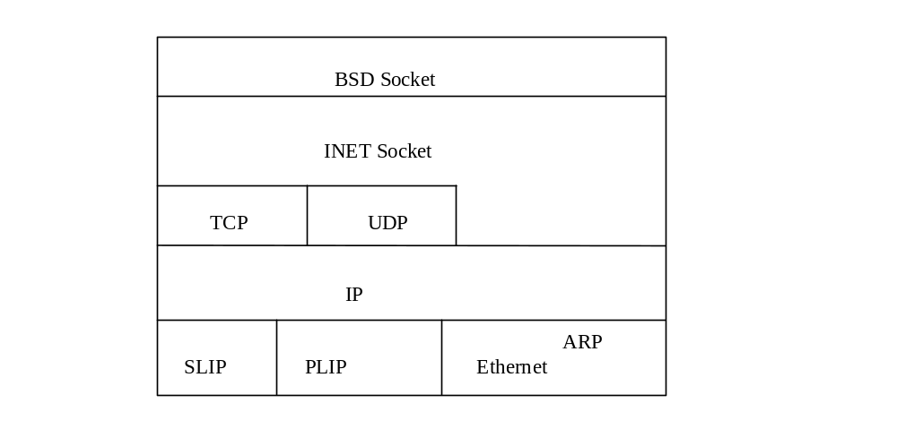
Layer model of network implementation
As communication with network components presents a fairly
complex task. It uses a layer structure like the file system. The
individual layers correspond to levels of abstraction, with the level
of abstraction increasing from layer to layer, starting with the hardware.

Slide 5
Getting data from A to B
Process A
|
Write(socket, data, length);
(sys_write of VFS)
|
BSD: sock_write -> inet_sendmsg
extracts INET socket structure, operation vectors by prot pointer
|
tcp_sendmsg : allocates sk_buff, builds header
| copies the data from process address space
tcp_send_skb() -> ip_queue_xmit : adds IP header
|
dev_queue_xmit -> hard_start_xmit, sends to network adapter

Slide 6
Receive the packet and trigger interrupt (ei_interrupt function)
|
ei_receive - write the packet to newly setup buffer
|
netif_rx -> net_bh()
|
decides the packet type and -> ip_rcv()
|
forwarding: ip_forward() and reassembly: ip_defrag()
|
tcp_rcv() -> get_tcp_sock()
tcp_data() - enters buffer sk_buff in list of receive
|
INET socket: data_ready() , wakes up process waiting for event
Process B receives the data sent by process, by calling
read(socket, data, length)
by calling sys_read, sock_read(), inet_rcvmsg(), tcp_rcvmsg()

Slide 7
Organization of the Linux IPv4 source code
Source tree used for TCP/IP code
linux/net - *.c
linux/net/ipv4 - *.c
linux/drivers/net - *.c
linux/include/net - *.h
linux/include/linux - *.h

Slide 8
BSD Socket
This is general interface and supports various forms of networking
and inter-process communication mechanism.
UNIX Unix domain sockets,
INET The Internet address family supports
communications via TCP/IP protocols
AX25 Amateur radio X25
IPX Novell IPX
APPLETALK Appletalk protocol
X25 X25
Linux BSD sockets support a number of socket types:
Stream, Datagram, raw
The socket structure forms the basis for BSD socket interface.

Slide 9
Important Data structure
socket - BSD socket interface
sock - INET socket , TCP, UDP and raw socket
sk_buff - buffer management in the network
proto - protocol operations (methods-connect, build headers
net_device - network device (ethernet, slip, plip, loopback etc.)
In linux, each file is described by an inode. There is an inode
for each BSD socket - one to one mapping between BSD socket
and their respective inodes.

Slide 10
The socket structure
The socket structure forms the basis for the implementation of the
BSD socket interface. It is setup and initialized with the system
call socket.
struct socket {
socket_state state;
struct proto_ops *ops;
struct sock *sk;
/* points to the sock structure for this socket */
:
short type;
};
Defined in include/linux/net.h

Slide 11
Relationships between the substructures within a socket
Socket
struct socket
struct sock
data
socket

Slide 12
The proto_ops structure
This structure contains the family type for this particular set of
socket operations.
struct proto_ops {
int family;
/* pointers to function for the protocol specific operation
int (*release) (struct socket sock);
int (*bind) (struct socket *sock, struct sockaddr *myaddr,
int sockaddr_len);
int (*connect) (struct socket *sock, struct sockaddr *vaddr,
int sockaddr_len, int flags);
:

Slide 13
The INET socket
It is in the INET structure that the network-specific parts of the
sockets are administered. This is required for TCP, UDP and RAW
socket.
struct sock {
struct sock_common __sk_common;
struct proto *sk_prot;
/* contains the operation vector for the protocol */
:
struct socket *sk_socket;
/* points to the associated BSD socket */
struct inet_opt inet;
/* points to individual IP options */
Defined in include/net/sock.h

Slide 14
Protocol operation in the proto structure
Protocols such as TCP and UDP are accessed via an abstract
interface. This consists of a number of operations and means
that functions whose actions are the same for all protocols.
struct proto{
void (*close)( struct sock *sk, int timeout);
int (*connect)(struct sock *sk, ….);
int (*ioctl)(struct sock *sk, cmd, arg);
Defined in include/net/sock.h

Slide 15
Socket Buffers
Internal architecture of socket buffers, or sk_buffs, how they are
allocated, how they are placed in a header cache and how the
queuing works.
sk_buff contains several fields and there are functions to manipulate
them.
The actual data associated with with the socket is in a separate buffer.

Slide 16
sk_buff_head
Next
Sk_buff
prev
sk_buff
buffer
Next
sk_buff
Sk_buff
Prev
Destination
Source
type
45
tos
List
len
ID
Flags/off
T
P
Csum
IP source
Dest
Sk
Stamp
Dest
Src p
Dst p
Len
Csum
Dev
H
Nh
Mac
Dst
Cb
Len
Data_len
Csum
U
C
P
I
Priority
Dataref
Nr_frags
Frag_list
Page
Users
Prot
Sec
Page offset
Size
Page
Page offset
Size
Page
Trunksize
Page offset
Size
Page
Page offset
Size
Page
Head
Data
Page offset
Size
Page
Page offset
Size
Tail
End
Destructor
skb_shinfo
sk_buff

Slide 17
The socket buffer structure, sk_buff
The sk_buff is defined in include/linux/skbuff.h
struct sk_buff {
struct sk_buff *next;
struct sk_buff prev;
struct sk_buff_head *list; // points to head list of socket buffers
};

Slide 18
On the transmit side of the TCP/IP stack, socket buffers are allocated
in the socket layer before data is ready to transmit.
Socket buffers may be allocated anywhere in the protocol stack.
On the receive side, the socket buffers are allocated by the network
driver’s ISR and remains until application receives the data.

Slide 19
Socket buffers, allocation and lists
Linux slab memory allocation is suitable for networking protocol
stacks because it is efficient and is not prone to fragmentation.
The socket buffer header cache also provides a performance
enhancement since socket buffers are not returned to the general
kernel memory when they are freed, but instead are placed on a
separate header cache.
There are multiple header caches, one for each CPU in SMP.

Slide 20
Socket buffers, utility functions
Utility functions to allocate, de-allocate and manipulate the socket
buffers.
Functions for socket buffer allocation and de-allocation
Functions to copy and clone socket buffers
Functions to manipulate socket buffer pointer fields
Functions to manage lists of socket buffers

Slide 21
Functions for socket buffer allocation and de-allocation
alloc_skb, allocates a new socket buffer
struct sk_buff *alloc_skb(unsigned int size, int priority);
kfree_skb, frees a socket buffer
void kfree_skb(struct sk_buff *skb);

Slide 22
Functions to manipulate socket buffer pointer fields
Functions are provided to prepend headers in the front of packets
or remove headers from a packet in addition to functions for
manipulating amount of space at the end of the packet.
int headroom(const struct sk_buff *skb);
unsigned char *skb_put(struct sk_buff *skb, unsigned int len);
int headroom(const struct sk_buff *skb);
unsigned char *skb_pull(struct sk_buff *skb, unsigned int len);

Slide 23
Functions to manage lists of socket buffers
Functions are provided for the use of writers of protocol and network
interface drivers to manage socket buffers lists.
Queues of socket buffers are a key part of all the layers and member
protocols.
void skb_queue_head(struct sk_buff_head *list, struct sk_buff *newsk);
void skb_queue_tail(struct sk_buff_head *list, struct sk_buff *newsk);
struct sk_buff *skb_dequeue_head(struct sk_buff_head *list);
struct sk_buff *skb_dequeue_tail(struct sk_buff_head *list);

Slide 24
Slab cache info
Slab cache allocation statistics are kept in the /proc file system.
They can be examined by executing the command
cat /proc/slabinfo
The following table shows the statistics for slab cache used by the
TCP/IP stack:
cache_name # # # Total #pages
of Active Available size pages #pages per slab
Ip_fib_hash 14 113 32 1 1 1
Arp_cache 4 30 128 8 9 1

