Slide 1
LOAN PREDICTION USING DECISION TREES
-BY S.Soumyasri
Y.Bindusree

Slide 2
AGENDA
Objective and Libraries used
Data Understanding
Data cleaning and Transformation
Data Inspection
Decision Trees
Results
Conclusion

Slide 3
Objective:
To predict the loan status of the borrower into class 0 or class 1
Libraries and platforms used
-Google Collaborator
-packages
-Pandas
-Numpy
-Seaborn
-Imblearn
-Graphviz
-Matplotlib
-SQL queries
-Scikitlearn

Slide 4
Data Description and cleaning:
Fetched the lending club loan database
Excluding the personal and bank details
Selected the required features are 17 include
-Loan amount, interest rate
-Funded amount, Employee length
-Home ownership, purpose
-open_acc , annual income
-loan_status, dti, tot_cur_bal and so on
Replaced null values with mean of the feature
Notes:
The date/time features of the data have not been taken into account.
Firstly, the personal features like
addr_state,
application_number,
member_id,
Zipcode,
emp_title(where the person works)
Area are not required
Then the bank details like(30)
collection_recovery_fee,descrption for the loan,id,payment plan code,issued month,Src_verification number and so on are not required
The values like revol_util,collections_12_mths_ex_med are replicated so they are not required
From the above data we can see that the features,open_acc_6m,open_il_6m
open_il_12m,
open_il_24m,
mths_since_rcnt_il,
total_bal_il,
il_util,
open_rv_12m,
open_rv_24m,
max_bal_bc,
inq_fi,
total_cu_tl,
inq_last_12m,
annual_inc_joint,
dti_joint,
verification_status_joint
all_util ,a total of 15 values are absolete as most of the data nearly 8 lakhs are absolete
Finally the features which need to be considered are 20 of which we will select the more dominant features through feature selection.Now we will select all those features from the database

Slide 5
Data Transformation
Data filtered using the titles in the purpose field:
- credit card
- medical
- debt
Conclusions:
-It is an imbalanced dataset with 17 features and 3 lakh data points for credit, debt and medical each
-Categorised Loan status as 0 and 1
0:Fully paid or Current
1:Late or charged off

Slide 6
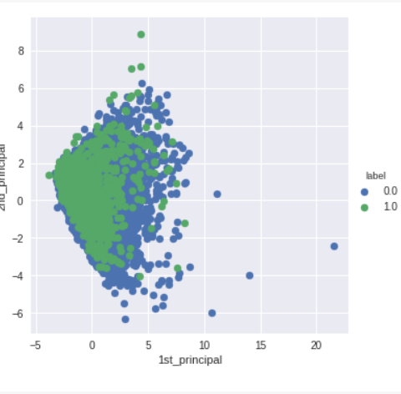
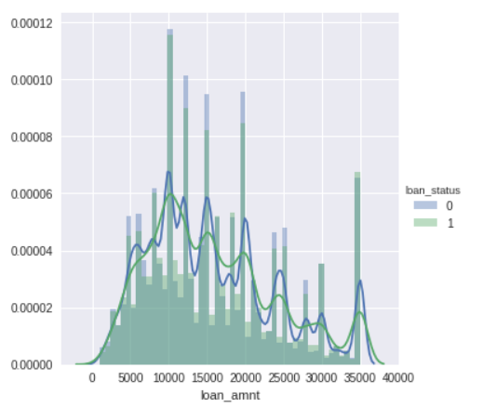
Data Inspection
CDF,PDF of features
PCA of the total data
Pair plots

Slide 7
Decision Trees:
Decision trees
-They are type of Supervised Machine Learning
-Data is continuously split according to a parameter
-Entropy or Gini impurity
Types of Decision trees
-Classification trees
-ID3(Iterative Dichotomiser 3)
-C4.5(Successor of ID3)
-CART(Classification And Regression Tree)
-Regression trees

Slide 8
Decision trees prerequisites
-There is no need for standardization of data
-The data set must be balanced at any cost
-The dataset may be of categorical or numerical
Advantages
-Interpretability
-Feature importance
Disadvantages
-Over fitting
-Unstable
Notes:
Telll about other advantages and disadvt of dtrees in scikitlearn

Slide 9
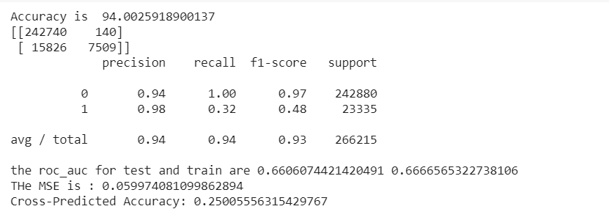
Result:
Accuracy of the model Using Decision tree classifier (scikit learn)
For total data

Slide 10
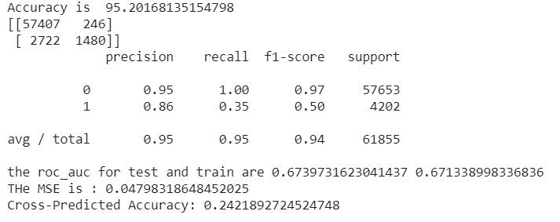
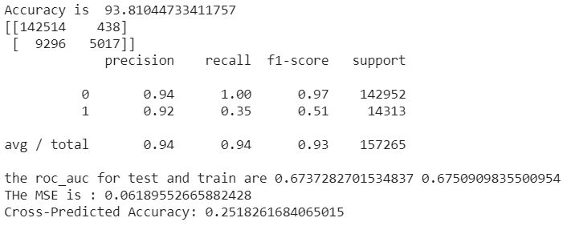
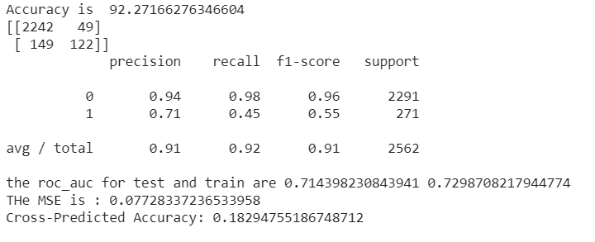
For Data with title credit
For data with title debt
For
For data with title medical

Slide 11
Conclusions:
The modal misclassifies some good points for bad points
The train and test errors can further be reduced by different sampling techniques
-Leave One Out
AUCROC score(0.67) can further be improved
The date/time features of the data have not been taken into account.

Slide 12
THANK YOU

