Slide 1
SARAC RAMSAY
GOOGLE ADS
The best sales and marketing advisors for
expat service companies
around the world.
ADS
GOOGLE ADS GROWTH PROPOSAL
Notes:
So this is the Google Ads growth proposal we put together for [Company Name]. Shall we jump in?
1

Slide 2
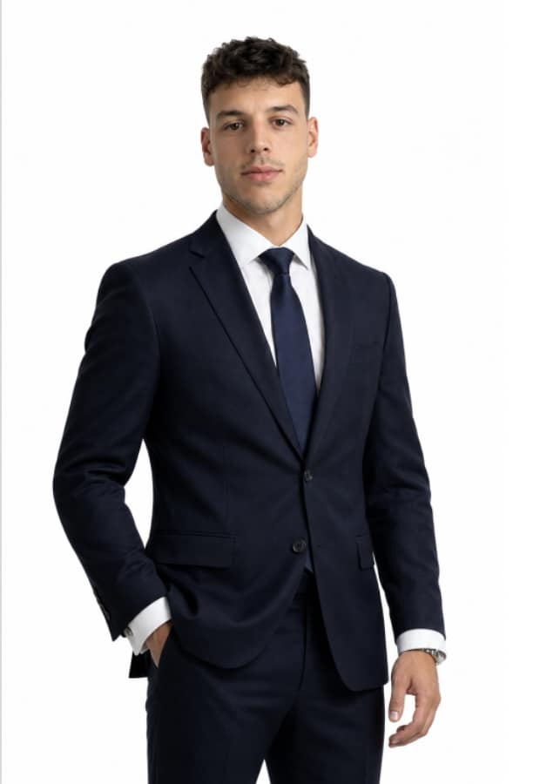
DIRECTOR
Matt Sarac
matt@saracramsay.com
Matt has spent six years in high-end business consulting. In the last three months alone, Matt and his team have generated over €310,000 in new business for their clients.
SARACRAMSAY.COM
Notes:
So a bit about me: I have six years in high-end business consulting, and in the last three months my team has generated over €310,000 in new business for clients. Does that give you a good picture of who you are talking to?
2

Slide 3
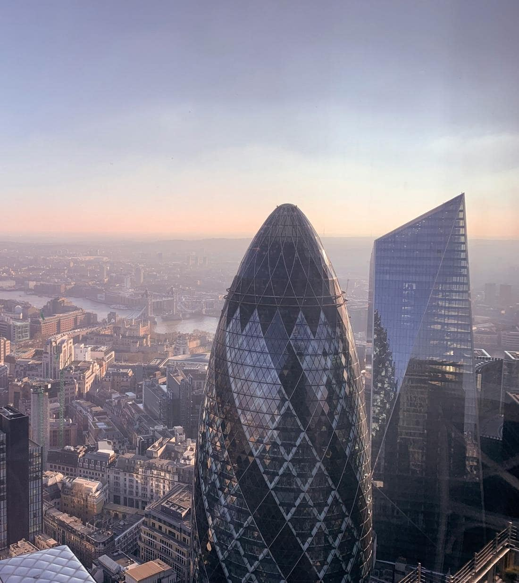
ABOUT SARAC RAMSAY
One of the world's leading
expat service
growth consultants.
We have worked across 189 countries in 10 different expat industries, building the sales and marketing engines that turn local businesses into market leaders.
189
10
Countries served
Expat industries
Google Ads
Social Media Ads
Website Design
SEO
AEO
Custom App Builds
Custom CRM Development
Notes:
And as a company, we are one of the leading expat-service growth consultants, working across 189 countries and 10 expat industries. Any questions about us before we move on?
3

Slide 4




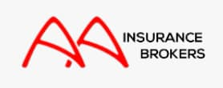
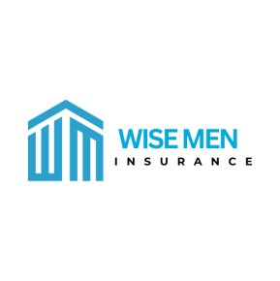










TRUSTED BY BUSINESSES WORLDWIDE
A few of the companies we grow
ATOMS TO ASTRONAUTS
MJEaton
Property Services
Notes:
And these are some of the companies we have worked with. Do any of these names ring a bell?
4

Slide 5
LEADING SALES & MARKETING ADVISORS FOR EXPAT BUSINESSES
In our clients' words
"They ranked us above Nike and Adidas for AI Search in 4 weeks"
"€74k in 32 days"
"€14k in new revenue in 32 days"
BORTZ HUNGARY
PARADISE POOL SERVICES
ATRIUM HR CONSULTING
"1,400 health insurance enquiries"
"€12k in 7 days with no extra ad budget"
"30% conversion landing page"
AA WORLD
ATOMS TO ASTRONAUTS
NOWCOMPARE
"€180,000 in commissions in 4 weeks"
"€92k through AI traffic in 4 weeks"
"Full upsell app build in 24 days"
Results
MARBELLA REAL ESTATE AGENCY
MARRIAGE COUNSELLOR
AA THAILAND
Notes:
So here is what a few of them have said about working with us. Does that sound like the kind of result you are after?
5

Slide 6

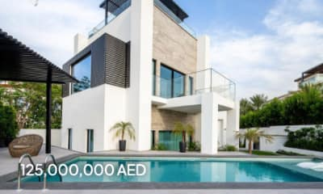


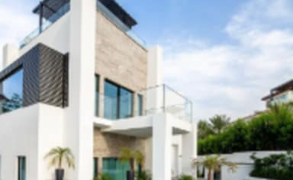

YOUR MARKET BEHAVIOUR
How expats
find a broker.
01
They search on Google
02
They land on your page
03
They enquire
G
o
o
g
l
e
yourbrokerage.com/expats
NEW ENQUIRY
⌕ expat health insurance dubai
YOUR BROKER
J
James Carter
2 min ago
Sponsored
Looking for
Family
Your Brokerage
yourbrokerage.com
Expat Health Insurance Dubai | Your Brokerage
Expat cover in [Location]
Budget
1k–2k
Compare 30+ insurers in one quote. Speak to a licensed broker today.
⌕
Source
Google Ads
Health · Family · Any budget
48 plans match
Compare
AED 1,250/mo
Global health, family
Worldwide · No excess
Gulf Cover Brokers
gulfcoverbrokers.ae
AED 890/mo
Dubai Health Insurance Plans
Regional health cover
GCC · Dental included
Emirates Cover
emiratesassure.ae
AED 640/mo
Call James
Get Insured in Dubai
Essential expat plan
UAE · Meets visa rules
Your ad shows above every other result.
Matched to exactly what they typed.
You get their details straight away.
GOOGLE ADS GROWTH PROPOSAL
SARAC RAMSAY
Notes:
So this is how your expats find a broker today: they search on Google, click the ad at the top, land on a page that matches what they typed, and enquire. Does that match how your clients find you?
6

Slide 7

OPERATION
THE STRATEGY
CODENAME
Paid Expat Capture
How we position [Company Name] to capture ready-to-buy expats the moment they search
GOOGLE ADS GROWTH PROPOSAL
SARAC RAMSAY
Notes:
So Martin, the strategy we prepared is Paid Expat Capture, and the goal is to put [Company Name] in front of ready-to-buy expats the moment they search. Does that sound like what you are looking for?
7

Slide 8

THE CHANNELS
What channels we use
PAID
Google Ads
Search ads
Google Maps ads
SARAC RAMSAY
09
Notes:
So the channel we use is Google Ads, but running ads is not a strategy on its own, which is what the next slides cover. Have you run Google Ads before?
8

Slide 9
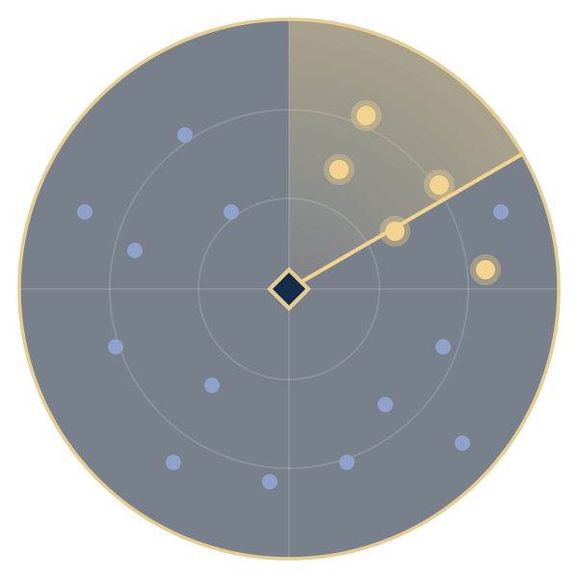
INTEL
THE OPPORTUNITY
Expats are already searching
INTERCEPTED SEARCHES
SIGNAL
SIGNALS DETECTED · MONTHLY
SECTOR · DUBAI
INT-01
“expat health insurance dubai”
INT-02
“health insurance for expats uae”
~X,000
INT-03
“family health insurance dubai”
high-intent insurance searches every month in Dubai
INT-04
“best health insurance dubai”
INT-05
“international health insurance uae”
▲ TARGETS IN RANGE · READY TO BUY
“dubai health insurance quote”
INT-06
Source: Google Keyword Planner, Dubai, Oct 2025 to Sep 2026. Estimate based on the midpoint of each keyword's volume range.
GOOGLE ADS GROWTH PROPOSAL
SARAC RAMSAY
Notes:
Because the opportunity is big: there are [X] searches a month in Dubai for these keywords alone. Were you aware the demand was that big?
9

Slide 10
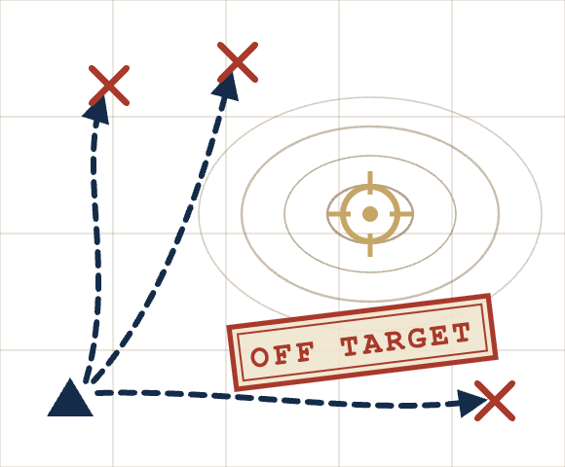
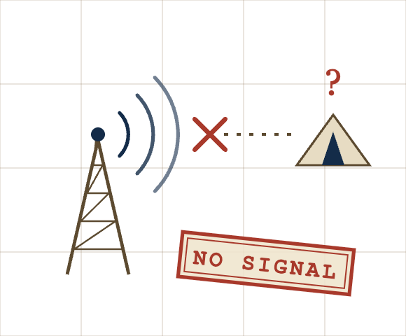
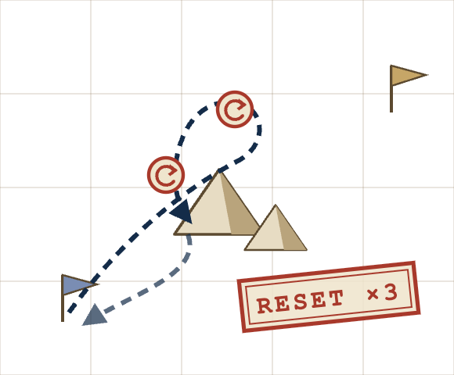

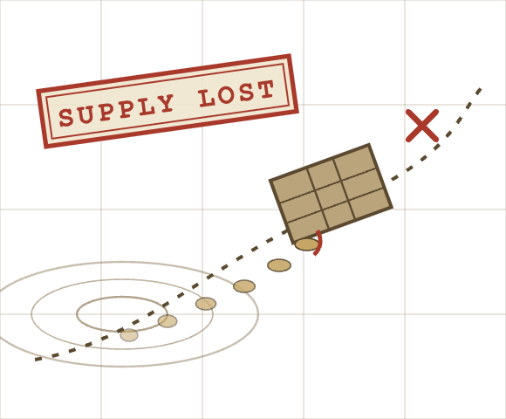
AFTER-ACTION REPORT
THE PROBLEM
Why most Google Ads strategies fail
to attract qualified expats.
REPORT 01
REPORT 02
REPORT 03
REPORT 04
REPORT 05
01
Reaching the wrong people
02
No tracking in place
03
Changed too often
04
Weak ads with no offer
05
Left to run on its own
Ads showed to price-checkers instead of expats ready to buy cover.
With no conversion data, nobody could tell which clicks turned into leads.
Constant edits reset Google’s learning before the results could land.
Nothing in the ad gave a buyer a reason to pick you over a competitor.
No weekly routine to cut what wastes money and scale what works.
GOOGLE ADS GROWTH PROPOSAL
SARAC RAMSAY
Notes:
These are the five reasons most Google Ads strategies fail to attract qualified expats, and our plan is built to avoid every one of them. Have you seen any of these happen in your own campaigns?
10

Slide 11
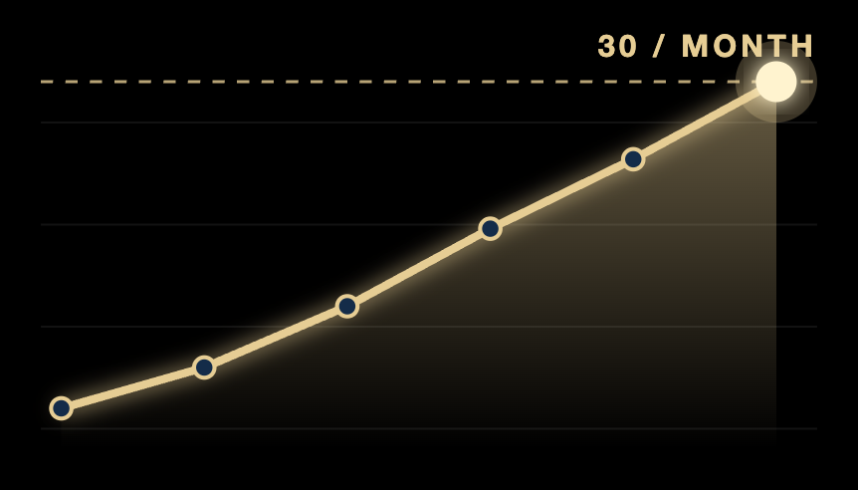

THE PLAN
3 components.
One strategy.
Built so none of the five mistakes can happen.
expat insurance
Sponsored
★
Sponsored · Your Brokerage
Expat Health Cover from AED 500 | Get a Free Quote
Ready-to-buy expat
Sponsored
Sponsored
✓ Tracking
✓ Weekly review
1
2
3
The intent
Stand out
The system
Only show up for expats ready to buy.
An ad that stands out on a crowded page.
Tracking, controlled bidding and a weekly routine until Google optimises for you.
AVOIDS
✕
01 Wrong people
AVOIDS
✕
04 No offer
KPI Cost per lead
KPI Click-through rate
AVOIDS
✕
02 No tracking
✕
03 Changed too often
✕
05 Left alone
KPI 30 conversions a month
GOOGLE ADS GROWTH PROPOSAL
SARAC RAMSAY
Notes:
And it comes down to three components, each one built to stop a specific mistake from happening: the intent, so we only show up for expats ready to buy, standing out, so your ad is the one they click, and the system, so Google ends up optimising for you. Does that make sense so far?
11

Slide 12
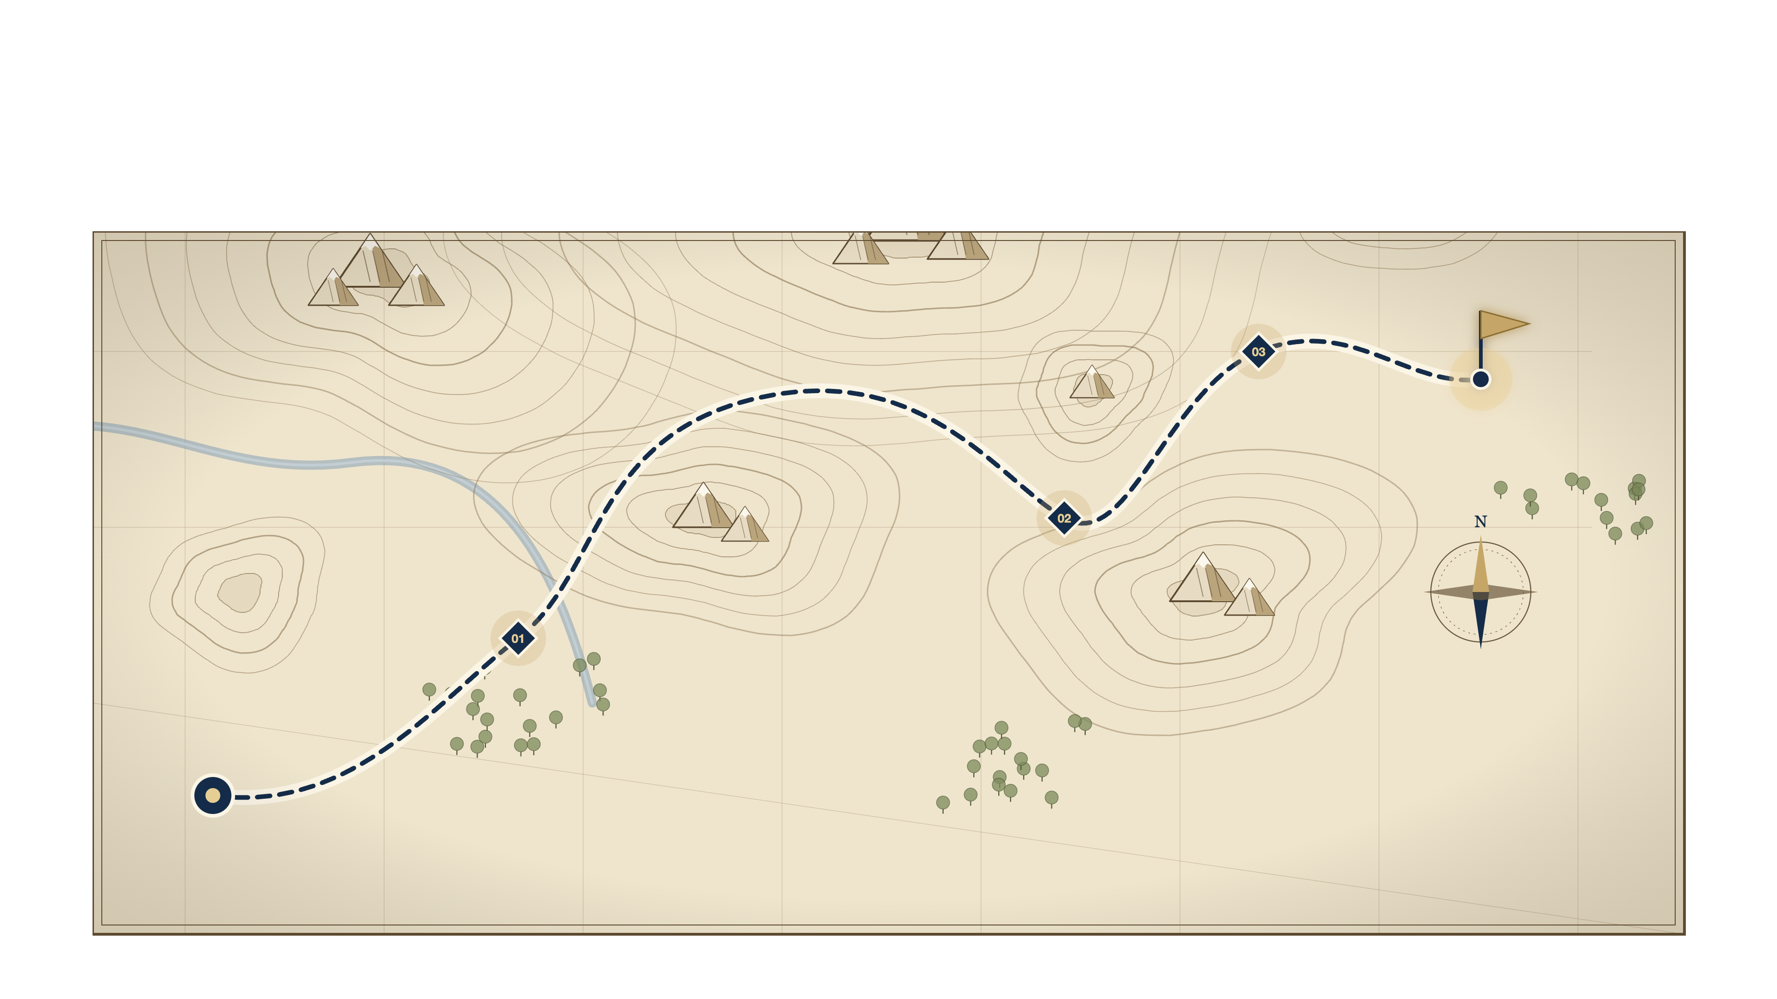



THE PLAN
From where you are
to where you want to be.
OBJECTIVE
OBJ 03 · THE SYSTEM
Qualified expats, every month
Hold the top position
OBJ 02 · STAND OUT
Take the top of the page
OBJ 01 · THE INTENT
Only ready-to-buy expats
YOU ARE HERE
Ads, but no steady leads
GOOGLE ADS GROWTH PROPOSAL
SARAC RAMSAY
Notes:
And these are the three objectives we take on the way. First the intent: we lock onto expats ready to buy. Second, stand out: we take the top of the results page with an ad they want to click. Third, the system: tracking, controlled bidding and a weekly routine that hold the top position, so we reach the objective and stay there.
13

Slide 13


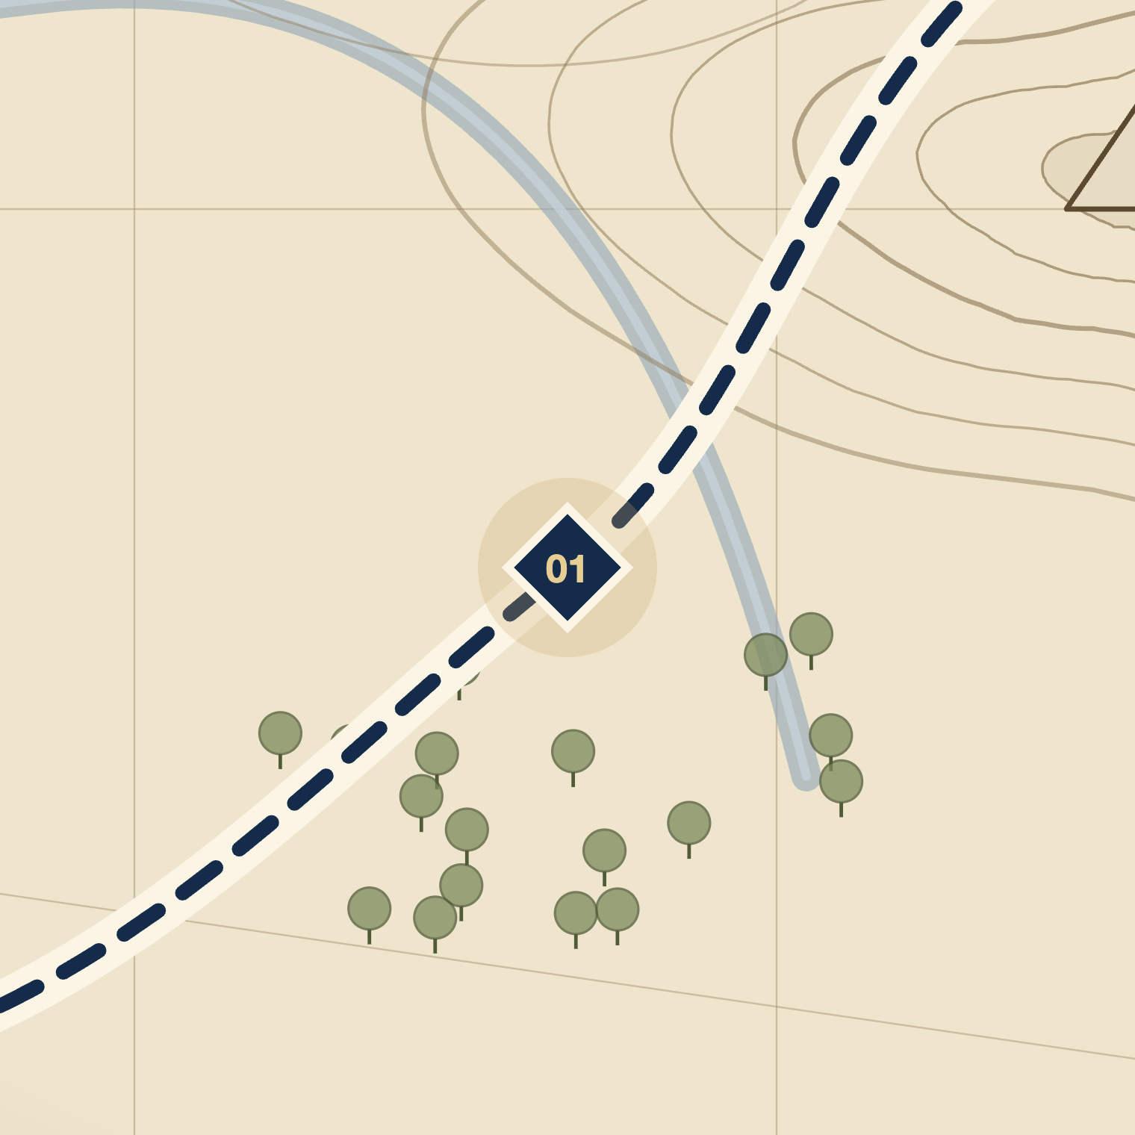

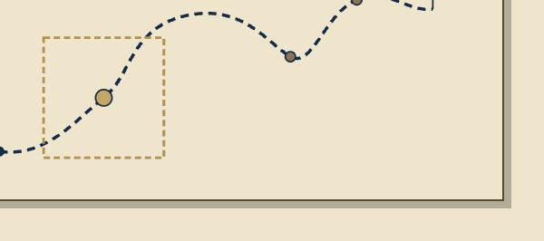
GRID C3 · OBJ 01
ZOOM ×4
OBJ 01
COMPONENT 01 OF 03
The intent
Only show up for expats ready to buy.
GOOGLE ADS GROWTH PROPOSAL
SARAC RAMSAY
Notes:
So the first component is the intent, which means only showing up for expats who are ready to buy.
14

Slide 14


OBJ 01
THE KEYWORDS
More qualified expats,
at a lower cost per lead.
A
B
C
D
⌖ TARGET ZONE
E
F
dubai weather
SEARCH VOLUME →
what is health insurance
is insurance mandatory uae
insurance jobs dubai
family health insurance dubai price
Just browsing
BUYING INTENT →
Ready to buy
SECTOR: [LOCATION] · SEARCH INTEL
High search volume
+
Clear buying intent
=
Higher-quality searchers find you
Enough expats searching every month
Ready to buy, not just browsing
Better leads at a lower cost per lead
GOOGLE ADS GROWTH PROPOSAL · EST. VOLUMES, GOOGLE KEYWORD PLANNER
SARAC RAMSAY
Notes:
We only target searches inside this zone: high search volume and clear buying intent. That is how you get more qualified expats at a lower cost per lead, because your budget goes on buyers, not browsers. Do these look like the searches your buyers make?
15

Slide 15
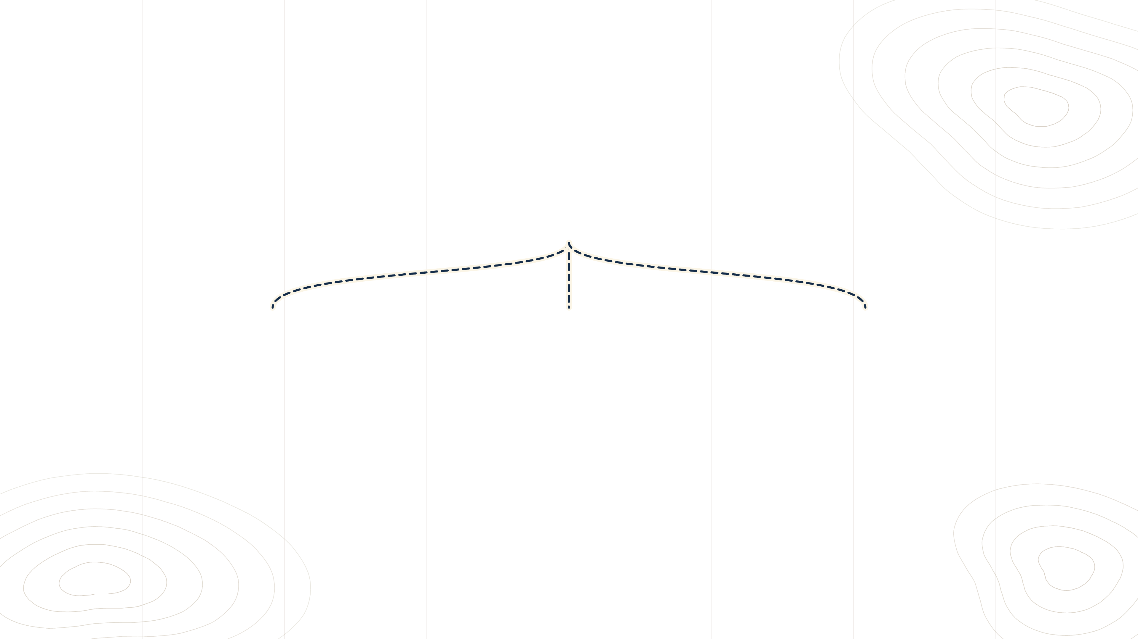
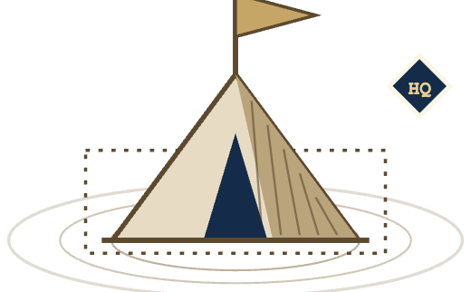




OBJ 01
THE CAMPAIGN STRUCTURE
Show every expat
exactly what they searched for.
BASE CAMP
SEARCH CAMPAIGN · [LOCATION]
CAMP 01 · AD GROUP
CAMP 02 · AD GROUP
CAMP 03 · AD GROUP
Health insurance
Family cover
Life insurance
health insurance [location]
family insurance [location]
life insurance [location]
health cover quote [location]
family medical [location]
life cover [location]
OWN AD
OWN PAGE
OWN AD
OWN PAGE
OWN AD
OWN PAGE
GOOGLE ADS GROWTH PROPOSAL
SARAC RAMSAY
Notes:
We group your keywords by theme, so every expat sees exactly what they searched for. Someone searching for family cover sees a family cover ad and lands on a family cover page. No friction, so it is easier for them to find the plan they want and enquire. Does that make sense?
16

Slide 16
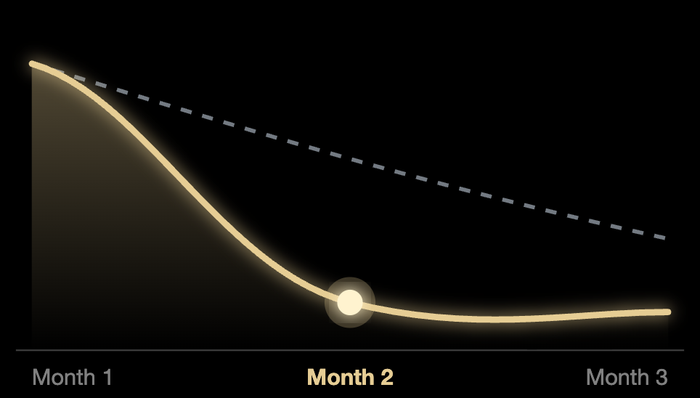






OBJ 01
WHY WE BUILD IT THIS WAY
More expat enquiries
for less money.
GENERIC PAGE
MATCHING PAGE
COST PER LEAD
One campaign
Split budget
buy
plan
in
[location]
⌖ CHEAPER LEADS
Expat cover in [Location]
From month 2, not month 3+
Welcome to Your Brokerage
Sponsored · Your Brokerage
Expat Cover in [Location]
Get a quote
↑ MORE CLICKS THAN COMPETITORS
← Back to Google
✓
New enquiry
ONE CAMPAIGN
AD GROUPS BY THEME
ONE PAGE PER THEME
Cheaper leads, sooner
More people click your ad
More visitors enquire
All your budget feeds one campaign, so Google learns faster and your cost per lead drops weeks earlier.
The ad repeats the exact words the buyer typed, so it looks like the answer and wins the click over competitors.
They land on exactly what the ad promised. No hunting, no bouncing back to Google, so more of them enquire.
GOOGLE ADS GROWTH PROPOSAL
SARAC RAMSAY
Notes:
Why do we build it this way? To get you more expat enquiries for less money: cheaper leads sooner, more people clicking your ad, and more of those visitors enquiring. Any questions on why we set it up this way?
17

Slide 17
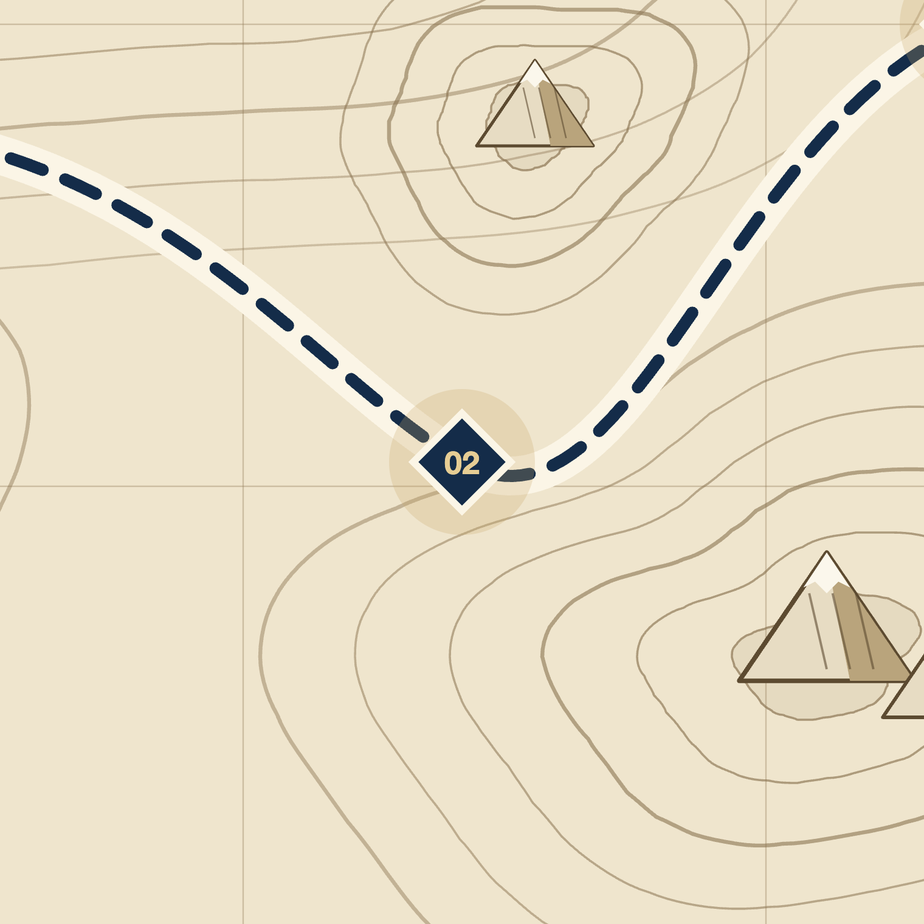
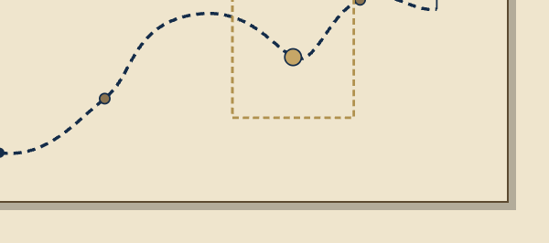
GRID E2 · OBJ 02
ZOOM ×4
OBJ 02
COMPONENT 02 OF 03
Stand out
An ad that stands out on a crowded page.
GOOGLE ADS GROWTH PROPOSAL
SARAC RAMSAY
Notes:
And the second component is making sure your ad is the one they click.
18

Slide 18





OBJ 02
STAND OUT
Same budget.
The ad expats click.
BEFORE · CURRENT AD
AFTER · OUR AD
Sponsored · Your Brokerage
YA
Sponsored · Your Brokerage
yourbrokerage.com
yourbrokerage.com/expats
Insurance in [Location] - Trusted Local Broker - Contact Us Today
Expat Health Cover in [Location] [Price]+ | [Your Offer] | Get a Free Quote
REWRITE
Choosing insurance can feel overwhelming. We are here to help, from quote to claim. Contact us today.
Plans from [Price]. Speak to your own broker, no call centres.
Quotes
Compare
Claims
No offer. No price. No reason to pick you.
Matches the exact search
An offer nobody else has
Price floor filters out browsers
The plan, right in the ad
GOOGLE ADS GROWTH PROPOSAL
SARAC RAMSAY
Notes:
So this is a before and after of your ad. The new one matches the search, leads with an offer comparison sites do not have, shows the plan and sets a price floor, so expats pick you over everyone else on the page. Which of the two would you click?
19

Slide 19







OBJ 02
WHAT AN EXPAT SEES
A crowded page.
You take the top.
INTEL · WHY OURS GETS THE CLICK
Google
expat health insurance [location]
Sponsored · Coastline Insurance
The price is in the headline
coastlineinsurance.com
[Price]+ tells browsers to scroll past.
Insurance Quotes | Find the Right Plan
Compare hundreds of plans. Contact us today.
⌖ TARGET LOCKED
YA
Sponsored · Your Brokerage
yourbrokerage.com/expats
Expat Health Cover in [Location] [Price]+ | [Your Offer]
An offer nobody else has
Plans from [Price]. Speak to your own broker.
[Your Offer] gives expats a reason to click.
Sponsored · Skyline Insurance Group
skylineinsurance.com
Buy Insurance | Best Prices Guaranteed
Health, life and travel cover. Speak to an expert.
The plan is in the ad
Sponsored · Harbour Brokers
An image extension shows the plan before they click.
harbourbrokers.com
Insurance Broker | Contact Us Today
Your trusted local insurance partner since 2010.
GOOGLE ADS GROWTH PROPOSAL
SARAC RAMSAY
Notes:
And this is what an expat actually sees on Google. Most ads look the same, and yours is the one that locks on: the price in the headline, an offer nobody else has, and the plan in the ad. Can you see how it stands out?
20

Slide 20
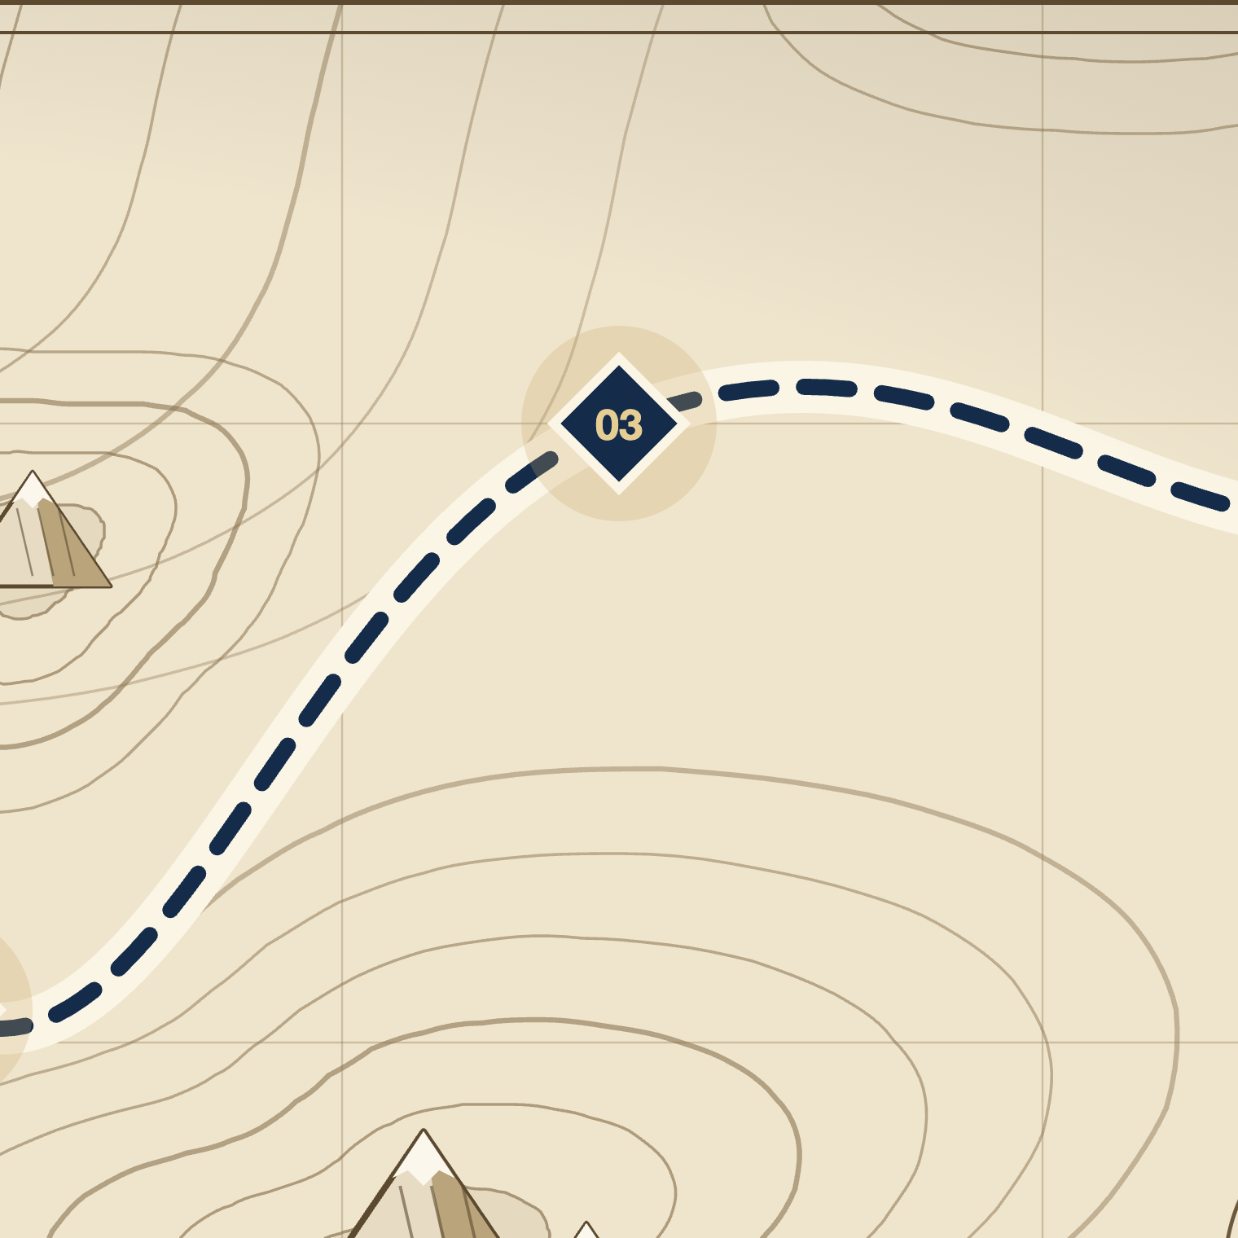


GRID F1 · OBJ 03
ZOOM ×4
OBJ 03
COMPONENT 03 OF 03
The system
Tracking, controlled bidding and a weekly routine until Google optimises for you.
GOOGLE ADS GROWTH PROPOSAL
SARAC RAMSAY
Notes:
And the third component is the system that gets Google optimising for you. Ready for the most important part?
21

Slide 21
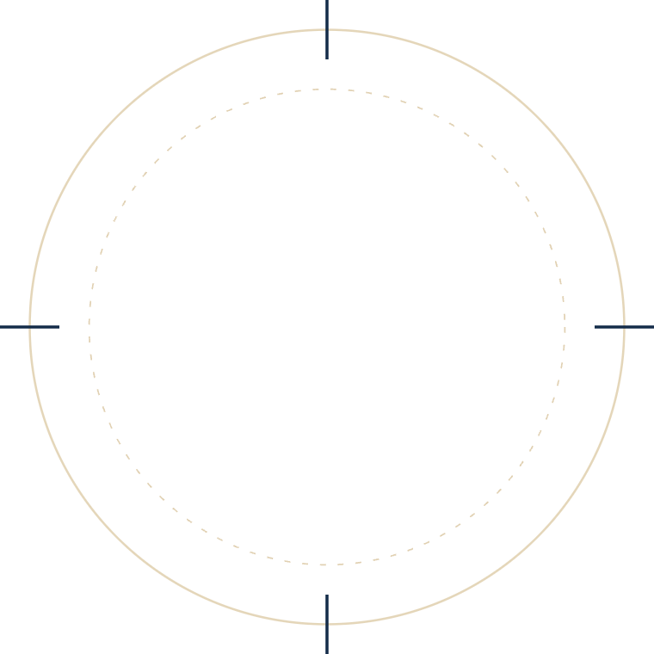
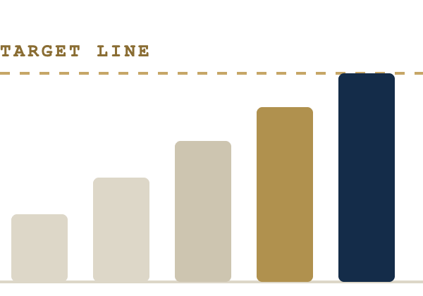
OBJ 03
THE TARGET
30
Thirty conversions a month is the point where Google has enough data to lower your cost per lead on its own.
Below it, we keep bidding manual so your budget stays under our control.
GOOGLE ADS GROWTH PROPOSAL
SARAC RAMSAY
Notes:
So the target is 30 conversions a month, because that is the point where Google has enough data to lower your cost per lead on its own. Does the 30 target make sense?
22

Slide 22


OBJ 03
THE 30 SYSTEM
After 30, Google aims
at the right buyers.
⌖ LOCKED ON
30 leads
BEFORE 30
AFTER 30
Every searcher looks the same
Google zeroes in on your buyer
GOOGLE ADS GROWTH PROPOSAL
SARAC RAMSAY
Notes:
Because before 30, every searcher looks the same to Google, but after 30 it learns what your buyer looks like and goes after them. Does that make sense?
23

Slide 23
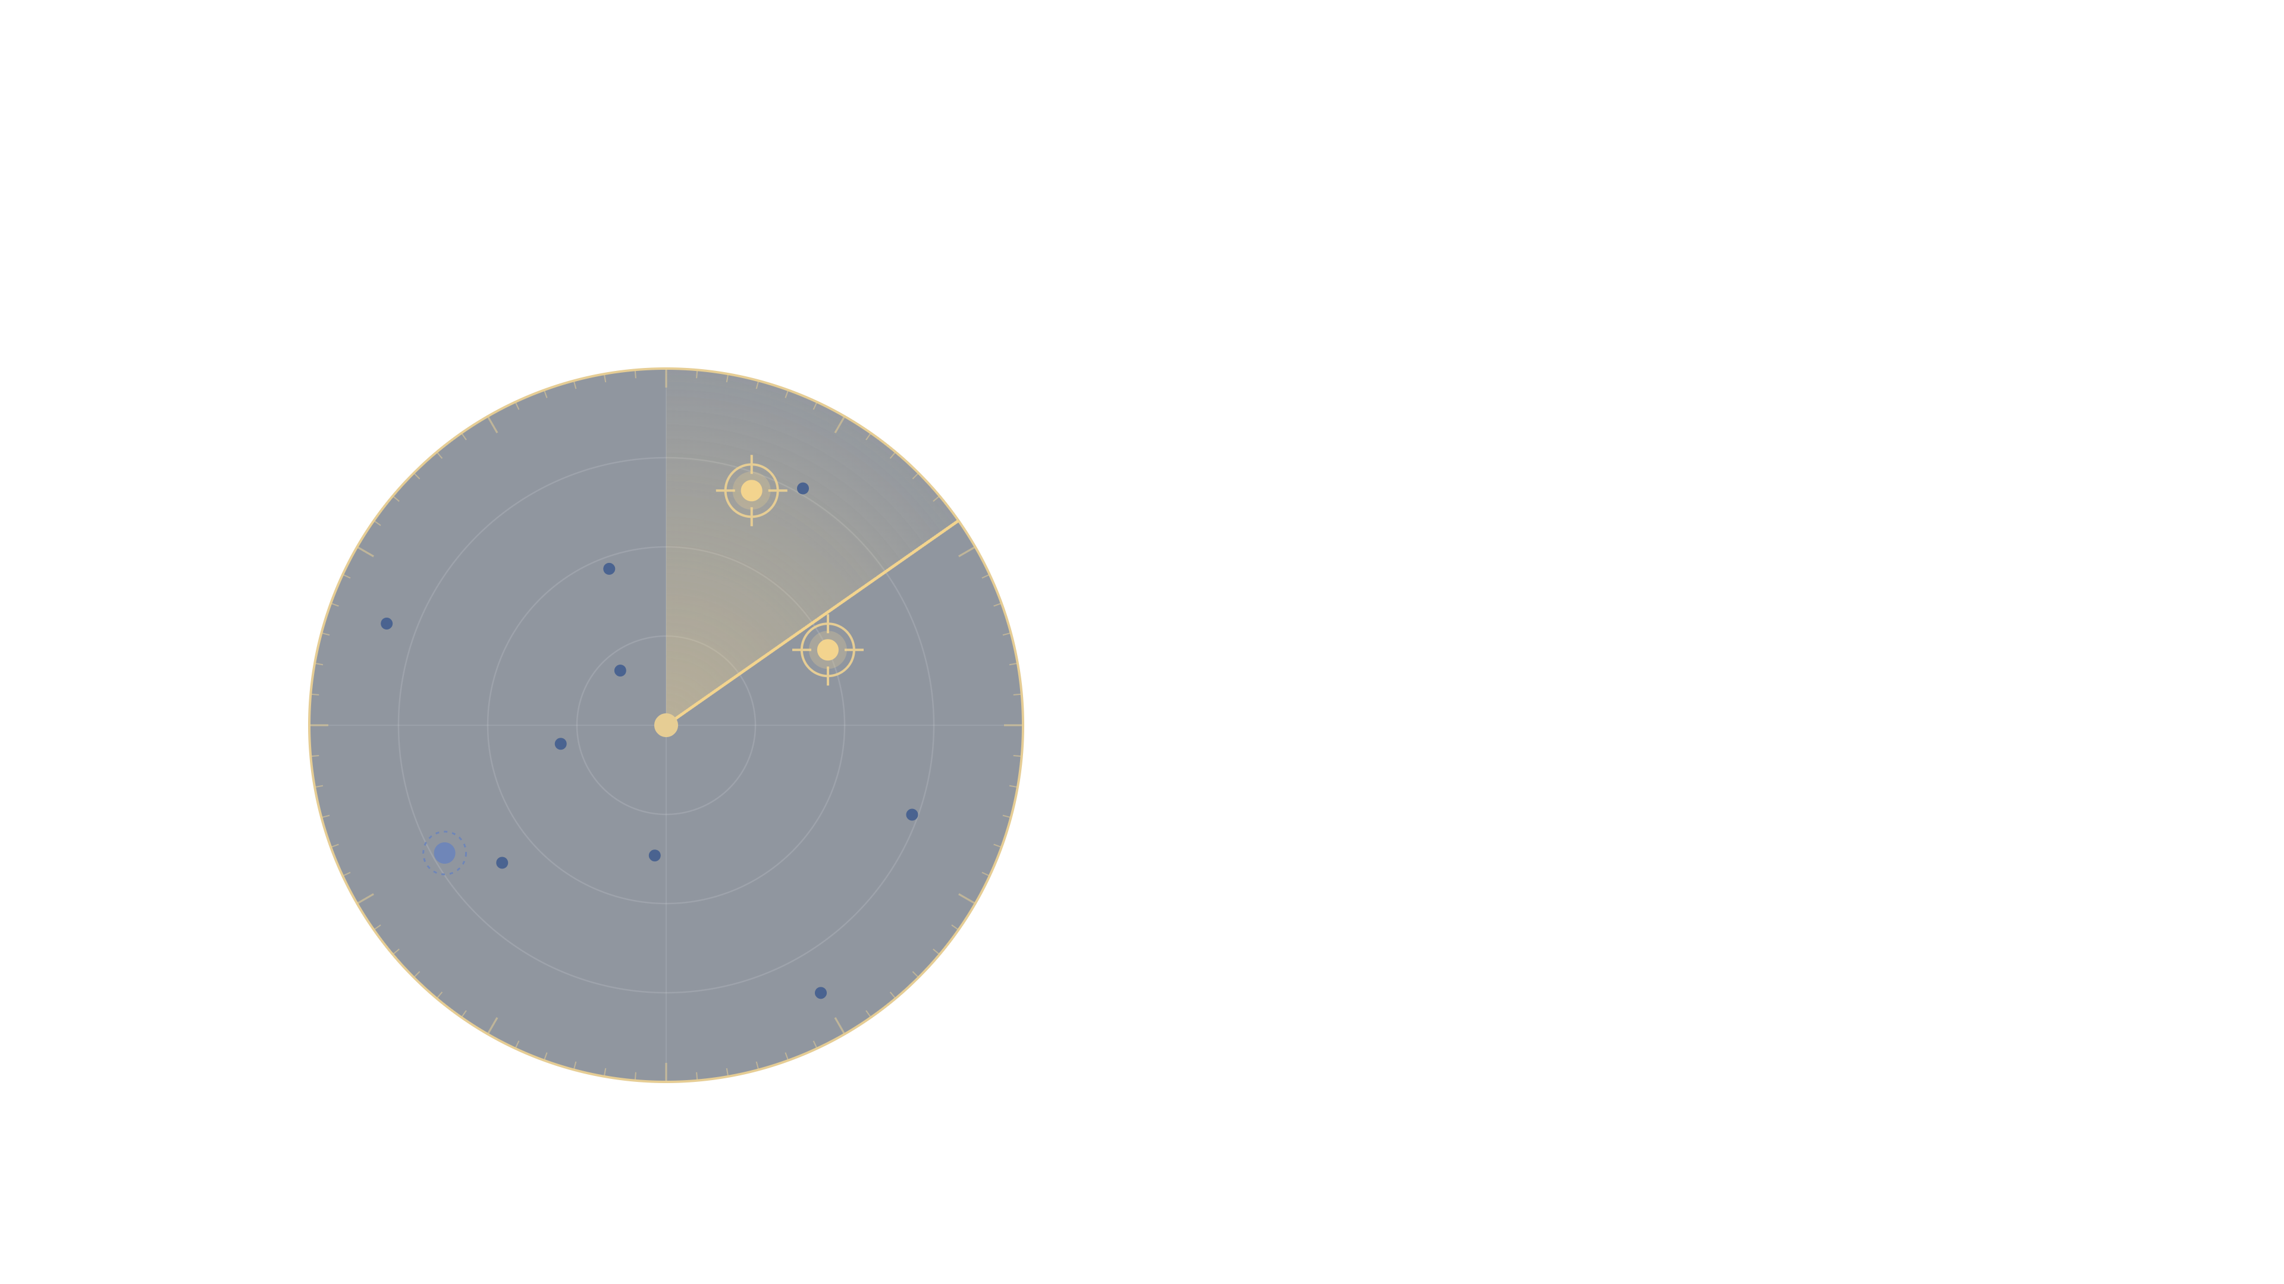
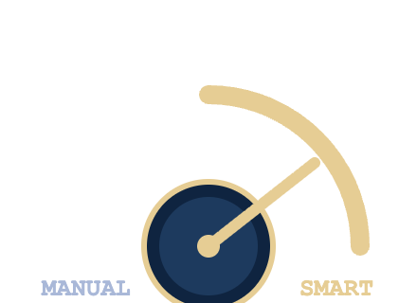
OBJ 03
THE 30 SYSTEM · SMART BIDDING
At 30, Google picks the targets.
Your cost per lead drops.
BIDDING MODE · AT 30 CONVERSIONS
health insurance [location]
Manual off. Smart on.
LIKELY BUYER · ↑ BID HIGHER
family cover [location]
LIKELY BUYER · ↑ BID HIGHER
Looks like your past buyers: bid higher
Unlikely to enquire: bid lower
free clinic [location]
BROWSER · ↓ BID LOWER
Less spent on browsers means every lead costs less.
SCANNING EVERY SEARCH · [LOCATION]
GOOGLE ADS GROWTH PROPOSAL
SARAC RAMSAY
Notes:
At 30 we switch to smart bidding. Google reads every search and judges how likely that person is to become a lead. Searches that look like your past buyers get a higher bid so you show up for them; browsers get a lower bid. Less spent on browsers means every lead costs less. Any questions on how smart bidding works?
24

Slide 24
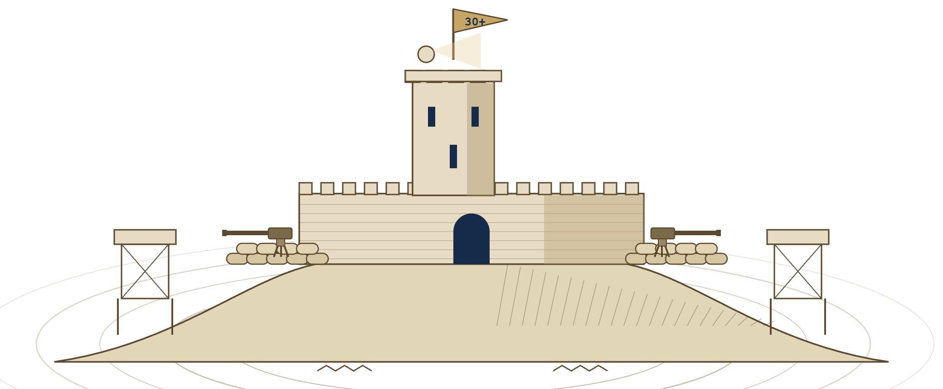
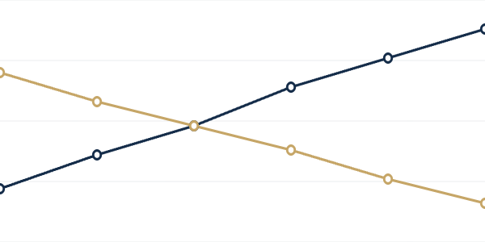
OBJ 03
THE 90-DAY ROADMAP · MONTH 3
STEP 3 OF 3
Hold
the fort.
MISSION
Hold 30+ conversions a month at a lower cost.
ORDERS
Switch to smart bidding, test ad copy, put more budget behind the winners.
WHY IT HOLDS
With 30+ conversions of clean data, Google lowers your cost per lead and scales.
FIELD REPORT · LAST 6 WEEKS
CONVERSIONS
COST PER LEAD
↑ 38%
CONVERSIONS
↓ 41%
COST PER LEAD
WK1
WK2
WK3
WK4
WK5
WK6
GOOGLE ADS GROWTH PROPOSAL
SARAC RAMSAY
Notes:
Month 3 is where we hold the fort. Once we reach 30 conversions we hold that position: smart bidding on, ad copy tested, more budget behind the winners. Over time your conversions go up while your cost per lead comes down. Does that make sense?
25

Slide 25
SUPPLY LINES
THE MATH · 90 DAYS
How one month of leads is calculated
30
2.5%
1,200
12.85
15,425
÷
=
×
AED
=
AED
LEADS TARGET
CONV. RATE
CLICKS
CPC
AD BUDGET
1,200 clicks at a 5% CTR need about 24,000 impressions
Month one
Month two
Month three
90 days
MISSION OUTCOME · 90 DAYS
IDEAL
REALISTIC
IDEAL
REALISTIC
IDEAL
REALISTIC
TOTAL
~[X]
Leads target
30
~15
30
~24
30
~30
~69
new policies
Conv. rate
2.5%
1.25%
2.5%
2.0%
2.5%
2.5%
–
~
AED
[X]
CPC
AED 12.85
AED 12.85
AED 12.85
AED 12.85
AED 12.85
AED 12.85
AED 12.85
commission
Ad budget
AED 15,425
AED 15,425
AED 15,425
AED 15,425
AED 15,425
AED 15,425
AED 46,275
[X]x your ad spend
Commission based on [average annual premium] at a [X]% broker commission.
GOOGLE ADS GROWTH PROPOSAL
SARAC RAMSAY
Notes:
So this is the maths: 30 leads at a 2.5% conversion rate needs 1,200 clicks, and the table shows the ideal month against a realistic one. Any questions on the numbers?
26

Slide 26
PROPOSAL
Google Ads Plans
Project Fee
Monthly Retainer
Retainer + Revenue Share
Pay once, we build and deliver
Ongoing management, cancel anytime
Aligned incentives, shared upside
€5,000
one-time
€2,000
/mo
€1,000
/mo
+ 5% of ad-generated revenue
WHAT YOU GET
SAME DELIVERABLES
✓
Keyword & intent research
✓
Keyword & intent research
SAME DELIVERABLES
✓
Full campaign build & launch
✓
Full campaign build & launch
✓
Keyword & intent research
✓
Ad copy & creative
✓
Ad copy & creative
✓
Full campaign build & launch
✓
Landing page optimization
✓
Landing page optimization
✓
Ad copy & creative
✓
Conversion tracking setup
✓
Conversion tracking setup
✓
Landing page optimization
✓
Bid & budget management
✓
Bid & budget management
✓
Conversion tracking setup
✓
A/B testing & optimization
✓
A/B testing & optimization
✓
Bid & budget management
✓
Reporting & strategy calls
✓
Reporting & strategy calls
✓
A/B testing & optimization
✓
Reporting & strategy calls
No lock-in. No setup fee. We manage and optimize month to month.
HOW IT WORKS
Lower retainer monthly. We take a percentage of ad-generated revenue, we only earn when you earn.
One payment. We build, launch, and manage it for 90 days.
GOOGLE ADS GROWTH PROPOSAL
SARAC RAMSAY
Notes:
So here is how we can get started, with three payment options, which one feels best for you?
27

Slide 27
100%
OUR GUARANTEE
Qualified leads in 30 days
[Guarantee details, e.g. "If we don't deliver qualified leads within 30 days of campaign launch, we refund your management fee in full. No questions asked."]
30
or
100%
DAYS TO LEADS
MONEY BACK
GOOGLE ADS GROWTH PROPOSAL
SARAC RAMSAY
Notes:
And we guarantee qualified leads in 30 days, or your money back. Does that make you feel more comfortable getting started?
28

Slide 28
SARAC RAMSAY
GOOGLE ADS — CASE STUDY
GOOGLE ADS — CASE STUDY
How we helped an Expat Insurance Broker earn
in commissions in 35 days
€180,000
€4M
€1,500/month in ad spend
€180,000+ in commission earned
[CLIENT NAME] — [LOCATION]
Notes:
So let me show you a client we did this for. Want to see where they started?
29

Slide 29
SARAC RAMSAY
[CLIENT NAME]
THE CHALLENGE
Where they were,
before we started.
SAME RESULTS
MARKETING SPEND
Google Ads
PAID
1–2
Meta Ads
PAID
SEO
PAID
Social media
PAID
Marketing staff
PAID
SALES / MONTH
Consultants
PAID
€10k+
before
TOTAL
01 · SALES
02 · SPEND
03 · LEAD QUALITY
1–2 sales a month
€10k+ already spent
2 in 100 enquiries qualified
Across health, life and travel cover.
Across every channel, plus staff and consultants.
Every channel, every hire. The result was always the same.
Notes:
Because before us, [Client Name] was making one to two sales a month, after spending more than €10,000 on marketing. Does any of that sound familiar?
30

Slide 30
SARAC RAMSAY
[CLIENT NAME]
THE RESULT
Six months later,
it’s still working.
MAIN RESULT
ENQUIRIES
Live
B
Quote request · Health
QUALIFIED
✓
Commission received
Today
€180,000
+ €180,000
B
Quote request · Family
QUALIFIED
2 days ago
From
Policy sales
B
Quote request · Life
QUALIFIED
4 days ago
Source
Google Ads leads
in new commissions
Status
Completed
Every 48 hrs
Within 35 days of going live.
A steady flow of qualified enquiries
PLUS · GOOGLE
PLUS · AI SEARCH
PLUS · WEBSITE
expat insurance
Best expat insurance broker?
yourclient.com
AI
Top picks for expats:
Cover that moves
GET A QUOTE
yourclient.com
1. [Client Name]
[Client Name] · Expat Insurance
Top 3
50%
New website
Organic Google rankings
Visibility on AI engines
Designed and optimised for conversion
Notes:
And now they have made €180,000 in new commission in 35 days, with a steady flow of qualified enquiries. Could you see something like that working for [Company Name]?
31

