Slide 1

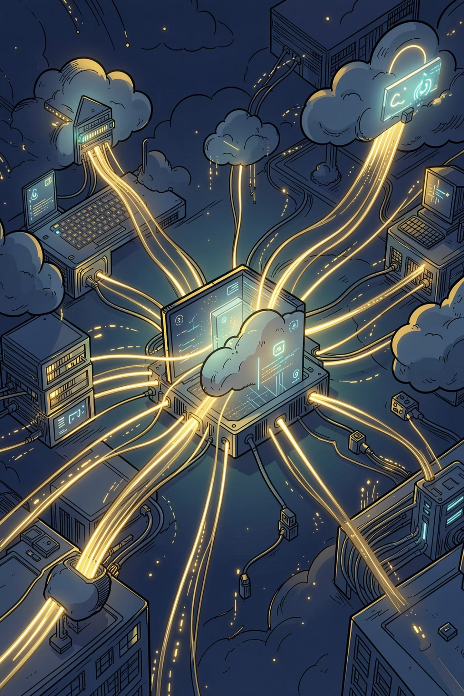
Project Title: Serverless Web Application using Lambda + API Gateway
Batch Number: 37
A Team of 5 members:
1. LINGALA SARACHANDRA,23BQ1A05C2,VVIT GUNTUR,(Batch-1)
2. JAGADALA NAGENDRA BABU,23BQ1A0591,VVIT GUNTUR,(Batch-1)
3. PACHIPALA NARESH KUMAR,23BQ1A05G3,VVIT GUNTUR,(Batch-1)
4. SUMALA JAGADEESH,23BQ1A0592,VVIT GUNTUR,(Batch-1)
5. GULLAPUDI DURGA PRASAD,23BQ1A0586,VVIT GUNTUR,(Batch-1)

Slide 2
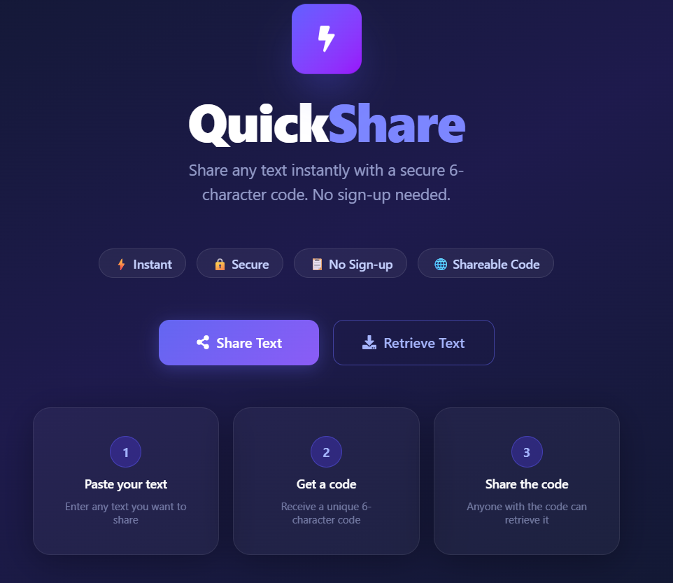

QuickShare
Serverless Web Application using React.js and AWS Cloud Services
QuickShare is a serverless web application that enables users to securely share text using a unique share code. Built with React.js for the frontend and powered by AWS Lambda, API Gateway, Amazon S3, IAM, and CloudWatch, it eliminates traditional server management while delivering scalability, reliability, and cost efficiency.

Slide 3
Project Overview
QuickShare is a cloud-based text-sharing platform where users generate a unique share code for their content and retrieve it later. The frontend, built with React.js, is hosted as a static website on Amazon S3. Backend logic runs on AWS Lambda, invoked through Amazon API Gateway. Shared data is stored in MongoDB Atlas, while CloudWatch monitors logs and IAM controls access between AWS services.
Frontend
Backend
React.js hosted on Amazon S3 as a static website with S3 bucket policies for public access
AWS Lambda functions invoked via RESTful API Gateway endpoints, processing requests on demand
Database
Monitoring
MongoDB Atlas cloud database for persistent, scalable storage of shared text content
Amazon CloudWatch captures execution logs and metrics for observability and debugging

Slide 4

Problem Statement
The Challenge with Traditional Architecture
The Serverless Solution
Traditional web applications require dedicated servers for hosting backend services, which increases infrastructure costs and operational complexity. These servers demand continuous maintenance, manual scaling, and regular monitoring — all of which consume time and resources even during periods of low traffic.
By adopting a serverless architecture, QuickShare removes the need to provision or manage servers entirely. AWS automatically handles infrastructure provisioning, scaling, and availability — allowing developers to focus purely on application logic.
High infrastructure and maintenance costs
Manual scaling and capacity planning
Continuous server monitoring overhead
Complex deployment and update cycles
With serverless, you pay only for actual compute time used — there are no charges when the application is idle.

Slide 5
Project Objectives
The primary objective is to develop a secure, scalable serverless web application for sharing text via unique share codes — leveraging the full power of AWS managed services.
1
Host Frontend on S3
Serve the React.js application as a static website via Amazon S3 with public read access configured through bucket policies.
2
Process Requests with Lambda
Execute backend logic using AWS Lambda, triggered only when API requests are received, ensuring cost-efficient compute.
3
Expose REST APIs
Use Amazon API Gateway to expose clean RESTful endpoints that route incoming requests to the appropriate Lambda functions.
4
Secure Data Storage
Stored shared text securely in MongoDB Atlas using a protected database connection, while IAM securely manages Lambda permissions for AWS services.
5
Monitor with CloudWatch
Automatically capture execution logs, track performance metrics, and set up alarms for operational visibility.

Slide 6
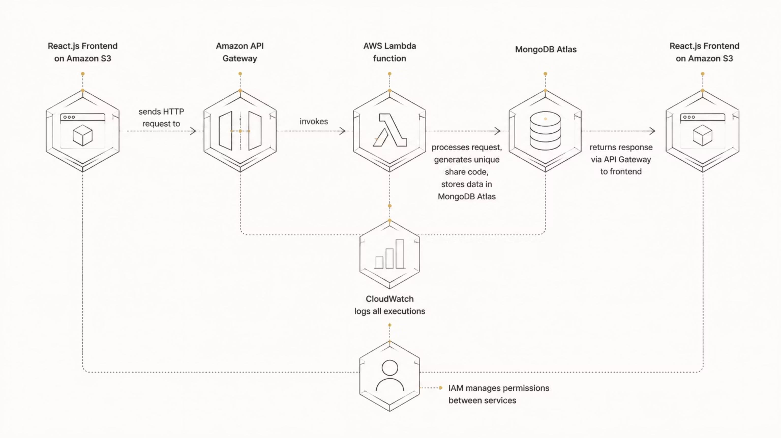
System Architecture
QuickShare follows a fully serverless architecture. The React.js frontend hosted on Amazon S3 communicates with backend services through API Gateway and Lambda, with data persisted in MongoDB Atlas and all execution monitored by CloudWatch.
This architecture ensures zero server management, automatic scaling, and pay-per-use billing — making it ideal for applications with variable traffic patterns.

Slide 7
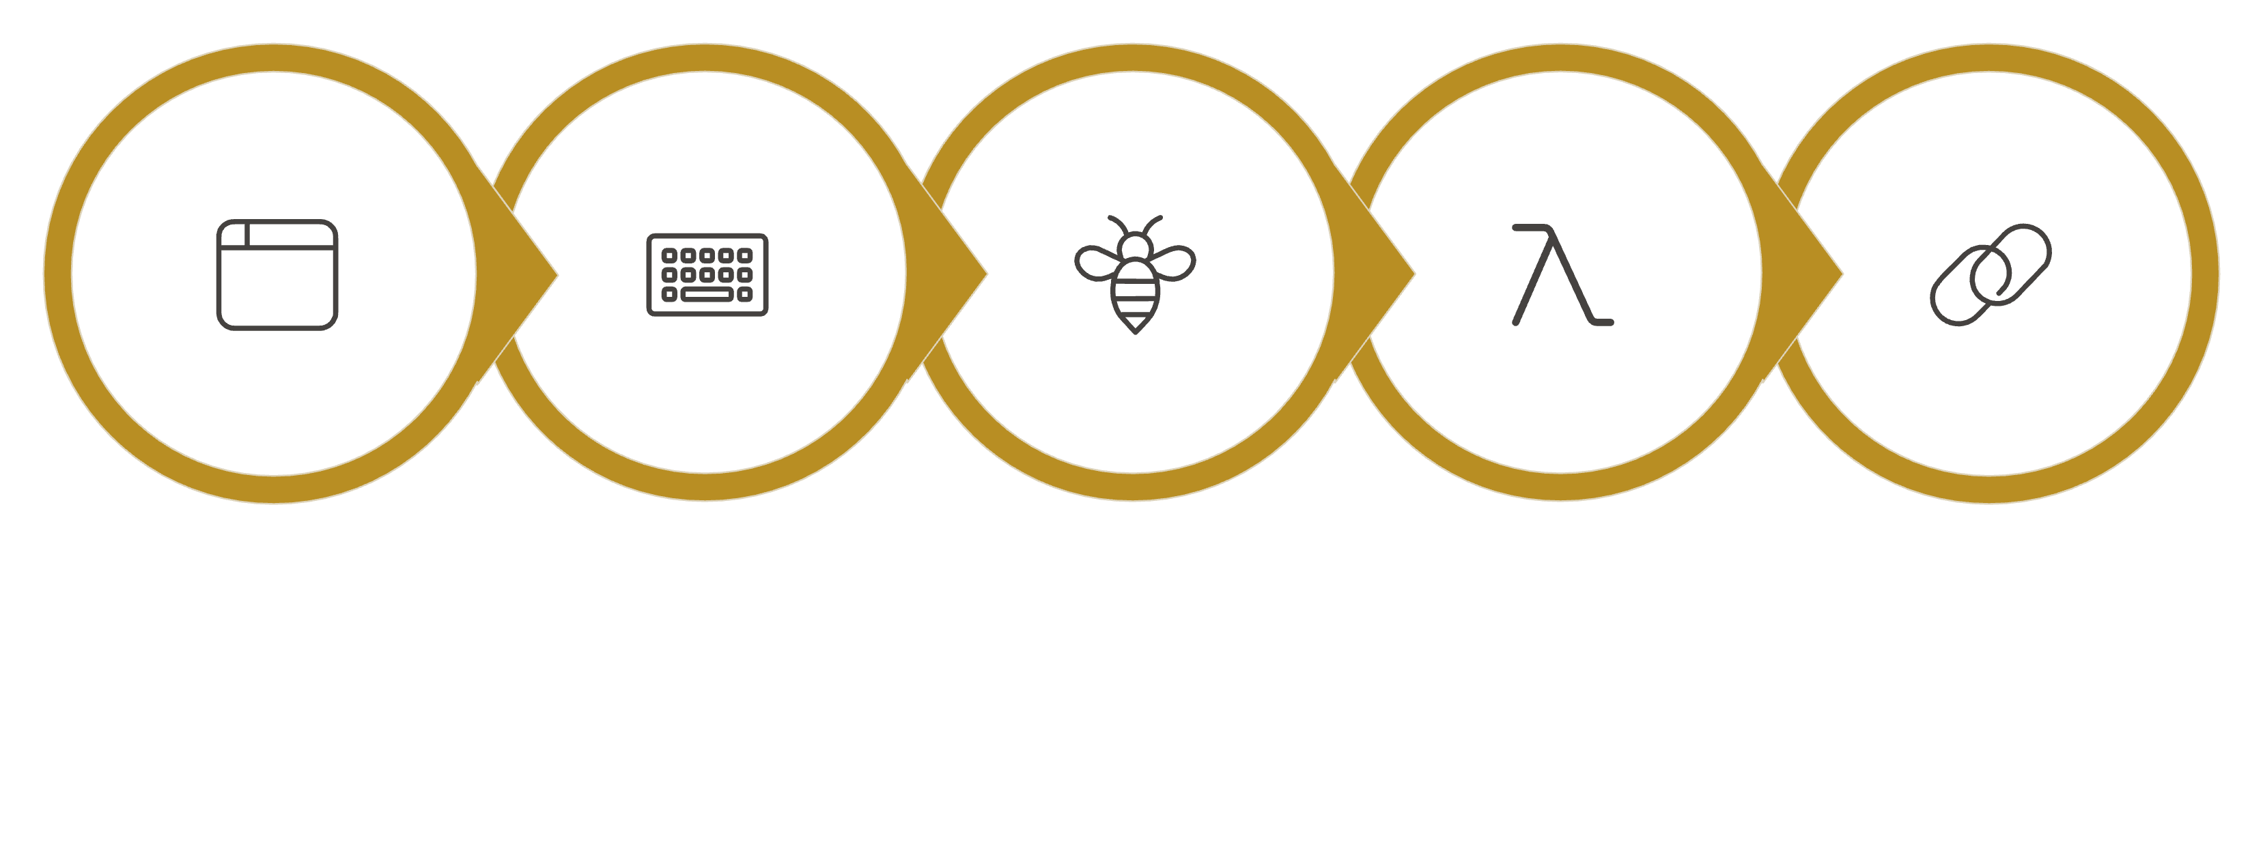
How QuickShare Works
The user workflow is streamlined and intuitive, with all heavy lifting handled by AWS serverless services behind the scenes.
Enter & Share
API Gateway
Lambda & DB
Return Code
Open App
The entire round-trip — from user input to share code generation — happens in milliseconds, with Lambda automatically scaling to handle concurrent requests without any manual intervention.
Share Flow
Retrieve Flow
User submits text → API Gateway → Lambda validates & generates code → Data stored in MongoDB Atlas → Share code returned to UI.
User enters share code → API Gateway → Lambda queries MongoDB Atlas → Content returned and displayed in the React application.

Slide 8
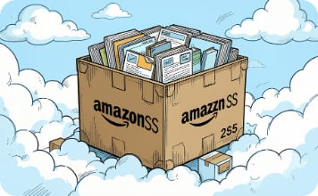
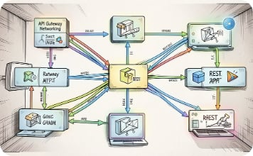
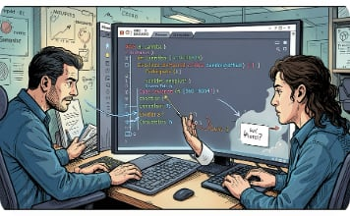
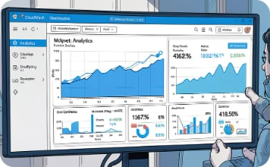
AWS Services Used
QuickShare integrates a carefully selected set of AWS services, each playing a distinct role in delivering a fully serverless, production-ready application.
Amazon S3
Amazon API Gateway
AWS Lambda
Amazon CloudWatch
Hosts the React.js frontend as a static website. S3 provides durable, highly available object storage with configurable bucket policies for public web access.
Manages all REST API requests, handles routing, authentication, and invokes the appropriate Lambda functions in response to HTTP calls.
Executes backend logic on-demand without provisioning servers. Lambda scales automatically and charges only for compute time consumed during execution.
Automatically captures Lambda execution logs, monitors performance metrics, and provides alarms and dashboards for operational visibility and debugging.

Slide 9

IAM and Security
IAM Execution Role
MongoDB Atlas Security
An IAM execution role is attached to the Lambda function via the AWSLambdaBasicExecutionRole managed policy. This grants Lambda the minimum permissions required to operate:
Since MongoDB Atlas is an external managed database, it is not controlled by IAM. Instead, secure access is established using a connection string containing encrypted credentials, stored safely in Lambda environment variables.
Create CloudWatch log groups
Create log streams
Write execution logs to CloudWatch
TLS-encrypted connections to Atlas cluster
Credentials managed via environment variables
IP access lists restrict database access
Separate from AWS IAM permission model
This follows the principle of least privilege — Lambda only has access to what it strictly needs.
IAM ensures that even if a Lambda function is compromised, the blast radius is limited to only the permissions explicitly granted by its execution role.

Slide 10

Advantages & Future Enhancements
Current Advantages
Future Enhancements
Automatic Scaling
🔐 User Authentication
📁 File Sharing
AWS Lambda scales instantly to handle any volume of requests without manual intervention.
Integrate Amazon Cognito for secure user sign-up, login, and session management.
Extend support beyond text to allow secure file uploads via S3 presigned URLs.
Pay-Per-Use Pricing
Costs are incurred only when functions execute — idle time is completely free.
📱 QR Code Generation
⏱ Auto Expiration
Zero Server Management
Generate QR codes for share links, enabling easy mobile sharing and scanning.
Implement TTL-based automatic expiration of shared content after a configurable duration.
AWS handles provisioning, patching, and availability — freeing developer focus for features.
High Availability
🌐 Custom Domains
📊 Analytics Dashboard
Built-in redundancy across AWS Availability Zones ensures reliable uptime.
Use Amazon CloudFront and Route 53 to serve the app on a custom domain with HTTPS.
Build usage analytics using CloudWatch metrics and a dedicated dashboard for monitoring.

Slide 11

Conclusion
QuickShare demonstrates the practical implementation of a modern serverless web application using AWS cloud services. By combining React.js with AWS Lambda, API Gateway, Amazon S3, CloudWatch, and IAM, the project delivers a scalable, efficient, and secure text-sharing solution — with MongoDB Atlas providing persistent data storage.
Reduced Overhead
Cost Efficient
No server provisioning, patching, or manual scaling required at any stage.
Pay only for actual compute usage — zero cost when the application is idle.
Production Ready
Scalable by Design
Built-in monitoring, security, and high availability from day one.
AWS automatically scales to meet demand without any configuration changes.
QuickShare serves as a strong reference architecture for teams looking to adopt serverless patterns for lightweight, event-driven applications on AWS.

Slide 12
