Slide 1
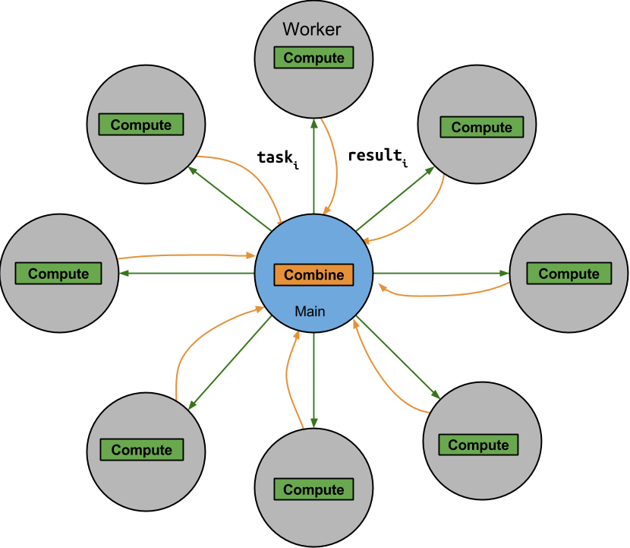
Topaz: Overview
Opportunity
Unreliable/inaccurate machines
Cheaper, faster, more energy efficient
Topaz
Computational Model
1 reliable ‘main’ machine
N unreliable/inaccurate ‘worker’ machines
Programming Model
Compute-combine
Multiple tasks
Unreliable machines execute tasks
Reliable machine combines results to get final answer
Notes:
Everybody agrees this Is a fabulous opportunity – how do we exploit this opportunity? Luckily for you and the world, I have come up with the answer to this – Topaz.

Slide 2
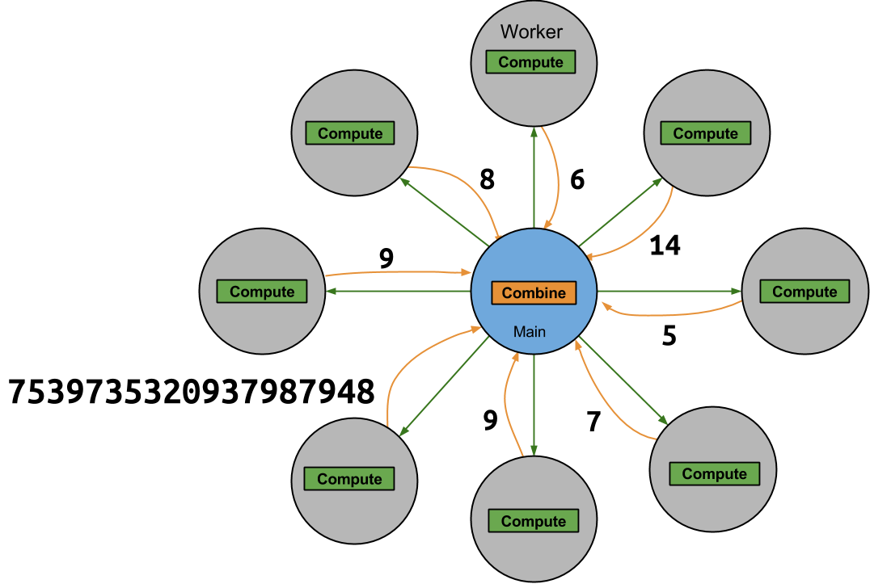
Topaz: Eliminating Outliers
Problem: Bad Results
Solution: Outlier detection
Discard outlier tasks OR
Replace with median values OR
Re-execute outlier tasks
To get right results
Notes:
Copy last slide, put bad results on edges – is there anything suspicious?
Problem bad results, figure with all the numbers in it.

Slide 3
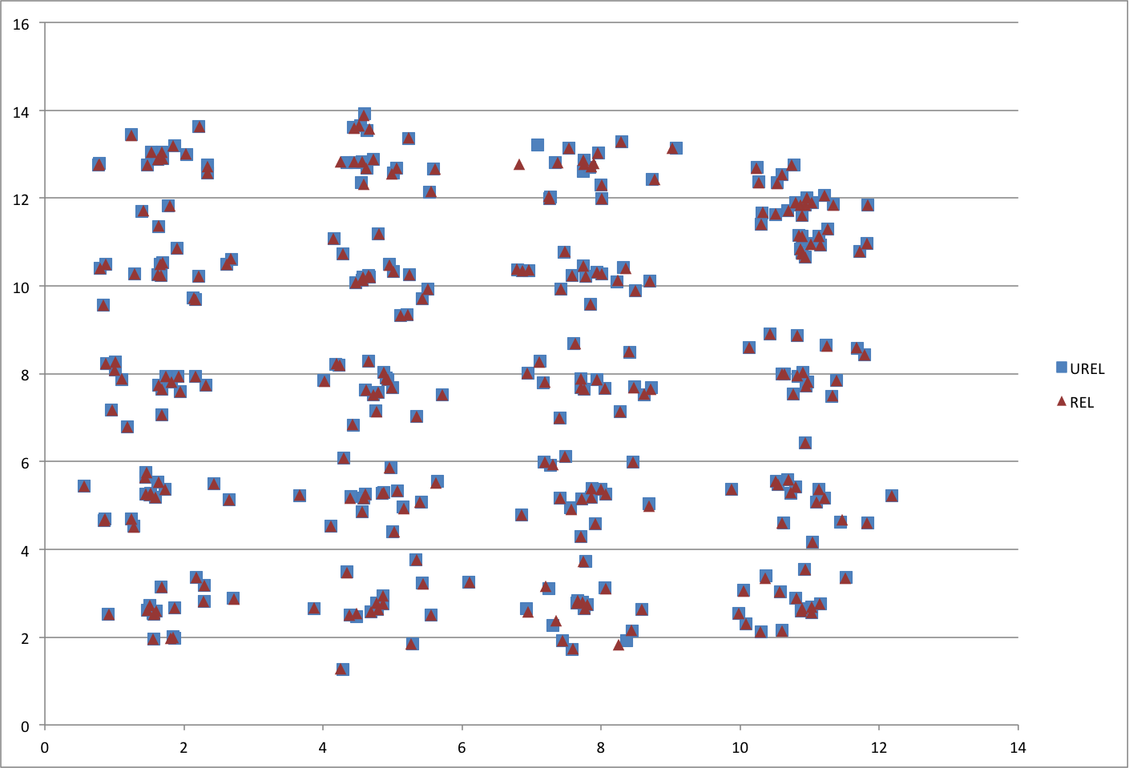
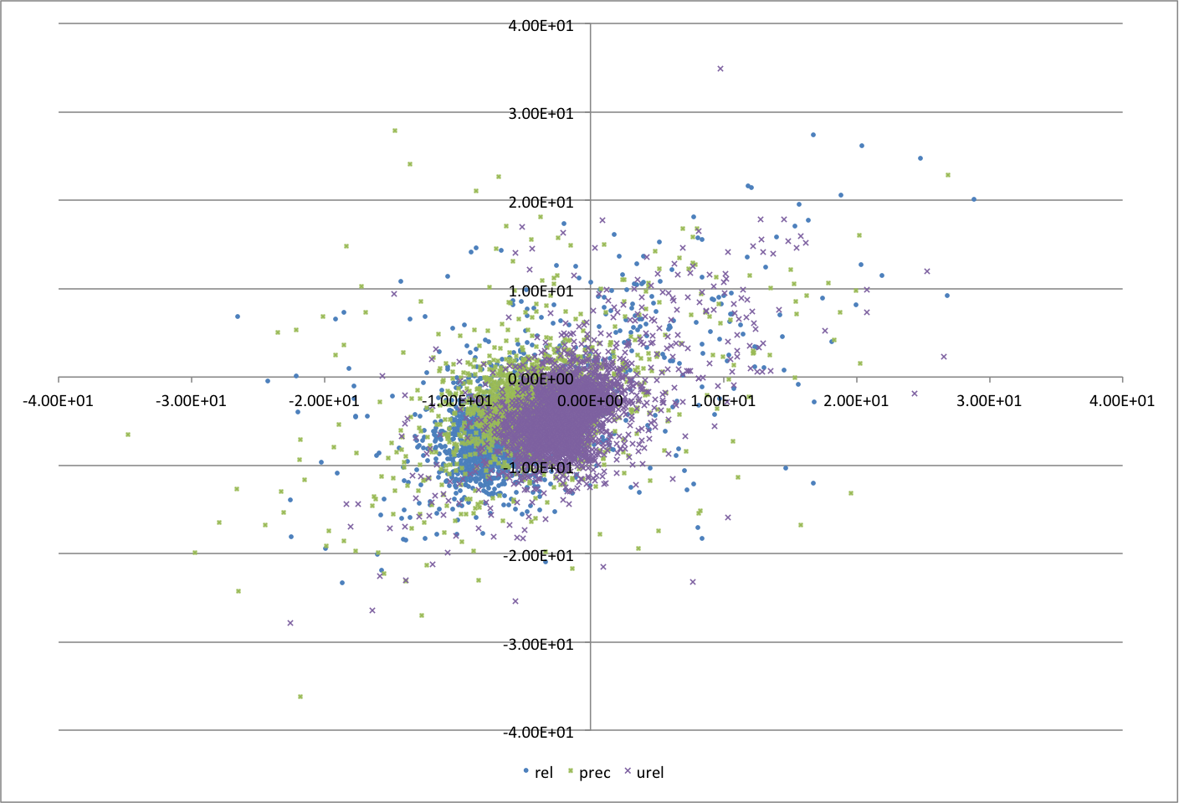
Does this Work?
Empirical Question
Implemented System, Benchmarks
Got Experimental Results
Bottom Line:
It Works
Notes:
It’s a complicated question
How do you know this is good enough?
Barnes: n log(n), precision parameter – imprecise is no worse than unreliable – within the expected range of results for the domain.
Water: n-body simulation anyway, n^2 instead of n log(n) – inherently approximate

