Slide 1
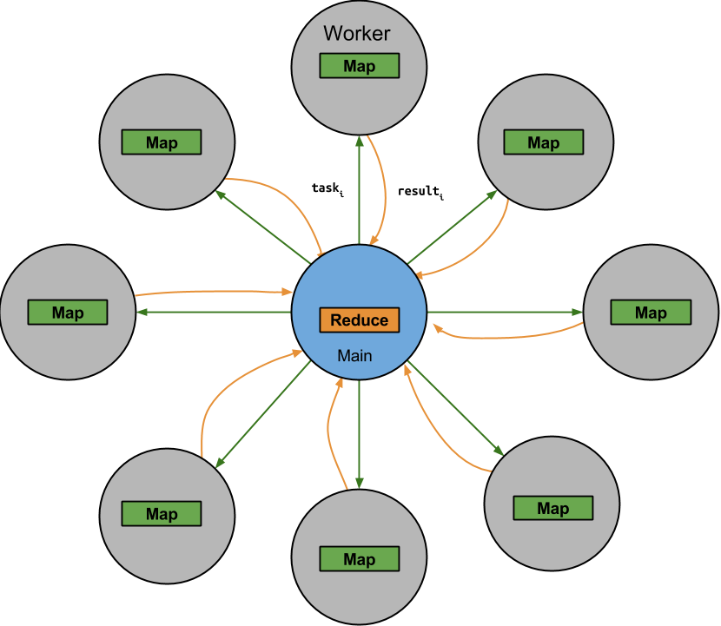
Topaz: Overview
We have an opportunity:
Unreliable/Inaccurate Machines
Cheaper, Faster, More Energy Efficient.
Question: ‘good’ result with little a-priori machine information?
Topaz
Computational Model
1 reliable ‘main’ machine
N unreliable/inaccurate ‘worker’ machines
Programming Model
Map-Reduce Programming Model
Notes:
No a priori knowledge of fault characteristics individual machines.
Can we do meaningful computation on unreliable distributed system without prior knowledge of the system’s fault characteristics?

Slide 2
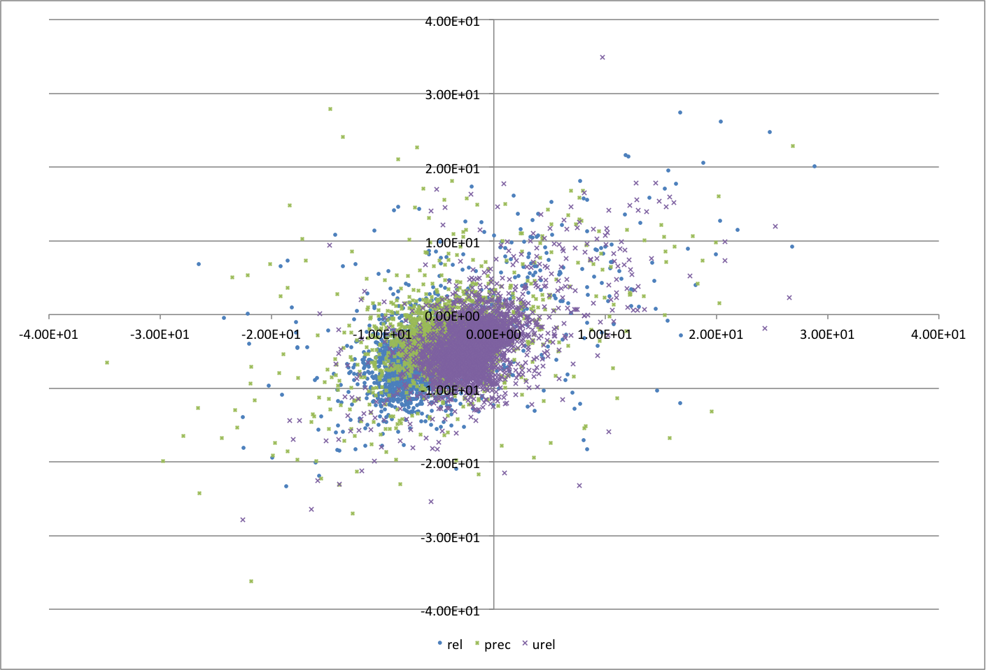
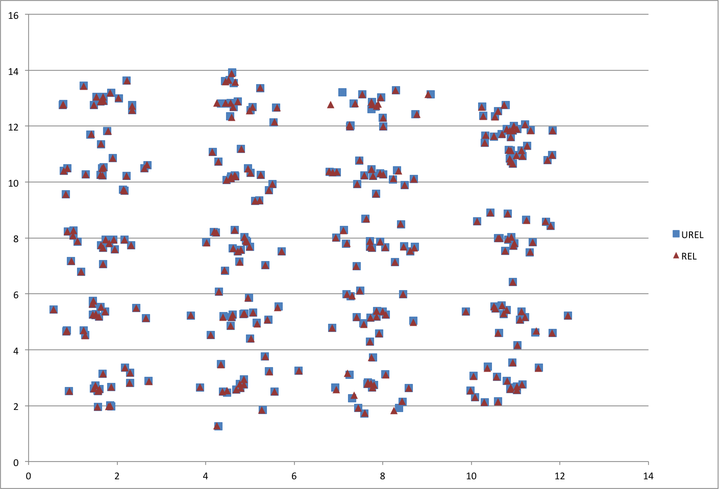
Topaz: Challenges/Solutions
January-March,May
Challenges
Problem: Faults in critical sections of program cause crash.
Solution: Map-Reduce Computational Model.
Critical/Reduce: Main Reliable Machine
Map: Unreliable Worker Machines
Problem: Result pollution from soft errors during task execution (Map)
Solution: Outlier detector
Problem: How to train Outlier Detector?
Solution: Re-Execution on Reliable Machine on outlier detect.
(top) barnes-hut galaxy simulation (bottom) water simulation

