Slide 1
Unit Tests
TVVS - Software Testing, Verification and Validation
2018/2019
Miriam Gonçalves - up201403441
Sara Fernandes - up201405955

Slide 2
Test-Driven Development (TDD)
Refactoring
Unit Testing
Test-Driven Development
Code
Notes:
is a method of implementing software programming that interlaces unit testing, programming and refactoring on source code, used in scrum
Before any new code is written, the programmer must first create a failing unit test.
2) Then, the programmer creates just enough code to satisfy that requirement.
3) Once the test is passing, the programmer may refactor the design, making improvements without changing the behavior.

Slide 3
“If the code ran correctly, how would I know?”

Slide 4
Unit Testing
It’s a small and isolated piece of code you write that happens to exercise another piece of code and determines whether the other piece of code is behaving as expected or not
What is it?
To isolate a section of code and verify its correctness
Whenever a change causes a fault, it can be quickly identified
Why do it?
Notes:
Unit tests are performed to prove that a piece of code does what the developer thinks it should do.
Unit tests don’t worry about validation and verification or correctness, either performance as well
All we want to do is to use unit testing to prove that code does what we intended, and so we want to test very small, very isolated pieces of functionality.
By doing unit testing you also force the design of the software into something that is unit testable

Slide 5
A "unit" in this sense is the smallest atomic component of the code that makes sense to test, typically a method of some class
Notes:
Practical aspect that when you test very small units, your tests can be run fast; like a thousand tests in a second fast.
Smaller tests give you a much more granular view of how your code is performing

Slide 6
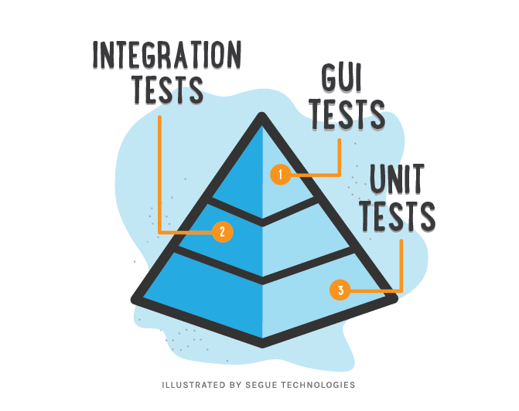
Notes:
Unit tests are the low-level tests, they are the first tests that must be written. By adding Unit Tests to the software build process, or as part of the Continuous Integration process, as the code base grows larger, these tests run automatically bringing with their use a lot of advantages

Slide 7
Advantages of Unit Testing (1/2)
Makes the Process Agile - Unit tests facilitate safe refactoring
Quality of Code - Improves the quality of the code
Code documentation - A unit test behaves as executable documentation, it helps communicating the code’s intended use
Finds Software Bugs Early - Unit testing is carried out by developers who test individual code before integration, issues can be found very early
Notes:
Unit Tests ensure that the code still functions properly as the code base changes with code refactoring and as the code base grows
Writing tests before actual coding makes you think harder on the problem. It exposes the edge cases and makes you write better code.

Slide 8
Advantages of Unit Testing (2/2)
Debugging process - If a test fails, then only the latest changes made in the code need to be debugged
Design - Force your design into something that hopefully will be easier to maintain than what it would be if you had not designed it for unit testing (especially in test-driven development)
Reduce costs - Since bugs are found in an early stage, unit testing helps reduce the cost of bug fixes
Notes:
Since Unit Test failures alert the Development Team before the code is pushed to Testers or Clients, it is still early in the development cycle making the fix less costly than if found later in the development cycle

Slide 9
Unit Testing Framework Tools (1/2)
JavaScript
PHP
Java
Karma
Jasmine
Mocha
Ava
SimpleTest
PHPUnit
Codeception
Behat
jUnit
TestNG
Jtest
Client-Side
Server-Side
Server-Side

Slide 10
Unit Testing Framework Tools (2/2)
C/C++
C#
Catch
GoogleTest
Parasoft
nUnit
xUnit.net
MSTest
csUnit
Server-Side
Server-Side

Slide 11


JavaScript Tools (1/2)
Karma
Test on Real Devices and web environments
Easy Debugging
Continuous Integration
No support for NodeJS
No plugin for Eclipse
Mocha
Run on NodeJS and in browsers
Asynchronous Tests
Highlights slow tests
No atomic test
Requires developers to select and set up assertion libraries
Some plugins may require certain imports or includes

Slide 12


JavaScript Tools (2/2)
Jasmine
No much room to flexibility
Slower than other frameworks
Needs _spec.js files to run
Run on NodeJS and in browsers
Behaviour Driven Development focused
Includes assertions and mocking
User-friendly syntax
Ava
Very minimal and simple
Includes mocking and coverage reports
Runs test in parallel by default
New libraries need to be installed if you want to use new features

Slide 13
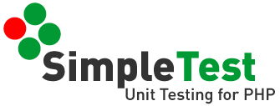

PHP Tools (1/2)
SimpleTest
Can custom output
Runs via both command line and browser
Customisable tests results
Tests state, behaviour and front-end
Not as well documented as PHPUnit
Can’t run directly via web browser
Codeception
Framework and browser testing
REST and SOAP testing
BDD
Unit and Integration tests
Better for other test types

Slide 14
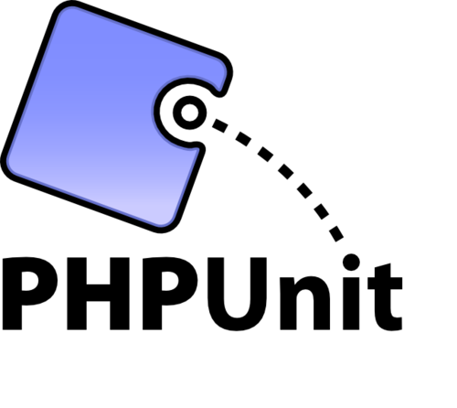

PHP Tools (2/2)
PHPUnit
Framework and browser testing
REST and SOAP testing
BDD
Can not run directly via a web browser
Mocked objects aren’t fluent
Behat
Framework testing
Very extensible
BDD
Takes time to implement
Better for other test types

Slide 15


Java Tools (1/2)
JUnit
Open-Source framework
Standard for testing in Java
Supported by almost all iDE’s
Has a lot of extensions
Doesn’t support dependency testing
Doesn’t have reporting tools included
TestNG
Inspired on JUnit and NUnit
Supports dependency testing
Enables grouping of test cases
Lack of documentation
Isn’t integrated with the most IDE’s
Less popular

Slide 16

Java Tools (2/2)
JTest
Static analysis product
Automatic regression testing
Automatica white box and black box testing
Commercial tool

Slide 17


C/C++ Tools (1/2)
Catch
No external dependencies
BDD
Quick and easy to get started
Tests might be run again if last section fails
GoogleTest
Portable
Wide assertion vocabulary
Detects tests automatically
Automatically detects the tests and it doesn’t require to enumerate them in order to run them

Slide 18

C/C++ Tools (2/2)
Parasoft
Commercial tool
Static analysis product
Automatic test generation and execution

Slide 19


C# Tools (1/2)
nUnit
Open-source framework
DDT
Fast
Provides GUI and console
Doesn’t integrate with Visual Studio
xUnit.net
Open-source framework
DDT
Extensible
Intuitive terminology
Lack of documentation
Not user friendly

Slide 20
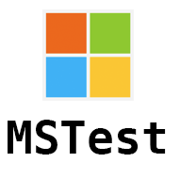

C# Tools (2/2)
MSTest
Integrated with Visual Studio
Automatically generate tests
Easy to get started
Struggle with interoperability
Slow
csUnit
Lack of documentation
Open-source framework
Easy to use GUI
Compatible with any .NET language

Slide 21
Open Source
Complete
Easy to install
Easy to use
Everyone knows it

Slide 22
“To check if code is behaving as you expect, you use an assertion, a simple method call that verifies that something is true.”

Slide 23
JUnit Asserts
assertEquals([String message],
expected,
actual)
String string1="Junit"; String string2="Junit";
assertEquals(string1,string2);

Slide 24
JUnit Asserts
assertNull([String message], java.lang.Object object)
assertNotNull([String message], java.lang.Object object)
String string1="Junit"; String string5=null;
assertNotNull(string1);
assertNull(string5);

Slide 25
JUnit Asserts
assertSame([String message], expected, actual)
assertNotSame([String message],expected, actual)
String string1="Junit";
String string3="test";
String string4="test";
assertSame(string3, string4); assertNotSame(string1, string3);

Slide 26
JUnit Asserts
assertTrue([String message], boolean condition)
int variable1=1;
int variable2=2;
assertTrue(variable1<variable2>);

Slide 27
JUnit Asserts
assertArrayEquals(expected, actual)
int[] airethematicArrary1 = { 1, 2, 3 };
int[] airethematicArrary2 = { 1, 2, 3 };
assertTrue(airethematicArrary1, airethematicArrary2);

Slide 28
Tutorial
Intellij & Eclipse

Slide 29
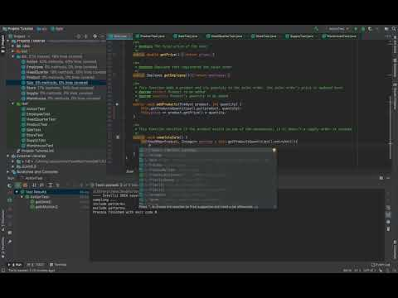
Intellij

Slide 30
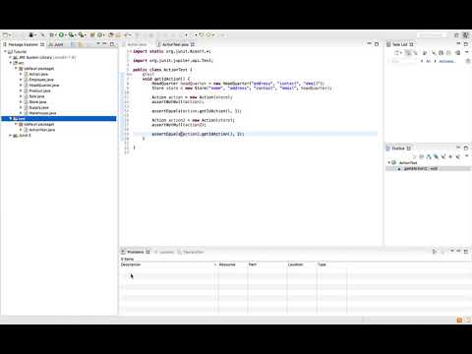
Eclipse

Slide 31
Exercises

Slide 32
The following exercises are related to a chain of stores. Each chain has a headquarter and each store has a set of employees and warehouses, which contains different products.
Whenever there is a sale, the quantities of the respective products to be sold are verified in the different warehouses of the store. If at the time the product doesn’t exist in a particular warehouse, a replacement order is issued for the product that has been sold out, since all warehouses must have some quantity of all products.

Slide 33
Exercise 1
In this first exercise, each student should simply run the created unit tests. To do this, just select the "test" directory and select the "Run all tests" option. This exercise serves to see the unit tests passing.

Slide 34
Exercise 2
Next, you must uncomment the function "getId()" in the class "ActionTest" and re-run the tests. The class "getId()" won’t pass the tests developed. Each student should then find the error in the code that causes that problem and should correct it. After correcting the source code, you should run the tests again to verify if all tests are finally passing.

Slide 35
Exercise 3
In this exercise you should create unit tests for the "searchEmployeesByStore()",”searchEmployeeByStoreByName()” and "searchStoreByEmployee()" functions that are in the "HeadQuarterTest" class.
The created tests should cover 100% of the code’s lines.
To check the coverage of the tests, simply select each test class individually and select the "Run (..) with Coverage" option.

Slide 36
Exercise 4 (1/3)
Now, you will exercise TDD (Test-Driven-Development). To do that each student will have to uncomment the "completeSale()" function of the "SaleTest" class and will have to create its source code.

Slide 37
Exercise 4 (2/3)
The "completeSale()" function verifies that the products related to a respective sales order exist in the different warehouses of the store where the sale is being made. If the products exist entirely in a given warehouse, nothing extra must be done, if it exists partially in a warehouse, the search should be continued looking for a warehouse that satisfies the remaining quantity desired and if no product exists in the warehouse, a supply order must be issued (all warehouses must have some quantity of all products).

Slide 38
Exercise 4 (3/3)
As an aid, you should use the function "changeProductQuantity()" which exists in the class "HeadQuarter".
After creating your source code, you should re-run the test function to verify that your code is correct.

Slide 39
References (1/4)
Unit Tests
Hunt, Andrew; Thomas, David. Pragmatic Unit Testing in Java with Junit. Volume 2. The Pragmatic Programmers. 2003
LPOO’s slides. Testes Unitários e Test-Driven Development com JUnit. 2015/2016
JavaScript Tools
https://raygun.com/blog/javascript-unit-testing-frameworks/
https://karma-runner.github.io/2.0/index.html
https://mochajs.org
https://jasmine.github.io
https://medium.com/allenhwkim/ava-the-test-tool-that-works-5d98ee03933e

Slide 40
References (2/4)
PHP Tools
https://phpunit.de
http://simpletest.sourceforge.net
https://codeception.com
http://behat.org/en/latest/
Java Tools
https://junit.org/junit5/
https://testng.org/doc/index.html
http://www.parasoft.com/products/jtest

Slide 41
References (3/4)
C++ Tools
https://github.com/google/googletest
http://www.parasoft.com/products/ctest
https://github.com/catchorg/Catch2
https://github.com/catchorg/Catch2/blob/master/docs/limitations.md#tests-might-be-run-again-if-last-section-fails
https://stackoverflow.com/questions/242926/comparison-of-c-unit-test-frameworks

Slide 42
References (4/4)
C# Tools
https://nunit.org
https://xunit.github.io
https://docs.microsoft.com/en-us/dotnet/core/testing/unit-testing-with-mstest
http://www.csunit.org

