Slide 1
DESIGN AND PERFORMANCE EVALUATION OF A CUSTOM
APPLICATION-LAYER PROTOCOL FOR LOW-LATENCY
IoT SENSOR DATA EXCHANGE
Sarada Ahalya- 24BCB0130
Siya Agrawal- 24BCT0270
Nimesha Subramanian- 24BDS0382
BCSE308P | Computer Networks Lab | October 2026

Slide 2
Problem and Motivation
THE PROBLEM
OUR OBJECTIVE
IoT sensors regularly transmit small readings.
Verbose message formats add application-layer bytes; unreliable delivery can lose updates.
Create a compact binary protocol for simulated sensors and evaluate message size, delivery and ACK-confirmation time.
Use TCP + JSON as a reference implementation.

Slide 3
Two Application-Layer Approaches
LLSP over UDP
TCP + JSON baseline
• Compact binary DATA messages
• CRC validation and sensor IDs
• Optional ACK-based reliable mode
• Bounded timeout/retransmissions
• Sender-side simulated DATA loss
• Compact newline-delimited JSON
• Persistent TCP connection
• Reading validation on server
• Application-level JSON ACKs
• RTT and byte measurements

Slide 4
LLSP: Custom Protocol Design
17-BYTE DATA PACKET
RELIABILITY CHOICE
Version + type (1 B) | Flags (1 B)
Sensor ID (2 B) | Sequence (2 B)
Payload: type (1 B) + value (4 B) + time (4 B)
CRC (2 B)
Unreliable: one DATA attempt.
Reliable: request ACK; timeout and retry, at most 3 total attempts.

Slide 5
System Architecture
Sensor simulator
5 threads
→
LLSP encoder
17-byte DATA
→
UDP server
CRC + deduplication
→
ACK / retry
Reliable mode
Independent baseline path: JSON reading generator → TCP client → TCP server → JSON ACK
The five-sensor live simulator and the controlled benchmark are separate senders.

Slide 6
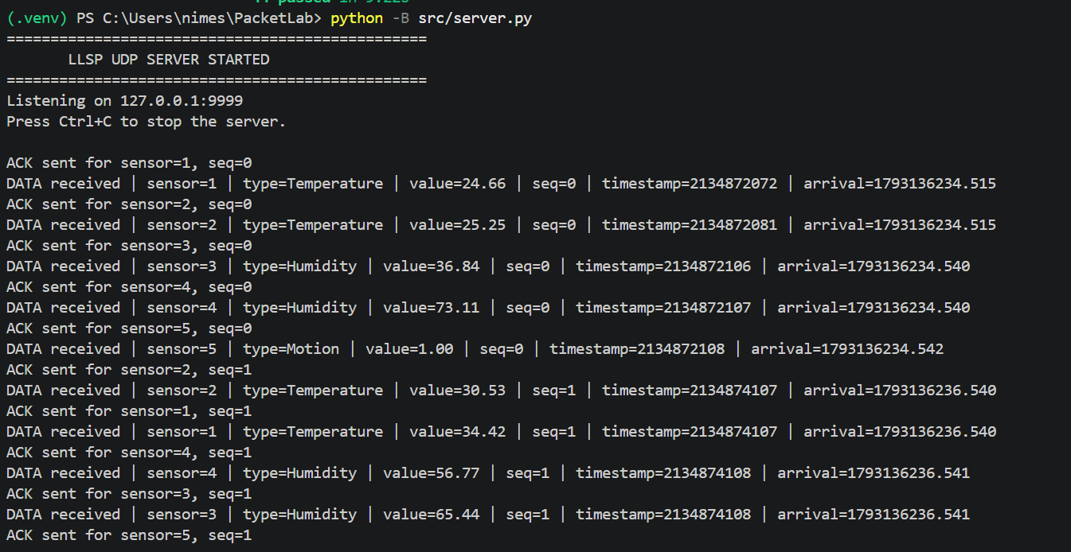
Live Demo: UDP Server Receives Readings
Verified: sensor IDs 1–5, values, sequence numbers and requested ACKs on 127.0.0.1:9999.

Slide 7
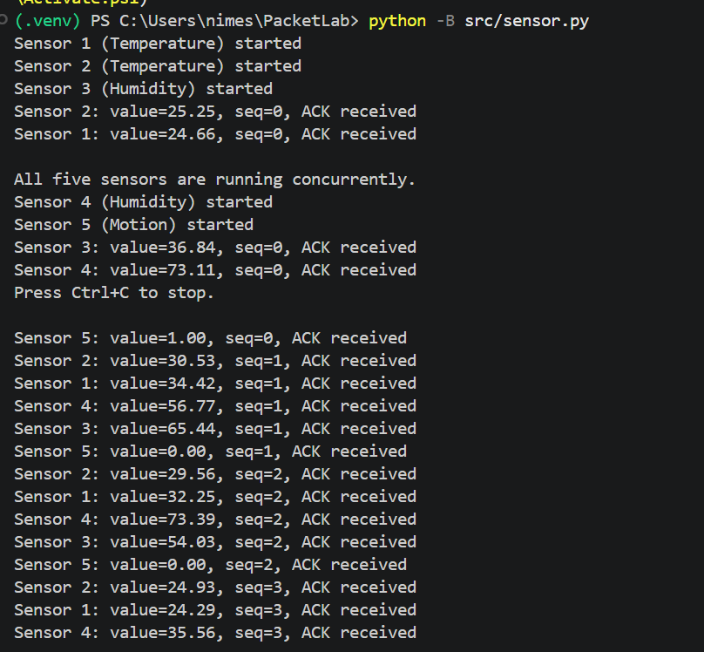
Live Demo: Five Concurrent Sensors
Verified: five running sensor threads; temperature, humidity and motion readings with ACK confirmations.

Slide 8
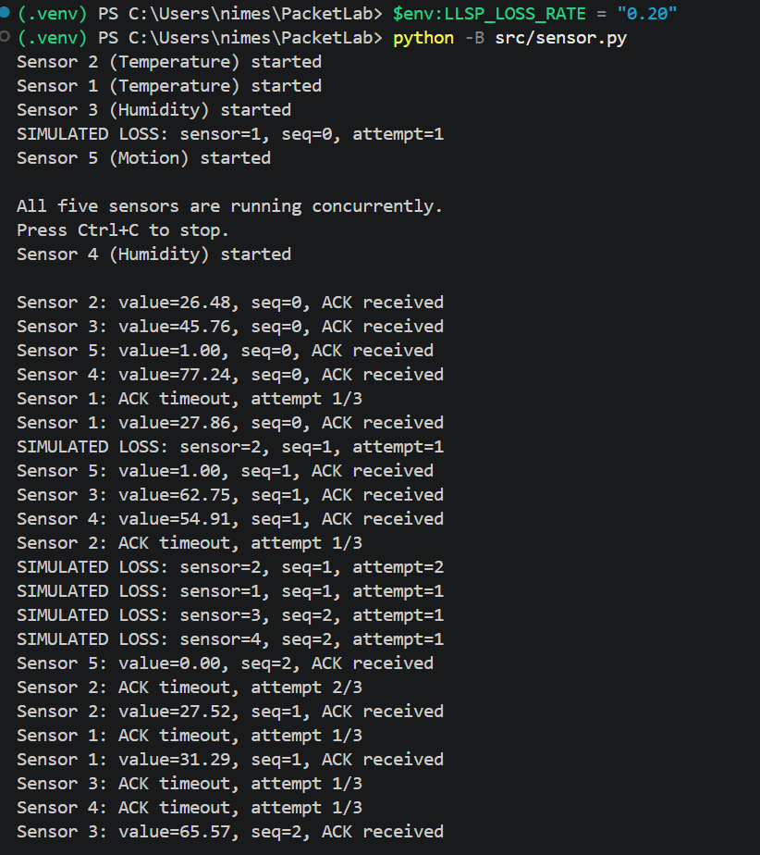
Live Demo: Simulated Loss and Retries
Verified: DATA omission → ACK timeout → successful later ACK; three attempts maximum.

Slide 9
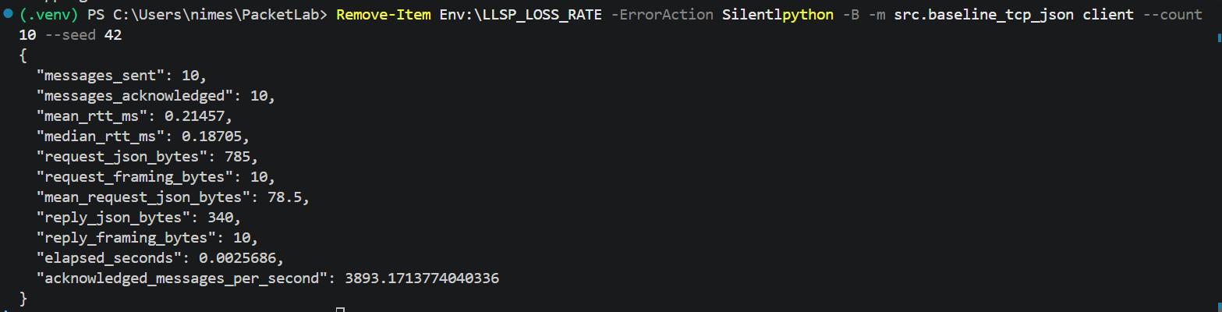
Live Demo: TCP + JSON Client
Verified: 10 of 10 application ACKs; measured request bytes, mean RTT and throughput.

Slide 10
Experimental Setup and Metrics
TEST SCENARIOS
RECORDED METRICS
• LLSP modes: reliable / unreliable
• Simulated DATA omission: 0, 5, 10, 20%
• Historical plots: five trials per setting
• 500 logical readings in each trial
• Localhost-based execution
• Unique delivery ratio (%)
• ACK-confirmed ratio (reliable)
• Retry-inclusive confirmation time (ms)
• Extra transmission attempts
• Application message bytes
• TCP application RTT

Slide 11
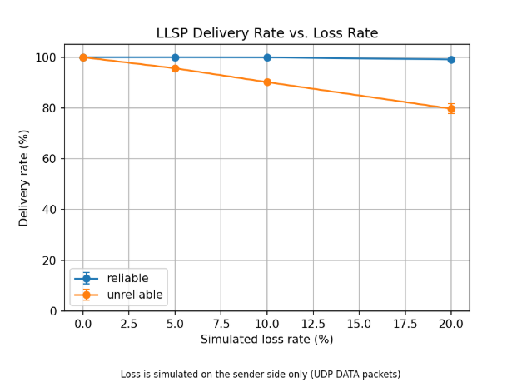
Result 1: Delivery Rate vs. Loss
RELIABILITY UNDER LOSS
At 20% simulated DATA omission:
Reliable: 99.12% delivered.
Unreliable: 79.72% delivered.
Retries improve successful delivery, but are bounded.
Historical benchmark: 5 trials × 500 readings per LLSP scenario; error bars = sample SD.

Slide 12
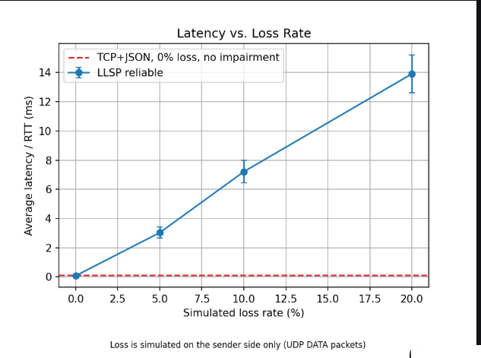
Result 2: Confirmation Time vs. Loss
COST OF RETRIES
Reliable LLSP average confirmation time rises from 0.084 ms at 0% loss to 13.910 ms at 20% loss.
The TCP dashed line is an unimpaired 0%-loss reference, not an equal-loss comparison.
Historical benchmark: 5 trials × 500 readings per LLSP scenario; error bars = sample SD.

Slide 13
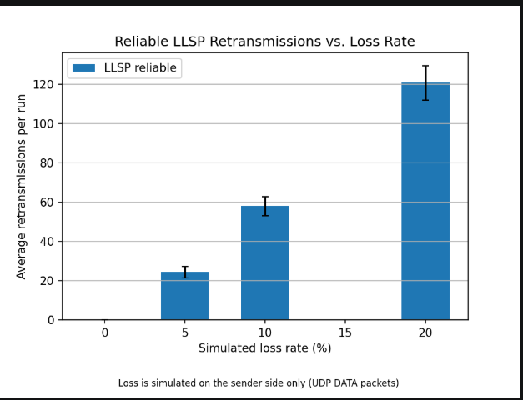
Result 3: Retransmissions vs. Loss
RETRY FREQUENCY
Additional attempts per 500-reading run increase with simulated loss:
5%: 24.4
10%: 58.0
20%: 120.8
More retries help delivery but increase completion time.
Historical benchmark: 5 trials × 500 readings per LLSP scenario; error bars = sample SD.

Slide 14
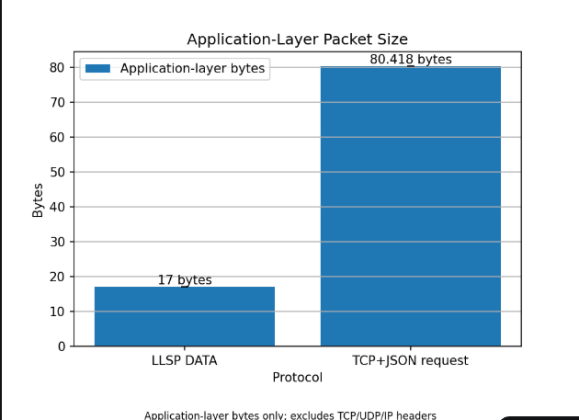
Result 4: Message Size Comparison
COMPACT ENCODING
LLSP DATA: 17 bytes.
TCP + JSON request: 80.418 bytes on average, including newline framing.
About 79% fewer application bytes per DATA request; network headers and ACK traffic are excluded.
Historical dataset; application-level requests only. Transport/IP overhead and ACK traffic not counted.

Slide 15
Interpretation and Limitations
WHAT THE RESULTS SUPPORT
WHAT THEY DO NOT ESTABLISH
• LLSP uses a smaller application request format.
• Retransmission increases delivery under sender-side DATA omission.
• Better delivery comes with higher confirmation time.
• TCP was not given equivalent network loss.
• Localhost results do not establish real wireless or hardware performance.
• Deduplication is session-limited; fresh UDP server between independent sessions.

Slide 16
Conclusion and Next Steps
CONCLUSION
FUTURE SCOPE
LLSP demonstrates compact sensor-oriented messaging with CRC and optional ACK-based reliability.
Measured trials expose a clear delivery–latency trade-off under controlled DATA omission.
• Session-aware deduplication
• Matched impairment for TCP / LLSP
• Separate-host and physical sensor testing
• More complete latency distributions
Sources: PacketLab README and docs/PROTOCOL.md | RFC 768 (UDP) | RFC 9293 (TCP)

Slide 17
THANK YOU

