Slide 1
Proiect FIC
Echipa : Micii calculatorişti
Profesor coordonator : Alexandru Bozdog
Facultatea de Automatică și Calculatoare, Timișoara

Slide 2
Echipa
Membrii
Mela Rusu: Developer
Andreea Radu: Developer
Erika Rusznak : Developer
Adelina Păsculescu: HW Designer
Ivan Savici: HW Designer
Anisia Roşu: QA & UX
Sara Băciuţ : Project Manager
Numele echipei:
Micii calculatorişti
Profesor coordonator:
Alexandru Bozdog

Slide 3
Tema proiectului
Calculator de buzunar

Slide 4
GitHub: https://github.com/saradaria/Calculator_de_buzunar

Slide 5
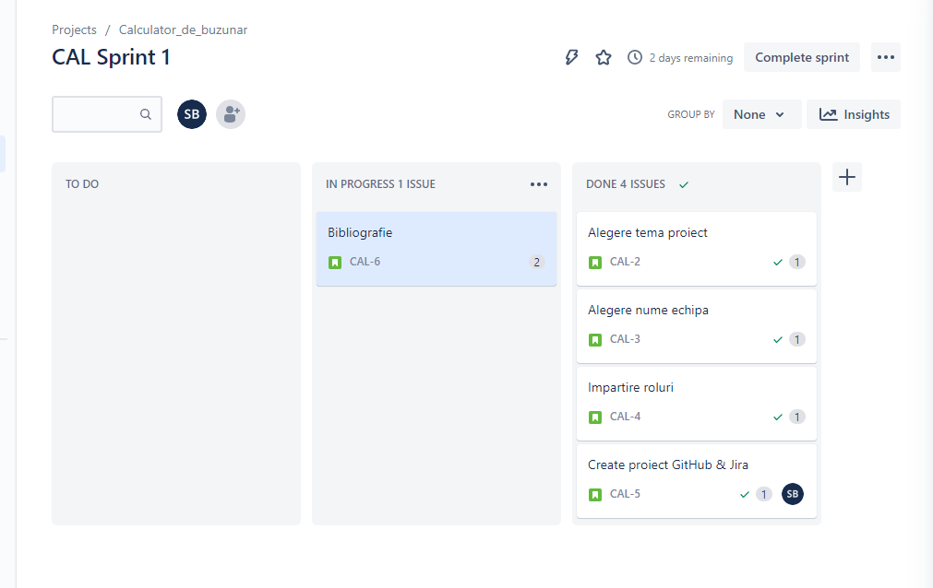
Sprint 1

Slide 6

Bibliografie
https://www.fpga4student.com/2017/06/Verilog-code-for-ALU.html?m=1
https://www.chipverify.com/verilog/verilog-math-functions
https://www.quora.com/What-is-the-Verilog-code-for-a-calculator
https://github.com/jaiswalaman/Calculator-Verilog-with-GUI/tree/master

Slide 7
THANK YOU

