Slide 1


HOTEL DATABASE MANAGEMENT SYSTEM Prepared By – BALAJI, SARADHI & AMMAN

Slide 2
Table of contents
Introduction
ERR Diagram
Tables & Relationships
Challenges
Questions
In a nutshell, this shows what we are going to cover today in our presentation of “Hotel Database Management System”.
It will be around 10 minutes presentation. We would be more than happy to answer your questions at the end of the presentation!

Slide 3


The main objective of this project is to create a database management system for a hotel.
We have build this project as a group of three. The group members are:
Balaji.a
Saradhi
Amman naidu
It was fun working together, overcoming each other’s flaws together and learning from each other's strengths in respective areas of Database Design & Management.

Slide 4
A Hotel consists of a wide areas to manage. We tried to include the main areas for a hotel management system in this project.
ROOMS
BOOKINGS
HOTEL
CUSTOMER DETAILS
PAYMENT DETAILS

Slide 5

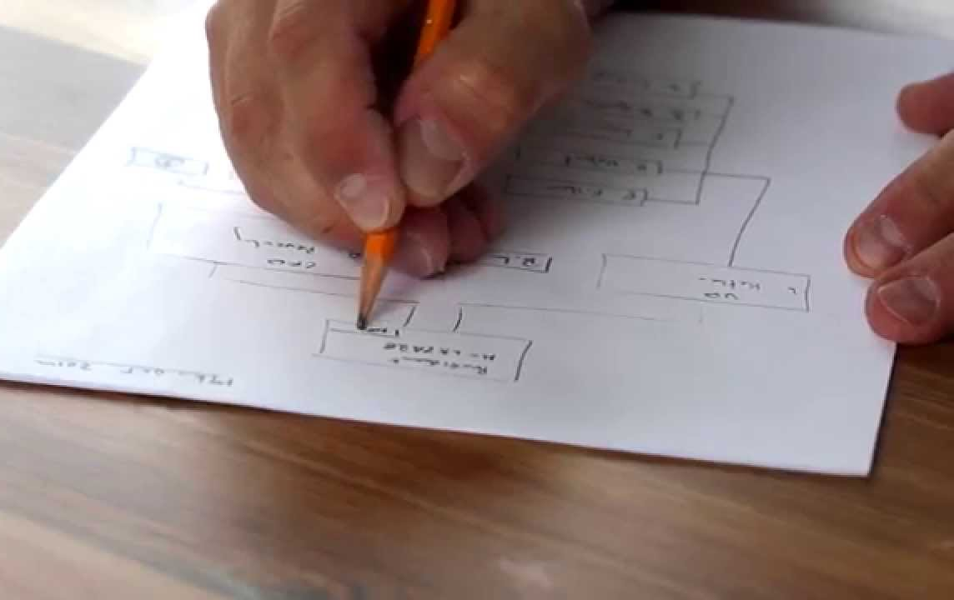
Step:1
ERR-Diagram
We drew the ERR diagram on a paper, noting down all the tables required

Slide 6

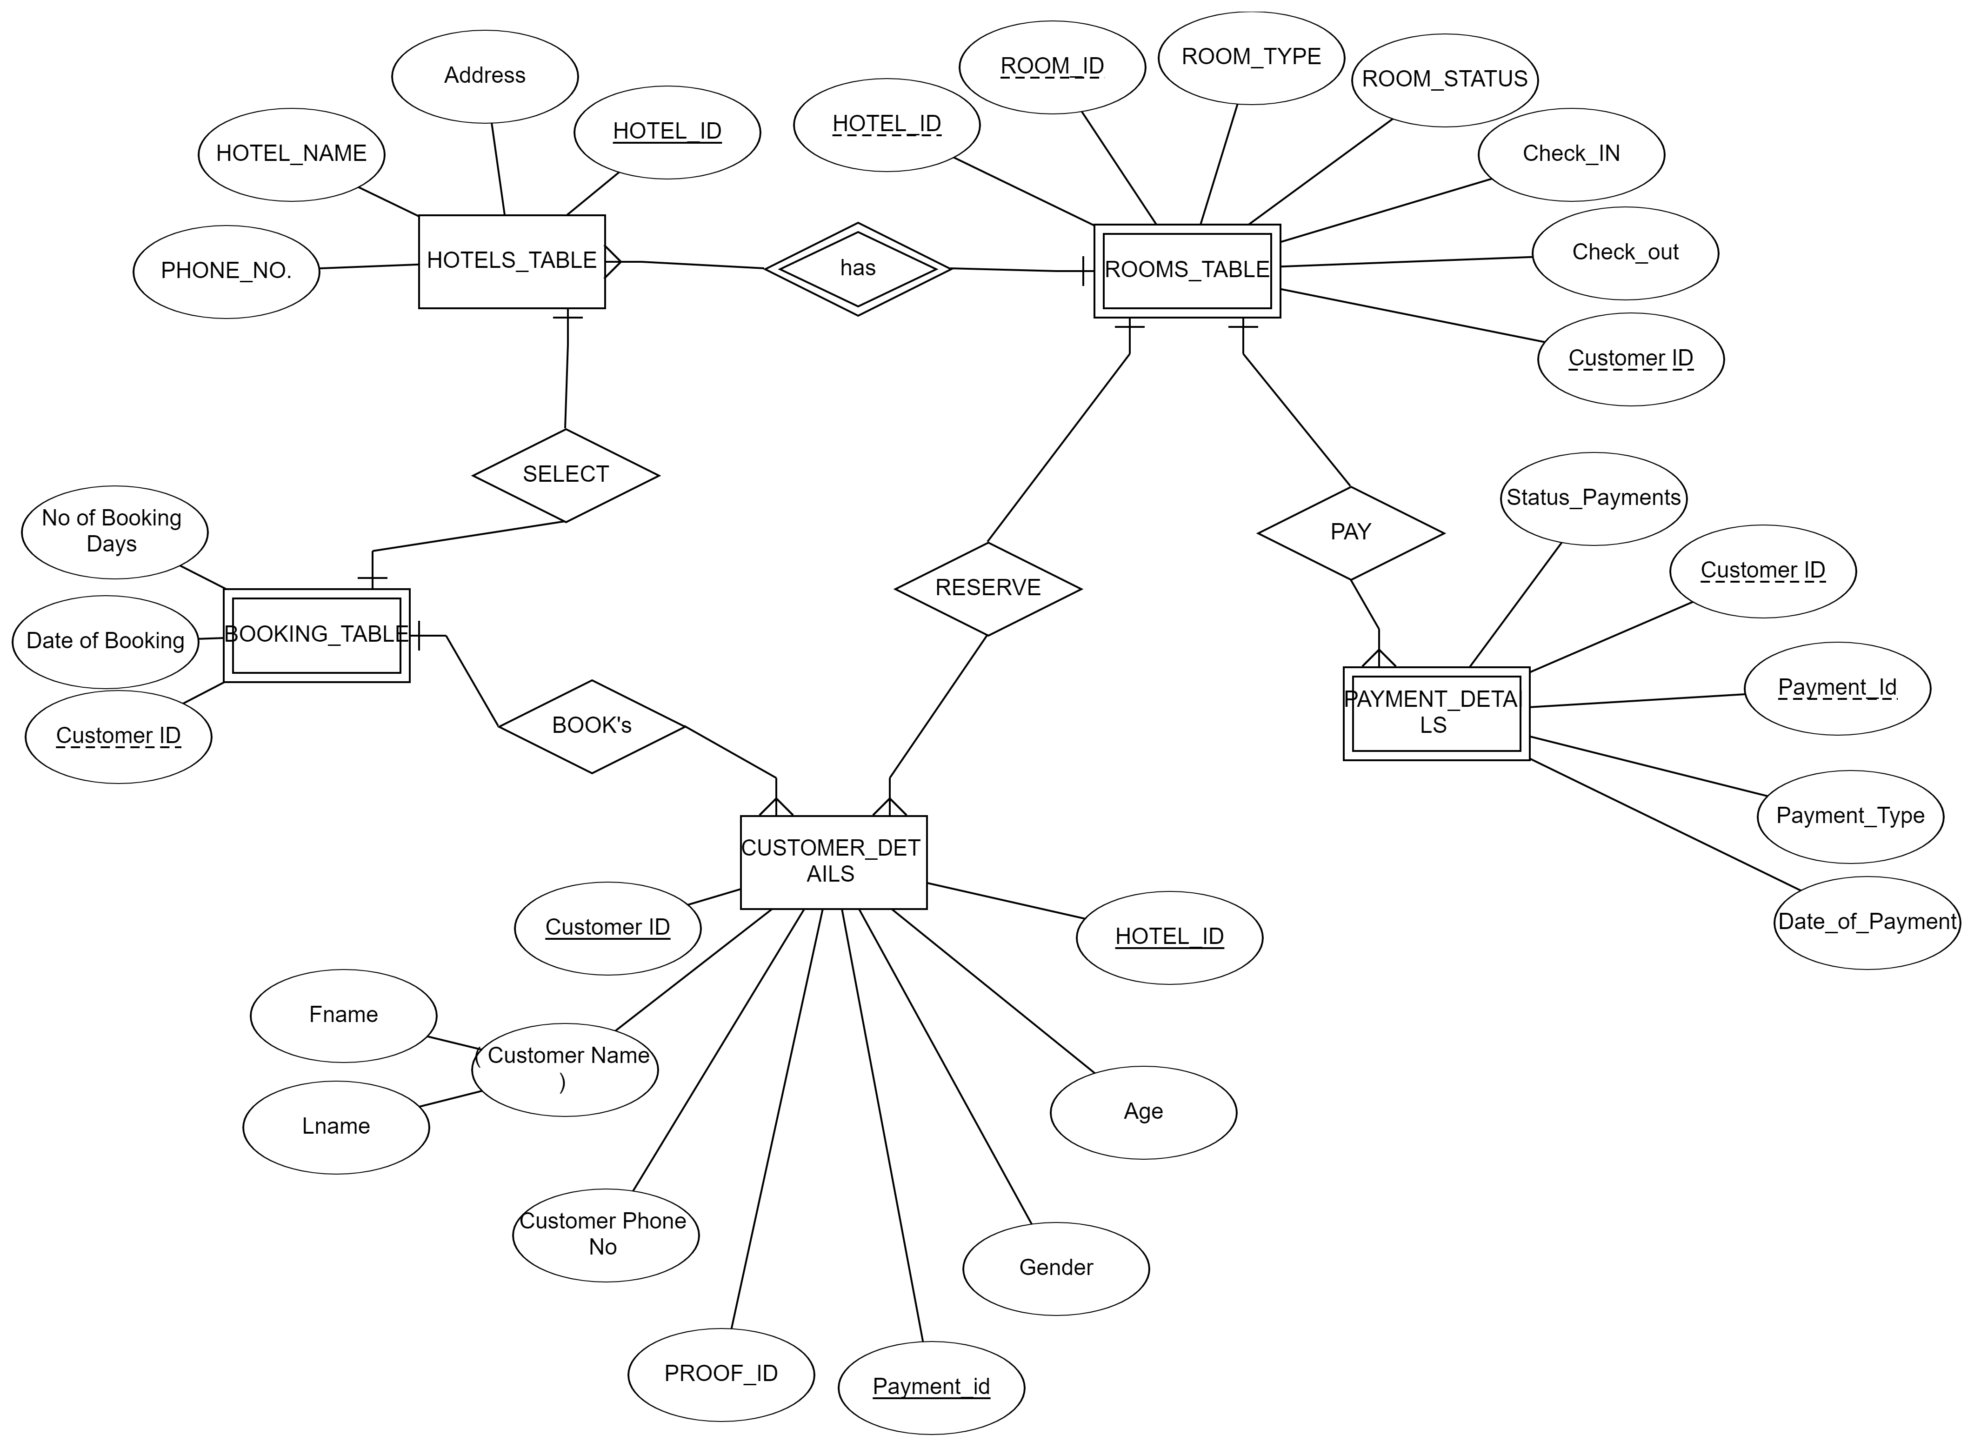
It looks messy, right? Yeah, we better look at the ERR diagram !

Slide 7
Let us begin exploring the TABLES

Slide 8
SQL> desc hotel_table;
Name Null? Type
----------------------------------------- -------- ----------------------------
HOTEL_NAME NOT NULL VARCHAR2(10)
HOTEL_ID NOT NULL VARCHAR2(5)
ADDRESS NOT NULL VARCHAR2(10)
HOTEL_CONTACT NUMBER(15)
This table consists of HOTEL_NAME , HOTEL_ID , ADDRESS , HOTEL_CONTACT .
And these will be having all the details of the hotel address and the contact information.

Slide 9
SQL> desc room_table;
Name Null? Type
----------------------------------------- -------- ----------------------------
ROOM_ID NOT NULL VARCHAR2(5)
ROOM_TYPE VARCHAR2(5)
NO_BEDS NOT NULL NUMBER(38)
CHECK_IN DATE
CHECK_OUT DATE
CUSTOMER_ID NUMBER(10)
HOTEL_ID NOT NUL VARCHAR2(5)
This table consists of the ROOM_ID, ROOM_TYPES, NO_BEDS, CHECK_IN, CHECK_OUT, CUSTOMER_ID, HOTEL_ID.
So we can retrieve the check out and check in date of the customer using this table and more

Slide 10
SQL> desc payment_details;
Name Null? Type
----------------------------------------- -------- ----------------------------
PAYMENT_ID NOT NULL NUMBER(10)
PAYMENT_TYPE VARCHAR2(10)
DATE_OF_PAYMENT DATE
CUSTOMER_ID NUMBER(10)
AMOUNT NUMBER(38)
This table consists of the PAYMENT_ID, PAYMENT_TYPE, DATE_OF_PAYMENT, CUSTOMER_ID, AMOUNT

Slide 11
SQL> desc customer_details
Name Null? Type
----------------------------------------- -------- ----------------------------
CUSTOMER_ID NOT NULL NUMBER(10)
FNAME VARCHAR2(10)
LNAME VARCHAR2(10)
PHONE_NO NUMBER(15)
DOB DATE
AGE NUMBER(38)
PROOF_ID NUMBER(15)
GENDER CHAR(10)
This table consists of the CUSTOMER_ID, FNAME, LNAME, PHONE_NO, DOB,AGE,PROOF_ID,GENDER.

Slide 12
There were indeed a lot of tables to design and a lot of relationships to manage..
Relationships..
A tricky business, eh?

Slide 13
And the came our favourite part.. Writing queires was fun ☺
QUERIES
To execute the required tasks and fetch the data from one or more tables.

Slide 14
TOTAL NUMBER OF ROOMS IN EACH HOTEL
TOTAL NO OF UNFILLED ROOMS IN EACH HOTEL
TOTAL NO OF FILLED ROOMS IN EACH HOTEL
DISPLAY THE CUSTOMER DETAILS WITH NAME HAVING 'al'
DISPLAY THE AVG,max and min AGE OF CUSTOMERS WHO ARE BOOKING HOTELS
display the room_id and hotel_id with in the hotels having 3 beds in the room
display the room_id and hotel_id with in the hotels having 3 beds in the room and which are Non AC
Display the names of custmers who booked for more than 15 days
Display the names of custmers who booked for more than 15 days

Slide 15
join roomtable and payment table
display the check out date and payment date .
dispaly the name of customer who booked room no 201;
display the total amount of collected by each hotel branch
get customer id of females who booked hotel in hyderabad
SQL statement to know how many customers have listed their names.
query to know about the max amount paid
query to know about the min amount paid
SQL statement to find the purchase amount ordered by the each customer with their ID and purchase amount.
statement to find the highest payment amount on a date '2012-08-17' for each salesman with their ID.

Slide 16
getting max amount for each customer with their amount and customer id above the given certain amount.
getting the customer id and amount paid by the customer within the range and the amount paid by them above 500.
Write a SQL statement that counts all orders for a date which is given by us.
Write a query that counts the number of customer with their order date and ID registering orders for each day.
get the names of the customer where no of booking days is maximum
Get the details of customer with respect to the check in dates by orderly way
get the hotel address where no of booking days is max;
get the names of customer names who are cash payers and female.
get the amont recevied by any brach at the particular date.
get the rooms which are free after a particular date

Slide 17
Challenges Faced
We faced most of the challenges in creating relationships among tables.
We need to make sure that all the relationships created among tables are logical
The most challenging part was creating the booking and the rooms table and its relationships with other respective tables.

Slide 18
A successful DBA
makes the data
easy to access
and
hard to lose!

Slide 19

That’s it! Thank you very much for your time!
If you have any questions regarding the presentation, please feel free to ask us!
We will be more than happy to answer you ☺

