Slide 1
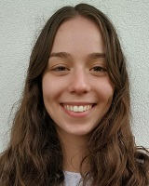
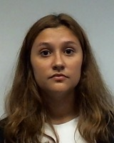
Formula 1 Bets Sistemas de Informação Empresarial
SIEM | Website Mockup
Joana Santos
up201606208@fe.up.pt
Sara Noronha
up201605755@fe.up.pt

Slide 2
Formula 1 Bets
Através da aplicação web “Formula 1 Bets” todos os tipos de utilizadores (até os que não têm conta) podem consultar as corridas, os drivers (e respetivas teams) e a odd de cada aposta que é possível fazer, ou seja, é permitida a consulta de 3 páginas.
Um utilizador com uma conta registada e validada pode usar a aplicação para fazer apostas no desporto de F1, sendo esta a principal funcionalidade da aplicação. O utilizador terá de introduzir os pontos que quer apostar, selecionar uma corrida e o tipo de aposta e apostar num driver.
Submetendo esta aposta, é possível consultá-la na página de todas as apostas feitas por esse utilizador. Cada user terá uma página com informação sobre a sua conta pessoal que poderá alterar sempre que quiser.
Para o gestor da página, é possível adicionar ou remover corridas, e consequentemente atualizam-se as odds. O gestor tem acesso a uma lista com todos os utilizadores e com todas as apostas submetidas, usufruindo de um sistema de pesquisa onde pode procurar um user pelo nome e consultar as apostas filtrando por status, race ou bet type. Além disso, é o gestor que altera o status de uma aposta, que quando é submetida tem o status de pendente e o gestor irá tornar essa aposta numa ganha ou perdida manualmente.

Slide 3
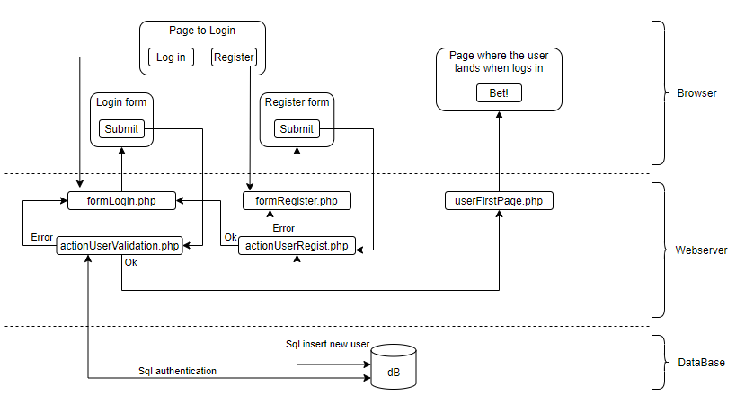
Diagram for the Authentication and Registry

Slide 4
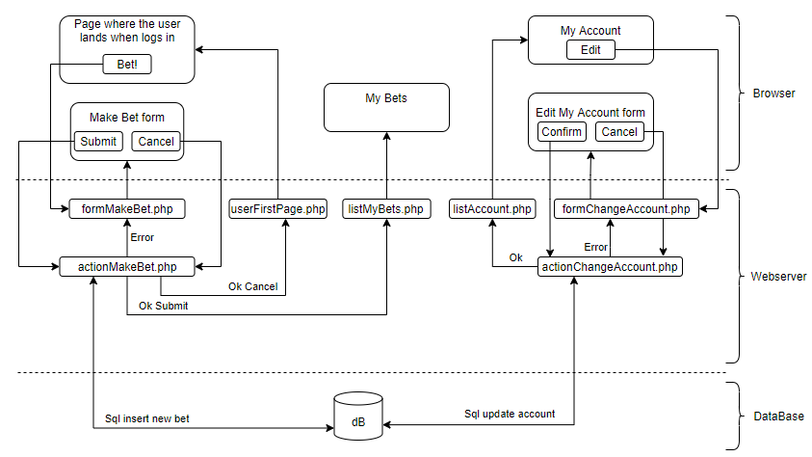
Diagram for the User

Slide 5
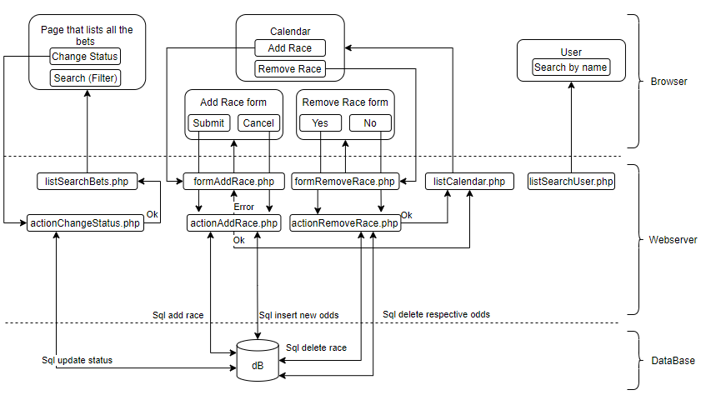
Diagram for the Manager

Slide 6
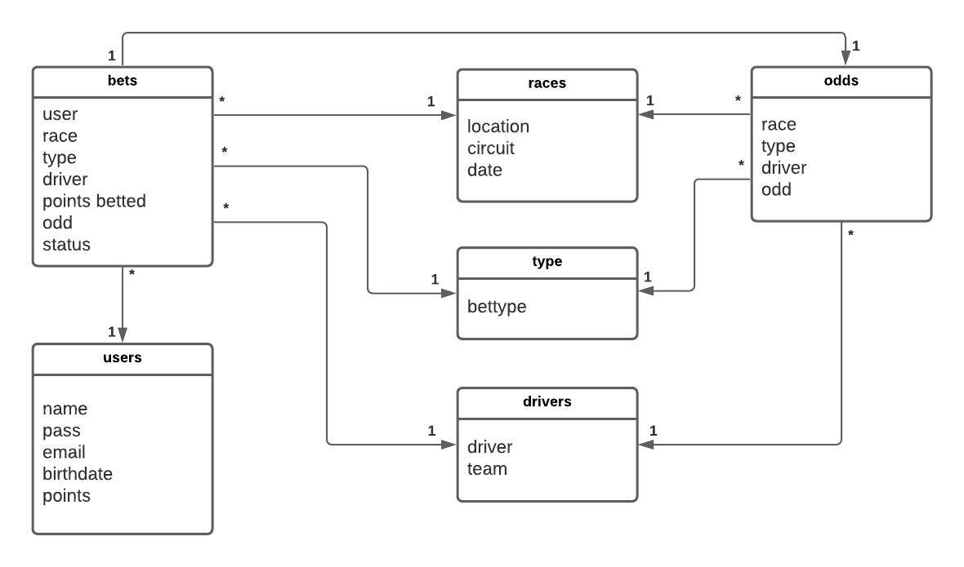
Relational Model of the Data Base
Tabela bets: id, user, race, type, driver, points betted, odd, status
Tabela users: id, name, pass, email, birthdate, points
Tabela races: id, location, circuit, date
Tabela type: id, bettype
Tabela drivers: id, driver, team
Tabela odds: ide, race, type, driver, odd

Slide 7
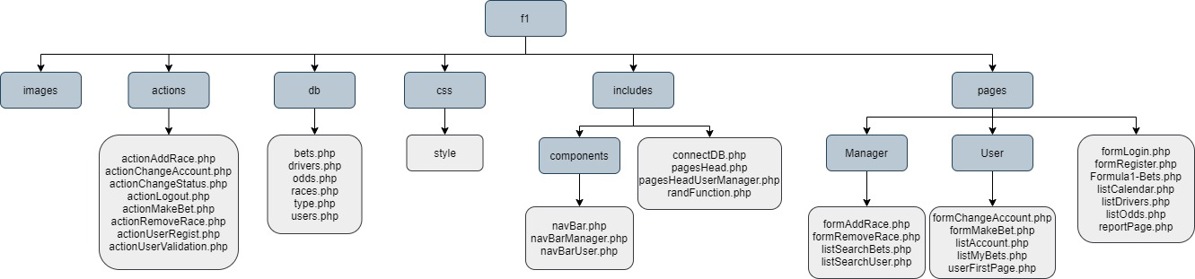
File Oganization

Slide 8
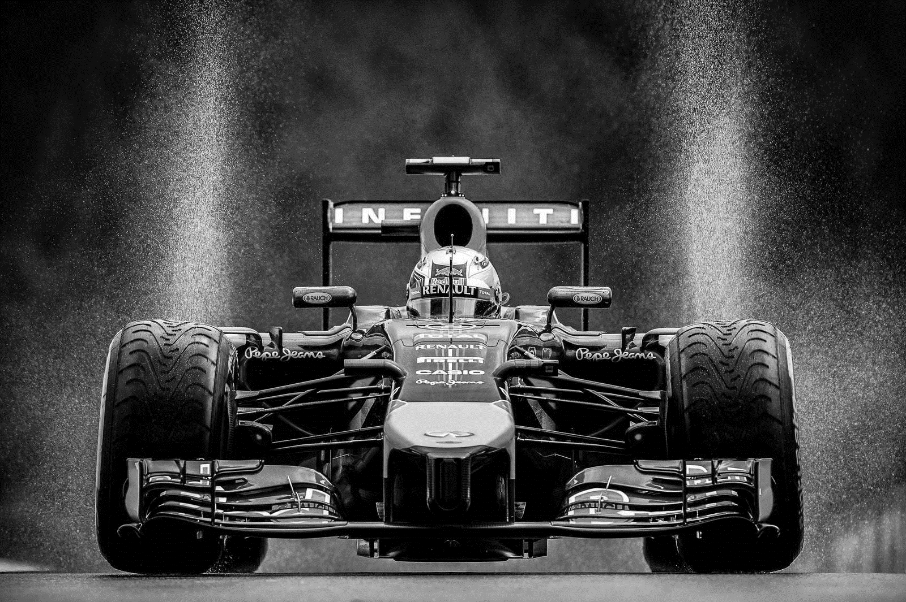
Calendar | Drivers | Odds | Login
Formula 1 Bets
Joana Santos
up201606208@fe.up.pt
Sara Noronha
up201605755@fe.up.pt

Slide 9
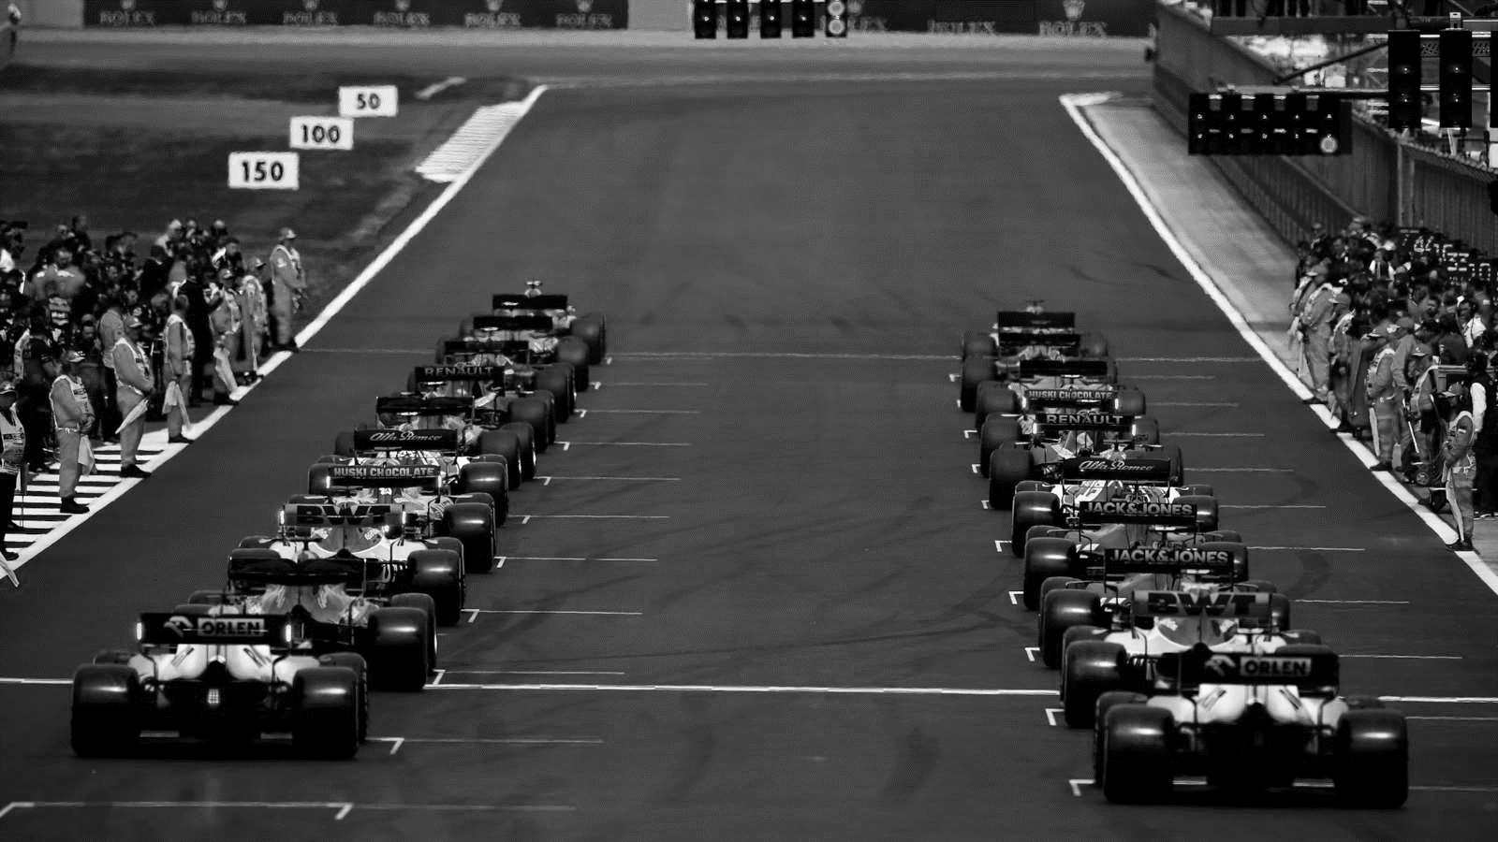

 | Calendar | Drivers | Odds | Login
2021 FIA Formula One World Championship
Grand Prix | Circuit | Date
F1 Australian GP | Albert Park Circuit | 19 – 21 Mar
F1 Gulf Air Bahrain GP | Sakhir Circuit | 26 – 28 Mar
F1 Chinese GP | Shangai International Circuit | 09 – 11 Apr
F1 GP de Monaco | Circuit de Monaco | 20 – 23 May
Table:
background-color: black,
Font-family: Franklin Gothic Book
Font-size: 20 px,
Border: 1.5 px solid white
Title and navbar font: Bahnschrift
Main title font size: 65 px
Navbar font size: 32 px

Slide 10
 | Calendar | Drivers | Odds | Login
2021 Drivers
Driver | Team
Lewis Hamilton | Mercedes-AMG Petronas F1 Team
Daniel Ricciardo | McLaren F1 Team
Sebastian Vettel | Aston Martin
Carlos Sainz | Scuderia Ferrari Mission Winnow
George Russell | Williams Racing
Mich Shumacher | Haas F1 Team
Sergio Perez | Aston Martin Red Bull Rancing

Slide 11
 | Calendar | Drivers | Odds | Login
Odds
Heading 3:
Font-family: Bahnschrift,
Font-size: 30 px,
Color: white,
Text-align: center.
Pole Position
Race | Driver | Odd
F1 Australian GP | Lewis Hamilton | 1.40
F1 Australian GP | Daniel Ricciardo | 9.07
F1 Australian GP | Sebastian Vettel | 7.43
F1 Australian GP | Carlos Sainz | 6.34
DNF
Race | Driver | Odd
F1 Australian GP | Lewis Hamilton | 4.24
F1 Australian GP | Daniel Ricciardo | 5.99
F1 Australian GP | Sebastian Vettel | 3.14
F1 Australian GP | Carlos Sainz | 7.12

Slide 12
 | Calendar | Drivers | Odds | Login
Login
Username:
Password:
Login
You don’t have an account? Click here
Paragraphs and forms:
Font-family: Franklin Gothic Book,
Font-size: 24 px,
Color: white,
Text-align: center
Seguinte

Slide 13
 | Calendar | Drivers | Odds | Login
Create your Account
Username:
Password:
Birthdate:
dd/mm/yyyy
E-mail:
Submit
Cancel

Slide 14
 | Calendar | Drivers | Odds | Login
My Bets
Account
Logout
Welcome
Welcome Miguel!
At the moment, you have 10 points
Bet!
Button:
Background-color: grey,
Border: 1.5 px solid white,
Border-radius: 10 px,
Padding: 6 px 16 px

Slide 15
 | Calendar | Drivers | Odds | Bet! | Login
 | Calendar | Drivers | Odds | Login
Make Your Bet
My Bets
Account
Logout
Points to bet:
Select the race:
Race ↓
Select the bet type:
Bet Type ↓
Select the driver:
Driver ↓
Submit
Cancel

Slide 16
 | Calendar | Drivers | Odds | Bet! | Login
 | Calendar | Drivers | Odds | Login
Make Your Bet
My Bets
Account
Logout
Points to bet:
50
Select the race:
F1 Australian GP
Select the bet type:
Pole Position
Select the driver:
Lewis Hamilton
Submit
Cancel

Slide 17
 | Calendar | Drivers | Odds | Bet! | Login
Users
Bets
My Bets
Account
Logout
My Bets
Races | Bet Type | Drivers | Betted points | Status
F1 Chinese GP | Pole Position | Sebastion Vettel | 30 | Pending
F1 Chinese GP | Fastest Lap | Lando Norris | 10 | Pending
2020 F1 Bahrain GP | DNF | Nicholas Latifi | 16 | Won
2020 F1 Bahrain GP | Fasted lap | Lewis Hamilton | 50 | Lost

Slide 18
 | Calendar | Drivers | Odds | Bet! | Login
Users
Bets
My Bets
Account
Logout
Account
Username:
Mrs. Sara Noronha
Birthday:
30 / 11 / 1998
Email:
sara.del@gmail.com
Password:
***********
Edit

Slide 19
 | Calendar | Drivers | Odds | Login
Users
Bets
Logout
2021 FIA Formula One World Championship
Grand Prix | Circuit | Date
F1 Australian GP | Albert Park Circuit | 19 – 21 Mar
F1 Gulf Air Bahrain GP | Sakhir Circuit | 26 – 28 Mar
F1 Chinese GP | Shangai International Circuit | 09 – 11 Apr
F1 GP de Monaco | Circuit de Monaco | 20 – 23 May
Remove
Remove
Remove
Remove
New Race

Slide 20
 | Calendar | Drivers | Odds | Login
Users
Users
Bets
Logout
Search by User:
Search
Name | E-mail | Birthdate | Points
Joana | joana.santos@gmail.com | 09/04/1998 | 2540
Miguel | miguel-campos@hotmail.com | 25/03/2000 | 10
Sara | sara.del@gmail.com | 30/11/1998 | 500

Slide 21
 | Calendar | Drivers | Odds | Login
Bets
Users
Bets
Logout
Bet Type: | Winner Pole Position DNF
Races: | F1 Chinese GP F1 GP de Monaco
Bet Status: | lost pending won
Search
Username | Race | Bet Type | Drivers | Betted points | Status
Sara Noronha | F1 Chinese GP | Winner | Sebastion Vettel | 30 | Pending
Sara Noronha | F1 GP de Monaco | Pole Position | Sebastion Vettel | 30 | won
Sara Noronha | F1 Chinese GP | DNF | Lando Norris | 10 | lost
Won ↓
Change Status
Won ↓
Change Status
Won ↓
Change Status

