Slide 1
Performance Analysis of Multi-Tier Hybrid Networks
Advisor: | Group Members:
Dr. Syed Ali Hassan | Osama Waqar
Co-Advisor: | Haris Suhail
Dr. Sajid Saleem | Uzair Akbar

Slide 2
Problem Statement
“The performance of next generation cellular networks and their various enablers need to be evaluated in order to assess their effectiveness towards improvement of various performance metrics.”

Slide 3
Introduction
Need
High data rates
Low latency
Longer battery life
Fig. 1: Predicted demand for connectivity.

Slide 4
Millimeter wave
More bandwidth means higher data rates ¹
Fig. 2: mmWave Bandwidth opportunity.
¹ T S Rappaport et al. IEEE Access 2013

Slide 5
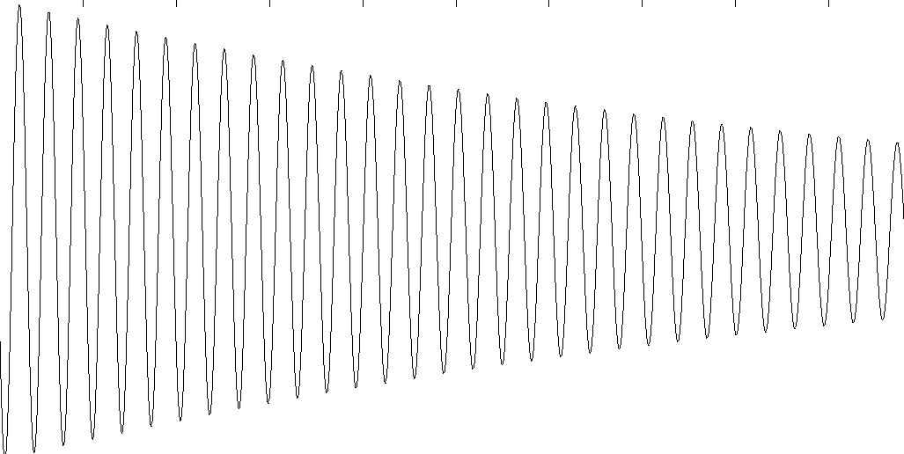
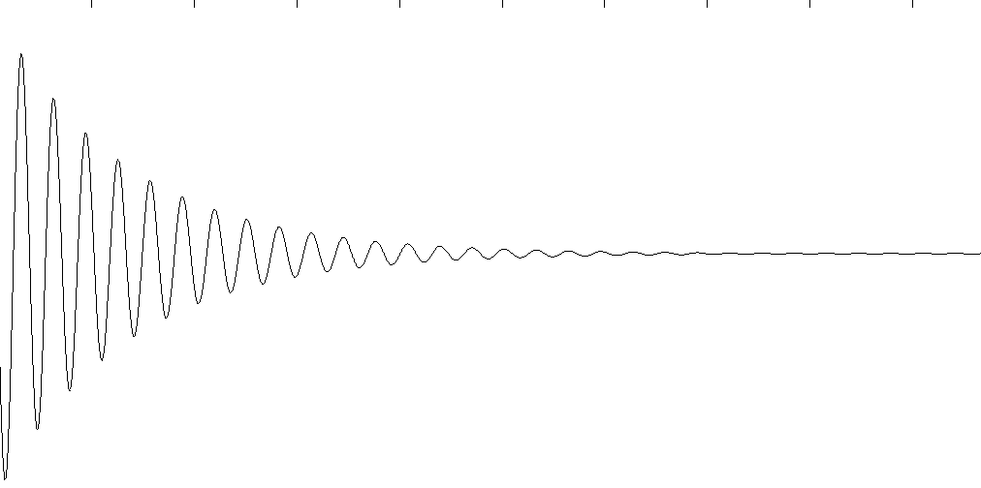


Millimeter wave
F < 6 Ghz (Traditional)
$$\begin{matrix}Free Space \\ {Path Loss}^{ 1}\end{matrix}={\left(\frac{4πrf}{c}\right)}^{2}$$
Where
$r=$ Distance to the base station, $f=$ operating frequency.
F > 24Ghz (mmWave)
¹ Rappaport, Wireless Communications,
Prentice Hall PTR, 2002.
Fig. 3: Penetration loss.

Slide 6
Heterogeneous Networks
Fig. 4: Example of a Heterogeneous Network (HetNet).

Slide 7
Heterogeneous Networks
Fig. 4: Example of a Heterogeneous Network (HetNet).

Slide 8
Heterogeneous Networks
Fig. 4: Example of a Heterogeneous Network (HetNet).

Slide 9
Heterogeneous Networks
Fig. 4: Example of a Heterogeneous Network (HetNet).

Slide 10
Decoupled access
Fig. 5: Coupled Uplink (UL) and Downlink (DL) Connection

Slide 11
Decoupled access
Fig. 6: Downlink Uplink Decoupling (DUDe) Allowed

Slide 12
System Model
3 tier system (Deployed via Poisson Point Process)
Ultra High Frequency (UHF) macro cells (Mcells).
UHF small cells (Scells).
mmWave Scells.
DUDe allowed.
Realistic blockage model.
Fig. 7: System Model

Slide 13

Blockage Model
The LoS probability between two points a distance $r$ apart is taken as ¹
$$p\left(r\right)=e^{−βr}$$
$$p\left(r\right)=e^{−βηr}$$
Where
$p\left(r\right)=$ Probability of link being LoS, $r=$ link distance, $β=$ 2D blockage parameter $η$ = 3D blockage parameter
¹ Analysis of blockage effects on urban cellular networks
T Bai et al. IEEE Trans, 2014

Slide 14


Blockage Model
$$β=0.0224$$
$$β=0.0014$$
(a) The urban environment of Chicago City (CC).
(b) The sub-urban environment of NUST Campus (NC).
Fig. 9: Extracted building locations of the environments under consideration.

Slide 15
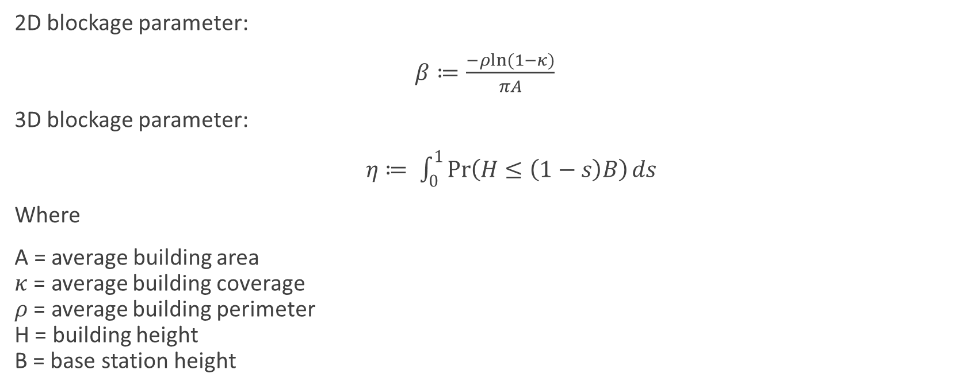
Blockage model continued…
2D blockage parameter:
$β≔\frac{−ρln⁡(1−κ)}{πA}$
3D blockage parameter:
$η≔ \int_{0}^{1}{\operatorname{Pr}\left(H≤\left(1−s\right)B\right)ds}$
Where
A = average building area $κ$ = average building coverage $ρ$ = average building perimeter H = building height B = base station height
¹ Analysis of blockage effects on urban cellular networks
T Bai et al. IEEE Trans, 2014

Slide 16
Cell Association
DL association via maximum biased received power criterion ¹.
UL association via minimum path loss/ distance ¹.
Minimum Rate threshold required for coverage ².
¹ J. G. Andrews et al., IEEE Trans. Wireless Commun., 2011.
² M. Bacha et al., IEEE Trans. Wireless Commun., (In Press) 2017 .

Slide 17
Results
Fig. 10: Coverage gain for different small cell densities.
Fig. 11: Uplink data rates with and without decoupling.

Slide 18
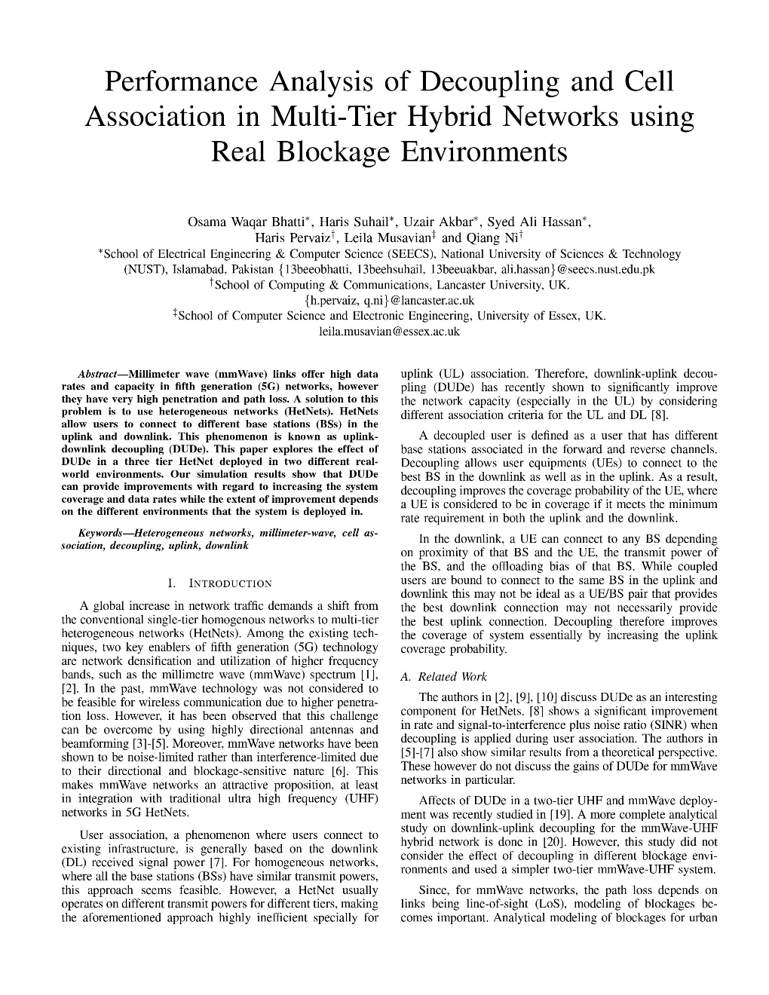
Conference Paper
Conference: 13th International Wireless Communications and Mobile Computing (IWCMC) Conference, June 2017.
Submission: March 6, 2017.
Result: Accepted for Publication.
In collaboration with Lancaster University, UK: Dr. Haris Pervaiz Dr. Leila Musavian Dr. Qiang Ni

Slide 19
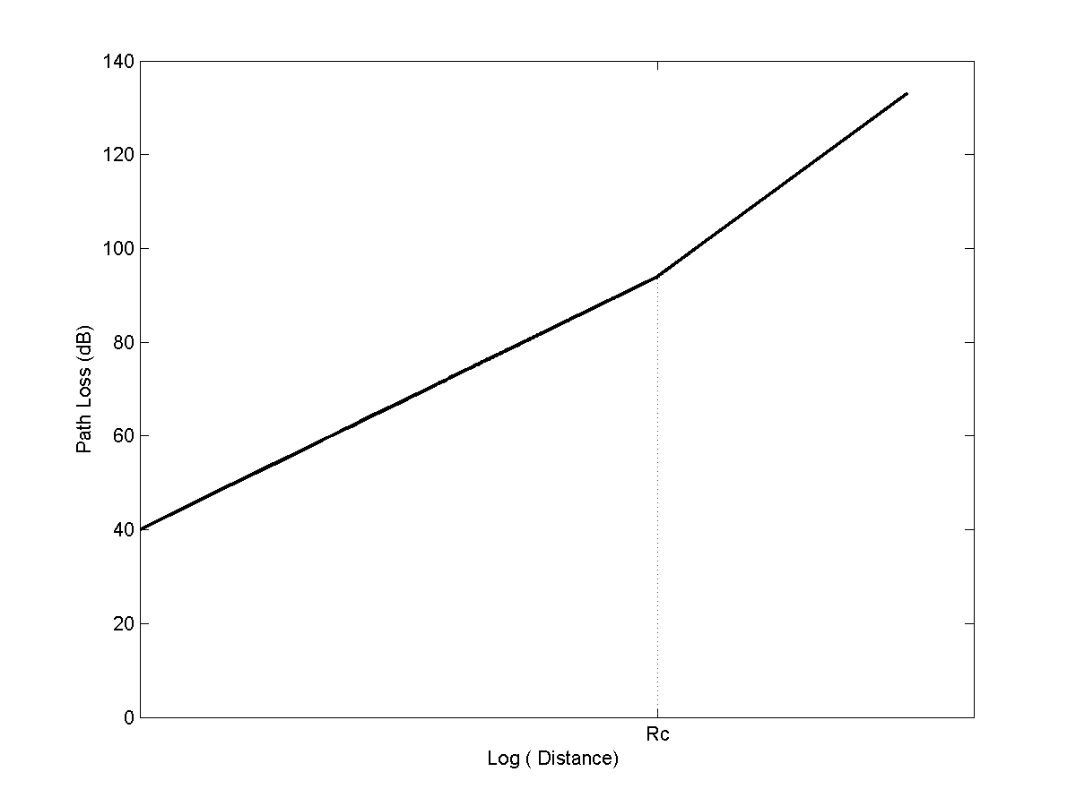

New System Model - Pathloss
New path-loss model
Sample Path Loss with dual Slope
Critical Radius, Rc
<>
<> - Location of measurement

Slide 20
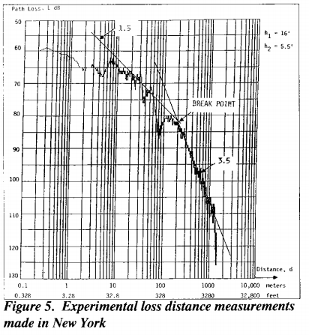
Why dual slope?
More Realistic!
“While the standard path loss model is well-motivated by the free space signal loss (also known as the Friis equation), it is also well-known to be quite idealized and does not capture the distance-dependence of the path loss exponent α, which is empirically known”
-Downlink Cellular Network Analysis with a Dual-slope Path Loss Model , Xinchen Zhang et al
Empirically Proven By Donald L. Schillings et al
-Broadband CDMA for Personal Communication Systems, 1991

Slide 21



New System Model – Blockage Model
New Blockage Model – Introduced the Effect of 3D
2D
3D

Slide 22
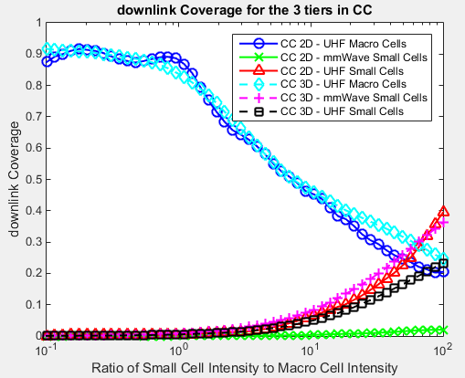
Results (2D vs 3D)
Figure 13

Slide 23
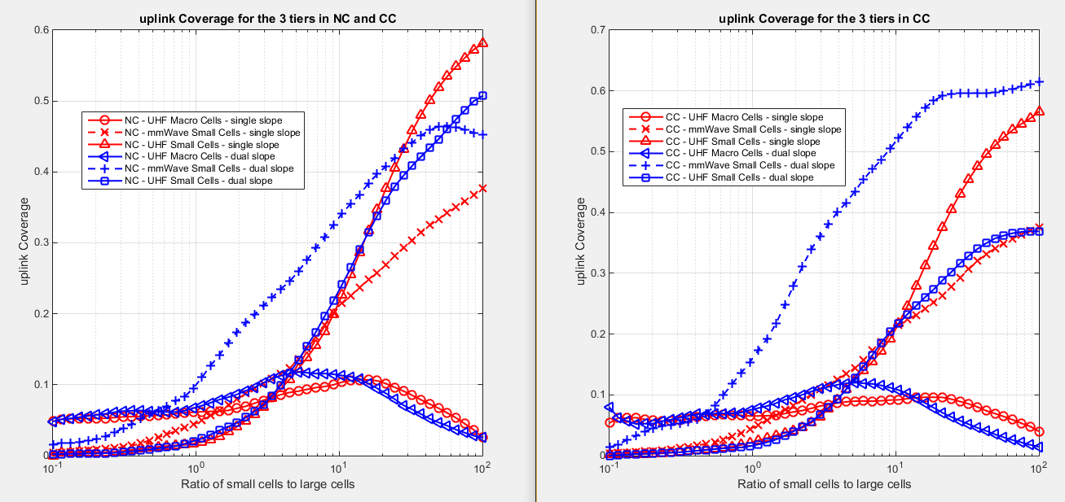
Results (single vs dual-slope)

Slide 24
Future Work
Incorporation of Multi-slope path loss model ¹.
3D channel modeling.
¹ M. Ding et al., IEEE Trans. Wireless Commun., 2016.
² H. Munir et al., IEEE VTC, 2016.

Slide 25
Timeline
Final-Defence
Report Submission
Project Start
IWCMC
14/11/16
15/2/17
19/5/17
31/5/17
Today
2016
Nov
Dec
2017
Feb
Mar
Apr
May
2017
Literature Review
14/11/16 - 27/11/16
27/2/17
23/5/17
2 Tier Model Simulation
28/11/16 - 11/12/16
Mid-Defence
Open House
2D Blockage Model Development
12/12/16 - 25/12/16
16/2/17
Addition of Tier 3
Design Expo
26/12/16 - 8/1/17
Addition of DUDe
9/1/17 - 22/1/17
Detailed Performance Analysis
23/1/17 - 5/2/17
IWCMC Submission
6/2/17 - 6/3/17
Multislope Path Loss Incorporation
20/2/17 - 23/4/17
3D Channel Modeling
3/4/17 - 2/5/17
Optimization via Game Theory
16/4/17 - present
Project Report
1/5/17 - 14/5/17

Slide 26
Work Distribution
Work | Leader | Members
Literature Review | Haris | Uzair, Osama
Problem Formulation | Uzair | Osama, Uzair
Deciding system model | Osama | Uzair, Haris
Extracting blockage environments | Uzair | Haris, Osama
Generating results | Haris | Uzair, Osama
Analyzing results | Osama | Haris, Uzair
Paper Writing | Uzair | Osama, Haris

Slide 27
THANK YOU

Slide 28
Spatial Distributions
Users and base stations distributed via poison point process (PPP) ¹.
¹ J. G. Andrews et al.,
IEEE Trans. Wireless Commun., 2011.
Fig. 8: Illustration of Macro and Micro Base Stations (BS) spatially distributed via poison point processes (PPP).

Slide 29

Path Loss Model
For UHF ¹
$$L_{UHF}(r)=20\log\left(\frac{4π}{λ_{UHF}}\right)+10α\log\left(r\right)+χ_{UHF}$$
Where
$L_{UHF}\left(r\right)=$ Path loss for UHF link, $λ_{UHF}=$ Wavelength of UHF, $α=$ UHF path loss exponent, $χ_{UHF}=$ UHF log normal shadowing.
¹ Rappaport, Wireless Communications,
Prentice Hall PTR, 2002.

Slide 30
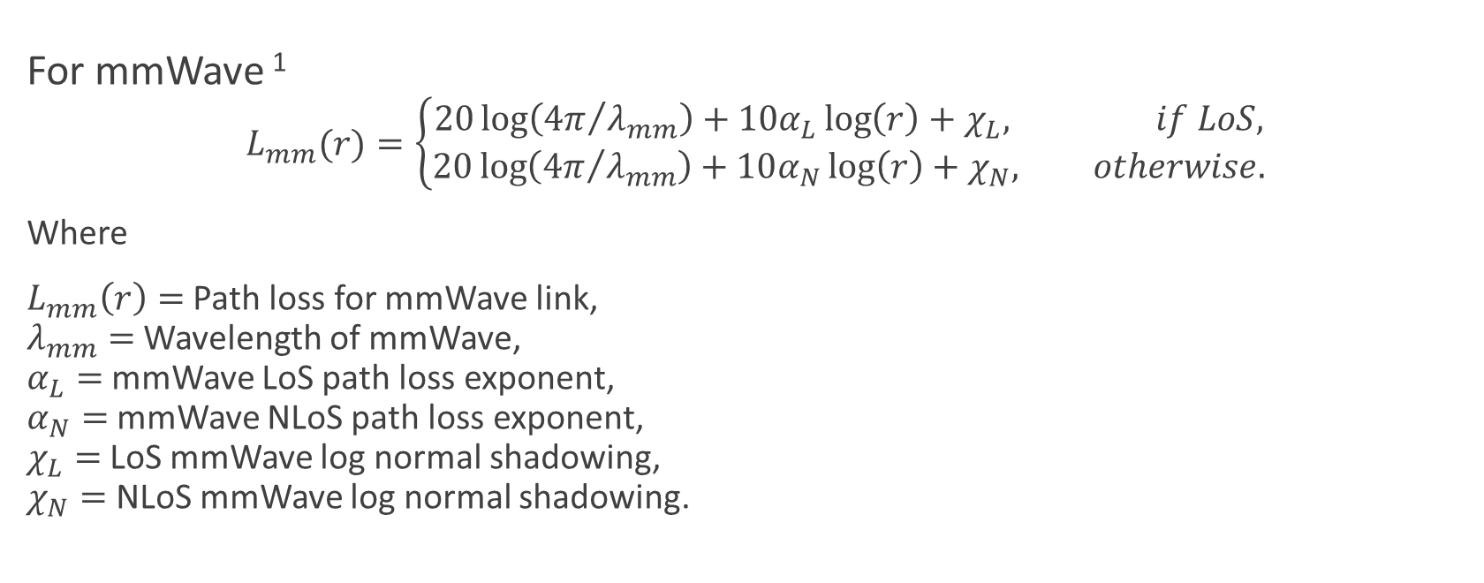
Path Loss Model
For mmWave ¹
$$L_{mm}(r)=\left\{\begin{aligned}20\log\left({4π}/{λ_{mm}}\right)+10α_{L}\log\left(r\right)+χ_{L}, if LoS, \\ &20\log\left({4π}/{λ_{mm}}\right)+10α_{N}\log\left(r\right)+χ_{N}, otherwise.\end{aligned}\right.$$
Where
$L_{mm}\left(r\right)=$ Path loss for mmWave link, $λ_{mm}=$ Wavelength of mmWave, $α_{L}=$ mmWave LoS path loss exponent, $α_{N}=$ mmWave NLoS path loss exponent, $χ_{L}=$ LoS mmWave log normal shadowing, $χ_{N}=$ NLoS mmWave log normal shadowing.
¹ T. S. Rappaport et al., IEEE Trans. Antennas Propag., 2013

Slide 31
Results
Ratio of UHF Scells to total Scells
Ratio of UHF Scells to total Scells
Fig. 12: DL and UL data rates with and without DUDe.
Fig. 13: Fraction of decoupled users in NC and CC.

Slide 32
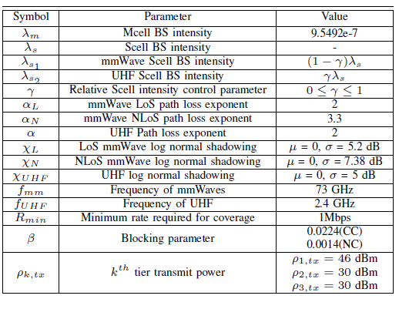
Simulation parameters

Slide 33
J Park, S L Kim, J Zander, “Tractable resource management with uplink decoupled millimeter-wave overlay in ultra-dense cellular networks” IEEE Transcations on wireless communications, VOL. 15 No. 6 Jun 16.

