Slide 1
Full-text search with the test data (id, title)

Slide 2
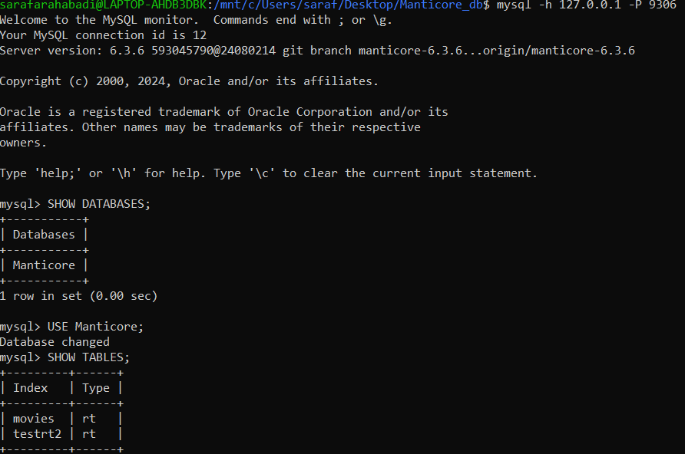

Slide 3
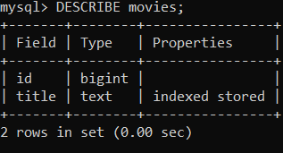

Slide 4
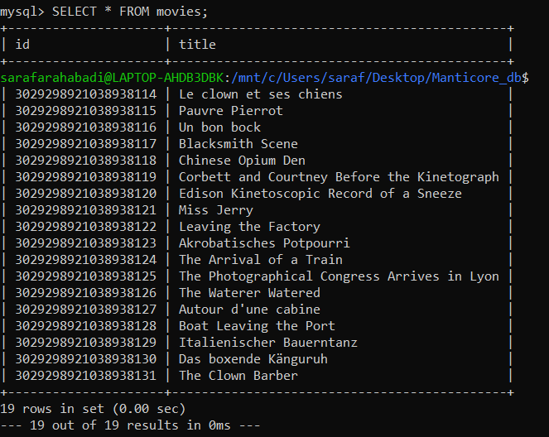

Slide 5
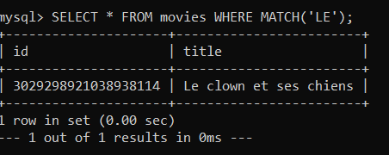

Slide 6
Full-text search with the test data all columns

Slide 7
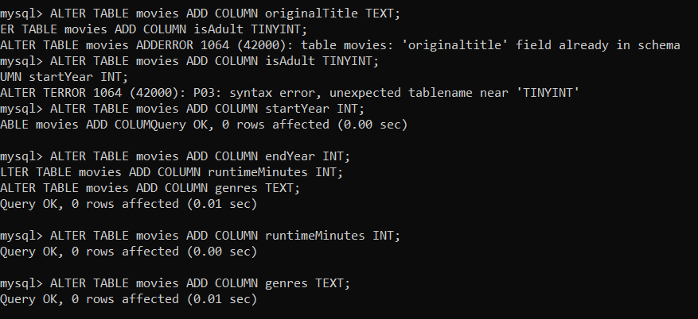

Slide 8
