Slide 1
Multivariate Time-Series Forecasting for
Energy Consumption Prediction
Authors
Saurabh Parkar
Vaibhav Saraf
Sanjan Vijayakumar
Kyu Ha, Kim

Slide 2
Index
Introduction
Dataset
Relation between datasets
Missing Value Imputations
EDA
Feature Engineering
Time Series
General Time Series Forecasting Methods
Challenges faced during the implementation
LSTM
Light GBM
Model Comparison
References

Slide 3
Introduction
The project seeks to predict the energy meter reading of buildings across four energy types – chilled water, electric, hot water, and steam meters based on historic usage rates and observed weather over a one year time-frame.
With better estimates of these energy-saving investments, large scale investors and financial institutions will be more inclined to invest in this area to enable progress in building efficiencies.

Slide 4
Dataset
The dataset includes hourly meter readings from over one thousand buildings at several different sites around the world including the following CSV files :
data.csv
building_metadata.csv
weather_data.csv
Link to Dataset - https://www.kaggle.com/c/ashrae-energy-prediction/data

Slide 5
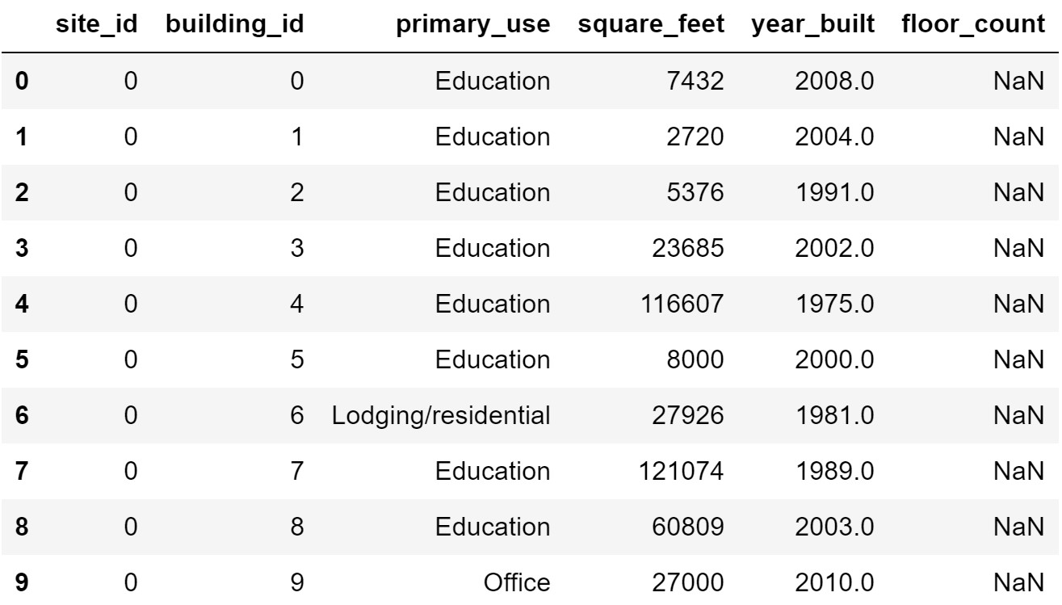
Dataset
Building_metadata.csv - This file contains buildings id’s and some features. Features include site id, building id, primary purpose of use of building, size of building in square feet, year built and floor count of the buildings.

Slide 6
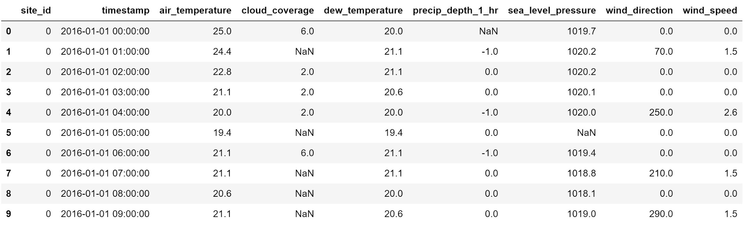
Dataset
Weather_data.csv - Contains hourly data on weather features that affect building energy consumption. Features include air temperature, cloud coverage, dew temperature, sea level pressure, wind direction and speed.

Slide 7
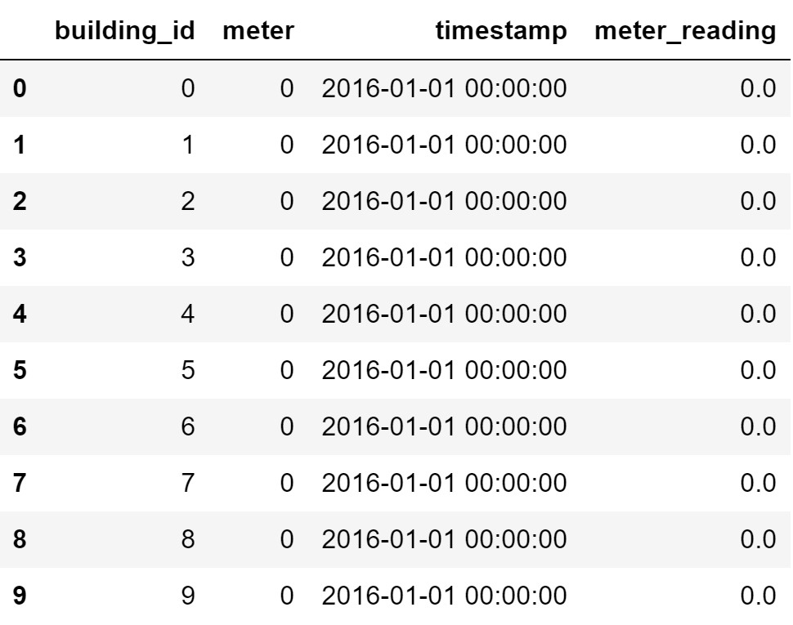
Dataset
Data.csv - Contains hourly data on meter readings of each of the 4 meter types in each building.

Slide 8
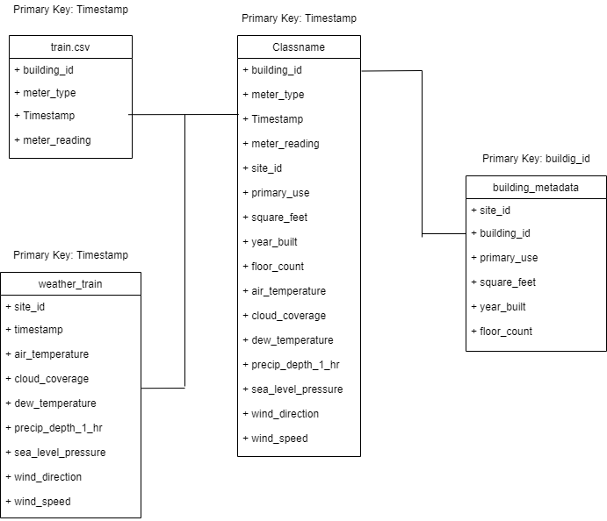
Relation between datasets
Number of Samples - 20,216,100
Number of Buildings - 1449
Meter Types - 4
Number of Time Series - 1449 x 4 = 5796

Slide 9
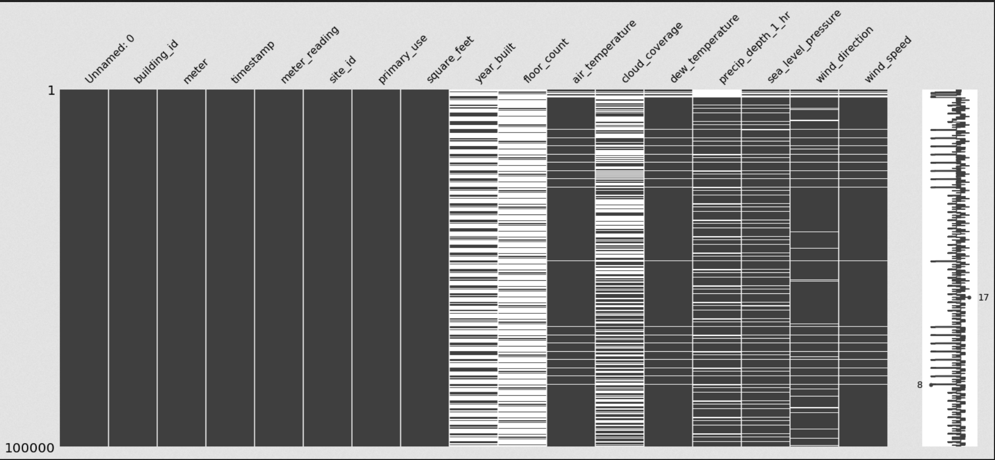
Missing Value Imputations

Slide 10
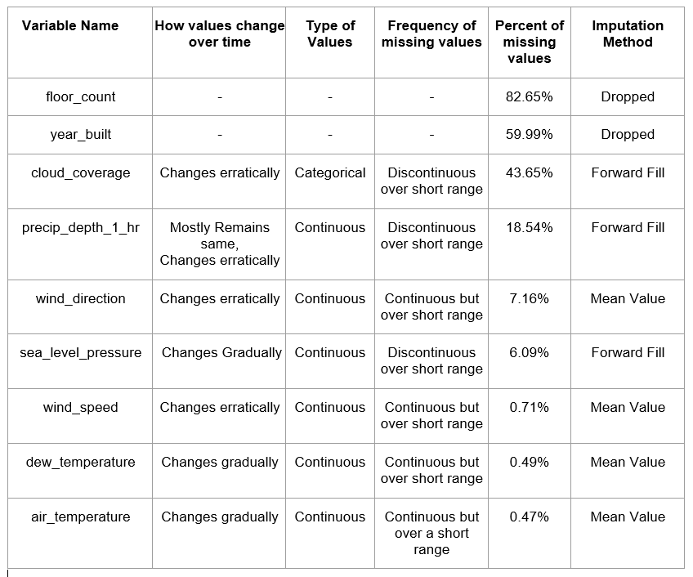
Missing Value Imputations

Slide 11
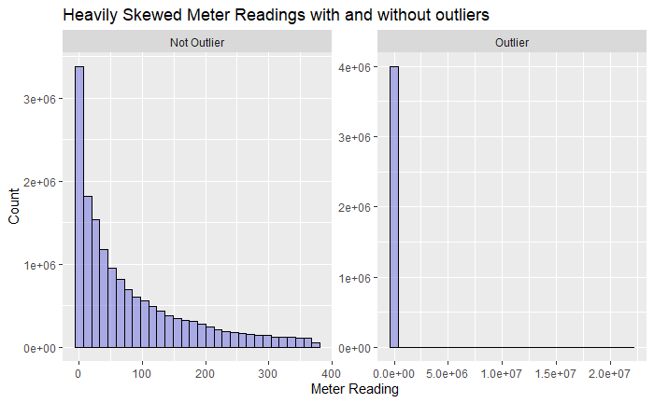
EDA

Slide 12
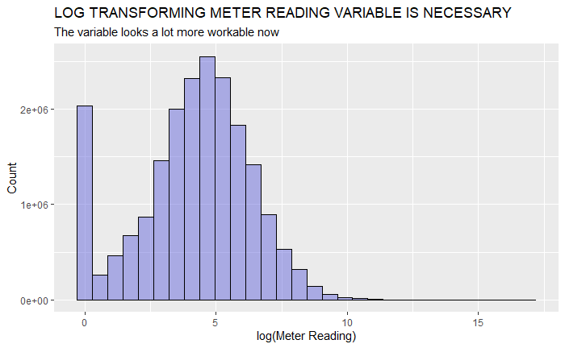

Slide 13
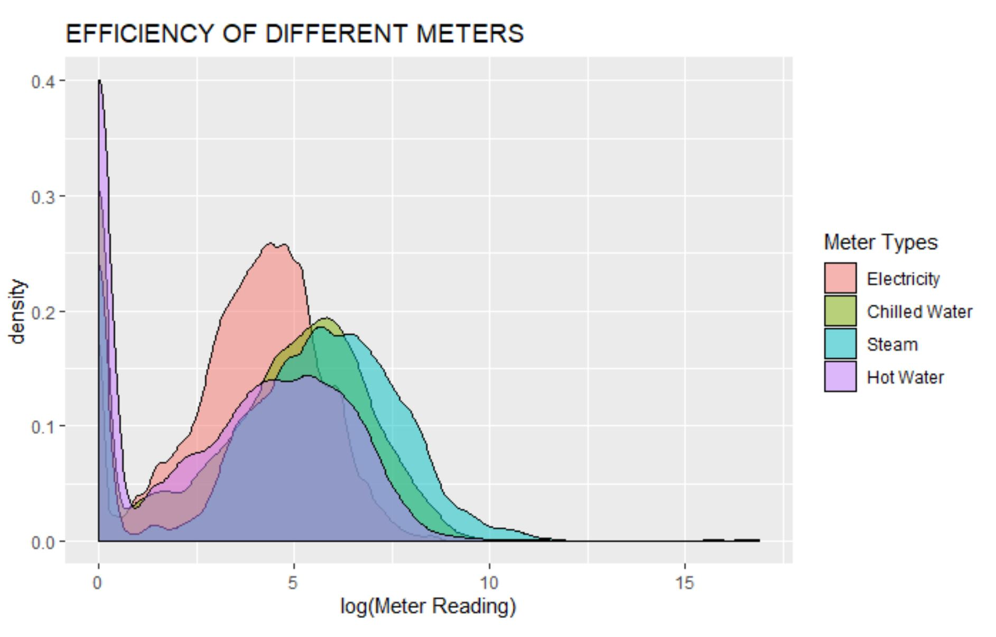

Slide 14
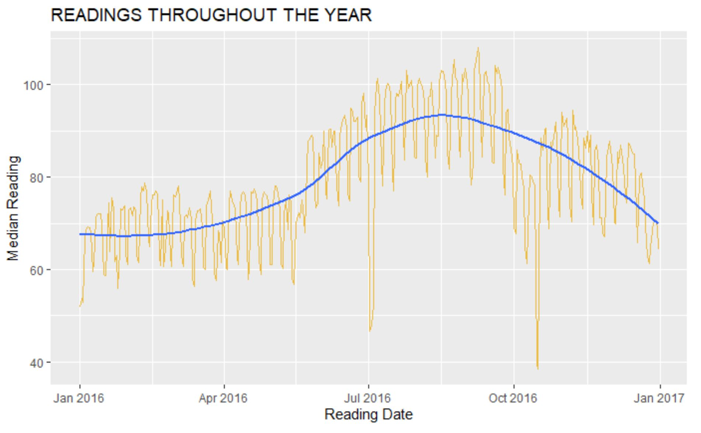

Slide 15
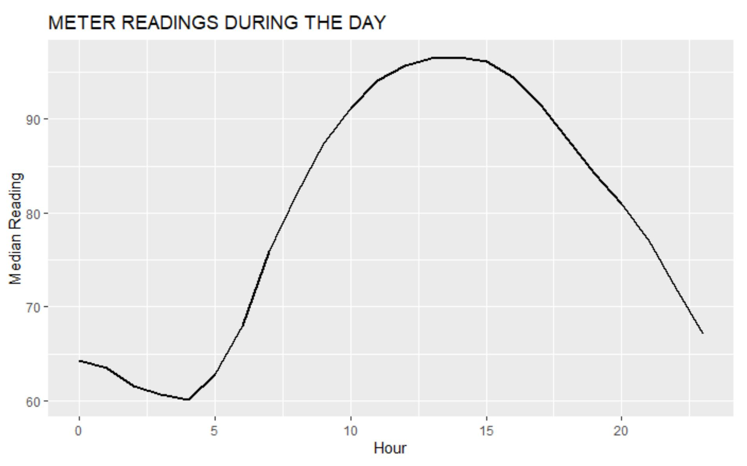

Slide 16
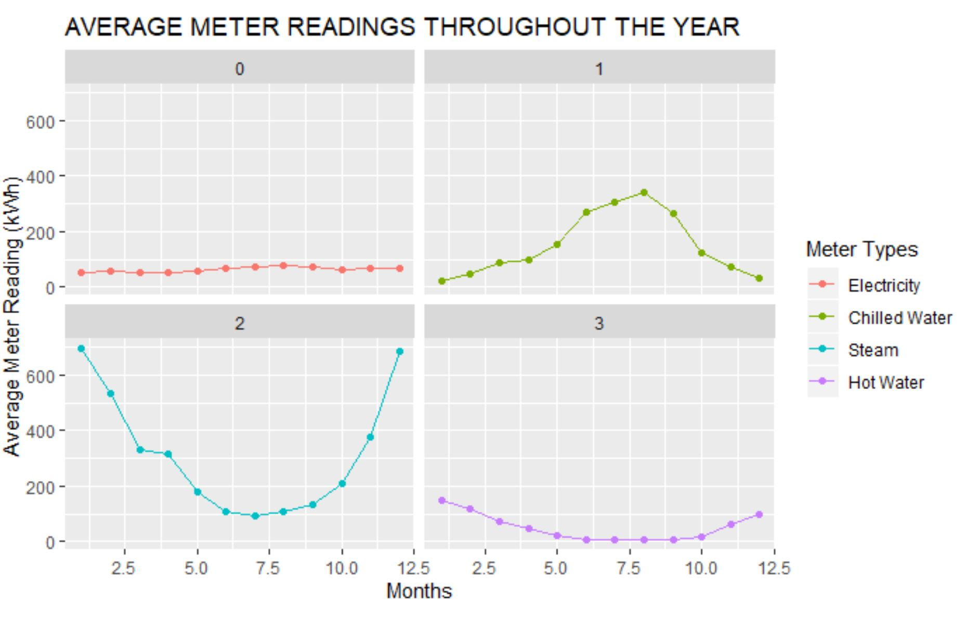

Slide 17
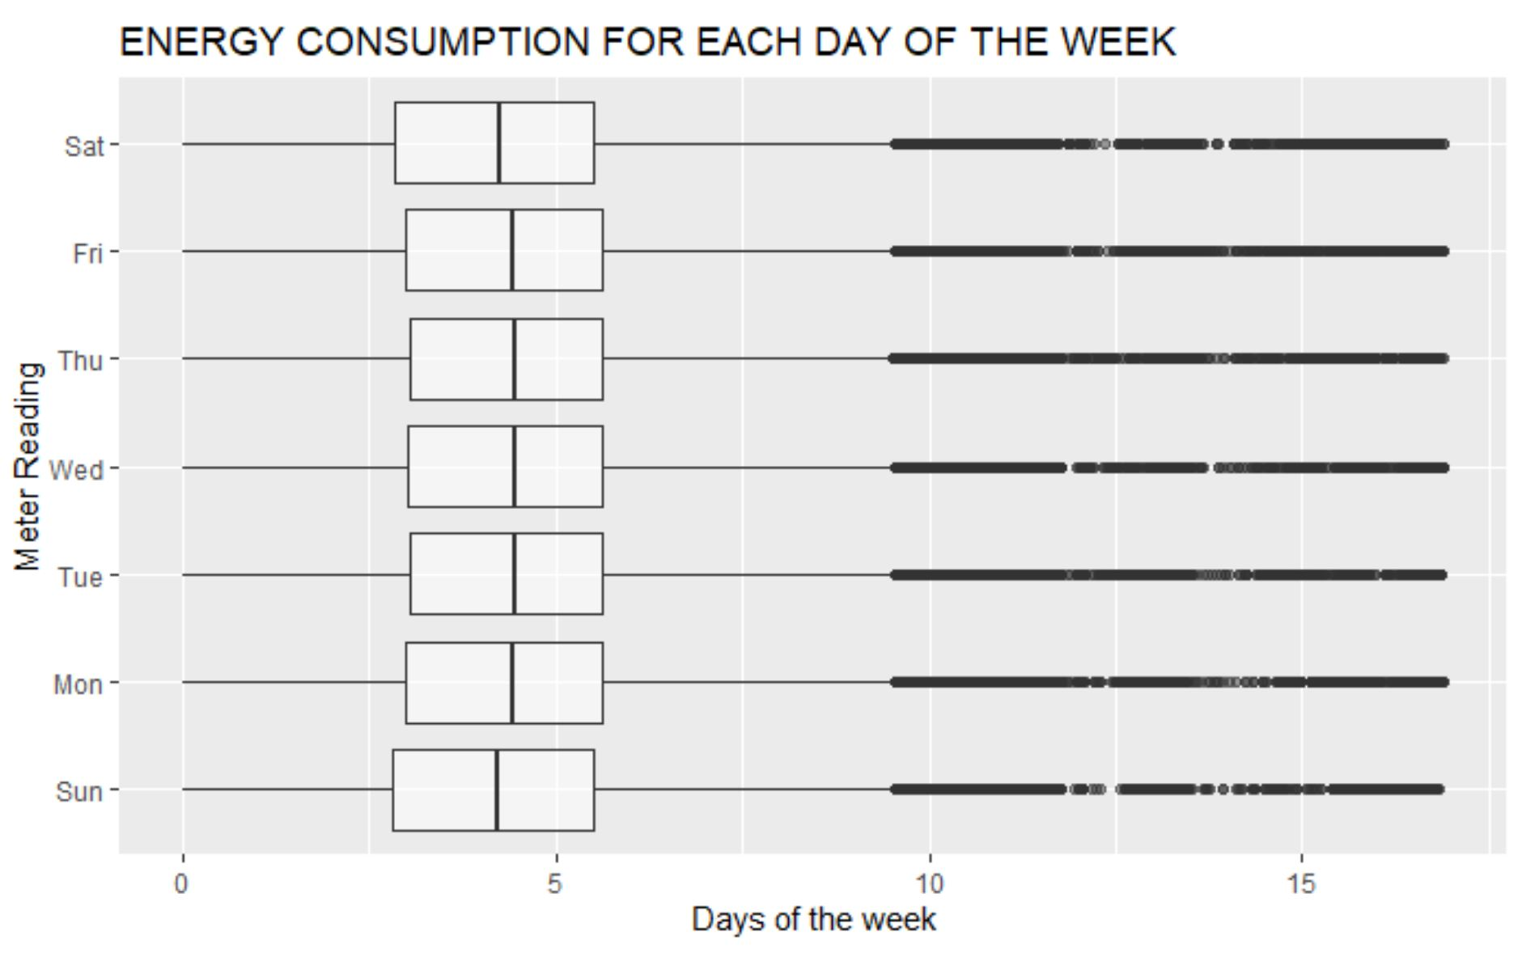

Slide 18
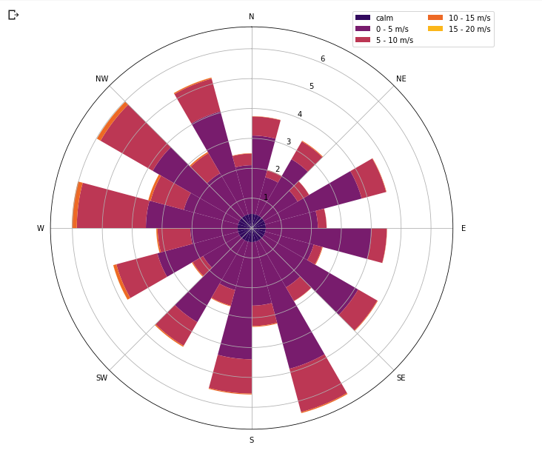
Wind Speed and Wind Direction

Slide 19
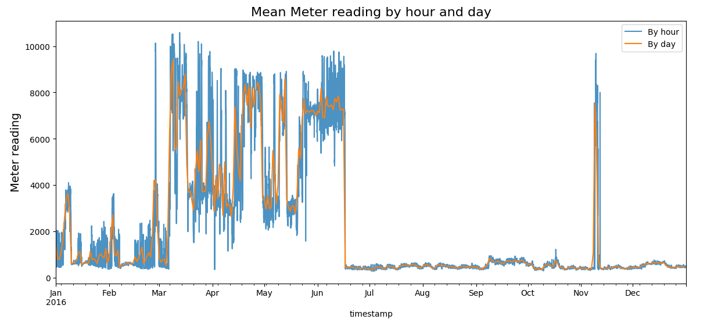

Slide 20
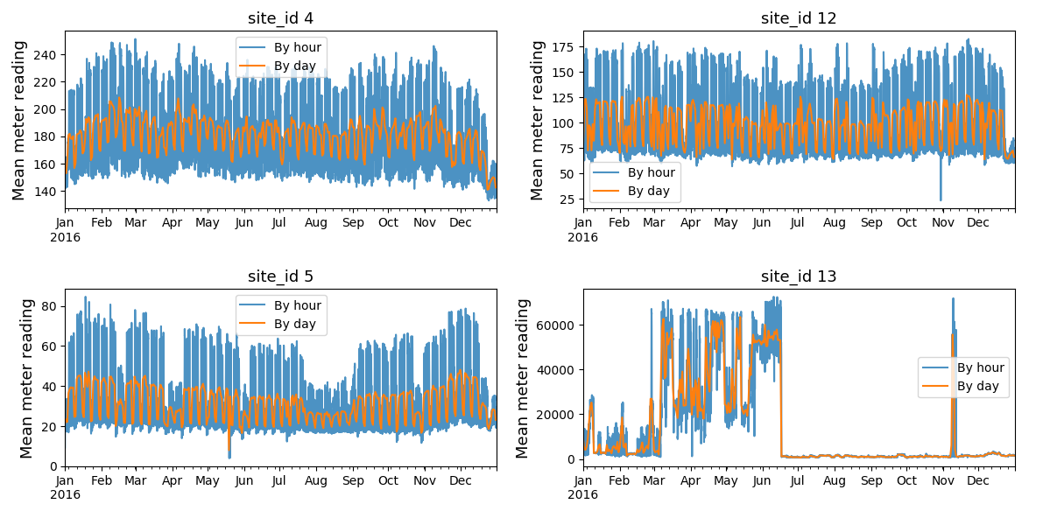
Mean meter reading by site_id

Slide 21
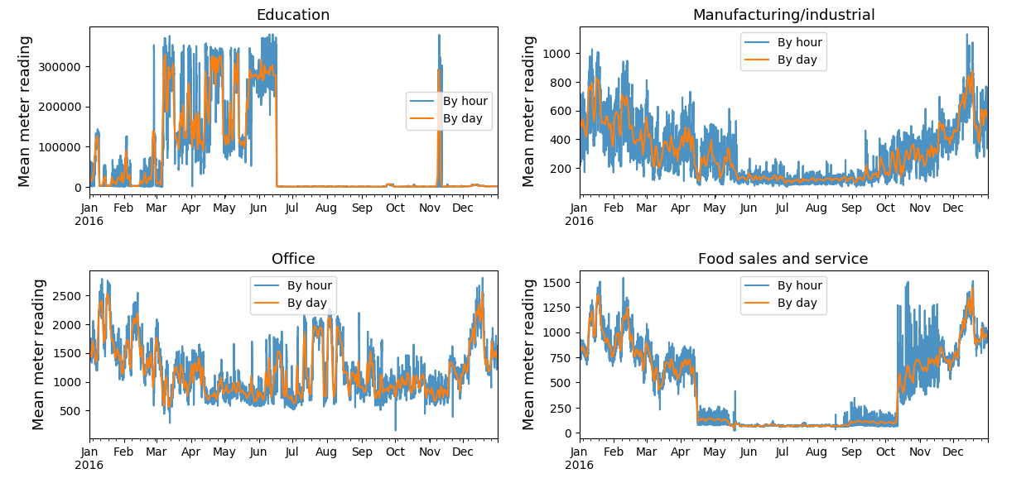
Mean meter reading by primary_use for site_id=13

Slide 22
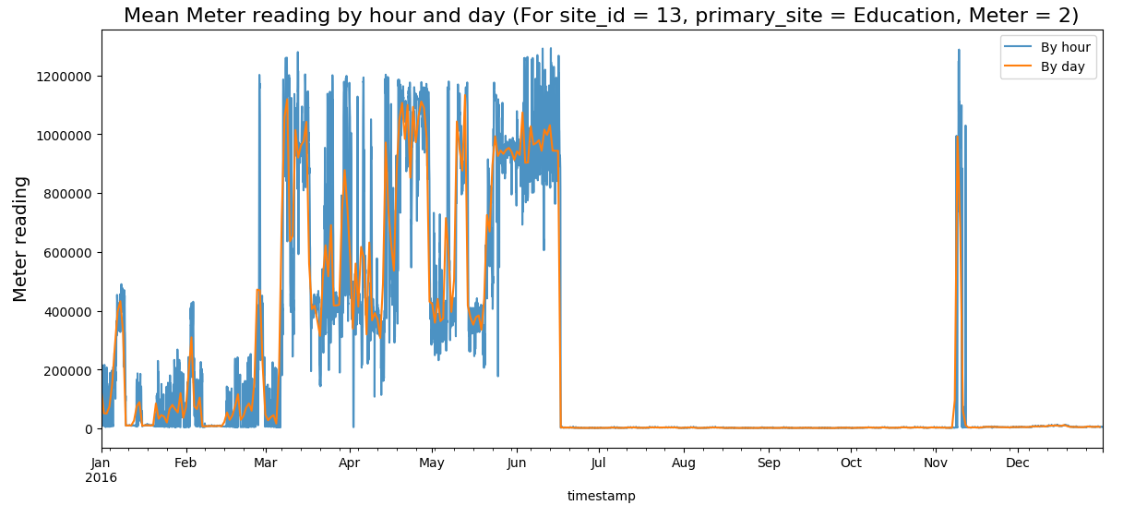

Slide 23
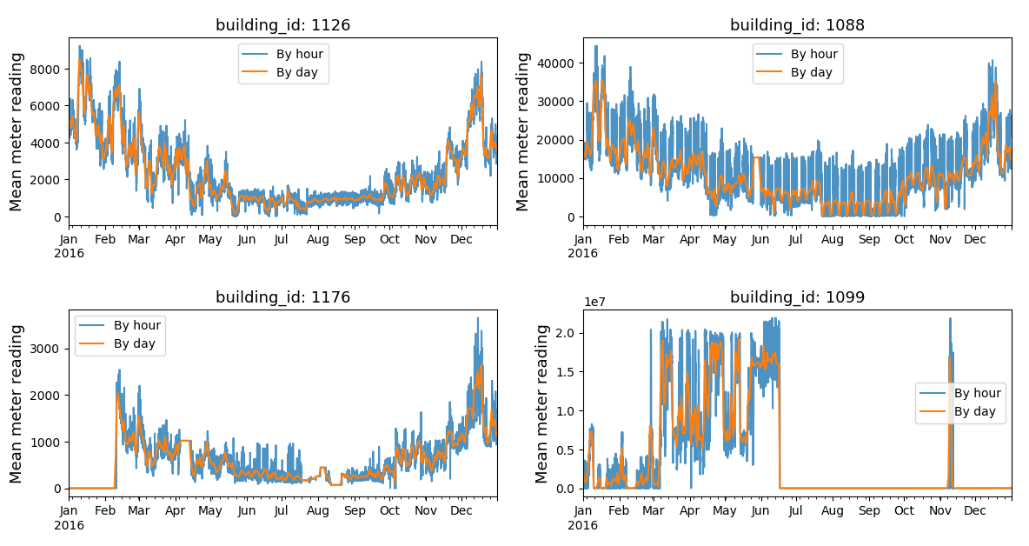
Mean meter reading by building_id for site_id=13, primary_use = Education, meter_id = 2

Slide 24
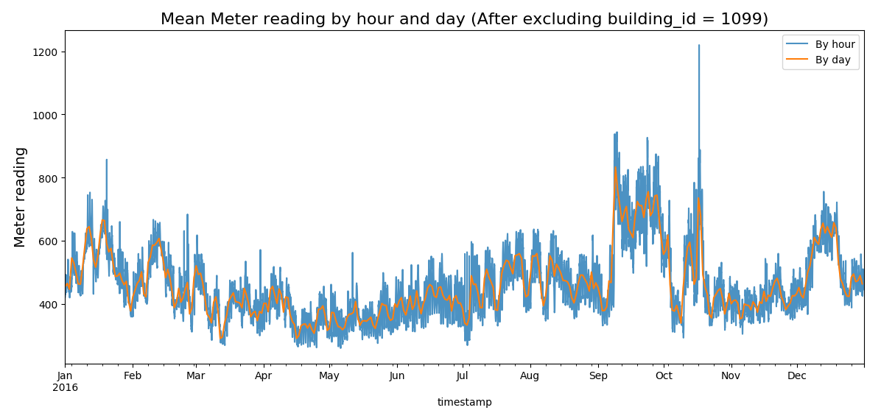

Slide 25
Feature Engineering
Building metadata and weather data were combined with train dataset
Label Encoding was performed for feature - primary_use
Meter Reading values upto building #104 had value 0. Thus these readings were dropped
Log transformation was performed on meter readings
Building #1099 was dropped
Imputations were performed on missing values

Slide 26
Time Series
What is a time series?
“A time series is a set of regular time-ordered observations of a quantitative characteristic of an individual or collective phenomenon taken at successive, in most cases equidistant, periods / points of time.”
A time series is usually modelled through a stochastic process Y(t), i.e. a sequence of random variables. In a forecasting setting we find ourselves at time t and we are interested in estimating Y(t+h), using only information available at time t..

Slide 27
General Time Series Forecasting Methods
Auto Regressive (AR) method try to describe a model to predict the target only using its past values. The moving average (MA) is a technical analysis tool that smooths out data by creating a constantly updated average using previous errors.
ARMA model attempts to capture both of these aspects.
VARMA is the generalization of ARMA to multivariate time series. Multivariate time series data means data where there is more than one observation for each time step.
The Long Short Term Memory neural network is a type of a Recurrent Neural Network (RNN) which use previous time events to inform the later ones. RNNs work well if the problem requires only short term dependencies to perform the present task.

Slide 28
Challenges faced during the implementation
Small amount of Training Data for Time Series Modeling as Time Series Modeling requires Seasonality and Trend in the data, which cannot be observed in only one year of data.
Hierarchical Time Series Dataset: The dataset contains 1449 number of time-series data of one year duration for each of 4 types of meters. This implies that performing any time-series forecasting will require us to fit 1449*4 models, which is computationally impractical. To overcome this, we can treat the problem as a regular regression problem and apply classical models.
If we use time series forecasting methods, we have to consider individual buildings which results in a loss of metadata features

Slide 29
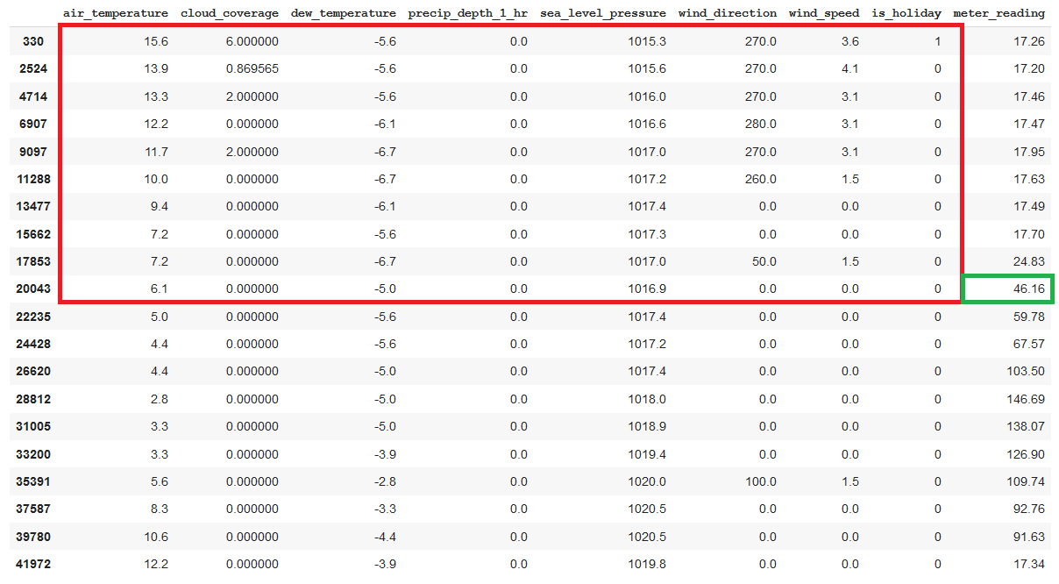
LSTM Implementation (Data Preparation)

Slide 30
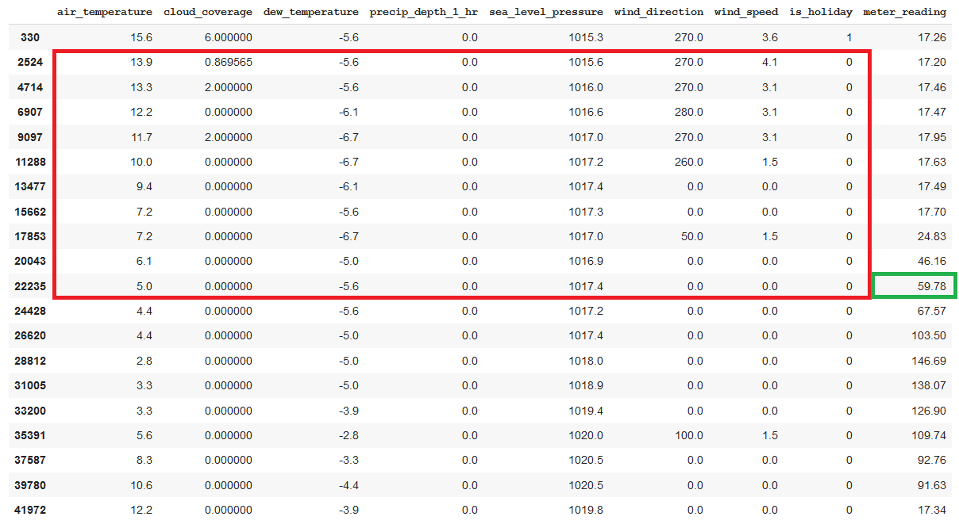
LSTM Implementation (Data Preparation)

Slide 31
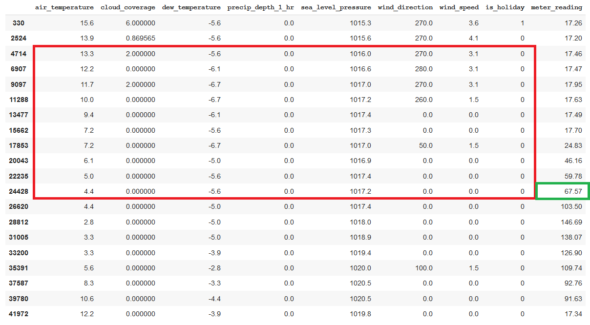
LSTM Implementation (Data Preparation)

Slide 32
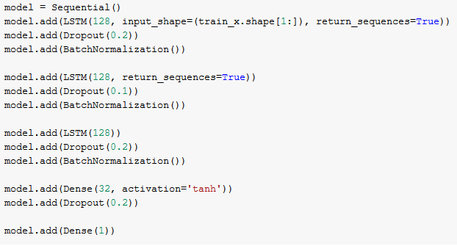
LSTM Implementation
Model Specifications-
Number of epochs - 15
Learning rate - 0.00001
Optimizer - Adam
Performance Metrics-
RMSE = 24.80
MAE = 4.66

Slide 33
LGBM (Light Gradient Boosting Model)
Light GBM is a gradient boosting framework that uses tree based learning algorithm.
Boosting is a method of converting weak learners into strong learners. In boosting, each new tree is a fit on a modified version of the original data set.
Gradient Boosting trains many models in a gradual, additive and sequential manner. Gradient Boosting identifies the shortcomings of weak learners by using gradients in the loss function.
Light GBM is prefixed as ‘Light’ because of its high speed. Light GBM can handle the large size of data and takes lower memory to run. Another reason of why Light GBM is popular is because it focuses on accuracy of results.

Slide 34
Model Comparison
The dataset is split as 70% training data and 30% testing data
Sr.No. | Model | RMSE | MAE
1 | LGBM (Light Gradient Boosting Method) | 1.214 | 0.552
2 | Linear Regression | 3.386 | 1.333
3 | Decision Tree Regressor | 0.798 | 0.301
4 | LSTM (Long Short-term Memory) | 24.8 | 4.66

Slide 35
Conclusion
Our goal was to predict the future energy consumption trends at various locations using one year of training data.
The above problem can be modelled better when treated as a regression problem rather than a time series data which is evident from the above performance metrics.
Tree based models such as Decision Tree Regressor, and Light GBM model gave better RMSE value than other regression models.

Slide 36
References
https://papers.nips.cc/paper/6907-lightgbm-a-highly-efficient-gradient-boosting-decision-tree.pdf
https://machinelearningmastery.com/time-series-prediction-lstm-recurrent-neural-networks-python-keras/
https://medium.com/@pushkarmandot/https-medium-com-pushkarmandot-what-is-lightgbm-how-to-implement-it-how-to-fine-tune-the-parameters-60347819b7fc
https://towardsdatascience.com/understanding-gradient-boosting-machines-9be756fe76ab
https://buildmedia.readthedocs.org/media/pdf/windrose/latest/windrose.pdf

Slide 37
Thank You!

