Slide 1

LANGUAGE TRANSLATOR
PRESENTED BY:
S.P.SARIGA
CSE - 3RD YEAR
GOVERNMENT COLEGE OF ENGINEERING DARMAPURI
AU613521104040
sarigasemmalai@gmail.com

Slide 2
AGENDA:
1. Problem StateM
2. Project Overvi
3. End users
4. our Soltion and Proposition
5.Key Features
6. Modelling Approach
7. Results and Evaluation
8. Conclusion

Slide 3
INTRODUCTION:
Provide context on the increasing need for language translation services in a globalized world.
Highlight the importance of effective communication across language barriers.
Introduce the language translator project as a solution to facilitate seamless multilingual communication.
Set the tone for the presentation by emphasizing the significance of the project's goals.

Slide 4
PROBLEM STATEMENT:
Identify common language barriers encountered in various scenarios, such as travel, business, and education.
Discuss the limitations and inefficiencies of traditional translation methods, such as manual interpretation and phrasebooks.
Highlight specific challenges, such as linguistic nuances, dialect variations, and cultural context, that complicate accurate translation.
Emphasize the negative impact of language barriers on productivity, efficiency, and inclusivity.

Slide 5
KEY FEATURES:
To implement the language translation mechanism for make the communication easy and comfortable.
To improve the limitation of understanding the languages and interaction in communication.
To support the user to improve the communication skills and to avoid the loneliness of the user.

Slide 6
END USERS:
Language translation software can be adopted by different end users such as individual consumers, businesses, and government organizations. Individual users of language translation software use it for a variety of personal purposes, including travel, intercultural communication, and language acquisition

Slide 7
REQUIREMENTS:
Hardware :
Computer
Processor
2GB RAM(min)
200MB
Software:
OS(windows)
python
Tkinter
Googletrans,Textblob

Slide 8
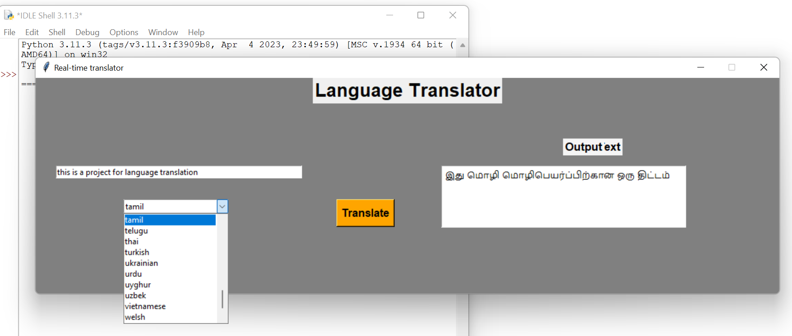
RESULT :

Slide 9
MODELING APPROACH:
N-N languages and communication development.
changing according to the user necessary language for communication.
Increase attraction and accuracy according to the user feedback.
It is especially important to adhere to pre-approved terminology and adapt to corrected translations in domain-specific projects.

Slide 10
CONCLUSION:
Summarize the key insights and takeaways from the presentation, emphasizing the value proposition and impact of the language translator project.
Reiterate the importance of overcoming language barriers to foster communication, collaboration, and understanding across diverse communities.
Express gratitude to the audience for their attention and participation, inviting further questions and discussion.
Provide contact information or resources for interested parties to learn more about the language translator project and get involved.
Feel free to adjust these points according to the specific focus and requirements of your presentation or meeting. Let me know if you need further assistance!

Slide 11
THANK YOU :)

