Slide 1
Web traffic analysis
Phase 4

Slide 2
Introduction
In this phase we’re going to Continue building the analysis by creating visualizations using IBM Cognos and integrating Python code for advanced analysis. By Using IBM Cognos to create interactive dashboards and reports that display insights such as popular pages, traffic sources, and user engagement metrics. In this we are using Python libraries like Pandas and Matplotlib to perform more complex analyses on the data, such as time series analysis, user segmentation, or machine learning-based predictions

Slide 3
Visualization
VISUALIZATION IS THE KEY ASPECT OF DATA ANALYSIS AND REPORTING….
Here Are some visualization techniques you can use with IBM Cognos and Python to enhance your analysis: 1. IBM Cognos Visualizations: Bar Charts: Create bar charts in Cognos to represent data such as page views, traffic sources, and engagement metrics. Line Charts: Use line charts to show trends over time, like changes in user engagement or page views. Pie Charts: Pie charts can be used to display the proportion of traffic from various sources or to showcase popular pages. Tables: Design tables to present detailed data and comparisons.

Slide 4
Python based visualization
Matplotlib: In Python, you can use Matplotlib to create a wide range of static visualizations. For example, line plots for time series data, histograms for distribution analysis, and scatter plots for correlation analysis. Seaborn: Seaborn is a Python library built on Matplotlib that provides a high-level interface for creating informative and attractive statistical graphics. Plotly: If you want interactive, web-based visualizations, Plotly is a Python library that allows you to create dynamic charts and dashboards.

Slide 5
Python based visualization
Heatmaps: Use Python libraries like Seaborn to create heatmaps for visualizing user behavior or correlation matrices. Geospatial Visualization: For location-based data, libraries like Folium can help you create interactive maps with markers or choropleth maps. Advanced Charts: Python libraries like Bokeh enable the creation of interactive, customizable charts like network graphs, 3D plots, and more.

Slide 6
Program
Import math from scipy.stats import norm import numpy as np import pandas as pd import matplotlib.pyplot as plt from Ipython.core.display import HTML
Import os for dirname, _, filenames in os.walk(‘/kaggle/input’): for filename in filenames: print(os.path.join(dirname, filename))
Df = pd.read_csv(“/kaggle/input/daily-website-visitors/daily-website-visitors.csv”, \ index_col = ‘Date’, thousands = ‘,’, parse_dates=True)

Slide 7
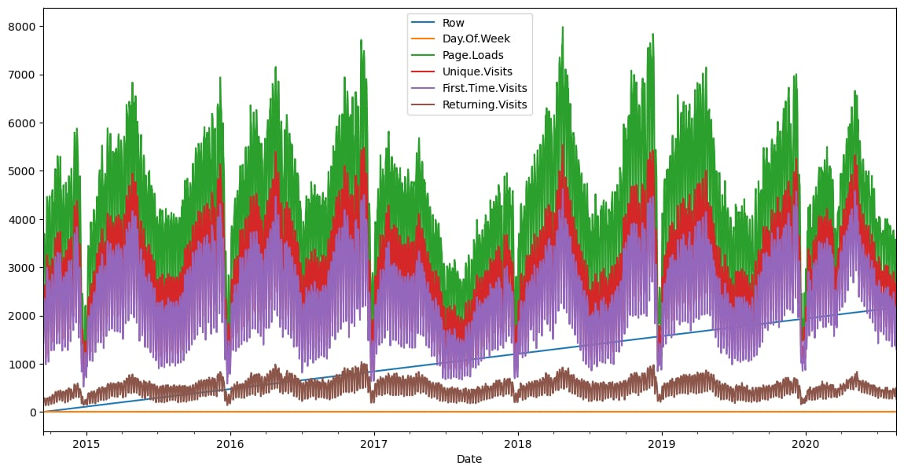
Area plot for time series
Df.plot(figsize=(14,7))
Plt.show()

Slide 8
Histogram
Fig, ax1 = plt.subplots() df[‘Page.Loads’].plot.hist(ax = ax1, label=‘Page.Loads’) plt.plot([mean, mean], [0, 480], label=‘mean’) plt.plot(px, py, label=‘normal’, color=‘red’) plt.legend() plt.show() HTML(‘<h3>using normal approximation to binomial distribution</h3>’)

Slide 9
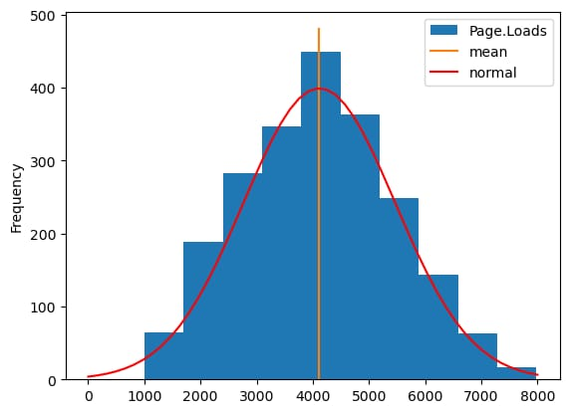
Histogram output

Slide 10
Finding mean and standard deviations
Def prob(t, n, lmbda): return math.pow(lmbda * t, n)/math.factorial(n)*math.exp(-lmbda*t) mean = df[‘Page.Loads’].mean() print( “mean loads per day:”, mean) std = df[‘Page.Loads’].std() print( “std deviation of loads per day:”, std) n = 1 px = np.linspace(1, 8000, 50) py = np.zeros(50) for I in range(0, 50): x = (px[i]-mean)/std p = norm.pdf(x) py[i] = 1000*p

Slide 11
Output
Mean loads per day: 4116.9893862482695 std deviation of loads per day: 1350.9778426999621

Slide 12
Scatter plot
Import pandas as pd import matplotlib.pyplot as plt data = pd.read_csv(‘https://www.kaggle.com/datasets/bobnau/daily-website-visitors.csv’) x = ‘’ row” y = ‘’ day of week” t.scatter(data[x], data[y]) plt.show()

Slide 13
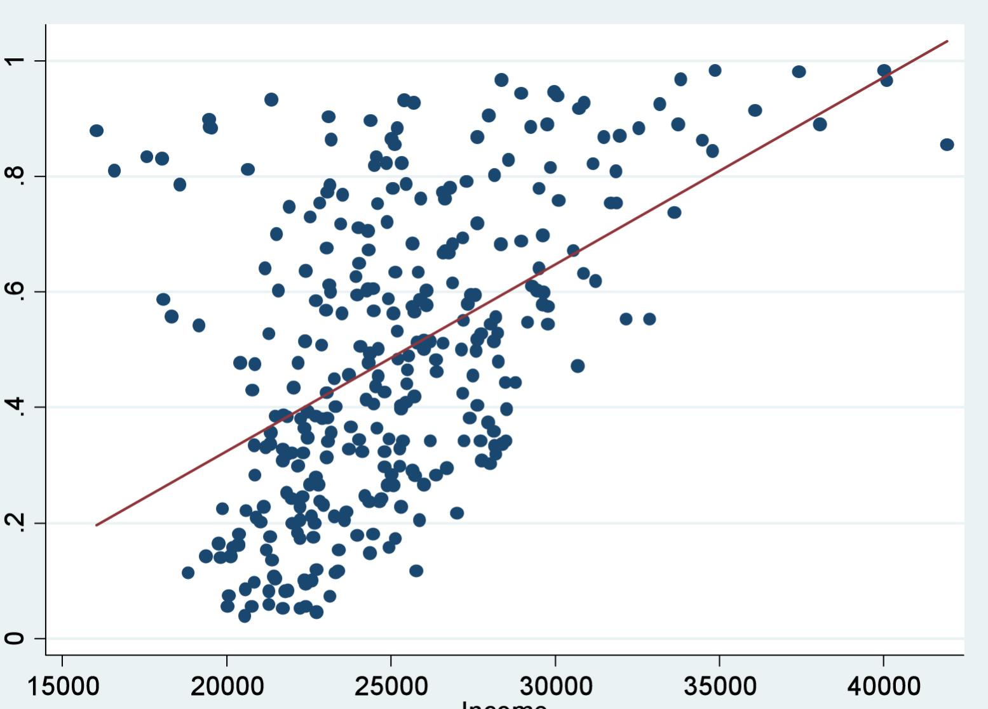
Scatter plot o/p

Slide 14
Bar chart
Import pandas as pd data = pd.read_csv(‘https://www.kaggle.com/datasets/bobnau/daily-website-visitors.csv’) [import matplotlib.pyplot as plt categories = data[‘Category’] values = data[‘Value’] plt.bar(categories, values) plt.xlabel(‘Categories’) plt.ylabel(‘Values’) plt.title(‘Bar Chart Example’) plt.xticks(rotation=45) plt.show()

Slide 15
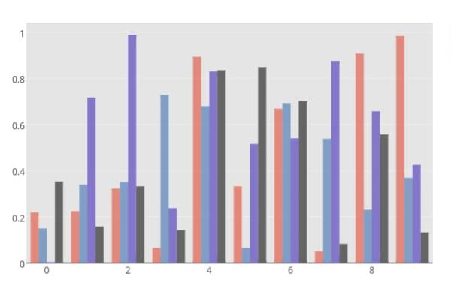
Bar chart o/p

