Slide 1
0
1
Impossible event
Certain event
Possible, but not certain

Slide 3
sample space S
basic outcome
event A
0
1
Impossible event
Certain event
Possible, but not certain

Slide 4
sample space S
basic outcome
event A

Slide 5
1
2
1
2
3
6
3
6
4
4
5
5
HHH
2
HTH
6
4
5

Slide 6
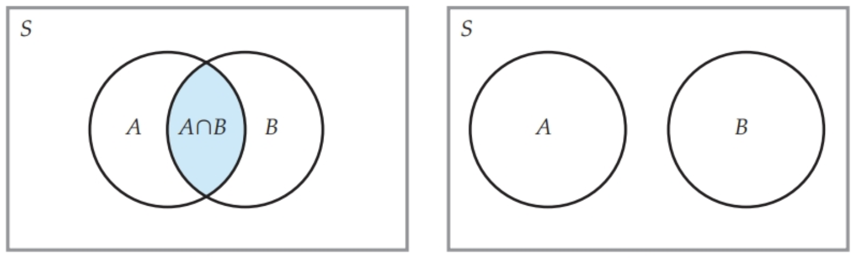
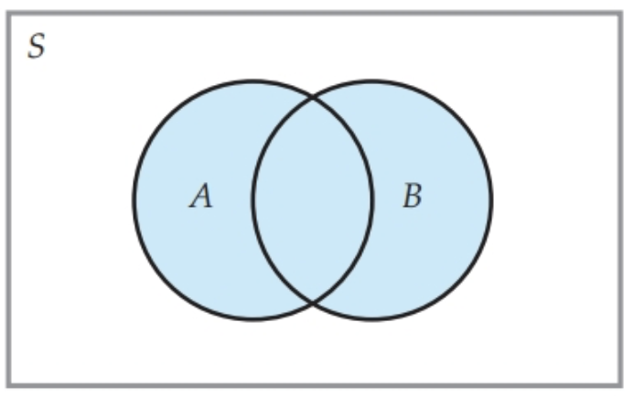
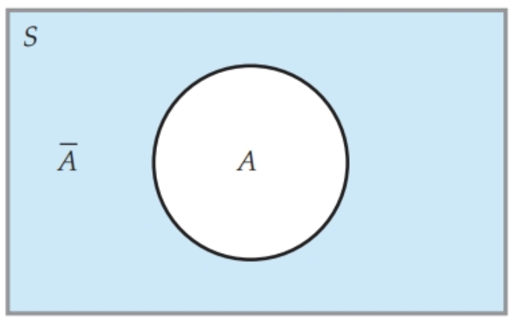




$A∩B$: intersection of events (AND)
Mutually exclusive events ($A∩B=∅$)
$A∪B$: union of events (OR)
$\overline{A}$: complement of A

Slide 7
A
B
A
B

