Slide 1
Car Price Prediction using Machine Learning
Presented By:
Abed El Kader El Shaar Sara Ghamloush

Slide 2

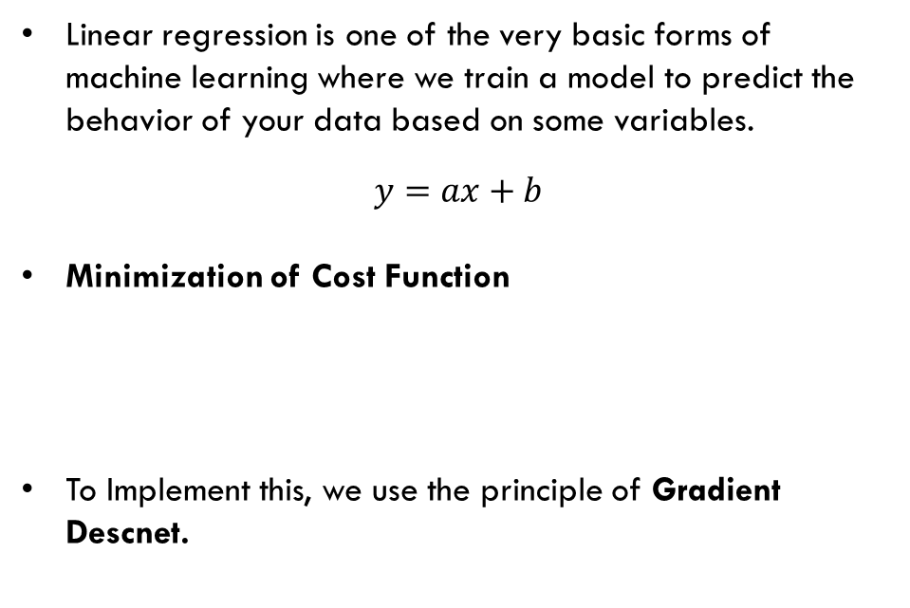
Linear Regression
Linear regression is one of the very basic forms of machine learning where we train a model to predict the behavior of your data based on some variables.
$$y=ax+b$$
Minimization of Cost Function
To Implement this, we use the principle of Gradient Descnet.
Notes:
To check if two variables are linearly correlated, a wonderful tool would be to use the Linear regression. Linear regression tries to find the best-fit line between a set of points by trying to minimize the cost function. A simple way to find the minimum is to use the gradient search which we are going to talk about in the next slide.
As we can see in the animation here, after each iterations, the model is trying to find the best fit line which corresponds to the minimum of the cost function.

Slide 3
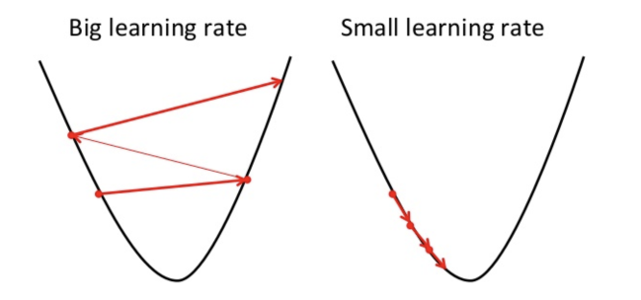
Gradient Descent
. Gradient descent is a method of updating a and b to reduce the cost function(MSE). The idea is that we start with some values for a and b and then we change these values iteratively to reduce the cost.
Notes:
Using gradient descent technique, we first calculate the derivative at a random point. We move to the right if it is negative and to he left if it is positive until we reach 0 value for the derivative. Make sure to use small iterations but not too small in order to converge fast Don’t use big iterations as it may overshoot from the minimum

Slide 4

Car Price predication
We will check if there is a linear relation between car features and their price. For this purpose.
To make it easier we are going to use the linear regression algorithm with which you can predict linear values.
For this purpose, we used the CarPricePreditionDataset.

Slide 5
GOOGLE COLAB
Let’s go to Google Colab

