Slide 1

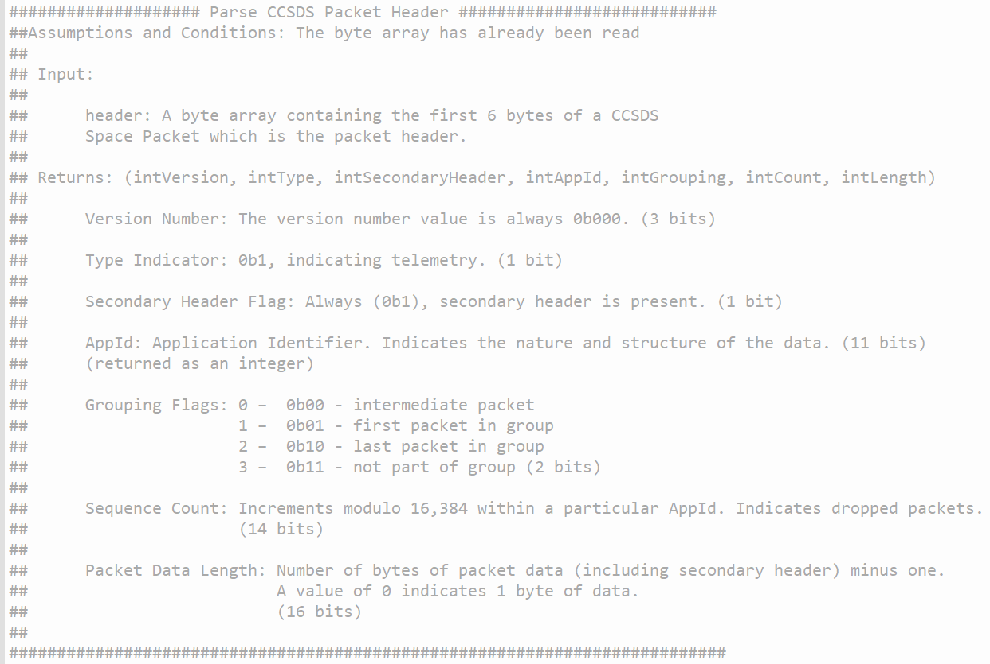
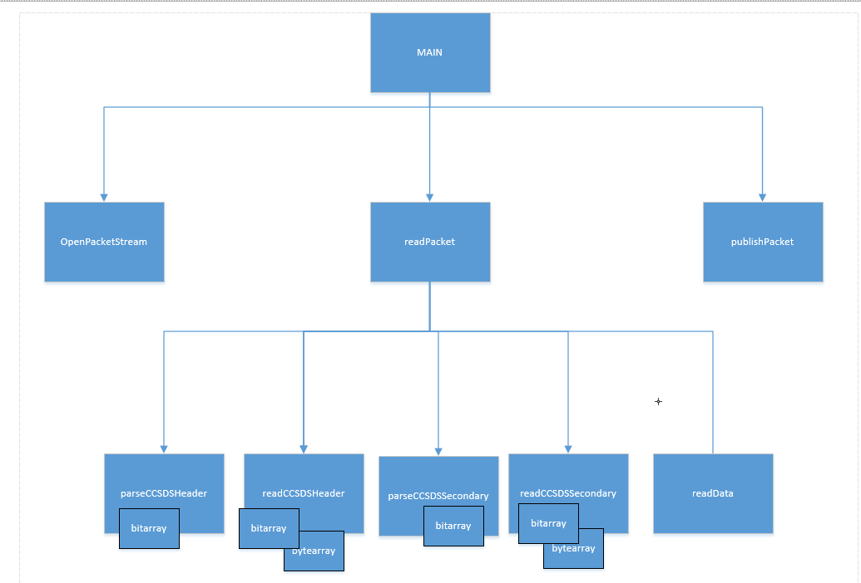
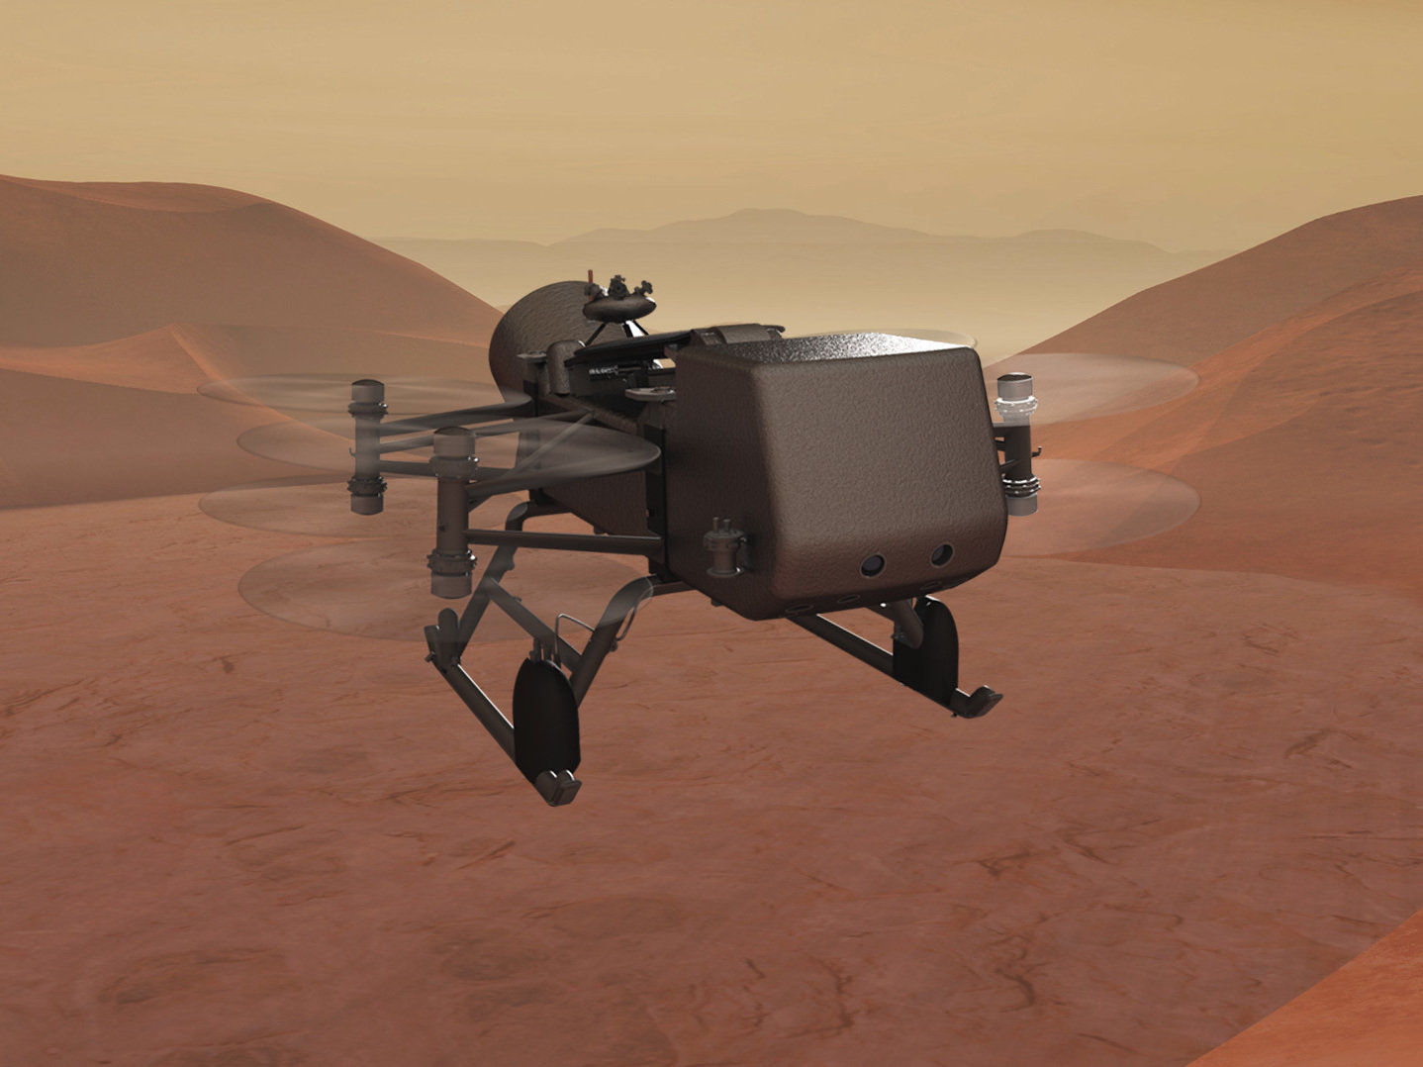
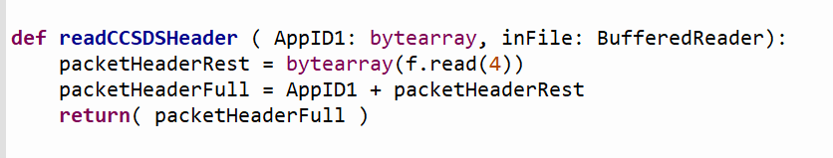
SciPy: Onboard Spacecraft Computing with Python
Saragha Surendra
JHU APL Poolesville High School
Background
Design- High Level
Design- Low Level
Dragonfly is a rotorcraft being sent to Titan (one of Saturn’s moons) to search the surface composition and investigate how far prebiotic chemistry has progressed. Data from NASA missions are brought in the form of CCSDS packets which are organized into multiple different sections containing the identification information and data. It takes time for data to be brought down to Earth depending on the distance, the size of the data packets, and the placement of the spacecraft respective to Earth. If scientists utilize a Python interpreter implemented on the spacecraft they will be able to access the data faster and more efficiently. By choosing to bring down only the relevant data, the effective data rate (good date rate/ total data rate) can be increased.
A structure chart is used to organize the process for how different functions will be used to read the packet and organize the data. A CCSDS packet consists of a primary header, secondary header, and data section. The primary header contains information to show how the packet is structured, where it came from, and where it is going to go. It includes the application id or APP Id that is unique to the packet similar to an IP address. The secondary header contains information such as the time stamp for the data. The data section has what the scientists want to read and interpret such as images or temperature information from the spacecraft. After labeling the order for each function, the next step is to describe their inputs and outputs to make it easier to code in future steps.
t
Structure Chart
Figure 3: Notional function header parse CCSDS primary header
Problem Statement and Requirement
Next Steps
The goal is to increase the effective data rate (by parsing through the packets and identifying the important information) and allow for easier access to data for scientists that want to observe it. Improving the effective data rate can allow scientists to choose the data that is necessary for their research and bring only that data down which permits for almost all the data being brought down to be useful. This is a feasibility assessment to determine if the Python language interpreter will work on the Dragonfly space system.
Following the design phase of the project, the actual implementation and prototype takes place. This includes writing the code of the functions that were previously outlined in the design stages. The code is then tested on sample files to make sure it can properly sort and identify packets in the packet stream. Scientists should be able to use the functions created to easily access the data from the packets and read it. Then it is ready to be tested on Dragonfly lander software platform and put onto the spacecraft.
Figure 4: Notional Python definition for read CCSDS primary header
Figure 2: Structure chart with program calling sequence for Python interpreter
Figure 1: Artist rendering of the Dragonfly lander

