Slide 1
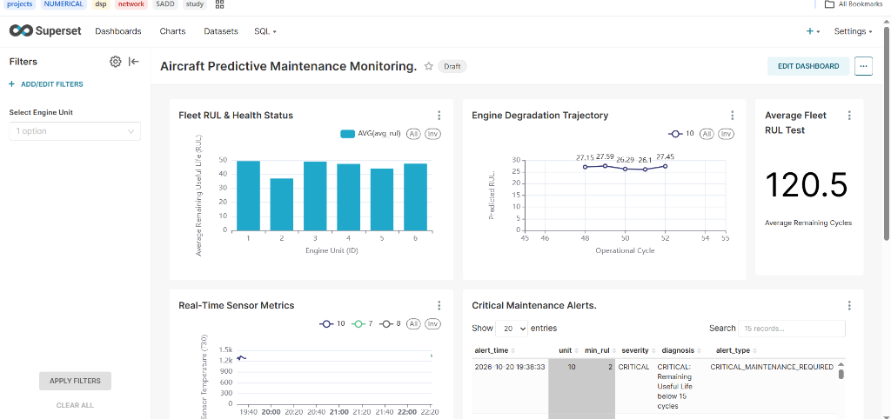
BIG DATA ENGINEERING & PREDICTIVE ANALYTICS
LIVE DASHBOARD PREVIEW (APACHE SUPERSET)
Aircraft Engine Health
Monitoring & Predictive
Maintenance
An End-to-End Big Data Pipeline Using NASA N-CMAPSS, Apache Spark,
Kafka, HDFS, Airflow, MLlib, ClickHouse & Apache Superset
WHAT THIS PROJECT DOES (SYSTEM SUMMARY)
▸ Goal: Predict engine Remaining Useful Life (RUL) and detect high-temperature faults early.
▸ Data Source: NASA N-CMAPSS turbofan engine sensor data (17.46 million rows / 6.12 GB).
▸ Two Processing Paths: Historical Batch processing (HDFS + Spark) and Streaming replay (Kafka).
▸ Final Output: Machine learning predictions and real-time alerts in ClickHouse and Superset.
KEY TECHNICAL FEATURES
▸ Batch + Streaming: Combines full history analysis with fast stream monitoring.
▸ No Data Leakage: Splits training and testing data by engine ID.
▸ Docker Containers: All 11 services run in isolated Docker containers.
17.46M Rows
RMSE: 6.36
10-Task DAG
ClickHouse
NASA N-CMAPSS Data
Random Forest Model
Apache Airflow
Database & Dashboard
DS01 (7.64M) & DS03 (9.82M)
R² = 0.945 on Unseen Engine
Automated Pipeline Steps
600K Predictions & Alerts
Big Data Project Presentation | All numbers, charts, and screenshots are verified from the actual running system
Notes:
SLIDE 1 — TITLE SLIDE (Easy Speaking Notes)
• Hello everyone. Today I will present our Big Data project: Aircraft Engine Health Monitoring and Predictive Maintenance.
• The main idea of this project is to monitor aircraft engine sensors, predict how many flights an engine has left before it needs maintenance, and send early alerts.
• We built an end-to-end pipeline using NASA engine data, Apache Spark, Kafka, HDFS, Airflow, ClickHouse, and Superset.

Slide 2
1. PROBLEM STATEMENT
02 / 12
Problem Statement: Why Aircraft Engine Monitoring Needs Big Data
Understanding engine failures, maintenance costs, and the challenge of processing massive sensor data
1. UNEXPECTED ENGINE FAILURES
2. HIGH MAINTENANCE COSTS
3. THE BIG DATA CHALLENGE
▸ Safety & Flight Delays: Sudden engine problems during operation cause major safety risks and costly flight cancellations.
▸ Different Flight Stress: Every engine wears out at a different speed depending on altitude, speed, and weather.
▸ Early Warning Signs: Small changes in temperature and pressure appear many flights before an engine actually fails.
▸ Fixing Too Late (Reactive): Waiting until a part breaks causes severe engine damage and expensive emergency repairs.
▸ Fixing Too Early (Fixed Schedule): Replacing parts on a fixed schedule wastes 20% to 40% of healthy engine life.
▸ Smart Solution (Predictive): We should perform maintenance based on the real condition of each engine.
▸ Huge Sensor Volume: Engines record 50 values every second—creating 17.46 million rows (6.12 GB) in our dataset.
▸ Memory Crashes (OOM): Normal tools like Excel or basic Pandas crash when loading multi-gigabyte HDF5 files into RAM.
▸ Two Speed Needs: We need heavy batch training on historical data AND fast monitoring on incoming sensor streams.
COMPARISON OF MAINTENANCE STRATEGIES
STRATEGY
WHEN DO WE FIX IT?
MAIN PROBLEM
TECHNOLOGY NEEDED
Reactive (Run-to-Failure)
Only after the engine breaks
Dangerous, causes flight delays and high repair cost
Basic fault logs only
Preventive (Fixed Schedule)
After a fixed number of flights
Wastes money by replacing parts that are still good
Simple flight counters
Predictive (Our Project)
When sensors show low Remaining Life
Needs Big Data storage, ML, and stream processing
HDFS + Spark + Kafka + ClickHouse
Source: NASA N-CMAPSS Dataset & Verified Project Pipeline Logs
Aircraft Engine Predictive Maintenance | Big Data Project
Notes:
SLIDE 2 — PROBLEM STATEMENT (Easy Speaking Notes)
• Why is this problem important? First, unexpected engine failures are dangerous and cause expensive flight delays.
• Second, airlines face a cost trap: if they wait for a part to break, repairs are very expensive. If they replace parts on a fixed schedule, they throw away healthy parts too early.
• Third, why is this a Big Data problem? Because aircraft sensors record 50 measurements every second, creating millions of rows and gigabytes of data that crash normal single-machine tools.

Slide 3
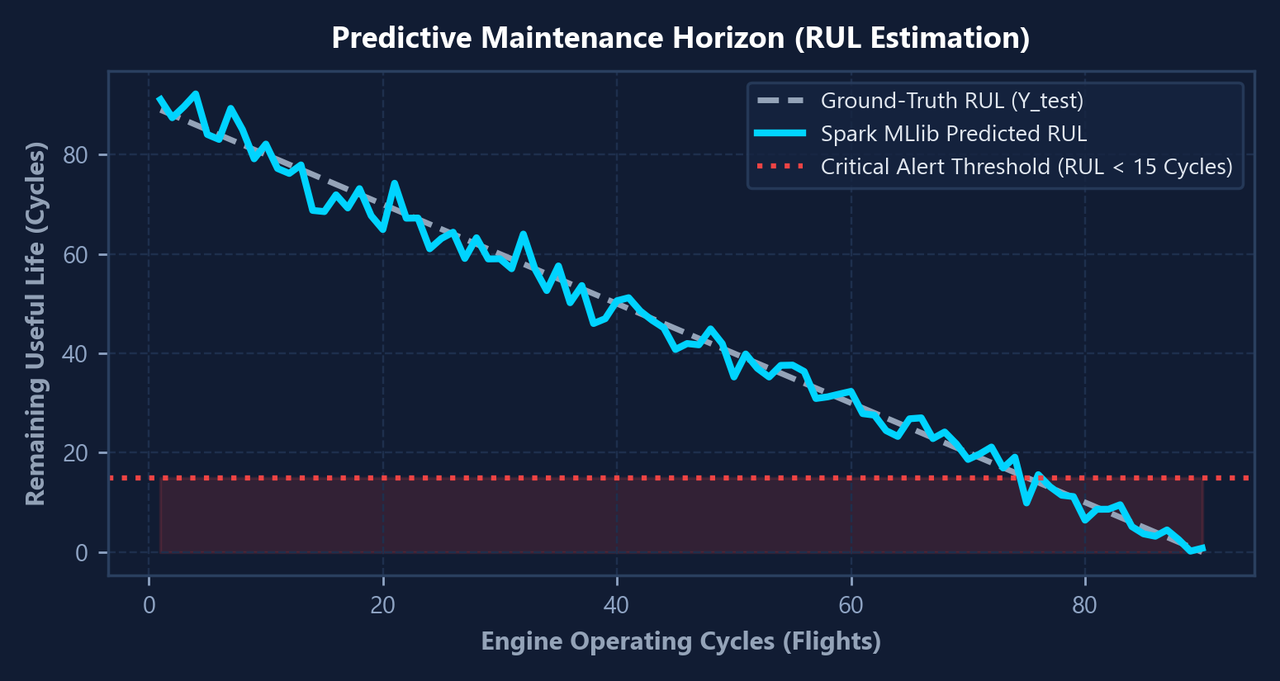
2. OBJECTIVES & SOLUTION
03 / 12
Objectives & Proposed Solution: Predicting Remaining Useful Life
How data analytics and machine learning help maintenance teams act before failures happen
WHAT IS REMAINING USEFUL LIFE (RUL)?
HOW RUL PREDICTION TRIGGERS ALERTS
▸ Simple Definition: RUL means Remaining Useful Life. It estimates how many flight cycles an engine can safely complete before it needs maintenance.
▸ Important Note: RUL is an estimated number of remaining flights based on sensor health — NOT an exact or guaranteed failure date.
▸ How It Helps: When predicted RUL drops below 15 cycles (or temperature T30 goes above 1580°R), the system sends a CRITICAL alert.
FOUR MAIN PROJECT OBJECTIVES
▸ 1. Safe Data Conversion: Convert large NASA HDF5 files into fast Parquet files in 50,000-row chunks without running out of memory.
▸ 2. Batch & Streaming Pipelines: Use Spark Batch for full historical analysis and Kafka + Spark Streaming for real-time alert simulation.
▸ 3. Accurate Machine Learning: Train and compare 3 regression models in Spark MLlib to predict RUL without data leakage.
▸ 4. Automated Workflow & Dashboard: Use Airflow to run all 10 pipeline steps automatically and show results in ClickHouse and Superset.
WHY WE CHOSE THESE TECHNOLOGIES
▸ Why Parquet? Reads specific sensor columns fast and shrinks file size.
▸ Why Kafka + Spark? Handles high-speed sensor streams and calculates 30-second averages.
▸ Why ClickHouse? Runs dashboard queries on 600,000+ predictions in milliseconds.
Source: NASA N-CMAPSS Dataset & Verified Project Pipeline Logs
Aircraft Engine Predictive Maintenance | Big Data Project
Notes:
SLIDE 3 — OBJECTIVES & PROPOSED SOLUTION (Easy Speaking Notes)
• Our solution predicts RUL, which stands for Remaining Useful Life. Importantly, RUL is an estimate of how many operating cycles remain before maintenance is needed—it is not a guaranteed failure date.
• As you can see in the chart on the right, as the engine flies more cycles, its RUL goes down. Once RUL drops below 15 cycles, our system raises a red critical alert.
• Our four objectives were: converting HDF5 data safely to Parquet, building both batch and streaming pipelines, training ML models in Spark MLlib, and showing the results in Superset.

Slide 4
3. SYSTEM ARCHITECTURE
04 / 12
End-to-End System Architecture: Batch, Streaming, ML & Dashboard
Connecting the dataset, ingestion, storage, Spark processing, machine learning, Airflow, and Superset
DIAGRAM COLORS:
Batch Path (HDFS + Spark + ML)
Streaming Path (Kafka + Spark Stream)
Database & Dashboard
1. DATA SOURCE & PREP
2A. BATCH PIPELINE (STORAGE, SUMMARY & MACHINE LEARNING)
3. DATABASE & BI
NASA N-CMAPSS HDF5
• DS01-005 (2.68 GB)
• DS03-012 (3.44 GB)
• 50 Columns Total
Hadoop HDFS Storage
• NameNode + DataNode
• Stores Parquet data,
ML models, and
predictions
Spark Batch Job
• spark_batch_summary.py
• Calculates min, max,
and average RUL
for each engine
Spark MLlib Models
• Splits by Engine ID
• Random Forest Winner
• Predicts RUL on
2.73M test rows
ClickHouse Database
Database: aircraft
1. engine_batch_summary
2. engine_rul_predictions
3. engine_stream_metrics
4. maintenance_alerts
➔
➔
➔
➔
▼ Convert (50K chunks)
Apache Parquet Files
• Snappy Compressed
• dev.parquet & test.parquet
• replay_sample.parquet
2B. STREAMING PIPELINE (HISTORICAL DATA REPLAY — NOT LIVE FLIGHT)
▼ Fast SQL Queries
Apache Superset
• Fleet RUL Status
• Degradation Curve
• Live Sensor T30
• Critical Alerts Table
➔
Python Kafka Producer
• Replays Parquet rows
• Sends 200 msgs/sec
• Adds 2% bad messages
to test error handling
Apache Kafka (KRaft)
• engine-telemetry (41K)
• engine-health-results
• maintenance-alerts
• 3 Partitions per topic
Spark Streaming
• 30-sec Window stats
• Sends bad JSON to
HDFS Quarantine (DLQ)
• Writes live alerts
WHY? Prevents memory crashes and checks that real RUL labels exist.
➔
➔
➔
4. ORCHESTRATION & DEPLOYMENT (AIRFLOW + DOCKER)
• Apache Airflow: Runs all 10 steps automatically in order, from checking the raw HDF5 file to verifying ClickHouse data.
• Docker Compose & Swarm: All services run in Docker containers; configured for 3-node Swarm over Tailscale VPN and tested on local Docker Desktop.
Source: NASA N-CMAPSS Dataset & Verified Project Pipeline Logs
Aircraft Engine Predictive Maintenance | Big Data Project
Notes:
SLIDE 4 — SYSTEM ARCHITECTURE (Easy Speaking Notes)
• This diagram shows how data moves through our system from left to right.
• On the left, we start with NASA HDF5 files and convert them into Parquet format.
• In the top blue path (Batch), we upload Parquet files to HDFS, run a Spark Batch summary job, and train our machine learning model in Spark MLlib.
• In the bottom orange path (Streaming), a Python producer replays sensor data into Kafka. Spark Structured Streaming reads from Kafka, filters out bad messages into an HDFS quarantine folder, and calculates 30-second window averages.
• On the right, both paths save their results into ClickHouse, which powers our Apache Superset dashboard.

Slide 5
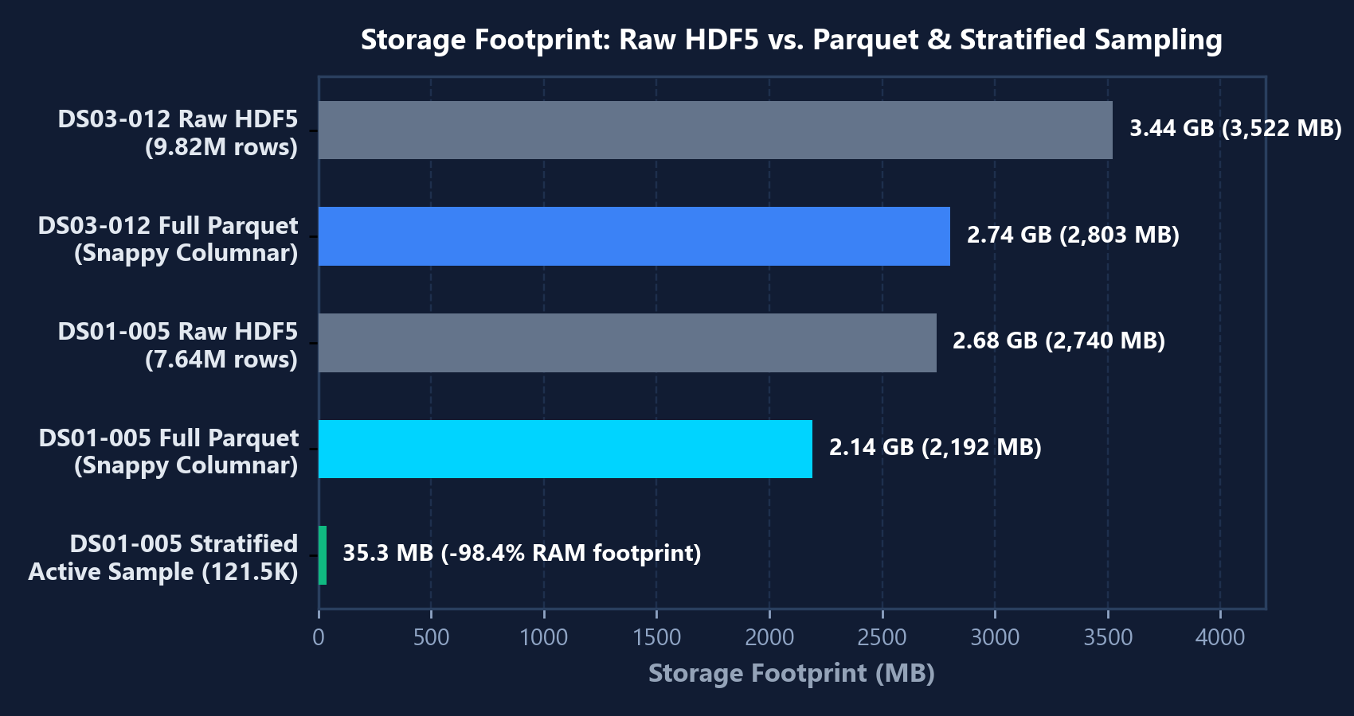
4. DATASET & PREPARATION
05 / 12
Dataset & Data Preparation: NASA N-CMAPSS & HDF5-to-Parquet
Verified dataset sizes, sensor groups, data validation, and memory-safe Parquet conversion
VERIFIED NASA N-CMAPSS FILES IN PROJECT
FILE SIZE REDUCTION: HDF5 VS. PARQUET
DATASET FILE
RAW SIZE
DEV SPLIT (TRAIN)
TEST SPLIT
N-CMAPSS_DS01-005.h5
(Main Pipeline Dataset)
2.68 GB
4,906,636 rows
(Units 1–6, RUL 0–99)
2,735,232 rows
(Units 7–10, 4 Engines)
N-CMAPSS_DS03-012.h5
(Inspected & Converted)
3.44 GB
5,571,277 rows
(A_dev: 5.57M × 4 cols)
4,251,560 rows
(Converted to Parquet)
Total Combined Data
in Project Folder
6.12 GB
10,477,913 rows
(Total Dev Rows)
6,986,792 rows
(17.46M Total Rows)
WHAT IS INSIDE THE 50 COLUMNS?
▸ Group A — Engine Info (4 cols): Engine `unit` ID, flight `cycle` number, flight class (`Fc`), and health state (`hs`).
▸ Group W — Flight Conditions (4 cols): Altitude (`W_alt`), Mach speed (`W_Mach`), throttle angle (`W_TRA`), and inlet temp (`W_T2`).
▸ Group X_s — Physical Sensors (14 cols): Temperatures (`T24`, `T30`, `T48`, `T50`), pressures (`P15..Ps30`), fan/core speeds, and fuel flow.
▸ Groups X_v (14), T (10) & Target Y (1): 14 virtual sensors + 10 health parameters + real target `rul` + `dataset` & `split` = 50 columns.
HOW WE VALIDATE & CONVERT THE DATA
▸ Step 1 — Data Validation: Checks that the HDF5 file exists and has real `Y_dev` RUL values (never invents fake labels).
▸ Step 2 — 50,000-Row Chunks: Reads 50,000 rows at a time using `h5py` and writes to Parquet so RAM never overflows.
▸ Step 3 — Fast Stratified Sample: Keeps full Parquet backups and creates a ~60K-row sample (17.8 MB) for fast daily pipeline runs.
Source: NASA N-CMAPSS Dataset & Verified Project Pipeline Logs
Aircraft Engine Predictive Maintenance | Big Data Project
Notes:
SLIDE 5 — DATASET AND DATA PREPARATION (Easy Speaking Notes)
• We have two NASA N-CMAPSS files in our project: DS01-005 (2.68 GB, 7.64M rows) and DS03-012 (3.44 GB, 9.82M rows, where A_dev has 5,571,277 rows and 4 columns).
• Each file contains 50 columns covering engine ID, flight cycle, operating conditions like altitude and speed, physical temperatures and pressures, and the target RUL column.
• Why did we convert HDF5 to Parquet? Because Spark reads Parquet much faster, and Snappy compression reduces the file size. We convert the data in chunks of 50,000 rows so our computer memory never crashes.

Slide 6
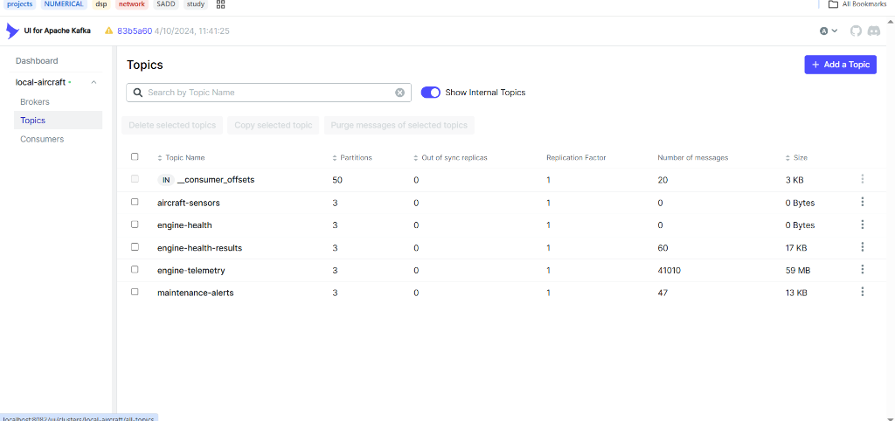
5. DATA INGESTION
06 / 12
Data Ingestion: Batch Pipeline vs. Kafka Streaming Path
Comparing historical batch loading with our Kafka streaming simulation
⚠ IMPORTANT NOTE: Our streaming path replays historical NASA Parquet rows with current timestamps using `producer.py` to test real-time processing — it is NOT live data from a flying airplane.
1. BATCH INGESTION (HDFS UPLOAD)
VERIFIED SCREENSHOT: KAFKA UI TOPICS (PORT 8082)
▸ How It Works: Converts HDF5 to Parquet files and uploads `dev.parquet` and `test.parquet` into Hadoop HDFS.
▸ WHY We Need Batch: Training machine learning models requires reading millions of historical rows across all engine flights at once.
▸ Smart Check: If the Parquet files are already in HDFS, the pipeline skips re-uploading to save time.
2. STREAMING INGESTION (APACHE KAFKA)
▸ How It Works (`producer.py`): Reads `replay_sample.parquet` (27,353 rows), adds a current timestamp, and sends JSON messages to Kafka at up to 200 messages/sec.
▸ WHY We Need Kafka: Kafka acts as a fast, safe buffer between the data sender and Spark Streaming, split across 3 partitions.
▸ Testing Bad Data (DLQ): Can inject 2% corrupted messages (`--inject-anomaly-rate 0.02`) to prove that bad data does not crash the stream.
VERIFIED KAFKA TOPICS & MESSAGE COUNTS
▸ `engine-telemetry`: 41,010 messages (59 MB) — incoming sensor readings.
▸ `engine-health-results`: 60 messages (17 KB) — 30-second window averages.
▸ `maintenance-alerts`: 47 messages (13 KB) — critical alerts (RUL < 15 or T30 > 1580).
Source: NASA N-CMAPSS Dataset & Verified Project Pipeline Logs
Aircraft Engine Predictive Maintenance | Big Data Project
Notes:
SLIDE 6 — DATA INGESTION: BATCH VS. STREAMING (Easy Speaking Notes)
• We have two ways to bring data into our system: Batch and Streaming.
• Batch ingestion uploads full Parquet files into HDFS so Spark can train machine learning models on complete flight histories.
• Streaming ingestion uses `producer.py` to replay historical records into Apache Kafka at 200 messages per second. To be accurate, this is replayed historical data, not live telemetry from a flying aircraft.
• On the right, our live Kafka UI screenshot proves that `engine-telemetry` received 41,010 messages (59 MB), `engine-health-results` has 60 window summaries, and `maintenance-alerts` captured 47 critical alerts.

Slide 7
6. PROCESSING & STORAGE
07 / 12
Big Data Processing & Storage: Spark, HDFS, Parquet & ClickHouse
What each technology does and WHY we selected it for our architecture
1. APACHE SPARK (v4.1.3) — PROCESSING ENGINE
2. HADOOP HDFS (v3.2.1) — DISTRIBUTED STORAGE
▸ WHAT It Does: Runs our Batch Summary job, Structured Streaming job, and Machine Learning training/prediction jobs.
▸ WHY We Used Spark: One single fast engine handles Batch, Streaming, and ML in memory—instead of needing 3 separate tools.
▸ Smart Error Handling (DLQ): In streaming mode, Spark uses 30-second windows and sends any broken JSON messages to an HDFS Quarantine folder (`Dead-Letter Queue`).
▸ WHAT It Does: Stores our processed Parquet files, trained ML models (`/aircraft/models/rul_model`), predictions, and streaming checkpoints.
▸ WHY We Used HDFS: Provides central shared storage so any Spark worker container can read the data and load the saved ML model.
▸ Docker Network Fix: Configured with `use.datanode.hostname=false` so containers connect smoothly by IP address.
3. APACHE PARQUET — COLUMNAR FILE FORMAT
4. CLICKHOUSE (v26.9) — FAST ANALYTICAL DATABASE
▸ WHAT It Does: Stores the 50-column dataset in a compressed columnar format on disk and inside HDFS.
▸ WHY Parquet Instead of CSV or HDF5? 1) Saves column data types automatically; 2) Spark only reads the 44 columns needed for ML; 3) Snappy compression makes files much smaller and faster to scan.
▸ Verified Result: Compresses millions of engine rows while keeping fast read speeds.
▸ WHAT It Does: Stores the final results in 4 tables: batch summaries, 600K RUL predictions, live stream metrics, and maintenance alerts.
▸ WHY ClickHouse Instead of PostgreSQL? HDFS is great for big files, but dashboards need fast SQL queries. We upgraded from PostgreSQL to ClickHouse because its columnar `MergeTree` engine answers queries in milliseconds.
▸ Safe Writing: Both Batch and Streaming write to ClickHouse over HTTP port 8123.
Source: NASA N-CMAPSS Dataset & Verified Project Pipeline Logs
Aircraft Engine Predictive Maintenance | Big Data Project
Notes:
SLIDE 7 — BIG DATA PROCESSING AND STORAGE (Easy Speaking Notes)
• Here we explain WHY we chose each processing and storage tool.
• First, Apache Spark: we use it because one single engine can do batch summaries, real-time stream windows, and machine learning in memory.
• Second, Hadoop HDFS: it gives us shared storage for Parquet data, checkpoints, and our trained ML model.
• Third, Parquet: it is a columnar format that compresses data and lets Spark read only the columns it needs.
• Fourth, ClickHouse: we used ClickHouse instead of PostgreSQL for the serving layer because it runs analytical dashboard queries on 600,000 rows in milliseconds.

Slide 8
7. WORKFLOW ORCHESTRATION
08 / 12
Workflow Orchestration: Apache Airflow 10-Step Pipeline
Automating task order, retries, and verification with `aircraft_engine_batch_pipeline`
THE 10 AUTOMATED STEPS IN OUR AIRFLOW DAG (@daily)
Step 1 (Python)
Step 2 (Bash)
Step 3 (Bash)
Step 4 (Spark)
Step 5 (Spark ML)
1_validate_raw_hdf5
➔
2_convert_hdf5_to_parquet
➔
3_upload_parquet_to_hdfs
➔
4_spark_batch_summary
➔
5_train_and_save_ml_model
Checks HDF5 file &
real Y_dev RUL (4.91M)
Converts HDF5 to
Parquet in 50K chunks
Uploads dev & test
Parquet to HDFS
Calculates cycle &
RUL summary per unit
Trains 3 models &
saves Random Forest
Step 6 (Spark ML)
Step 7 (ClickHouse)
Step 8 (Streaming)
Step 9 (Kafka)
Step 10 (Verify)
6_predict_rul_test_engines
➔
7_load_results_to_clickhouse
➔
8_spark_structured_streaming
➔
9_kafka_producer
➔
10_clickhouse_verification
Predicts RUL on
2,735,232 test rows
Loads summaries &
50K predictions/run
Checks/starts Spark
Streaming job
Sends 1,000 sample
messages @ 200/sec
Checks stream count
in ClickHouse (57 rows)
WHY WE USED APACHE AIRFLOW
VERIFIED RESULTS FROM AIRFLOW LOGS
▸ Runs Steps in Strict Order: Spark ML training will never start unless raw data validation and HDFS upload finish first (`Task 1 >> Task 2 >> ... >> Task 10`).
▸ Automatic Retries: If a container is busy, Airflow waits 3 minutes and retries automatically (for example, Step 4 recovered and succeeded on retry).
▸ Non-Blocking Stream Test: Step 8 starts Spark Streaming in the background, and Step 9 sends 1,000 Kafka messages (`--no-loop --limit 1000`) so the pipeline finishes cleanly.
▸ 16 Pipeline Runs Logged: Recorded between Oct 20 and Oct 23, 2026, stored in PostgreSQL.
▸ Full 10/10 Success Verified: Multiple runs completed all 10 steps 100%, with Step 10 returning `57` streaming rows from ClickHouse.
▸ Honest Note on Latest Run (Oct 23): Steps 1 to 9 succeeded completely. Step 10 failed (`exit code 125`) only because its command looked for network `aircraft_bigdata_swarm` while Docker Compose used `compose_default`.
Source: NASA N-CMAPSS Dataset & Verified Project Pipeline Logs
Aircraft Engine Predictive Maintenance | Big Data Project
Notes:
SLIDE 8 — WORKFLOW ORCHESTRATION (Easy Speaking Notes)
• Instead of running Python scripts manually one by one, we used Apache Airflow to automate all 10 steps.
• Why Airflow? Because it guarantees that each step only starts after the previous step succeeds, and it automatically retries if a task has a temporary delay.
• Our Airflow logs show 16 pipeline runs. Multiple runs passed all 10 steps completely. In the most recent run on October 23, Steps 1 through 9 passed, and Step 10 showed a small Docker network name difference between Swarm mode and Compose mode.

Slide 9
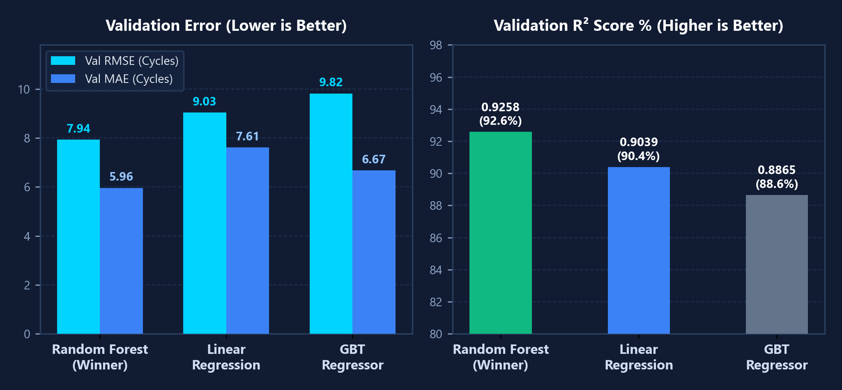
8. MACHINE LEARNING
09 / 12
Machine Learning & RUL Prediction: Spark MLlib Benchmark
How we trained, compared, and evaluated our RUL prediction models on real NASA data
1. HOW WE TRAINED THE MODELS (`ml_train.py`)
MODEL COMPARISON CHART (FROM AIRFLOW TASK 5 LOGS)
▸ Target to Predict (`rul`): True Remaining Useful Life (0 to 99 cycles across 4.91M rows in DS01-005).
▸ 44 Input Features: Uses all 44 numeric sensor and flight condition columns (`VectorAssembler` + `StandardScaler`). Excludes ID columns (`unit`, `cycle`, `rul`).
▸ No Data Leakage (Split by Engine ID): We split data by engine `unit` so the same engine is NEVER in both Train and Test:
• Train Engines `[2, 3, 4, 5]`: 363,672 rows (10% sample)
• Validation Engine `[1]`: 433,325 rows
• Unseen Test Engine `[6]`: 836,850 rows
2. VERIFIED MODEL ACCURACY TABLE
MODEL / DATASET
RMSE
MAE
R² SCORE
Linear Regression (Val Unit 1)
9.0328
7.6089
0.9039
3. PREDICTIONS ON TEST ENGINES (`ml_predict.py` — UNITS 7–10)
GBT Regressor (Val Unit 1)
9.8152
6.6737
0.8865
▸ Winning Model Saved to HDFS: `RandomForestRegressor` (25 trees, max depth 6) had the lowest error and highest R² score.
▸ Lowest Predicted RUL per Test Engine (across 2,735,232 rows): • Engine Unit 10 (82 cycles): Min Predicted RUL = 3.49 cycles (Most Urgent!)
• Engine Unit 8 (89 cycles): Min Predicted RUL = 4.38 cycles
• Engine Unit 9 (80 cycles): Min Predicted RUL = 4.65 cycles | Unit 7: Min RUL = 4.90
Random Forest [WINNER - Val]
7.9351
5.9612
0.9258
Random Forest (Unseen Unit 6)
6.3599
5.4292
0.9451
Random Forest (Full 2.73M Test)
7.5074
5.6703
0.9059
Source: NASA N-CMAPSS Dataset & Verified Project Pipeline Logs
Aircraft Engine Predictive Maintenance | Big Data Project
Notes:
SLIDE 9 — MACHINE LEARNING AND RUL PREDICTION (Easy Speaking Notes)
• To predict RUL fairly, we split the engines by Unit ID so readings from the same engine never mix between training and testing. Engines 2, 3, 4, and 5 were used for training, Engine 1 for validation, and Engine 6 for testing.
• We trained three models in Spark MLlib using 44 numeric sensor features: Linear Regression, Random Forest, and GBT.
• Random Forest won with the lowest validation RMSE of 7.94 cycles and an R² score of 92.6%.
• On unseen Engine 6, Random Forest achieved an RMSE of 6.36 and R² of 94.5%. And when tested on the full 2.73 million rows of `test.parquet` (Engines 7 to 10), it achieved an RMSE of 7.51 and R² of 90.6%, clearly identifying Engine 10 as the most urgent engine needing maintenance.

Slide 10
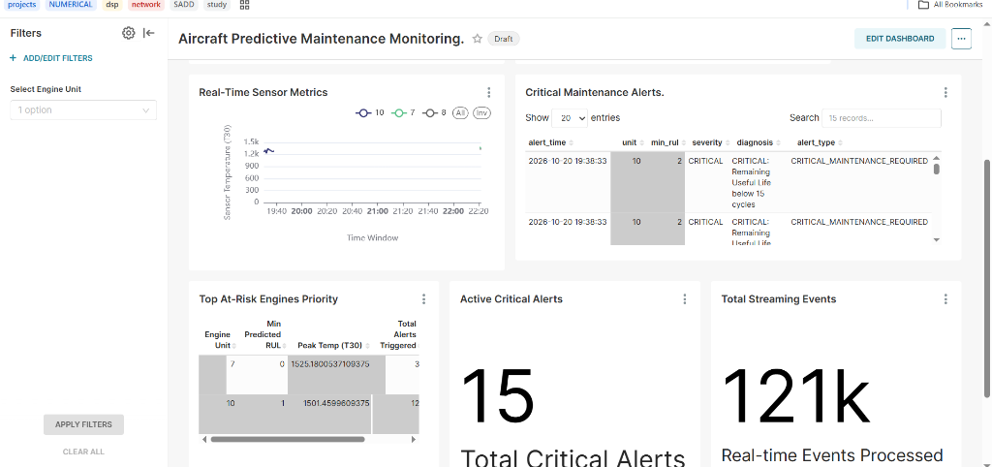
9. RESULTS & DASHBOARD
10 / 12
Results & Dashboard: ClickHouse Tables & Apache Superset
Verified database row counts and real screenshots from our running Superset dashboard
VERIFIED APACHE SUPERSET DASHBOARD (`localhost:8088`)
VERIFIED CLICKHOUSE TABLE COUNTS
Top Dashboard Charts:
• Fleet RUL Status bar chart (Units 1–6)
• Engine 10 RUL Degradation curve
• KPI: 120.5 Average Fleet RUL
TABLE NAME (`aircraft`)
ROWS
PURPOSE
engine_batch_summary
12
Per-engine stats
engine_rul_predictions
600,000
ML RUL predictions
engine_stream_metrics
57
30s stream windows
maintenance_alerts
15
Critical alerts
Bottom Dashboard Charts:
• Real-Time Sensor T30 temperature
• Critical Maintenance Alerts table
• 15 Active Alerts & 121k Stream Events
BATCH SUMMARY OUTPUT (UNITS 1–6)
▸ Engine 1 (100 cycles): 433,325 rows | Avg RUL: 49.45 | Max: 99
▸ Engine 2 (75 cycles): 1,049,088 rows | Avg RUL: 37.00 | Max: 74
▸ Engine 3 (100 cycles): 893,054 rows | Avg RUL: 49.07 | Max: 99
▸ Engine 4 (95 cycles): 414,172 rows | Avg RUL: 47.45 | Max: 94
▸ Engine 5 (89 cycles): 1,280,147 rows | Avg RUL: 44.11 | Max: 88
▸ Engine 6 (94 cycles): 836,850 rows | Avg RUL: 47.58 | Max: 93
Source: NASA N-CMAPSS Dataset & Verified Project Pipeline Logs
Aircraft Engine Predictive Maintenance | Big Data Project
Notes:
SLIDE 10 — RESULTS AND DASHBOARD (Easy Speaking Notes)
• On the left, we show two real screenshots from our running Apache Superset dashboard on port 8088.
• The top screenshot shows the average RUL for Engines 1 to 6 and the RUL degradation curve for Engine 10.
• The bottom screenshot shows live T30 temperature readings, the Top At-Risk Engines table, and 15 active critical maintenance alerts.
• On the right, we queried ClickHouse directly to verify the exact row counts: 600,000 rows in `engine_rul_predictions`, 12 rows in `engine_batch_summary`, 57 streaming window rows, and 15 critical alerts.

Slide 11
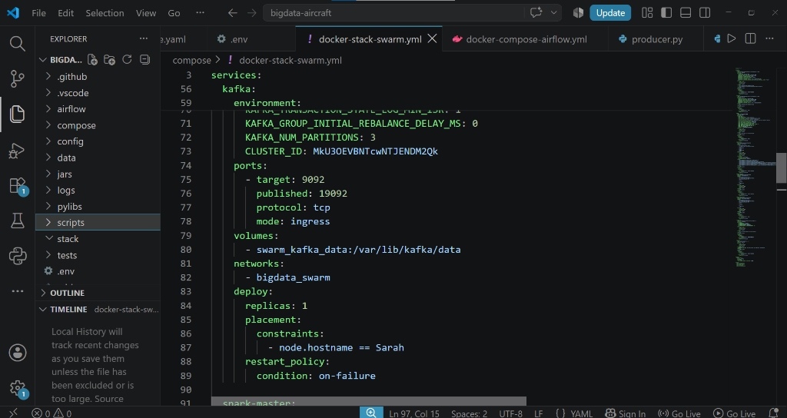
10. DEPLOYMENT & LIMITATIONS
11 / 12
Deployment, Testing & Honest Project Limitations
Docker Swarm & Tailscale setup, automated unit tests, and current technical limitations
DOCKER SWARM CONFIG (`compose/docker-stack-swarm.yml`)
AUTOMATED UNIT TESTS & CI (`tests/test_pipeline.py`)
▸ GitHub Actions CI (`.github/workflows/ci.yml`): Automatically runs `ruff` code checks and `pytest` on every push to `main`.
▸ 4 Verified Unit Tests: 1. HDF5-to-Parquet chunk conversion and column names check
2. Kafka JSON message format and corrupted message injection
3. Disjoint engine-unit split check (zero data leakage)
4. Dead-Letter Queue (DLQ) filter check for invalid messages
CURRENT LIMITATIONS & REMAINING ISSUES
▸ 1. Single-Machine Memory Limits: To avoid RAM crashes on 1 laptop, ML training samples 10% of rows (`--sample-ratio 0.1`) and ClickHouse loads 50,000 predictions per run.
▸ 2. Airflow Step 10 Network Name: In local Compose mode, Step 10 fails if it looks for network `aircraft_bigdata_swarm` instead of `compose_default`.
▸ 3. DS03-012 Not Yet in Default DAG: DS03-012 (9.82M rows) is converted to Parquet on disk, but the Airflow DAG currently runs on DS01-005 by default.
▸ 4. Replayed Data, Not Live Flight: Kafka streams historical NASA data rather than live sensors from a real airplane.
MULTI-NODE DESIGN VS. ACTUAL RUNNING STATUS
▸ Configured 3-Node Swarm Plan: Designed to split containers across 3 team laptops connected by a private Tailscale VPN network (`mtu: 1200`).
▸ Actual Running Status Today (Honest Report): Currently running on 1 local Docker Desktop node (`Tailscale is stopped`), where all 11 containers (Airflow, Spark, HDFS, Kafka, ClickHouse, Superset) are up and healthy via Docker Compose.
Source: NASA N-CMAPSS Dataset & Verified Project Pipeline Logs
Aircraft Engine Predictive Maintenance | Big Data Project
Notes:
SLIDE 11 — DEPLOYMENT, TESTING, AND LIMITATIONS (Easy Speaking Notes)
• For deployment, we wrote a 3-node Docker Swarm configuration (`docker-stack-swarm.yml`) designed to connect 3 machines over Tailscale VPN.
• Being 100% honest about our live status today: we are running on 1 local Docker Desktop machine with Tailscale stopped, and all 11 containers are running and healthy using Docker Compose.
• On the right, we have automated GitHub Actions CI and 4 unit tests in `pytest` that verify our Parquet converter, JSON schema, anti-leakage split, and Dead-Letter Queue.
• Finally, we list our 4 current limitations: using a 10% training sample and 50K ClickHouse batch size to save laptop RAM, the Step 10 network name difference, DS03 waiting to be added to the default DAG run, and using historical replay instead of a live aircraft.

Slide 12
11. CONCLUSION & NEXT STEPS
12 / 12
Conclusion, Verified Achievements & Future Work
Summary of what we built and tested, plus realistic next steps for the project
WHAT WE SUCCESSFULLY ACHIEVED
REALISTIC FUTURE WORK
▸ Complete End-to-End Big Data Pipeline: Connected NASA HDF5 data (6.12 GB, 17.46M rows) -> Parquet -> HDFS -> Spark Batch & Streaming -> Spark MLlib -> Airflow -> ClickHouse -> Superset.
▸ Accurate RUL Prediction Without Leakage: Split engines by unit ID and trained 3 models. Random Forest won with RMSE = 6.36 (R² = 0.945) on unseen Engine 6 and RMSE = 7.51 (R² = 0.906) across 2.73M test rows.
▸ Reliable Streaming with Quarantine (DLQ): Verified 41,010 Kafka messages, 30-second window stats, HDFS quarantine for bad JSON, and automatic critical alerts.
▸ Interactive Dashboard in Superset: Loaded 600,000 predictions and live alerts into ClickHouse and built visual charts in Apache Superset.
▸ 1. Train on Both DS01 & DS03 Together: Update the Airflow DAG to train on 100% of both DS01-005 and DS03-012 across multiple Swarm machines.
▸ 2. Live ML Prediction Inside Spark Streaming: Load the saved Random Forest model inside `streaming_job.py` to predict RUL directly on incoming Kafka messages.
▸ 3. Fix Step 10 Network Auto-Detection: Update Step 10 in Airflow so it automatically detects `compose_default` vs. `aircraft_bigdata_swarm`.
▸ 4. Try Deep Learning (LSTM / GRU): Test sequence deep learning models to capture long-term sensor trends across flight cycles.
DATASET & TECHNOLOGY REFERENCES
1. Dataset: Chao, M. A., Kulkarni, C., Goebel, K., & Fink, O. (2021). "Aircraft Engine Run-to-Failure Dataset under Real Flight Conditions for Prognostics and Diagnostics." Data, 6(1), 5. NASA Ames Prognostics Data Repository (N-CMAPSS DS01-005 & DS03-012).
2. Big Data Stack: Apache Spark 4.1.3 (SQL, Structured Streaming, MLlib), Apache Kafka 4.0.0 (KRaft), Hadoop HDFS 3.2.1, Apache Airflow 2.9.1, Apache Parquet, ClickHouse 26.9, & Apache Superset 3.1.0.
Source: NASA N-CMAPSS Dataset & Verified Project Pipeline Logs
Aircraft Engine Predictive Maintenance | Big Data Project
Notes:
SLIDE 12 — CONCLUSION AND FUTURE WORK (Easy Speaking Notes)
• In conclusion, we built and verified a complete Big Data pipeline for aircraft engine predictive maintenance.
• We converted 17.46 million rows of NASA data into Parquet, trained a Random Forest model in Spark MLlib that achieved 94.5% R² on an unseen engine and 90.6% R² on 2.73 million test rows, tested Kafka and Spark Streaming with Dead-Letter Queue protection, and displayed the results in ClickHouse and Superset.
• For future work, we plan to combine DS01 and DS03 in the DAG, run the ML model directly inside the live Spark stream, and fix the Step 10 network name check.
• Thank you for listening, and I am happy to answer any questions.

