Slide 1
LSTM to predict parking space in Denmark
Sarah Alkharif

Slide 2
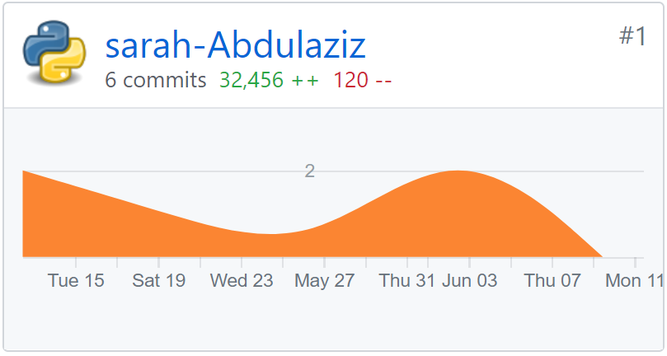
INTRODUCTION
Sensors usually give us the actual parking space at any given instant.
Forecasting the packing space enables users save time by knowing the space availability ahead of time

Slide 3
Statistical models for time series prediction

Slide 4


Time-series Analysis Algorithm
Auto Regressive (AR)
Moving Average (MA)
$\hat{y_{t}}=w_{0}\text{+}$ $σ_{1}ε_{t−1}$+$σ_{2}ε_{t−2}$+ ….….+$σ_{n}ε_{t−n}$
$$\hat{y_{t}}=w_{0}\text{+}β_{1}x_{t−1}\text{+}β_{2}x_{t−2}\text{+}\text{…}\text{.}\text{…}\text{+}{β_{n}x}_{t−n}$$

Slide 5
Deep learning model for time series prediction

Slide 6
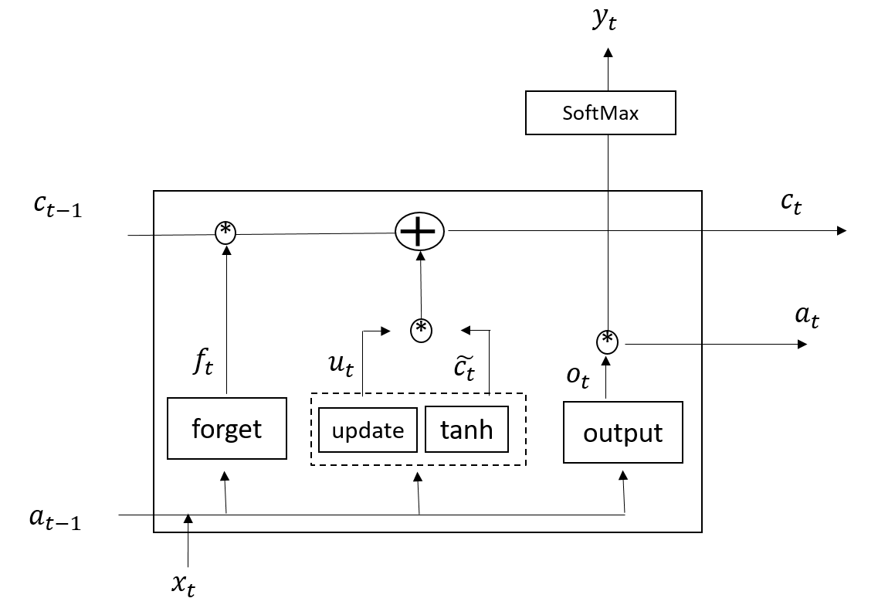
Long Short Term Memory (LSTM)
Notes:
We apply Long Short Term Memory where the model take every observation not predicted next step or price
Th benefit of LSTM is cell unit or cell memory $c_{t}$ where the model remember the output
The lstm has 3 main gates forget gate where the model use sigmoid function to make a decision to remember the output or not
Update gate where the model update the parameter that will be able to updated in backpropagation step
Output gate which is our result

Slide 7
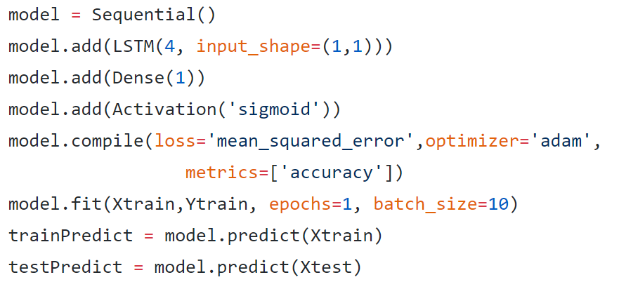
Evaluation
8 parking lots
6 months (from MAY. 2014 to Nov. 2014)
Hourly time step
80% for training set, and 20% for test set
Using Keras

Slide 8
Result

Slide 9
Thank you

