Slide 1
SUBMITTED BY: BUSHRA
Digital Audio PCB Design
Using Altium Designer
Complete PCB Design Workflow | Schematic → Layout → 3D View → DRC → Gerber Export
Schematic Design
PCB Layout
3D Visualization
DRC & Gerber Output
Altium Designer 23.9.1 | Digital Audio PCB Project |

Slide 2
Project Overview
Project Name
Core Component
Board Specs
Digital Audio Amplifier PCB
Rev 1.0 — 2-Layer Board
TL072 Dual Op-Amp
Low-Noise Audio IC
65mm × 45mm
FR4 — 1.6mm thickness
Components
Power Supply
Output
12 Total Parts
SMD + Through-Hole
+12V / GND
15W Max Power
Gerber Files Ready
DRC: 0 Errors
Bushra | Digital Audio PCB — Altium Designer Demo | 2026

Slide 3
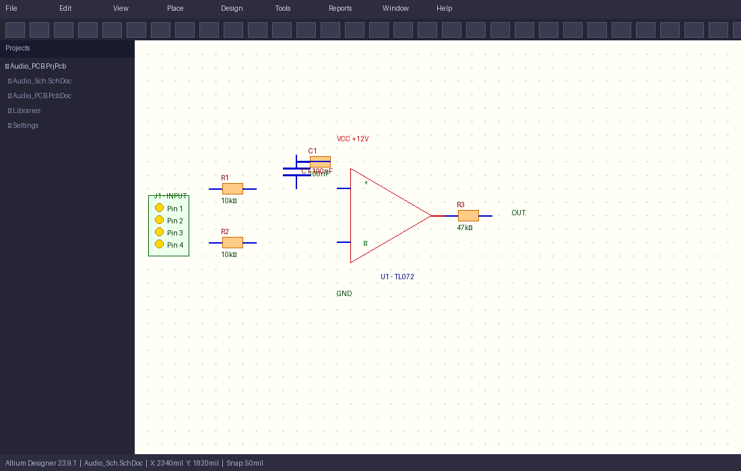
Step 1 — Schematic Design
Altium Designer — Audio_Sch.SchDoc
Bushra | Digital Audio PCB — Altium Designer Demo | 2026

Slide 4
Step 1 — Schematic Design
Altium Designer — Audio_Sch.SchDoc
Op-Amp Circuit
TL072 configured as no inverting amplifier
Resistors
R1, R2: 10ΚΩ
R3: 47k feedback
Capacitor
C1: 100nF decoupling capacitor
Connector
J1: 4-pin audio input
Bushra | Digital Audio PCB — Altium Designer Demo | 2026

Slide 5
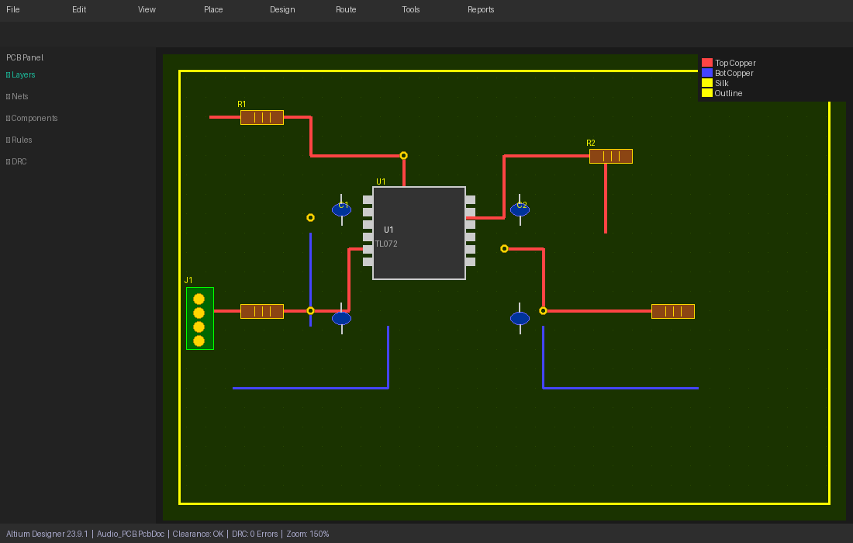
Step 2 — PCB Layout & Routing
Altium Designer — Audio_PCB.PcbDoc
Bushra | Digital Audio PCB — Altium Designer Demo | 2026

Slide 6
Step 2 — PCB Layout & Routing
Altium Designer — Audio_PCB.PcbDoc
Top Copper Signal traces on top copper layer
Bot Copper Power traces on bottom layer
Via Holes Inter-layer connections
Board Outline 65mm x 45mm FR4 board size
Bushra | Digital Audio PCB — Altium Designer Demo | 2026

Slide 7
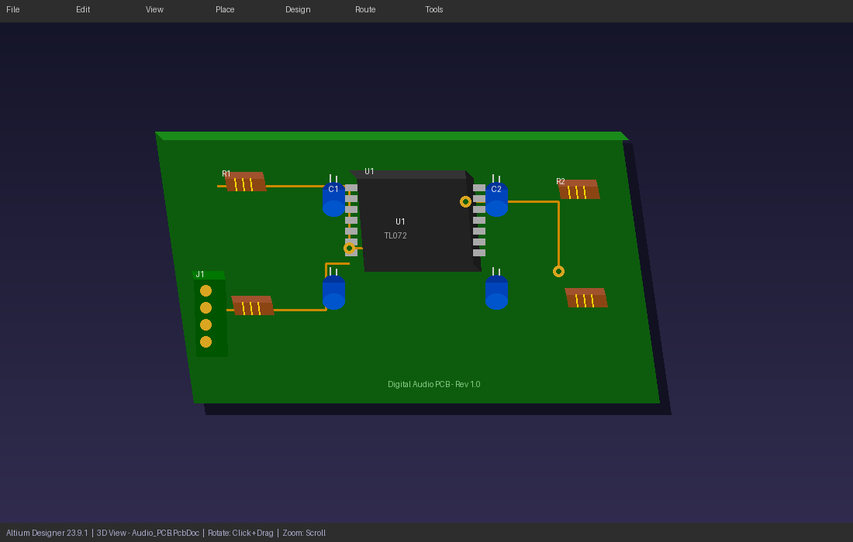
Step 3 — 3D PCB Visualization
Altium Designer — 3D View
Bushra | Digital Audio PCB — Altium Designer Demo | 2026

Slide 8
Step 3 — 3D PCB Visualization
Altium Designer — 3D View
Resistor
Rsistors visible on top layer
Capacitors
4x electrolytic caps with leads
IC Package
TL072 SOIC-8 SMD package
PCB Board
Green FR4 substrate 3D view
Bushra | Digital Audio PCB — Altium Designer Demo | 2026

Slide 9
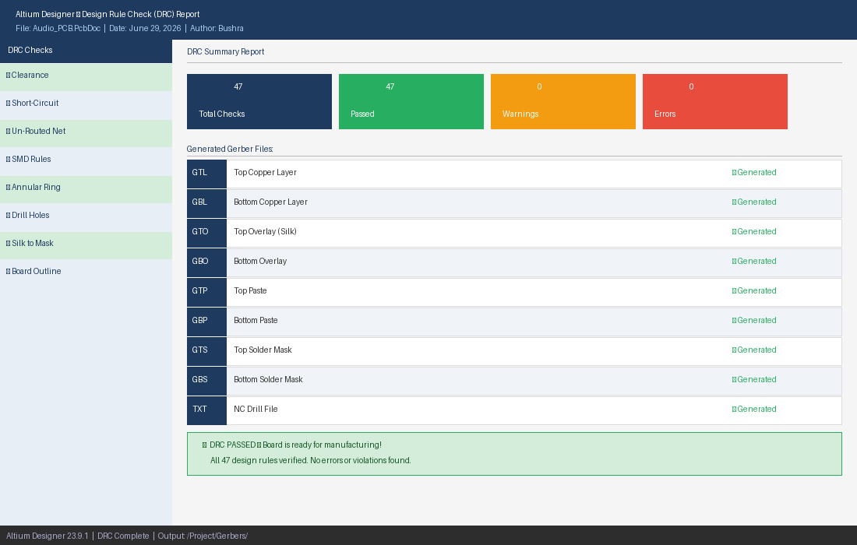
Step 4 — DRC Check & Gerber Output
0 Errors — Board Ready!
Bushra | Digital Audio PCB — Altium Designer Demo | 2026

