Slide 1
Elementary Statistics DATA1220-55
Fall 2024
Sarah Grabinski

Slide 2
Important Times
Class Meetings
Dolan E243
MWF 1:30-2:20pm
Office Hours
Dolan E252
MW 2:30-4:00pm, Friday by appointment

Slide 3
Course Description
No prerequisite
Students will learn to…
Describe data with summary statistics and visualizations
Analyze data using hypothesis tests and linear regression
Perform basic statistical programming in R
Apply these learnings to multidisciplinary data sets
This course satisfies the Quantitative Analysis requirement in the Core Curriculum as well as being a foundational course in the Statistics minor.

Slide 4
Textbook
OpenIntro Statistics - Fourth Edition
FREE!!
Download PDF from https://www.openintro.org/book/os or Canvas

Slide 5
Software
We will be learning statistical programming with R
http://www.r-project.org/
FREE!
We will be producing publication-ready documents in Rstudio
https://www.rstudio.com/
FREE!

Slide 6
Canvas
Primary source for announcements, syllabus, homework, course materials
Canvas.jcu.edu
All due dates will be published and communicated here

Slide 7
Objectives
Find and pose questions that can be appropriately analyzed by quantitative methods.
Draw inference from data.
Represent data.
Think critically about quantitative statements.
Recognize sources of error.
Encounter ethical arguments and consider the ethical use of data.
Apply statistical methods in a variety of realistic research contexts.
Communicate statistical results using proper use of statistical notation and terminology.

Slide 8
Grading
Attendance and Participation (5%)
Homework (60%)
Surveys (5%)
Quiz (10%)
Final Exam (20%)
Grade | Percentage
A | 93% | Outstanding scholarship
A- | 90%
B+ | 87%
B | 83% | Superior work
B- | 80%
C+ | 77%
C | 73% | Average
C- | 70%
D+ | 67%
D | 60% | Work of the lowest passing quality

Slide 9
Tentative Schedule
Week 1 (8/19 – 8/23): Introduction to R, Introduction to Data (Ch 1)
VIRTUAL CLASS: Friday 8/23/24
Week 2 (8/26 – 8/30): Introduction to Data (Ch 1), Summarizing Data (Ch 2)
VIRTUAL CLASSES: Monday 8/26/24, Wednesday 8/28/24, Friday 8/30/24
Week 3 (9/2 – 9/6): Summarizing Data (Ch 2)
NO CLASS: Monday 9/2/24 (Labor Day)
Week 4 (9/9 – 9/13): Probability (Ch 3)
Week 5 (9/16 – 9/20): Sampling Distributions (Ch 4)
Week 6 (9/23 – 9/27): Sampling Distributions (Ch 4)

Slide 10
Tentative Schedule
Week 7 (9/30 – 10/4): Statistical Inference (Ch 5)
Week 8 (10/7 – 10/11): Statistical Inference (Ch 5)
NO CLASS: Monday 10/7/24 (Fall Break)
Week 8 (10/14 – 10/18): Statistical Inference (Ch 5)
Week 9 (10/21 – 10/25): Categorical Data (Ch 6)
Week 10 (10/28 – 11/1): Numerical Data (Ch 7)

Slide 11
Tentative Schedule
Week 11 (11/4 – 11/8): Linear Regression (Ch 8)
Week 12 (11/11 – 11/15): Linear Regression (Ch 8)
Week 13 (11//18 – 11/22): Linear Regression (Ch 8)
Week 14 (11/25 – 11/29): Review, Applications
NO CLASS: Wednesday 11/27/24, Friday 11/29/24 (Thanksgiving Break)
Week 15 (12/2 – 12/6): Review, Applications
LAST CLASS: Wednesday 12/6/24
Week 16 (12/9 – 12/13): Final Exam

Slide 12
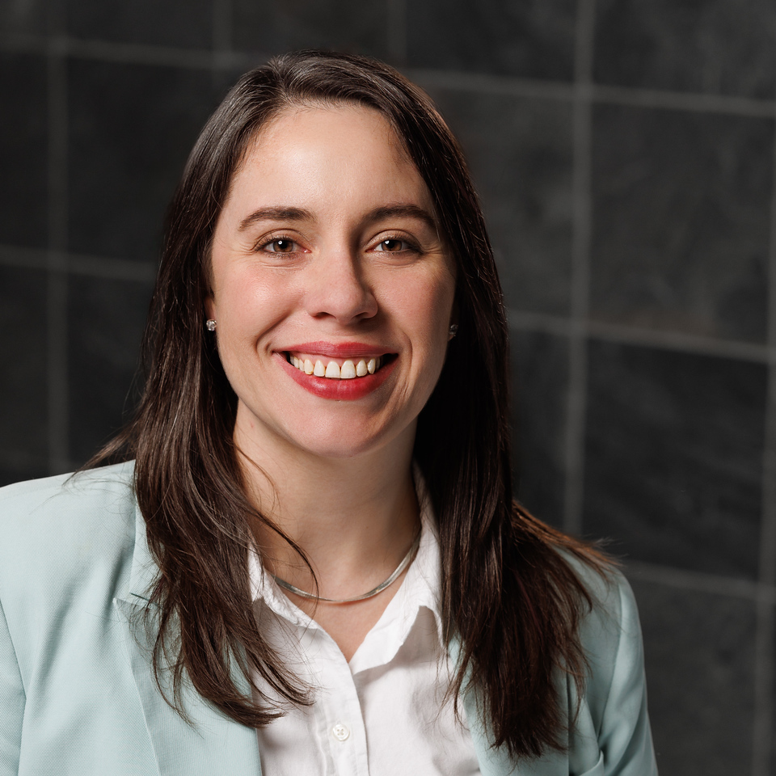
Who am I???
Sarah Grabinski
BA in Biology, Oberlin College
Data Analytics Boot Camp, Case Western Reserve University
MS in Epidemiology & Biostatistics, Case Western Reserve University
Experience
Molecular Biology Research, Wet Lab
Business Analyst for Hilton Hotels
Consulting Biostatistician at Case Western Reserve University
Research Interests
DNA & RNA Sequencing studies (genomics, microbiome, RNA-seq)
Evolutionary biology, ecology
Political science

Slide 13
Download RStudio
https://posit.co/download/rstudio-desktop/

Slide 14
Who are you??
Name
Year
Hometown
Major
Your most useless talent

