Slide 1
A Proportional Share Resource Allocation Algorithm For Real-Time, Time-Shared Systems: A Closer Look
Honors Thesis Defense

Slide 2
Outline
EEVDF
Dynamic Systems
Linux
Discussion of Mathematical Results

Slide 3
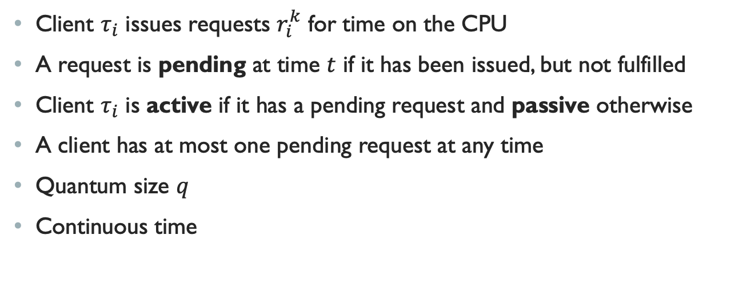
Task Model
Client $τ_{i}$ issues requests $r_{i}^{k}$ for time on the CPU
A request is pending at time $t$ if it has been issued, but not fulfilled
Client $τ_{i}$ is active if it has a pending request and passive otherwise
A client has at most one pending request at any time
Quantum size $q$
Continuous time
Notes:
Ian Stoica, Hussein Abdel-Wahab paper in 1995, Ian Stoica, Hussain Abdel-Wahab et. Al in an RTSS paper in 1996 (doesn’t include all the proofs from the version that Jim gave me)

Slide 4

Fluid/Ideal System
Each $τ_{i}$ has $w_{i}∈ℚ, w_{i}>0$
Instantaneous share at time $t$, Eq. (1):
Ideal allocation in $[t_{1},t_{2})$, Eq. (2):

Slide 5
Lag
Notes:
How the client is performing with respect to the ideal system
What pos/neg lag mean
Keep in mind that ideal allocation changes a lot when you’ve got a lot of clients in the system

Slide 6
Proportional-Share Algorithms
Aim to allocate each task proportionally fair time on the CPU
EEVDF optimal in the class of proportional-share algorithms

Slide 7

The Virtual Time Domain
Ticks along in inverse proportion to the sum of the weights in the system
Each $τ_{i}$ will be scheduled for $w_{i}$ time units in each virtual time unit
Scheduling decisions are made in the virtual time domain

Slide 8
EEVDF
Notes:
For clients that just issue subsequent requests, have this set of equations. Pretty directly useful, simpler way of looking at things
W1=1, w2=2
Q=1
T2 joins at t=1
Virtual time mapping changes
Lag of client 1 at time 1 is zero

Slide 9
DYNAMIC SYSTEMS
Notes:
Clients can leave, join, change weight at any time
Trivial to support them in a fluid system, but, again, we run into issues with discreet allocation in the real world
WHY IS IT IMPORTANT TO ALLOW DYNAMIC OPERATIONS AT NON-ZERO LAG POINTS?
Responsive systems, delaying the joining of a latency sensitive client or to idle if something doesn’t use all of its time slice
Responsiveness is a high-class concern
Ability for a client to not use all of its request time and not be punished allows request time to become a latency parameter
If clients leave with 0 lag, these reduce to no update

Slide 10
DYNAMIC SYSTEMS
Notes:
Quantum size 1.
3 clients, equal weights
Issue requests of size 1 continuously after first issuing them at t=0
CLIENT T3 leaves with positive lag at t=2
at time T=2, each client has executed in the fluid schedule for 2/3 time units
Only t1, t2 have been allocated time on the processor
Lag3(2) = 2/3, lag1(2)=lag2(2)=-1/3

Slide 11
DYNAMIC SYSTEMS
Notes:
At the moment that client 3 leaves, LAG INVARIANT IS VIOLATED
Virtual time continues to tick along, this time at a rate of ½ that of real time, so after 2/3 real time units, the ideal time added is 1/3, lags hit zero at 2 2/3 but are negative before that, meaning they’re both ineligible
We get system idling

Slide 12
DYNAMIC SYSTEMS
Notes:
We avoid this on the right by using rule 1 and updating virtual time
Now, t1,t2 are eligible to be scheduled at time 2
In the positive lag leaving case, we can think of rule 1 as “skipping ahead” in virtual time to avoid the processor idling
The other cases all have similar intuitions, just redistributing lag

Slide 13
DYNAMIC SYSTEMS
Notes:
I won’t go through the derivation, but these rules are actually a consequence of this invariant
This is an invariant that matters to us because if it does not hold, the service time provided to clients in the ideal system is not the same as the service time provided to clients in the actual system, and the systems are no longer comparable; the lag of a client no longer refers to something meaningful.

Slide 14
DYNAMIC SYSTEMS
Notes:
\Many implementations use only a subset of these rules
1995:
Use R1, R2
Apply R1 when a client leaves but forget upon rejoining
Only leave/come back when lag=01
1996:
Clients that leave with positive lag use R1. clients that leave with negative lag are delayed in the background until their lag is 0 – dummy req
Lag is forgotten on rejoin
Linux:
Leave/join at any point in time
pos lag retained indefinitely
Neg lag decayed at the rate of virtual time
Rules R1, R2 are indirectly applied – they are referenced in the code, but everything is done a bit more crudly, using vruntime and no central value of virtual time

Slide 15
Linux
New default scheduler for fair scheduling classes (previously CFS)
Merged as an option for the 6.6 Linux kernel, Oct 29, 2023
Notes:
CFS -> EEVDF
Lots of CFS structures are still around
CFS basically a red black tree sorted by least vruntime
Now, we’re using vruntime as a parameter to calculate lag, and sorting the rb tree by virtual deadline

Slide 16
Linux
Rb tree of `sced_entity` structs
vruntime
Virtual time ~ average virtual runtime
vlag
Weight -> niceness
Larger niceness values -> lower weight
Request size
More complicated
sched_base_slice_ns
sched_setattr() sys call
Latency nice
Notes:
Rb – ordered by virtual deadline, O(log n). Picks leftmost eligible node
DEFFERED DEQUEUE – IMPLEMENTATION OF decaying negative lag
Why? latency
Put deadline equation up there, mapping between concepts

Slide 17
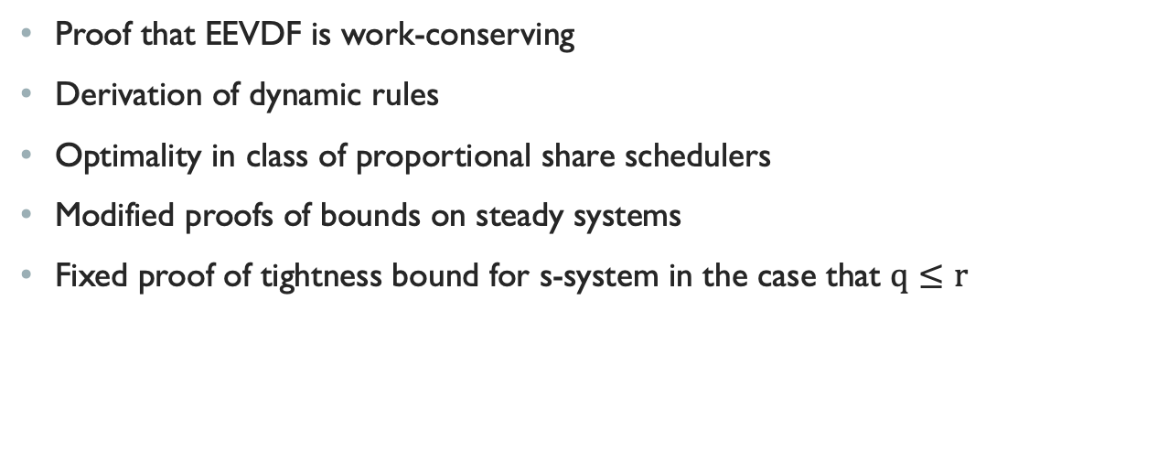
Mathematical Results
Proof that EEVDF is work-conserving
Derivation of dynamic rules
Optimality in class of proportional share schedulers
Modified proofs of bounds on steady systems
Fixed proof of tightness bound for s-system in the case that $q≤r$
Notes:
Consolidated a lot of existing results, a few fixes/mathematics results that weren’t there before

Slide 18
Further Work
Precise model of EEVDF in Linux
Latency-nice patch
Notes:
right now there is a line of code that manually makes sure lag never exceeds bounds instead of it falling out of the implementation
.A lot of the promise of using EEVDF instead of CFS was that it would more naturally handle processes of varying latency. This does happen because I/O tasks that do not use all their time quantum are like usually always eligible when they return, but there’s really limited mechanisms to affect your deadline

Slide 19
Questions

