Slide 1


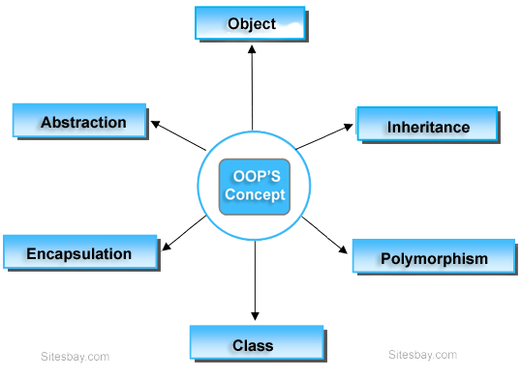
"Why do programmers prefer OOP? Because it's the classiest way to code!"
p

Slide 2
p
CONTENTS
Programming paradigms
Brief history
What is oop
Objects
Classes
Contractors
codes
OOP IS A PROGRAMMING PARADIGM

Slide 3
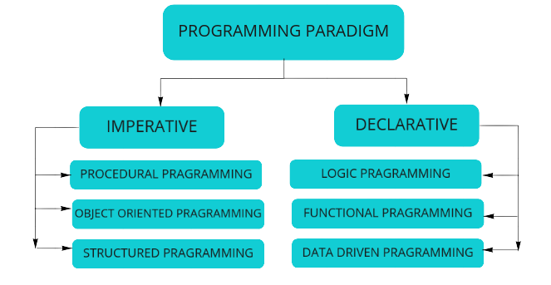
PROGRAMMING PARADIGMS
p
Approach to writing computer programs.
Set of principles, concepts, and practices
Different programming paradigms offer distinct ways of thinking about and solving problems in the context of software development

Slide 4
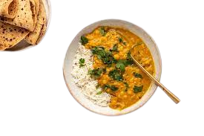
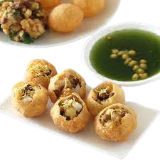
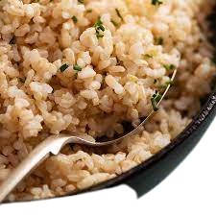
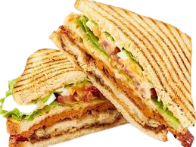
DIFFERENT WAYS TO DO SOME WORK
p
Making sandwich
Rice
Pani puri
daal

Slide 5
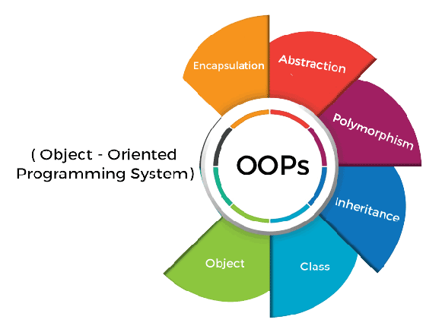
p
WHY OOP WAS INVENTED
CODE REUSABILITY
Why not functional programming then?
MAINTENANCE
4 PILLARS
Encapsulation
Abstraction
Inheritance
polymorphism
Consider writing a function to add 2 numbers vs creating a bank system

Slide 6
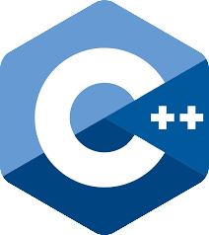


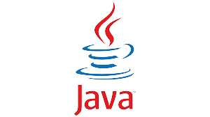

WHO INVENTED OOP
Simula ➔ 1960s first object-oriented language
Small Talk ➔ 1970s by Alan Kay ➔ first pure object-oriented language
Some other languages that offer object-oriented programming
Java
C++
Python
C#
Ruby
PHP

Slide 7
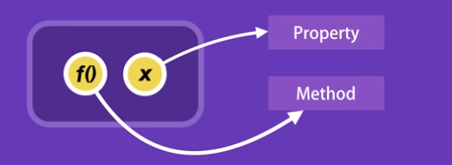
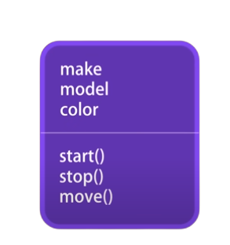
WHAT ACTUALLY IS OOP
object
Definition: oop is a popular programming paradigm based on the concept of objects
Object ➔ collection of attributes (variables) and methods(functions)
Examples:
Objects ➔ Date,String,localStorage
Methods ➔ toLowerCase(), toFixed(), parseInt()
car
Live coding on its way!!

Slide 8
Real example because we don’t have cars in our codes
localStorage
Property: length
Methods : setItem(),…

Slide 9
CLASS
A class is like a blueprint or a template that describes how an object should be created and what properties (attributes) and behaviors (methods) it should have
Live coding on its way!!

Slide 10
constructors
a constructor is a special method that is automatically called when you create an instance (object) of a class.
class calculation {
constructor() {
console.log("we are doing calculations");
}
}

