Slide 1
Education Poverty in China
Sarah Xu

Slide 2
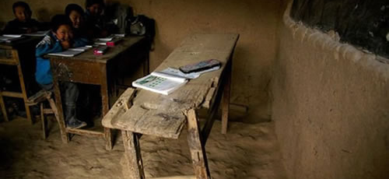
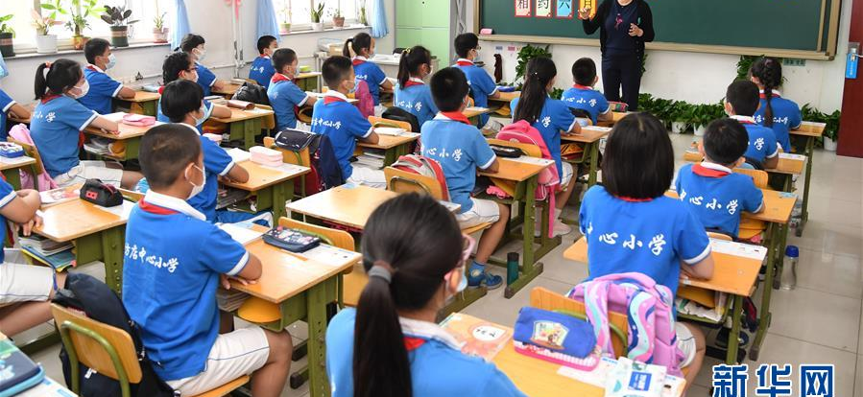
What is Education Poverty?
Education poverty defined by Save the Children as a process of limitation children’s right to education and deprivation of their opportunities to learn and develop skills they will need to succeed in a rapidly changing society.
Notes:
Aside from individual factors that might’ve caused education poverty,
Can also be called education inequality
(link how these two are similar/same)
Top picture came from an article asking for donations to help with education resources in povetry areas
Bottom pictures is taken in a public beijing elementary school

Slide 3
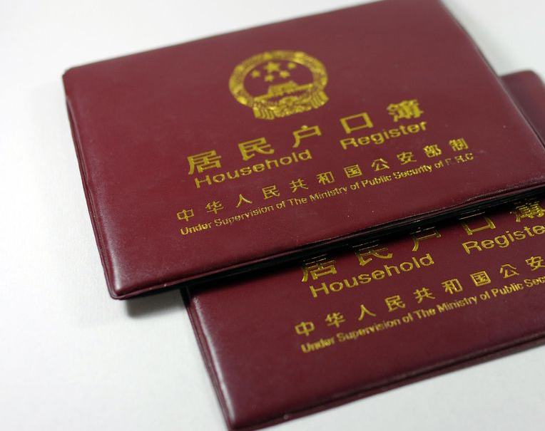
Migration
“Why can’t they just migrate?”
Hukou system: a registration system in China, Hukou is a record where your family origin from, where your name is registered

Slide 4
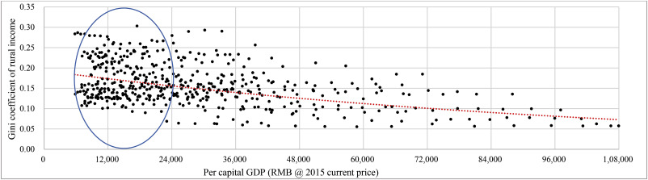
Income Inequality
Notes:
GINI Coefficient income distribution of rural areas
Gini coefficients of rural income were not significantly correlated with increases of per capital GDP until it surpassed 24,000 RMB, which is roughly equivalent to the bottom end of the upper-middle income (4036 USD) bracket.

Slide 5
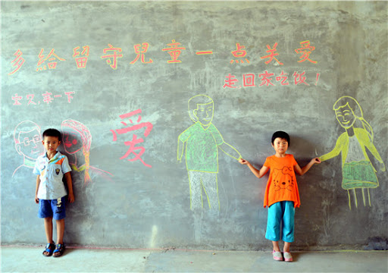
Left-Behind-Children

Slide 6

Future Research
Donation:
Wechat: hope91love
Wechat: cydfhope
cydf.org.cn
Volunteer

