Slide 1

A level Biology Year 1 Homework booklet
Student name:
Section 1a Biological molecules

Slide 2
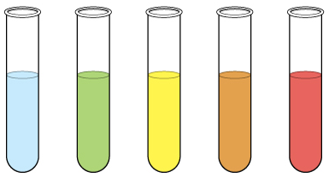
Section 1: Section 1: Biological molecules
1.2 Carbohydrates – monosaccharaides:
How are large molecules like carbohydrates constructed?
What is the structure of a monosaccharide?
How would you carry out the Benedict’s test for reducing and non-reducing sugars?
Key words:
Benedict’s test; carbohydrate; monomer; monosaccharide;
Draw the monomer α-glucose:
Explain how to carry out the Benedict's test:
Label the tubes below to show the result:
How are large molecules like carbohydrates constructed?
Blue
Green
Yellow
Orange
Red

Slide 3
Section 1: Section 1: Biological molecules
1.3 Carbohydrates - disaccharides:
How are monosaccharaides linked together to form disaccharides?
How are α-glucose molecules linked to form starch?
What is the test for non-reducing sugars?
What is the test for starch?
Key words:
cellulose; condensation; disaccharide; glycogen; glycosidic bond; iodine/KI test; polymers; polysaccharide; starch;
Draw the formation of maltose, name the bond formed and the type of reaction:
Draw the breaking of sucrose and name the type of reaction:
Glucose links to glucose to form:
Glucose links to fructose to form:
Glucose links to galactose to form:
What is the test for non-reducing sugars, and what results would you expect?
Why is this different to a test for reducing sugars?

Slide 4
Section 1: Section 1: Biological molecules
1.4 Carbohydrates: Polysaccharides
What is the test for starch?
What makes starch and glycogen such good storage molecules?
What makes cellulose a good structural carbohydrate?
How does the way they are bonded change their properties?
Key words:
Monomer, glycosidic bond, starch,
Iodine, glycogen, branching, cellulose, hydrogen bonding,
How is the structure of starch, cellulose and glycogen different (make reference to the monosaccharide AND the type of bond(s)?
How does the structure of starch relate to it’s function?
How does the structure of glycogen relate to it’s function?
How does the structure of cellulose relate to it’s function?

Slide 5
A level Biology Year 1 Homework booklet
Student name:
Section 1b Biological molecules

Slide 6
Section 1: Section 1: Biological molecules
1.5 Lipids:
How are triglycerides formed?
How can fatty acids vary?
What is the structure of a phospholipid?
What is the presence of a lipid identified?
Key words:
emulsion test; hydrophilic; hydrophobic; mono-unsaturated; plasma membrane; polar; polyunsaturated; saturated; triglycerides
Draw a diagram to show the formation of triglycerides and name the type of reaction:
Draw and label the structure of a phospholipid
What are the roles of lipids in the body?
What is the test for lipids, and what results would you expect?

Slide 7
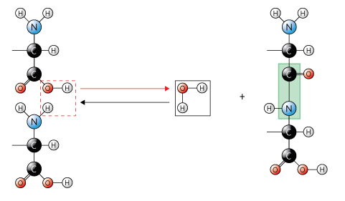
Section 1: Section 1: Biological molecules
1.6 Proteins – amino acids
How are amino acids linked to for polypeptides – the primary structure of proteins?
How are polypeptides arranged to form the secondary structure and then the tertiary structure of a protein?
How is the quaternary structure of a protein formed?
How are proteins identified?
Key words:; amino acid; biuret test; dipeptide; peptide bond; polymerisation; amino group, carboxyl group
Draw and label an amino acid:
Label the diagram to show the formation of a polypeptide bond:
What is the test for proteins and what results would you expect?

Slide 8
Section 1: Section 1: Biological molecules
1.6 Proteins: Primary to quaternary structure
How are amino acids linked to for polypeptides – the primary structure of proteins?
How are polypeptides arranged to form the secondary structure and then the tertiary structure of a protein?
How is the quaternary structure of a protein formed?
How are proteins identified?
Key words: alpha-helix; amino acid; β-pleated sheet; biuret test; dipeptide; disulphide bonds; ionic bonds; hydrogen bonds; peptide bond; polymerisation; polypeptide; primary structure; protein; quaternary structure; secondary structure; tertiary structure;
Draw the primary structure of a protein:
Draw the tertiary structure of a protein (label the bonds involved):
Draw the quaternary structure of a protein:
Draw the secondary structure(s) of a protein (label the bonds involved):

Slide 9
Section 1: Section 1: Biological molecules
1.7 Enzyme action:
How do enzymes speed up chemical reactions?
How does the structure of enzyme molecules relate to their function?
What is the lock and key model of enzyme action?
What is the induced-fit model of enzyme action?
Key words:
activation energy; catalyst; enzyme; enzyme-substrate complex; induced fit; lock and key; substrate;
Draw a diagram to explain the lock and key model of enzyme action:
How does an enzyme’s structure relate to it’s function?
Draw a diagram to explain the induced-fit model of enzyme action:
Draw a sketch graph to show how enzymes speed up a reaction:

Slide 10
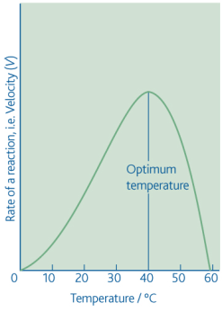
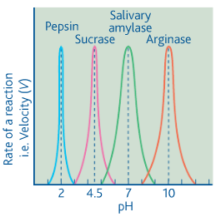
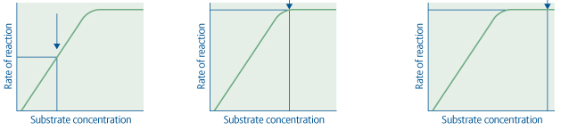
Section 1: Section 1: Biological molecules
1.8 Factors affecting enzyme action:
How is the rate of an enzyme-controlled reaction measured?
How does temperature affect the rate of an enzyme-controlled reaction?
How does pH affect the rate of enzyme-controlled reaction?
How does substrate concentration affect the rate of reaction?
Key words:
active site; denature; optimum; pH; substrate concentration; temperature;
Describe the different ways the rate of an enzyme-controlled reaction can be measured?
How does temperature affect the rate of an enzyme-controlled reaction?
How does pH affect the rate of an enzyme-controlled reaction?
How does substrate concentration affect the rate of an enzyme-controlled reaction?

Slide 11
Section 1: Section 1: Biological molecules
1.9 Enzyme inhibition:
How do competitive inhibitors and non-competitive inhibitors affect the active site?
What is enzyme inhibition?
Key words:
competitive inhibitor; end-product inhibitor; irreversible; reversible; non-competitive inhibitor
How do competitive inhibitors affect the active site? Use diagrams in your explanation.
How do non-competitive inhibitors affect the active site? Use diagrams in your explanation.

