Slide 1
Displacement Reactions of Metals
Combined Science - Chemistry - Key Stage 4
Mr Campbell

Slide 2
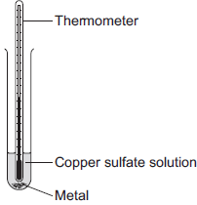
Q1.
A student investigated displacement reactions of metals.
The student added different metals to copper sulfate solution and measured the temperature change.
The more reactive the metal is compared with copper, the bigger the temperature change.
(a) State three variables that the student must control to make their investigation a fair test. (3)
Question from exampro

Slide 3
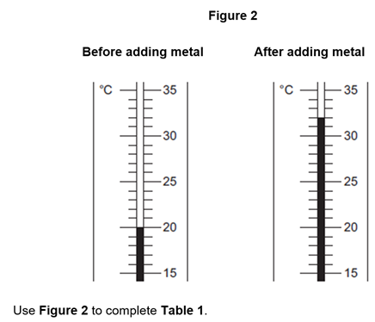
(b) Figure 2 shows the thermometer in one experiment before and after the student added a metal to the copper sulfate solution.
Temperature before adding metal in °C | ________
Temperature after adding metal in °C | ________
Change in temperature in °C | ________
Question from exampro
Table 1
(3)

Slide 4
(c) The student repeated the experiment three times with each metal.
Table 2 shows the mean temperature change for each metal.
Metal | Mean temperature change in °C
Cobalt | 4.5
Gold | 0.0
Magnesium | 10.0
Nickel | 3.0
Silver | 0.0
Tin | 1.5
(i) Use the results to work out which metal is the most reactive.
Give a reason for your answer.
Most reactive metal _________________________
Reason _________________________________
_________________________________
(2)
Question from exampro

Slide 5
(ii) Explain why there was no temperature change when silver metal was added to the copper sulfate solution.
______________________________________________________________
______________________________________________________________
(2)
(iii) It is not possible to put all six metals in order of reactivity using these results.
Suggest how you could change the experiment to be able to put all six metals into order of reactivity.
______________________________________________________________
______________________________________________________________
(2)
Question from exampro

Slide 6
Answers
Q1.
a) Z
1
(b) magnesium sulfate does not react with any of the metals
allow there is no change / increase in temperature with any of the metals
1

Slide 7
Q2.
(a) any three from:
• concentration of (salt) solution
• volume of (salt) solution
ignore amount of solution
• initial temperature (of the solution)
ignore room temperature
• surface area / form of metal
• moles of metal
allow mass / amount
ignore time
ignore size of tube
3

Slide 8
(b) 20
1
32
1
12 (if you have correctly calculated a temperature change from incorrect readings you would get 1 mark here)
1

Slide 9
(i) magnesium
1
because biggest/largest temperature change
accept gives out most energy
1
(ii) does not react / silver cannot displace copper
1
because silver not more reactive (than copper) or silver below copper in reactivity series
do not accept silver is less reactive than copper sulfate
1

Slide 10
(iii) replace the copper sulfate
could be implied
1
with any compound of a named metal less reactive than copper (platinum, gold, silver)
1

