Slide 1


The Digital Renaissance
of African Heritage
A Modern Synthesis of Ancestral Tradition and Emerging Technology
Presented by Sarah Wairimu Thuo
Innovation & Heritage
Slide 01

Slide 2

Leapfrogging with Purpose
How African societies are bypassing legacy systems to create a unique, culturally-rooted digital future.

Slide 3







CORE PHILOSOPHIES
Ubuntu 2.0
Frugal Innovation
The Digital Griot
Digital communalism where social media and WhatsApp groups act as modern community councils for collective growth.
Traditional oral history transformed into global podcasts, archiving indigenous languages for the next generation.
"Jua Kali" tech spirit: Creating high-impact solutions with minimal resources to solve localized challenges.
Conceptual Framework
Slide 03

Slide 4
FINTECH AS A BRIDGE
Mobile Money: The New Market Pulse
In local markets across the continent, tradition meets tech at every stall. Traditional traders use mobile money platforms like M-Pesa to manage complex cross-border trade, proving that digital tools thrive when they mirror cultural exchange patterns.
70% of global mobile money transactions occur in Africa.
Economic Transformation
Slide 04

Slide 5

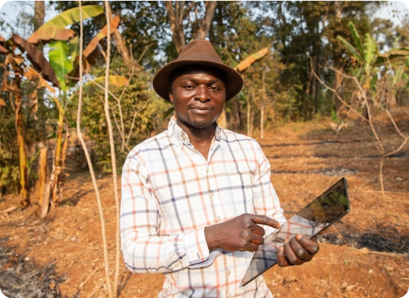
ANCESTRAL WISDOM & IOT
Smart Farming
Farmers are combining generational knowledge of the land with IoT sensors and satellite data. This synergy allows for precision agriculture that respects the ecological rhythms of the continent.
Real-time weather forecasting in local dialects.
Soil health monitoring via mobile apps.
Direct-to-market blockchain supply chains.
Precision Agriculture
Slide 05

Slide 6

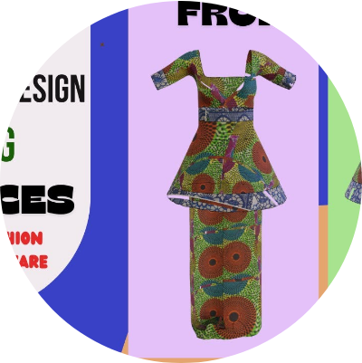
DIGITAL FASHION & IDENTITY
Weaving the Future
Designers are utilizing 3D modeling and blockchain to protect the intellectual property of traditional patterns like Kente and Bogolan. This intersection ensures that as African style goes global, the benefits return to the local artisans who own the heritage.
"We are no longer just exporting fabric; we are exporting digital assets that carry our story."
Creative Tech
Slide 06

Slide 7
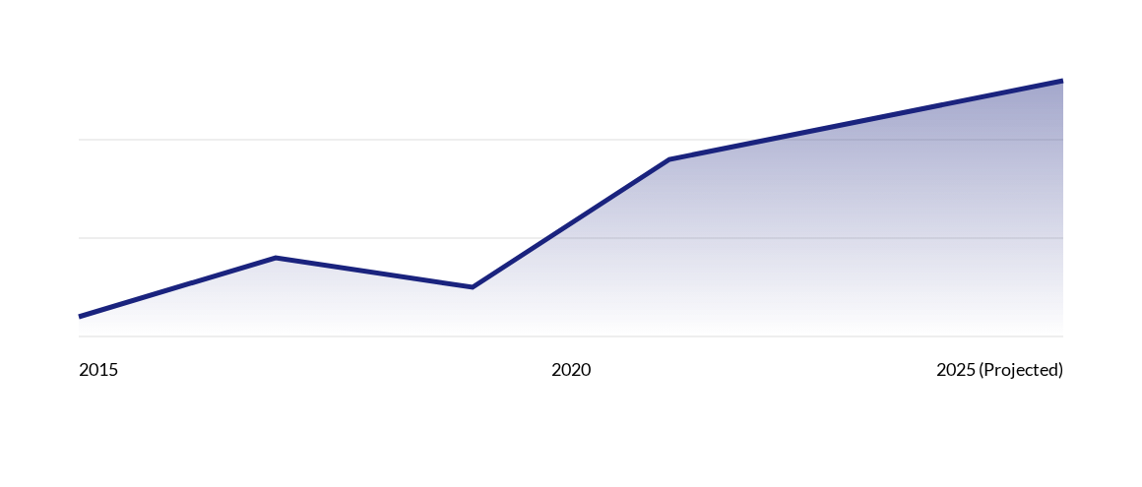
CULTURAL TECH ADOPTION TRENDS
Exponential growth in digital platform usage for cultural preservation and creative commerce.
Market Growth
Slide 07

Slide 8



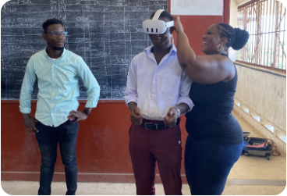


CREATIVE CONVERGENCE
Digital Arts
Immersive Education
The New Pattern
NFTs and crypto-art empower artists to bypass global gatekeepers.
VR/AR tools used to teach traditional dance and rituals in urban schools.
Visual metaphors blending textiles with silicon architectures.
Visual Synergy
Slide 08

Slide 9

"The tools are new, but the spirit is ancient. Africa isn't just adapting to tech; it is giving technology an African soul."
— The Silicon Savannah Vision

Slide 10




MILESTONES OF THE DIGITAL VILLAGE
M-Pesa
Tech Hubs
Afrobeats
Ethic AI
Financial inclusion revolutionized through SMS banking.
Nairobi (iHub) and Lagos (CcHub) spark the startup boom.
Digital streaming turns local sound into global culture.
Localized NLP models preserve indigenous dialects.
Evolutionary Path
Slide 10

Slide 11

FUTURE-PROOFING HERITAGE
Data Sovereignty: Ensuring local communities own and control their cultural datasets.
Multilingual AI: Moving beyond colonial languages in the digital sphere.
Digital Literacy: Bridging the generational gap between elders and youth.
Ethical Tech: Building algorithms that respect communal values over pure profit.
Future Outlook
Slide 11

Slide 12

Questions?
Join the Digital Renaissance
innovation@africadigital.com | #SiliconSavannah

