Slide 1
Mobile Application for medieval walking tour of Galway City.
By Abigail Culkin and Sarah Carroll

Slide 2
Project Management Phases
Follow 5 phases of project management.
Conception Phase - Idea for our project, technologies we are using.
Project planning – Goals, milestones, breakdown of how our app will work.
Execution – Split tasks between the two of us, Start developing software and testing
Project performance – Measure our app progression.
Project closure – Completed and on schedule for April.

Slide 3
Deliverables
A fully functioning flutter mobile application which connects to maps and uses gps to navigate the user to locations on the tour. All information is read from the database using node.js.
A Dart web application which creates, updates and deletes information from the database. This is an administration account and therefore needs user login.
Dissertation which will include a design document , reasons for choosing our technologies , and conclusion

Slide 4
Aims and Objectives
Aims
To develop mobile application in flutter for a walking medieval tour of Galway city
Objectives
To develop a mobile application using flutter .
Use googles api to pinpoint locations for the tour.
Pull information from a mongo database on a virtual machine.
Dart web application that updates the database.
Using node.js and express.js to interact with database.

Slide 5
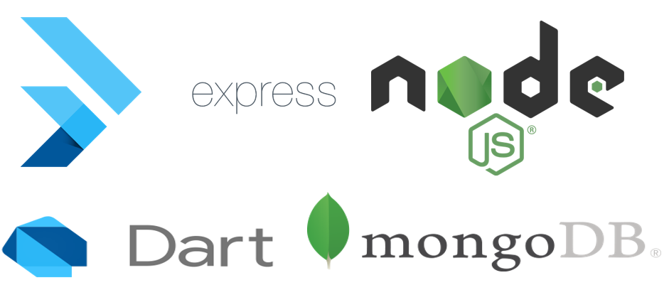
Technologies

Slide 6
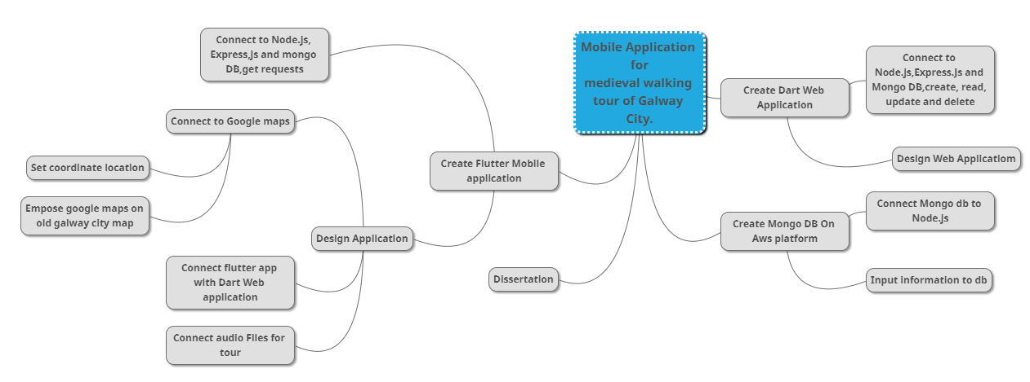
Work Breakdown

Slide 7
Time Estimates
Create Flutter Mobile application
Connect to Node.js, Express,js and mongo DB,get requests
Design Mobile Application
Create Dart Web application
Connect to Node.js, Express.Js and Mongo DB, create, read, update and delete
Design Web Application
Create Mongo DB On Aws platform
Input information to db
Dissertation
1 Week
2 Week
4 weeks
1 week
2 weeks
2 weeks
2 weeks
1 week
8 Weeks

Slide 8
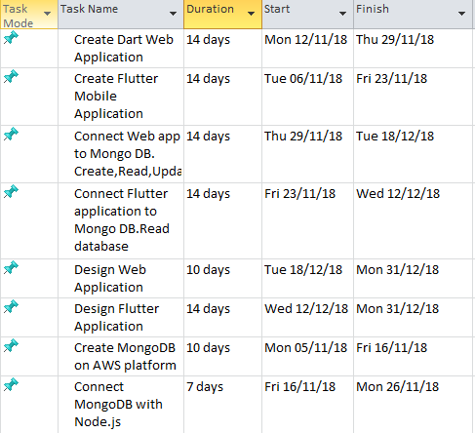
Time Estimates

Slide 9
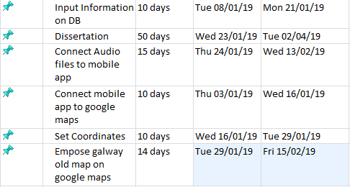
Time Estimates

Slide 10
Mile Stones
M1 = Create basic flutter mobile application.
M2 = Create simple web application in Dart.
M3 = Connect applications to database.(Create,Read,Update,Delete)
M4 = Connect mobile application to google maps.
M5 = Write Dissertation.

Slide 11
Communication
Developing for Galway Civic Trust.
Working back and forth with organization to complete the app.
Information will be coming from Galway civic trust and we must make app to suit the organization and pinpoint the locations they intend for the tour.
Meet the expectations of organisation as app is developed.
Galway Civic Trust
Project Team

Slide 12
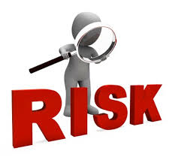
Project Risk
Technical – bugs or testing which will be done along side software implementation.
If a task is not complete - our schedule will be affected.
Dissertation time may be taken up due to software problems.
Client - Information from company is not received or changes.

Slide 13
Execution
Divide tasks involved between us.
Front end app design and backend will be done in conjunction.
Information, images and audio will be received from organisation.
Start of execution, Database and app running.
Get to each milestone we have for our app to work.

Slide 14
Performance
Review our scope and objectives.
Have we completed the app and connected the database in order to test app.
Discuss progress with company, are they happy with the idea.
Main app feature is our gps and geolocation. Have we completed this to work for tour.
Is there any changes or milestones we need to go back on and complete in order to complete project.
Software
Dissertation
App

Slide 15
End of Project
Need to revise design and plan.
Have we completed all features and included the technologies we intended to use, Flutter, MongoDB, NodeJS, Express,AWS.
Have we been in contact with Galway civic trust. Are the organisation happy is this the app they intended to have.
Is our dissertation complete all before due date.

