Slide 1
Google Trends & Covid Data Analysis Project
Sarah DalleyHood
Angeli Lucila
Dramane Nebie
Perry Reynolds
Keiko Yara
Notes:
Title Slide
Include the name of the Project and Group Members

Slide 2
Outline
Motivation
Covid disrupted a lot of industries, and people ended up with lots of free time - so we were interested in what people’s interests were during this time.
Project Theme
Exploration of Top Google Searches in the US between 2019-2020.
Key Questions
Has Covid-19 impacted Google searches in the US compared to previous years?
Did State Restrictions play a Factor?
Hypothesis
We hypothesize that states will differ in their average search interests between 2019 and 2020, and states will vary amongst themselves in their 2020 search interests.
Notes:
(Read Me) Motivation & Summary Slide
Define the core message or hypothesis of your project.
Describe the questions you asked, and why you asked them
Describe whether you were able to answer these questions to your satisfaction, and briefly summarize your findings

Slide 3
Summary
Brainstorm
Ideas
Collect Data
Organize Data
Visualize Data
Analyze
Graphs
Review
Review
Explore Data Sources
Covid-19 Cases
Review Collected Data
Trim Data
Review Cleaned Data
Choose Graphs of best fit
Use Graphs to spot trends
Google Search Trends
Defined a Common Measure
Brainstorm Visualization ideas
Brainstorm Visualization ideas
Consult TA's
Arrange Data
Define Project Hypothesis
State Restrictions
Phase
Phase Gate

Slide 4
Questions & Data
Project Questions
Will states will differ in their average search interests between 2019 and 2020? Will states vary amongst themselves in their 2020 search interests?
Expectations
1) The coronavirus had shifted people's google searches, where people would probably search more for entertainment, video online communication, and health information
2) A state with strong lockdowns would have more interest in the above categories, due to having more free time
Data Sources
Google Trends API, Covid Tracking Project Data (Atlantic Monthly Group), ESRI Disaster Response Program API for Stay at Home Orders
Assumptions
Default search engine in the US is Google
States are homogeneous within themselves
2019 represents a typical year
Notes:
Questions & Data
Elaborate on the questions you asked, describing what kinds of data you needed to answer them, and where you found it

Slide 5
Data Cleanup & Exploration
Step 1: Collecting the Data
Google API: conduct a Top Trends keyword search on 2018, 2019, 2020, connect those into larger categories for calling to Google Trends Interest Over Time search
Covid Data: importing CSVs of data for all states over time
Stay At Home Orders API: calling API for all 50 states (and DoC)
Step 2: Cleanup
Creating CSVs for each state with Covid case numbers and stay at home orders
Notes:
Data Cleanup & Exploration
Describe the exploration and cleanup process
Discuss insights you had while exploring the data that you didn't anticipate
Discuss any problems that arose after exploring the data, and how you resolved them
Present and discuss interesting figures developed during exploration, ideally with the help of Jupyter Notebook

Slide 6
Two State Comparison
California vs Wyoming
Stringent lockdown vs. No lockdown
Coastal vs. Midwestern
Large population vs. Small population

Slide 7
Data Analysis - Visualization
Nested Pie Charts
2020 and 2019 groups, 2020 groups and categories
Popularity Graphs
For each state, for each group of categories, line graph of the popularity of each category over time, along with a bar chart of positive Covid cases
Means Comparisons
The mean percentage popularity for 2020 in that category different to the mean percentage popularity for 2019?
2020-2019 Difference Graphs
Shows difference between the 2019 search percent at any point in time and the 2020 search percent at the same point in time
Notes:
Discuss the steps you took to analyze the data and answer each question you asked in your proposal
Present and discuss interesting figures developed during analysis, ideally with the help of Jupyter Notebook

Slide 8
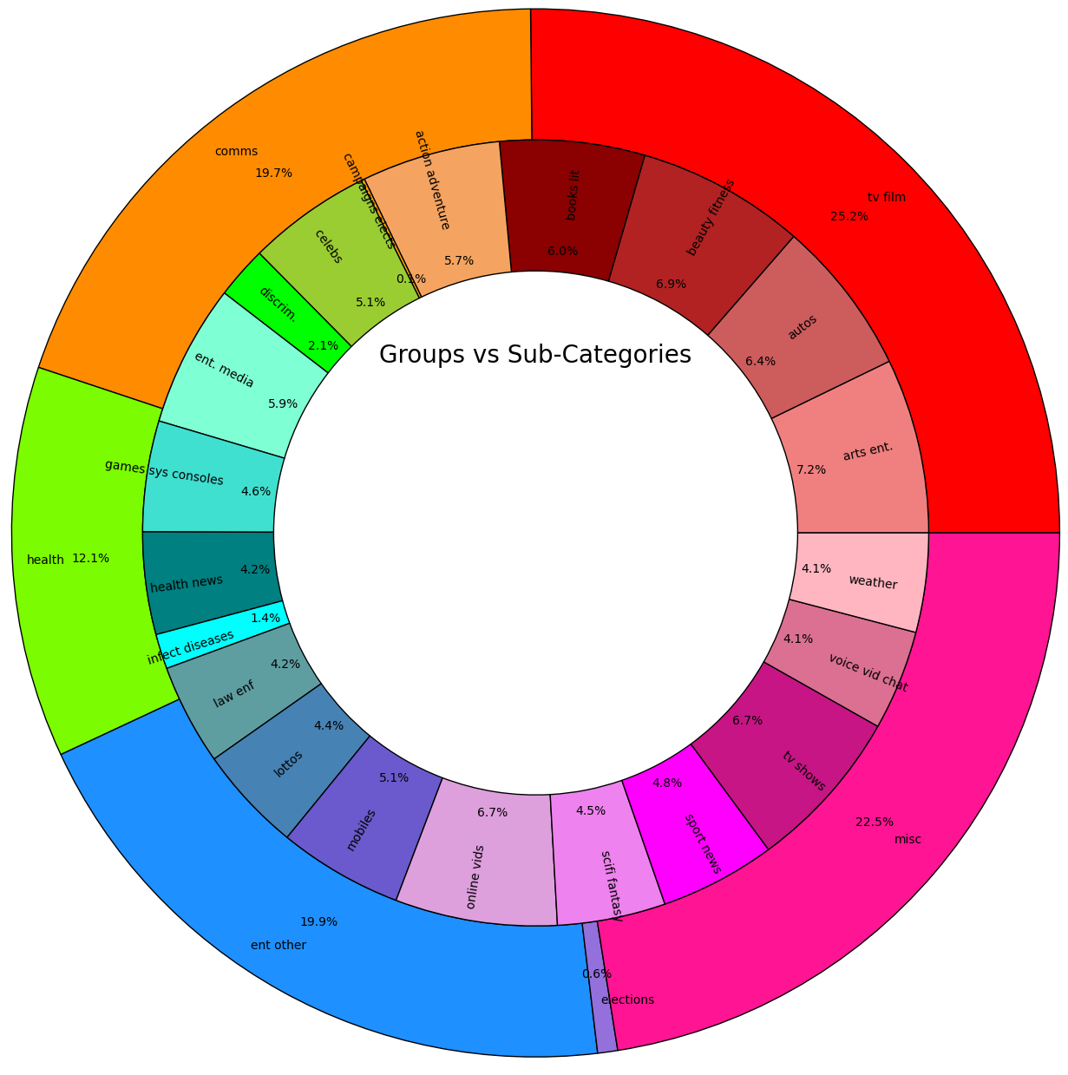
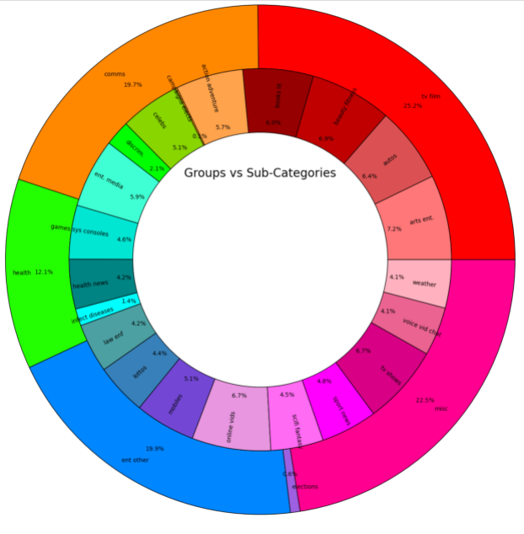
Groups 2019 vs 2020 Groups v. Categories 2020

Slide 9
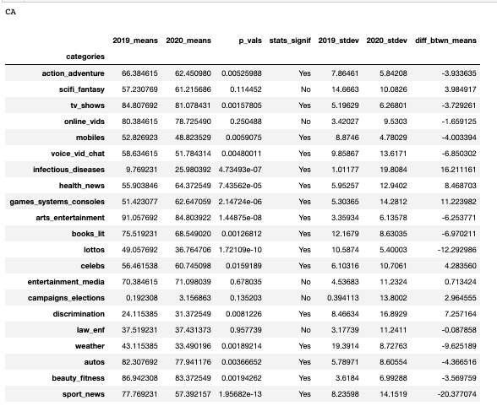
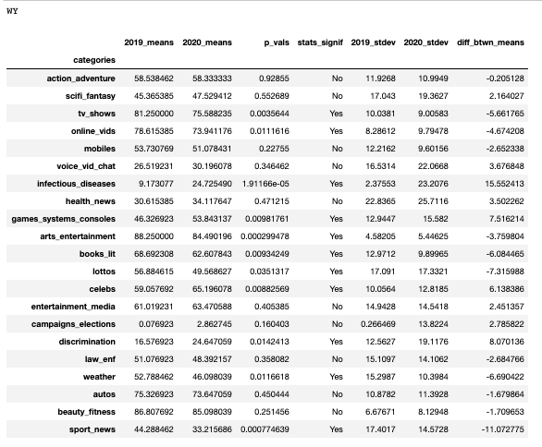
Means Comparisons: what is significant?

Slide 10
Category Samples
Entertainment Media
Book retailers
CD & Audio Shopping
DVD & Video Shopping
Entertainment Media Rentals / Video Game Retailers
Health News
All health news
Health policy
Covid topics

Slide 11
Data Analysis - Means Comparison
Entertainment Media
Average interest in entertainment media stayed the same for both states
Health News
Average interest in Health News increased for California, but not for Wyoming
Do either of these sound odd? Let’s look at the graphs
Notes:
Discussion
Discuss your findings. Did you find what you expected to find? If not, why not? What inferences or general conclusions can you draw from your analysis?

Slide 12
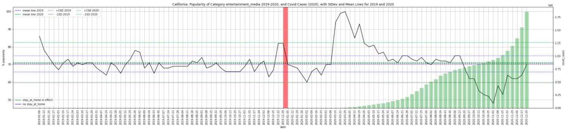
Entertainment Media, California (YOY by Month)

Slide 13
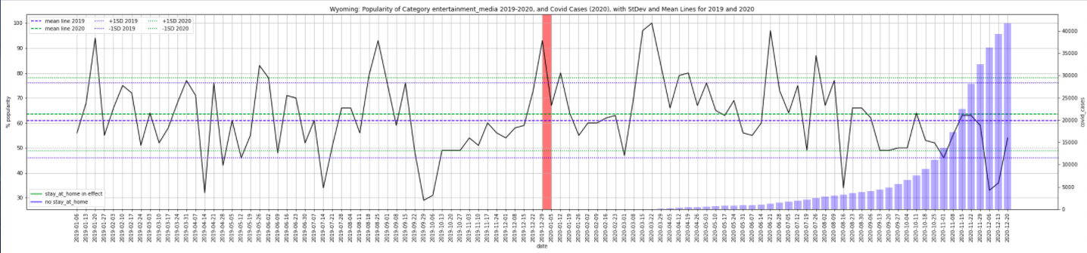
Entertainment Media, Wyoming (YOY by Month)

Slide 14
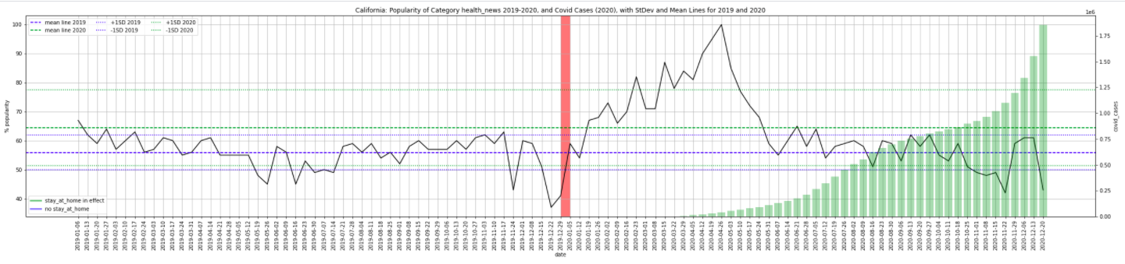
Health News, California (YOY by Month)

Slide 15
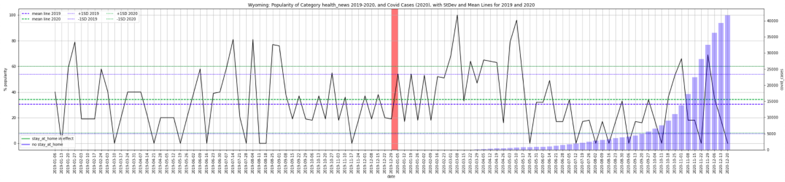
Health News, Wyoming (YOY by Month)

Slide 16
Discussion
Entertainment Media
The means test is somewhat misleading
CA: spike in early months of the lockdown - makes sense, people are looking for more kinds of entertainment to access during their free time
WY: also a peak in early in the same months, but no lockdown. Perhaps people were in a similar mindset as the rest of country.
Health News
Both states have spikes in interest when cases rise, but only CA maintains interest throughout the year.

Slide 17
Post Mortem
Conclusions
the lockdown under pandemic led people to be more interested in entertainment and health. However, a simple lockdown/no lockdown dichotomy cannot be drawn.
Problems
Google Trends scope: we wanted to try to analyse +1000 categories. Even using the sleep function, it was taking days to even create a csv for one category. Reduction to 21 categories. Additional issues with some of those categories required changing some specific categories (e.g. errors with specific television categories).
Future Research
Challenging assumption that 2019 is a typical year, comparing 2020 data with more previous years; looking into what employers did despite/in concert with lockdown orders
Notes:
Post Mortem
Discuss any difficulties that arose, and how you dealt with them
Discuss any additional questions that came up, but which you didn't have time to answer: What would you research next, if you had two more weeks?

Slide 18

Questions?
Notes:
Questions
Open-floor Q&A with the audience

