Slide 1
Improving Multimodal Learning via Imbalanced Learning
ARL (Asymmetric Representation Learning) modulates multimodal training so that each modality’s contribution is inversely proportional to its variance, reducing bias‑variance error and achieving state‑of‑the‑art performance on diverse multimodal benchmarks.
Shicai Wei1, 2 Chunbo Luo1* Yang Luo1 1University of Electronic Science and Technology of China 2 National and Local Joint Engineering Research Center for Cloud Operating System shicaiwei@std.uestc.edu.cn, {c.luo
2026

Slide 2
Key concepts
Multimodal Learning
multimodal model
action recognition

Slide 3
Abstract
Multimodal learning often encounters the under-optimized problem and may perform worse than unimodal learning. Existing approaches attribute this issue to imbalanced learning across modalities and tend to address it through gradient balancing. However, this paper argues that balanced learning is not the optimal setting for multimodal learning. With bias-variance analysis, we prove that imbalanced dependency on each modality obeying the inverse ratio of their variances contributes to optimal performance. To this end, we propose the Asymmetric Representation Learning(ARL) strategy to assist multimodal learning via imbalanced optimization. ARL introduces auxiliary regularizers for each modality encoder to calculate their prediction variance. ARL then calculates coefficients via the unimodal variance to re-weight the optimization of each modality, forcing the modality dependence ratio to be inversely proportional to the modality variance ratio. Moreover, to minimize the generalization error, ARL further introduces the prediction bias of each modality and jointly optimizes them with multimodal loss. Notably, all auxiliary regularizers share parameters with the multimodal model and rely only on the modality representation. Thus the proposed ARL strategy introduces no extra parameters and is independent of the structures and fusion methods of the multimodal model. Finally, extensive experiments on various datasets validate the effectiveness and versatility of ARL. Code is available at https://github.com/shicaiwei123/ICCV2025-ARL

Slide 4
Builds on previous research
The training and validation split of the dataset follows [27]. Here, we extract frames from event-localized video segments and capture corresponding audio clips, creating a labeled multimodal classification dataset. . Page 6
Implementation details. To ensure a fair comparison, we utilize ResNet18 as the encoder backbone for all datasets, as is common in previous methods [21, 10]. Page 6
The entire audio data is transformed into a spectrogram of size 257×1,004. The training configurations mirror those of previous methods [21, 10], including a mini-batch size of 64, an SGD optimizer with momentum 0.9, a learning rate of 1e-3, and a weight decay of 1e-4. $\gamma$ is set as 4 for all datasets. $T$ is set 8,4,4,4,4 for CREMA-D, AVE, KS, MOSI, and UCF101 datasets, respectively. Page 6

Slide 5
Differs from previous work
Existing balance-based methods [21, 18, 10, 34] try to modulate the learning of different modalities to balance their optimization. However, we found that imbalanced learning obeying the inverse of the modality variance ratio can contribute to better performance. Page 6

Slide 6
Snapshot
ARL boosts multimodal AI performance by allocating more learning weight to the most reliable modality, improving overall understanding without extra components.

Slide 7
Key findings
Enhancing the strongest modality (e.g., audio) raises the performance of the entire multimodal system, contrary to the prior belief that modalities should be balanced.
The approach yields consistent score improvements across a variety of tasks, ranging from modest to substantial gains.
ARL is effective for configurations with two, three, or more modalities and works with different model architectures.

Slide 8
Objectives
The goal was to create a technique (ARL) that improves multimodal learning by preferentially strengthening the most reliable input streams.

Slide 9
Study Subjects
The study involved computer models learning from multiple modalities such as sound, images, and text.

Slide 10
Methods
ARL modifies the learning step sizes based on each modality’s reliability, giving larger updates to steadier (less noisy) inputs while requiring no new hardware or memory overhead.

Slide 11
Results
Across multiple benchmark tests involving audio‑visual games and speech tasks, models using ARL achieved higher accuracy scores than baseline methods, with improvements varying from a few percent to large margins.

Slide 12
Conclusions
Prioritizing learning capacity for the most reliable modality leads to overall better multimodal performance, and this can be achieved without additional model components or memory.

Slide 13
Limitations
The provided text does not specify any experimental or methodological limitations.

Slide 14
Future Work
No explicit future research directions are mentioned in the excerpt.

Slide 15
Practical Applications
ARL can be applied to any multimodal AI system—such as games that combine sound, video, and speech—to improve performance without extra hardware, making it suitable for real‑world deployments where computational resources are limited.

Slide 16
Study subjects
6698 samples They are further divided into 6698 samples as the training set and 744 samples as the testing set

Slide 17
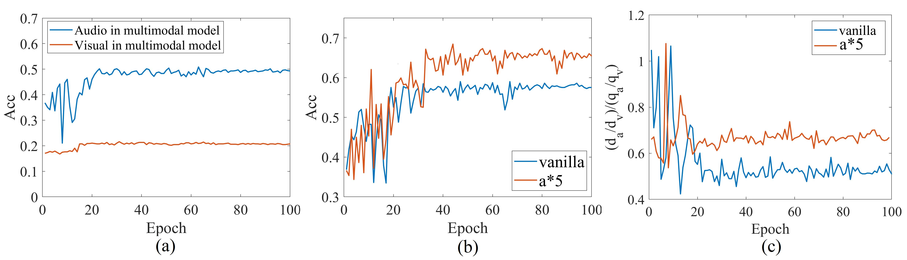
Figure 1
The visualization on the audio-visual dataset CREMA-D. (a) presents the performance of the unimodal branch in the vanilla multimodal model. (b) presents the performance of the multimodal model with audio branch modulation. ‘ $a*5$ ’ represents increasing the gradient for the audio branch by fivefolds to accelerate its optimization. (c) presents the gap between the modality dependence and modality variance. $\frac{d_{a}}{d_{v}}$ denotes the model optimization dependence ratio on the audio and visual modalities (see Equation 4 ). $\frac{q_{a}}{q_{v}}$ denotes the inverse of the variance ratio of audio and visual modalities (see Equation 17 )

Slide 18
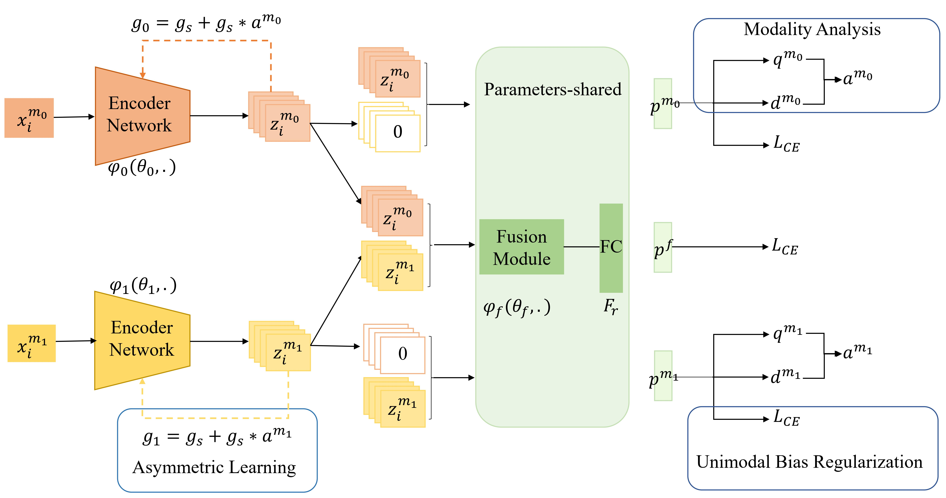
Figure 2
The pipeline of the multimodal model with ARL strategy. It consists of three components: the modality analysis to measure the modality variance; the asymmetric learning to align the optimization dependency on each modality with the inverse of their variance ratio; and the unimodal bias regularization to reduce multimodal bias. $g_{s}$ is the gradient passed back from the fusion module

Slide 19
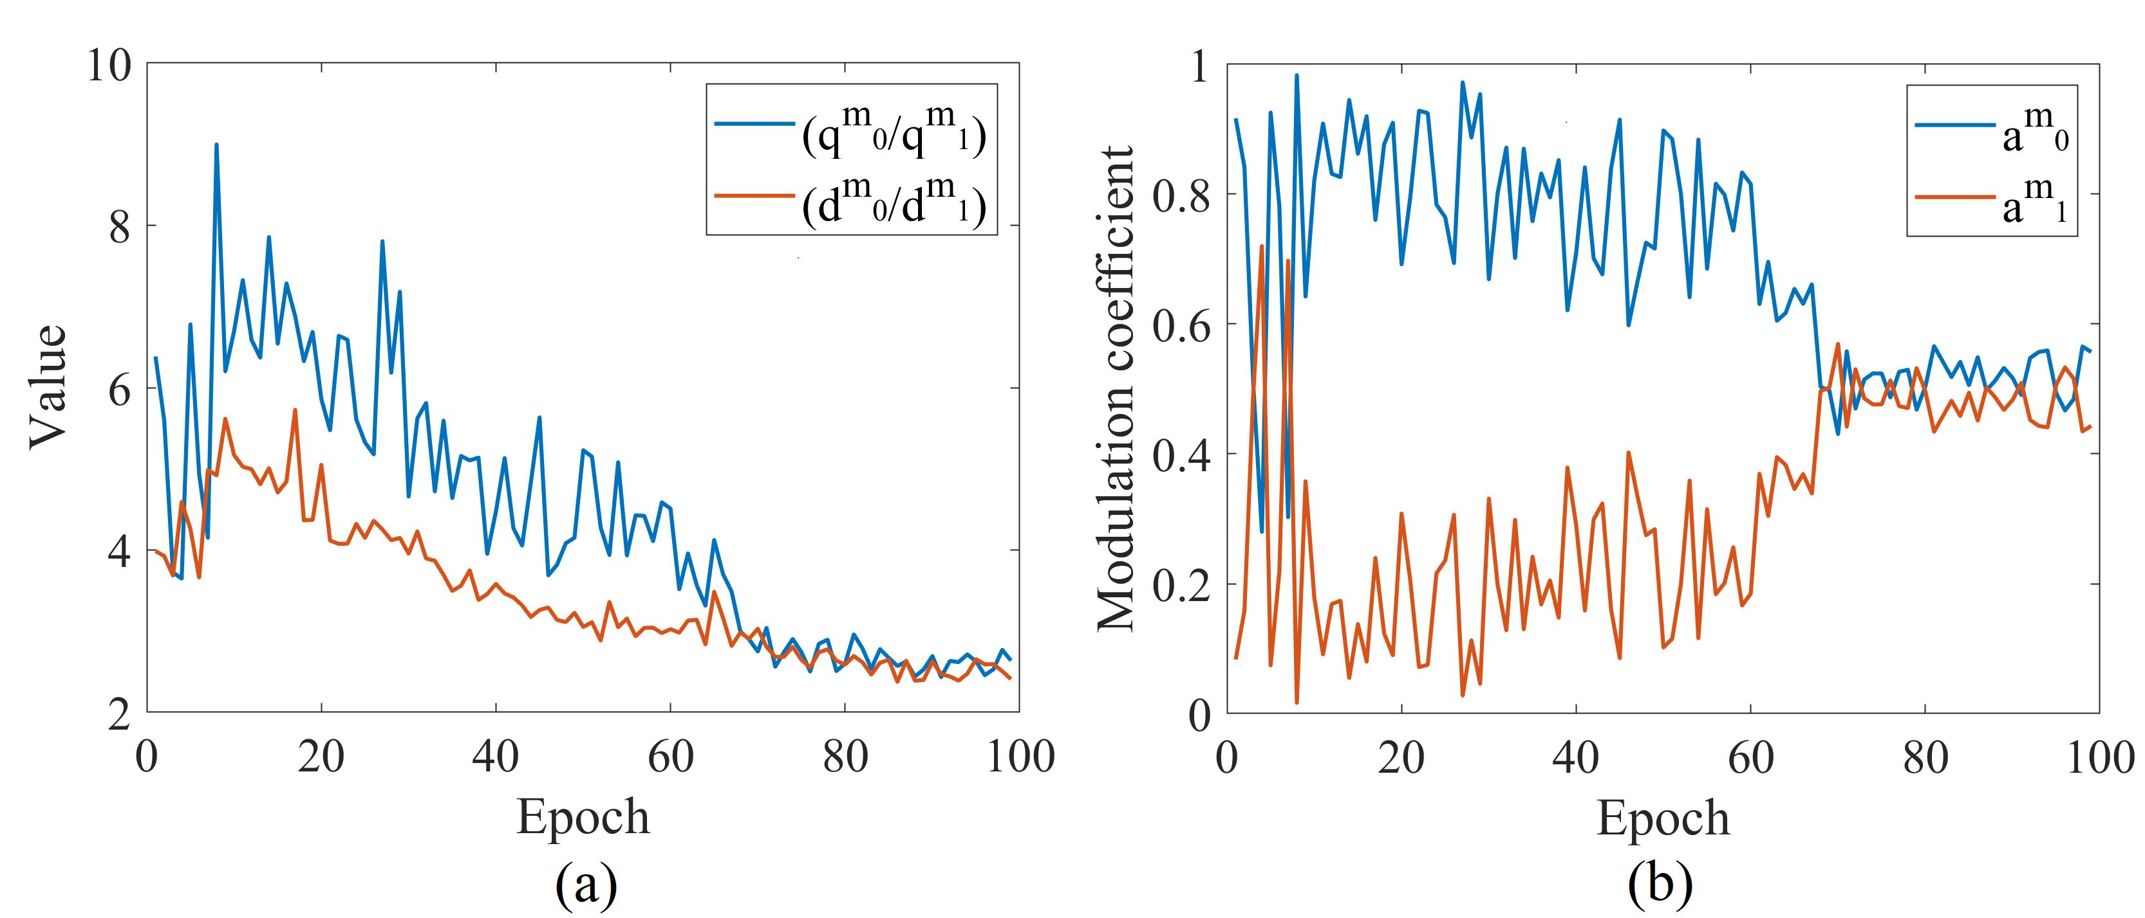
Figure 3
Algorithm 1 Multimodal learning with ARL strategy

