Slide 1
[2107.00135] Attention Bottlenecks for Multimodal Fusion
A novel transformer architecture (MBT) that uses a small set of cross‑modal bottleneck tokens to fuse audio and visual information, achieving state‑of‑the‑art performance on multiple video classification benchmarks while reducing computational cost.
Arsha Nagrani Shan Yang Anurag Arnab Aren Jansen Cordelia Schmid Chen Sun {anagrani, shanyang, aarnab
2026

Slide 2
Key concepts
Vision Transformer
audio visual
multimodal fusion
mean average precision
action recognition

Slide 3
Abstract
Humans perceive the world by concurrently processing and fusing high-dimensional inputs from multiple modalities such as vision and audio. Machine perception models, in stark contrast, are typically modality-specific and optimised for unimodal benchmarks, and hence late-stage fusion of final representations or predictions from each modality (‘late-fusion’) is still a dominant paradigm for multimodal video classification. Instead, we introduce a novel transformer based architecture that uses ‘fusion bottlenecks’ for modality fusion at multiple layers. Compared to traditional pairwise self-attention, our model forces information between different modalities to pass through a small number of bottleneck latents, requiring the model to collate and condense relevant information in each modality and share what is necessary. We find that such a strategy improves fusion performance, at the same time reducing computational cost. We conduct thorough ablation studies, and achieve state-of-the-art results on multiple audio-visual classification benchmarks including Audioset, Epic-Kitchens and VGGSound. All code and models will be released.

Slide 4
Counterpoint to earlier claims
We note that first, the model focuses on semantically salient regions in the video for audio classification, particularly regions where there is motion that creates or modifies sound, i.e. the mouth of humans making sounds, fingertips on a piano, hands and instruments. This is unlike state of the art sound source localisation techniques trained with images [11], which tend to highlight the entire object.
Page 10

Slide 5
Builds on previous research
For many works, the inputs to transformers are the output representations of single modality CNNs [39, 23] – unlike these works we use transformer blocks throughout, using only a single convolutional layer to rasterise 2D patches. The tokens from different modalities are usually combined directly as inputs to the transformers [42], for example, the recently released Perceiver model [32] introduces an iterative attention mechanism which takes concatenated raw multimodal signals as inputs, which corresponds to our ‘early fusion’ baseline. Page 3
The dataset consists of 90,000 variable length clips spanning 100 hours. We report results for action recognition following standard protocol [14] - each action label is a combination of a verb and noun, and we predict both using a single network with two ‘heads’, both trained with a cross-entropy loss. Page 6
In this section we report results on 2 additional datasets, Moments in Time [47] and Kinetics [35]. In this section we report results on 2 additional datasets, Moments in Time [47] and Kinetics [35]. Page 16

Slide 6
Differs from previous work
Audiovisual learning: Audiovisual multimodal learning has a rich history, both before and during the deep learning era [53]. In contrast, we carefully examine the impact of different modality fusion strategies, including limiting cross-modal attention flow to later layers of our model, and ‘channeling’ cross-modal connections through bottlenecks in our proposed Multimodal Bottleneck Transformer (MBT). . Page 3
Multimodal transformers have been applied to various tasks including audio enhancement [19, 60], speech recognition [27], image segmentation [66, 60], cross-modal sequence generation [43, 41, 56], image and video retrieval [28, 23, 8], visual navigation [51] and image/video captioning/classification [46, 59, 58, 40, 31]. For many works, the inputs to transformers are the output representations of single modality CNNs [39, 23] – unlike these works we use transformer blocks throughout, using only a single convolutional layer to rasterise 2D patches. Page 3

Slide 7
Snapshot
A novel transformer architecture (MBT) that uses a small set of cross‑modal bottleneck tokens to fuse audio and visual information, achieving state‑of‑the‑art performance on multiple video classification benchmarks while reducing computational cost.

Slide 8
Key findings
1. Restricting cross‑modal attention to a limited set of bottleneck latents forces each modality to summarise salient information, leading to better fusion quality.
2. The bottleneck approach mitigates the quadratic scaling of full pairwise attention, making the model more scalable to longer video sequences.
3. Mid‑layer fusion (introducing cross‑modal attention after unimodal feature extraction) is more effective than pure early or pure late fusion baselines.
Mid‑fusion (L. f ≈ 8–10) outperforms both early (L. f = 0) and late (L. f = 12) fusion, with optimal performance at L. f = 10 for vanilla cross‑attention and L. f = 8 for bottleneck fusion. Bottleneck fusion consistently matches or exceeds vanilla cross‑attention while incurring negligible extra GFLOPs, especially for early fusion where it gains &gt;2 mAP with &lt;½ the computation. Varying the number of bottleneck tokens (B = 4–1024) has minimal impact on accuracy (≤0.5 mAP), justifying the use of B = 4.
We propose a new transformer architecture (MBT) for audiovisual fusion, and explore a number of different fusion strategies using cross-attention between latent tokens

Slide 9
Objectives
The goal is to design a generic multimodal transformer architecture that efficiently fuses heterogeneous modalities, investigates where (early, mid, late) and how (vanilla cross‑attention vs. bottleneck) to fuse them, and evaluates the impact of these design choices on video classification accuracy and computational complexity.

Slide 10
Methods
The MBT builds on Vision Transformer (ViT) and Audio Spectrogram Transformer (AST) tokenisation, converting image patches and spectrogram patches into 1‑D tokens with learned positional embeddings.
Three fusion strategies are explored: (1) early fusion (cross‑modal attention at every layer), (2) mid fusion (cross‑modal attention introduced only at a designated “fusion layer”), and (3) bottlenecked fusion, where a small set of latent “fusion units” act as attention bottlenecks forcing each modality to condense information before sharing.
Cross‑modal interactions are implemented via Multi‑Headed Cross‑Attention (MCA) between modality tokens and the bottleneck latents, while intra‑modal tokens attend freely within their own stream.
The core component is a Cross‑Transformer layer that performs generalized cross‑attention between modality‑specific token sets, with separate parameters θ_rgb and θ_spec. To curb quadratic attention cost, a small set of B fusion‑bottleneck tokens (B ≪ N. v, N. a) is inserted; all cross‑modal attention must pass through these tokens. Three fusion strategies are explored: (i) unrestricted self‑attention, (ii) vanilla cross‑attention with separate modality weights, and (iii) bottleneck fusion. Fusion can occur at any layer L. f, enabling early, mid, or late fusion. The backbone is ViT‑Base (L = 12, N_H = 12, d = 3072) initialized from ImageNet‑21K; B is set to 4 for all experiments. Training uses binary cross‑entropy for multi‑label AudioSet and cross‑entropy for single‑label datasets, with a base learning rate 0.5, 50 epochs, Mixup (α = 0.3), stochastic depth (p = 0.3), batch size 64, and cosine LR schedule on TPUs. Input tokens are generated from 16×16 RGB patches (8 frames for AudioSet/VGGSound, 32 frames for Epic‑Kitchens) and 16×16 spectrogram patches (400 patches for 8 s audio).
MBT employs cross‑attention between modality‑specific tokens and a set of B = 4 bottleneck tokens at each fusion layer; sampling windows of length t seconds (2, 4, 6, 8) are tested, with synchronized versus asynchronous modality sampling; a “modality MixUp” regulariser samples independent mix‑up weights per modality; ablations include symmetric/asymmetric bottleneck updates, shared vs separate ViT encoders, and three ViT backbones (Small, Base, Large).
The authors train MBT models on large video corpora, using a ViT‑B backbone for audiovisual fusion. They compare MBT to visual‑only and late‑fusion baselines (Table 8), and conduct ablations with checkpoints pre‑trained on VGGSound, Kinetics‑400, and AudioSet‑500K before fine‑tuning on Audioset‑mini and VGGSound (Table 10).

Slide 11
Results
MBT attains new state‑of‑the‑art performance on all three benchmarks, most notably improving AudioSet mean average precision (mAP) by 5.9 points (a 12.7 % relative gain).
Ablation studies show that bottlenecked fusion matches or exceeds unrestricted full‑attention models while using fewer FLOPs, confirming the computational advantage of the bottleneck design.
On the mini‑AudioSet evaluation split, the best MBT configuration (bottleneck fusion, L. f = 8, B = 4) achieves higher mean average precision than comparable vanilla cross‑attention models while keeping GFLOPs essentially constant across fusion layers. Across all three datasets, MBT matches or surpasses state‑of‑the‑art multimodal video classifiers, with comparable or lower computational overhead.
Fusion with bottlenecks (t = 8 s, B = 4, Fₗ = 8) consistently beats visual‑only and audio‑only baselines across all datasets.
Modality MixUp raises AudioSet mAP from 42.6 to 43.9.
Performance improves monotonically with training set size, especially for audio‑only models.
MBT surpasses prior fusion methods (e.g., Perceiver, Attn Audio‑Visual) despite training on only 500 K samples.
Per‑class analysis shows fusion improves 57/60 top AudioSet classes; gains exceed 60 % absolute AP for classes like “bicycle”.
Attention Rollout visualisations reveal the model focuses on semantically relevant, sound‑producing regions (e.g., mouths, hands).
On the full Kinetics test set, MBT improves top‑1 accuracy by ~1% over the visual baseline.
On the Kinetics‑Sound subset, the improvement exceeds 4%.
On Epic‑Kitchens, MBT gains almost 6% top‑1 action accuracy versus late‑fusion.
Pre‑training on VGGSound yields a 3% mAP boost on Audioset‑mini, while Kinetics‑400 adds only 0.7%.
On VGGSound, AS‑500K pre‑training gives a 1.2% top‑1 accuracy increase, whereas Kinetics‑400 offers no benefit.

Slide 12
Conclusions
A transformer‑based multimodal architecture that channels cross‑modal communication through compact bottlenecks can simultaneously boost classification accuracy and reduce computational demands, establishing a new benchmark for audio‑visual video understanding.
A bottleneck‑based cross‑attention mechanism enables efficient multimodal fusion in transformers, allowing later‑stage cross‑modal interactions that preserve unimodal feature learning while reducing quadratic attention costs. Mid‑layer fusion with a few bottleneck tokens provides the best trade‑off between accuracy and computation for video classification.
Restricting cross‑modal attention to a few bottleneck tokens yields superior audiovisual fusion with lower compute, establishing a new state‑of‑the‑art across diverse video benchmarks and demonstrating that multimodal information is complementary even when one modality is weak.

Slide 13
Study subjects
3 video classification datasets We then ablate the key design choices in our model (Sec. 4.3), before finally comparing our model to the state of the art (Sec. 4.4).4.1 Datasets and evaluation protocolWe experiment with three video classification datasets – AudioSet [24], Epic-Kitchens-100 [14] and VGGSound [12], described in more detail below

Slide 14
Study analysis
For images we apply the standard data augmentations used in [6] (random crop, flip, colour jitter), and for spectrograms we use SpecAugment [50] with a max time mask length of 192 frames and max frequency mask length of 48 bins following AST [26]. We set the base learning rate to $0.5$ and train for $50$ epochs, using Mixup [67] with $\alpha=0.3$ and stochastic depth regularisation [30] with probability $p=0.3$. All models (across datasets) are trained with a batch size of $64$, synchronous SGD with momentum of $0.9$, and a cosine learning rate schedule with warmup of $2.5$ epochs on TPU accelerators using the Scenic library [15]

Slide 15
Study limitations
The study focuses exclusively on audio‑visual data; extending the bottleneck design to additional modalities (e.g., text, depth) remains untested.
Full scalability to very long videos is still constrained by the need to sample a fixed number of frames and spectrogram patches, which may omit fine‑grained temporal dynamics.
The study evaluates MBT on three video datasets (AudioSet, Epic‑Kitchens‑100, VGGSound) and reports additional results only in the appendix; broader generalization to other modalities or larger‑scale settings is not demonstrated. The impact of extremely large bottleneck token counts (&gt;1024) and of alternative backbone architectures is not explored.
The optimal fusion layer depth is a hyper‑parameter that may need dataset‑specific tuning; the current work only explores fully supervised training, and the transformer backbone remains computationally intensive, raising environmental and bias‑related concerns.

Slide 16
Future work
The authors plan to release code and models, and suggest exploring the bottleneck paradigm for other multimodal combinations and for unsupervised pre‑training tasks such as cross‑modal synchronization.
Investigating adaptive bottleneck sizes and dynamic fusion‑layer selection could further improve efficiency and adaptability to diverse datasets.
While not explicitly detailed in the text, the authors note that the formulation is generic to any number of modalities, suggesting future extensions could involve additional sensory streams, larger bottleneck capacities, or alternative transformer backbones to further test scalability and generality.
Planned extensions include applying MBT to additional modalities such as text and optical flow, and investigating self‑supervised learning frameworks to reduce reliance on large labelled datasets.

Slide 17
Practical applications
The MBT can be deployed for real‑time multimodal video analysis tasks such as action recognition, event detection, and content moderation where both sound and sight provide complementary cues.
Its reduced computational footprint makes it suitable for edge devices or large‑scale video indexing services that must process massive video libraries efficiently.
MBT can be deployed for efficient multimodal video understanding tasks such as action recognition, sound‑event detection, and any scenario requiring joint processing of visual and audio streams, benefiting real‑time systems where computational resources are limited.
The bottleneck‑based multimodal transformer can be deployed for robust video classification, sound‑source localisation, and any real‑world system that benefits from combining audio and visual cues, while its reduced computational footprint makes it more feasible for large‑scale or edge deployments.

Slide 18
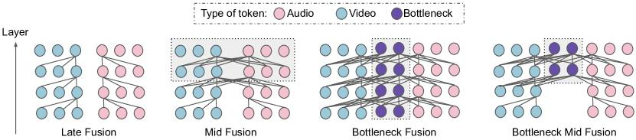
Figure 1
Cross-modal Fusion . Unlike late fusion (left), where no cross-modal information is exchanged in the model until after the classifier, we investigate two pathways for the exchange of cross-modal information. The first is via standard pairwise self attention across all hidden units in a layer, but applied only to later layers in the model – mid fusion (middle, left)

Slide 19
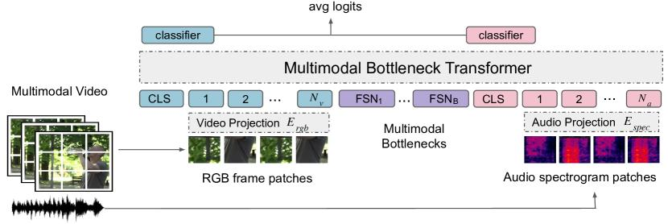
Figure 2
A Multimodal Fusion Transformer applied to audiovisual inputs. The input sequence consists of image and spectrogram patches. These are then projected into tokens and appended to special CLS (classification) and FSN (fusion bottleneck) tokens. Our transformer encoder then uses self attention to model unimodal information, and restricts cross-modal information flow via cross attention with the bottleneck tokens at multiple layers of the network

Slide 20
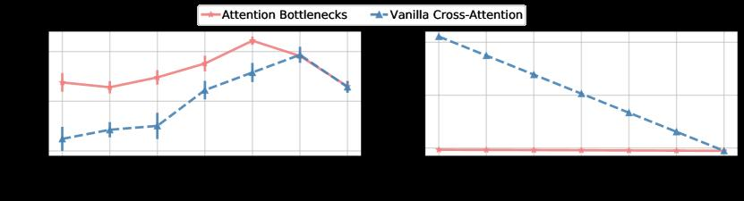
Figure 3
The impact of using attention bottlenecks for fusion on performance (left) and compute (right) at different fusion layers $L_{f}$ on AudioSet, using clip span $t=4$ and $B=4$ bottleneck tokens. Attention bottlenecks improve performance at lower computational cost

Slide 21
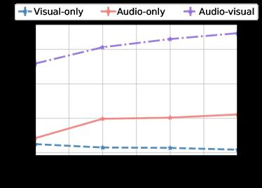
Figure 4
The effect of varying input clip span $t$ on the AudioSet test set

Slide 22
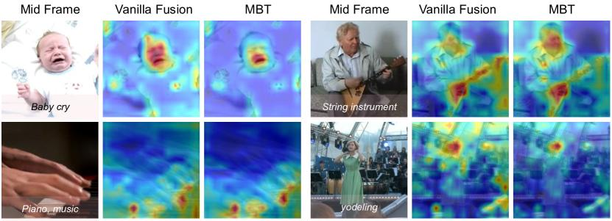
Figure 5
The effect of training data size on the AudioSet test set

Slide 23
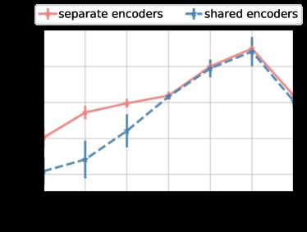
Figure 6
Attention Maps. We compute maps of the attention from the output CLS tokens to the RGB image input space for a vanilla self-attention model and MBT on the Audioset test set. For each video clip, we show the original middle frame on the left with the ground truth labels overlayed at the bottom. The attention is particularly focused on sound source regions in the video that contain motion, eg. the fingertips on the piano, the hands on the string instrument, faces of humans. The bottlenecks in MBT further force the attention to be localised to smaller regions of the images (i.e the mouth of the baby on the top left and the mouth of the woman singing on the bottom right)

Slide 24
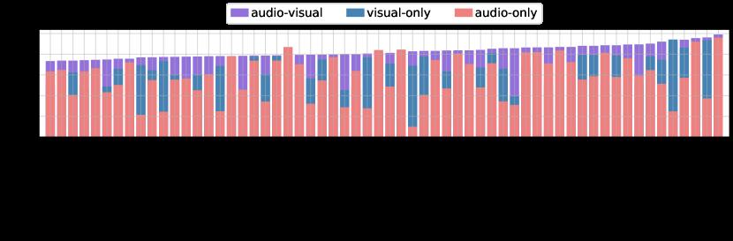
Figure 7
The effect of sharing weights for vanilla fusion

Slide 25
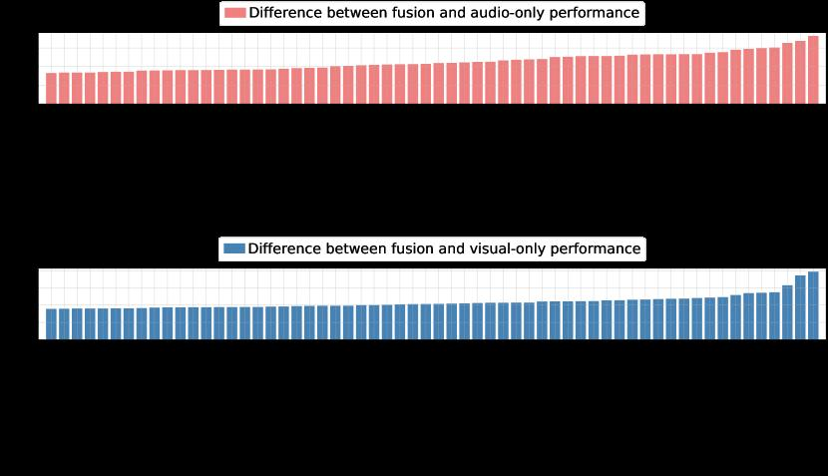
Figure 8
Asynchronous vs synchronous sampling of RGB and spectrogram inputs

Slide 26

Figure 9
Per-class average precision for the top 60 classes in Audioset ranked by mAP. Best viewed in colour and zoomed in. Note how audio-visual fusion helps improve performance over audio only for almost all classes. The visual only model performs well for classes that have a stronger visual signature than audio, eg ‘bicycle’, ‘mechanical fan’, ‘boat’ and ‘arrow’

