Slide 1
[2103.05677] SMIL: Multimodal Learning with Severely Missing Modality
A meta‑learning framework (SMSM) that combines K‑means‑guided missing modality reconstruction, uncertainty‑guided feature regularization, and Bayesian inference achieves superior classification performance under severely missing modalities compared to generative baselines.
Mengmeng Ma1, Jian Ren2, Long Zhao3
2026

Slide 2
Key concepts
meta learning
multimodal learning
Variational Autoencoder
Generative Adversarial Network
MOSI

Slide 3
Abstract
A common assumption in multimodal learning is the completeness of training data, i.e., full modalities are available in all training examples. Although there exists research endeavor in developing novel methods to tackle the incompleteness of testing data, e.g., modalities are partially missing in testing examples, few of them can handle incomplete training modalities. The problem becomes even more challenging if considering the case of severely missing, e.g., 90% training examples may have incomplete modalities. For the first time in the literature, this paper formally studies multimodal learning with missing modality in terms of flexibility (missing modalities in training, testing, or both) and efficiency (most training data have incomplete modality). Technically, we propose a new method named SMIL that leverages Bayesian meta-learning in uniformly achieving both objectives. To validate our idea, we conduct a series of experiments on three popular benchmarks: MM-IMDb, CMU-MOSI, and avMNIST. The results prove the state-of-the-art performance of SMIL over existing methods and generative baselines including autoencoders and generative adversarial networks. Our code is available at https://github.com/mengmenm/SMIL.

Slide 4
Builds on previous research
One important direction in this area is multimodal fusion, which focuses on effective fusion of multimodal data. Early fusion is a common method which fuses different modalities by feature concatenation, and it has been widely adopted in previous studies (Wang et al 2017; Poria et al 2016). Page 2
However, under severely missing modality, it is non-trivial to train a reconstruction network from limited modality-complete samples. Inspired by (Kuo et al 2019), we approximate the missing modality using a weighted sum of modality priors learned from the modality-complete dataset. Page 3
The dataset includes $25,956$ movies and $23$ classes. We follow the training and validation splits provided in the previous work (Vielzeuf et al 2018). Page 4
We train the models for $10,000$ iteration with a learning rate of $10^{-4}$ for inner-loop and $10^{-3}$ fro outer-loop. Besides, we follow previous work (Vielzeuf et al 2018) to add a weight of $2.0$ on the positive label to balance the precision and recall since the labels are unbalanced. Page 6

Slide 5
Differs from previous work
Lee et al(Lee et al 2020b) proposed a more general algorithm for latent feature regularization. Other than perturbing features, we propose to learn the regularization function following (Lee et al 2020b) but regularize the feature to reduce discrepancy between the reconstructed and true modality. Page 2

Slide 6
Snapshot
A meta‑learning framework (SMSM) that combines K‑means‑guided missing modality reconstruction, uncertainty‑guided feature regularization, and Bayesian inference achieves superior classification performance under severely missing modalities compared to generative baselines.

Slide 7
Key findings
We highlight that our method is better than typical generative designs, such as Autoencoder (AE)(Tran et al 2017), Variational Autoencoder (VAE)(Kingma and Welling 2013), or Generative Adversarial Network (GAN)(Goodfellow et al 2014), since they often require a significant amount of full-modality data to learn from, which is usually not available in severely missing modality learning
To the best of our knowledge, we are the first work to systematically study the problem of multimodal learning with severely missing modality
We are interested in multimodal learning with severely missing modality, e.g., 90% of the training samples contain incomplete modalities
Our approach significantly outperforms all baselines among all ratios of modality missing, which showcases the efficiency of our approach in the missing modality problem
We analyze the results of the proposed algorithm for multimodal learning with severely missing modality on three datasets from two perspectives: efficiency under severely missing modality (Section 4.2) and flexibility to various modality missing pattern (Section 4.3)

Slide 8
Objectives
The work aims to (1) develop a learning strategy that can reconstruct missing modalities without bias, (2) regularize multimodal features to reduce cross‑modal discrepancy, and (3) employ a Bayesian meta‑learning framework to infer posterior distributions for robust performance under various missing patterns.

Slide 9
Methods
The approach integrates three components within a modified Model‑Agnostic Meta‑Learning (MAML) loop: (i) a main prediction network $f_{\theta}$; (ii) a feature‑reconstruction network $f_{\phi_{c}}$ that generates approximations of missing‑modality features from available modalities; and (iii) a feature‑regularization network $f_{\phi_{r}}$ that uses Bayesian neural‑network‑based uncertainty to perturb latent features and reduce bias. Reconstruction is trained by predicting weighted combinations of modality priors learned from the limited complete data, while regularization leverages uncertainty estimates to guide learning.
Model modality weights $\bm{\omega}$ as $\mathcal{N}(\mathbf{I},\bm{\sigma})$, where $\bm{\sigma}=f_{\phi_c}(\mathbf{x}^1)$ is predicted by a feature‑reconstruction network.
Reconstruct missing modality $\hat{\mathbf{x}}^{2}$ via the weighted sum $\langle\bm{\omega},\mathcal{M}\rangle$.
Introduce a feature‑regularization network that outputs a Gaussian $\mathcal{N}(\bm{\mu},\bm{\sigma})$; the sampled regularization $\mathbf{r}$ modulates latent features through a Softplus‑scaled operation.
Employ a bilevel meta‑learning scheme: inner loop updates main network parameters $\theta$ using loss on partially‑observed data $D^{m}$; outer loop updates all parameters $\{\theta,\phi_c,\phi_r\}$ based on loss on full data $D^{f}$. = \theta - \alpha \nabla_{\theta}\mathcal{L}(D^{m};\psi)$.”}
Optimize a variational lower bound: $\mathcal{L}_{\theta,\psi}= \mathbb{E}_{q(z|X)}[\log p(Y|X,z;\theta)] - \mathrm{KL}[q(z|X;\psi)\|p(z|X)]$, approximated via Monte‑Carlo sampling.
Training details: Adam optimizer, batch sizes (32 for CMU-MOSI, 128 for MM-IMDb), learning rates $10^{-4}$ (inner) and $10^{-4}$–$10^{-3}$ (outer), 5k–10k iterations.
Two modality‑specific feature extractors (standard LeNet‑5 for images and a modified version for audio) extract features that are concatenated and fed into fully‑connected layers for classification; training uses Adam (batch size 64, 15 000 iterations, learning rate 10⁻³) for both inner and outer loops of meta‑learning. Missing modalities are reconstructed via a network that generates feature weights guided by K‑means clustering; uncertainty‑guided feature regularization reduces representation discrepancy; a Bayesian approach with variational inference models the posterior over reconstruction and regularization parameters.

Slide 10
Results
Across all three benchmarks, SMIL consistently outperforms prior multimodal methods and strong generative baselines such as autoencoders, VAEs, and GANs, demonstrating superior accuracy even when 90 % of training samples are missing a modality.
Across all missing‑data ratios, the proposed method outperforms all baselines (Lower‑Bound, AE, GAN, MVAE) on both CMU-MOSI and MM‑IMDb.
When only 20 % of text data is available (η=20 %), accuracy gains over AE and GAN are ~5.0 %; when η=10 %, gains increase to 7.6 % and 7.4 % respectively.

Slide 11
Conclusions
The study establishes that multimodal learning can be both flexible and efficient under severe modality loss by using Bayesian meta‑learning and feature‑level reconstruction, marking the first systematic treatment of this problem and setting a new performance baseline.
The proposed SMIL framework effectively handles severely missing modalities by leveraging meta‑learned reconstruction, regularization, and Bayesian inference, achieving consistent improvements over generative baselines across multiple datasets and missing patterns.

Slide 12
Missing Pattern 1 (test Image Only)
With 20 % audio during training, SMIL outperforms the best generative baseline by 6.7 % and the lower bound by 3.3 %; with only 5 % audio, it is 1.10 % higher than the lower bound.

Slide 13
Missing Pattern 2 (test Image + Audio)
SMIL exceeds the lower bound by 4.3 % and generative methods by 2.1 %; its performance drop when moving from two modalities to one is only 1.0 % versus 5.6 % for AE/GAN.

Slide 14
Ablation On MM‑IMDb
Removing K‑means (SMIL w/o K‑means) degrades performance, confirming its necessity; omitting feature regularization (SMIL w/o Regularization) also reduces accuracy, highlighting the benefit of regularization; deterministic or fixed‑Gaussian variants of the Bayesian component underperform the full Bayesian approach, demonstrating the advantage of Bayesian inference.

Slide 15
Study subjects
3 datasets In this section, we analyze the results of the proposed algorithm for multimodal learning with severely missing modality on three datasets from two perspectives: efficiency under severely missing modality (Section 4.2) and flexibility to various modality missing pattern (Section 4.3).Experiment SettingDatasets

Slide 16
Study analysis
K-means We achieve this by learning a set of modality priors $\mathcal{M}$ which can be clustered among all modality-complete samples using K-means (MacQueen 1967) or PCA (Pearson 1901) Gaussian distribution Instead of generating a deterministic regularization $\mathbf{r}=f_{\phi_{r}}(\mathbf{h}^{l-1})$, we assume that $\mathbf{r}$ follows a multivariate Gaussian distribution $\mathcal{N}(\bm{\mu},\bm{\sigma})$, where the means and variances are calculated using $(\bm{\mu},\bm{\sigma})$ = $f_{\phi_{r}}(\mathbf{h}^{l-1})$

Slide 17
Study limitations
SMIL’s reconstruction relies on a small set of modality‑complete examples to learn priors, which may limit its effectiveness when complete data are extremely scarce or when more than two modalities are involved; the paper also does not explore scalability to large‑scale real‑world deployments.
The study evaluates only on datasets where the missing modality is audio (avMNIST) or limited to the MM‑IMDb setting, and the reconstruction component relies on K‑means clustering, which may limit scalability to higher‑dimensional or more complex modalities.

Slide 18
Future work
Planned extensions include handling a larger number of modalities, improving prior‑learning and reconstruction quality under even harsher missing‑data regimes, and applying the framework to real‑world domains such as autonomous driving and privacy‑sensitive social‑network analysis.
Future research could extend the framework to other modality combinations, explore alternative clustering or generative mechanisms for reconstruction, and assess scalability to larger, real‑world multimodal datasets with diverse missing patterns. {Inferred from the discussion of flexibility and the desire to apply the method to real‑world scenarios where “partial modalities are missing or hard to collect.”}

Slide 19
Practical applications
The ability to train robust multimodal models despite missing data enables applications in intelligent tutoring systems, robotics, healthcare diagnostics, autonomous vehicles, and privacy‑constrained social‑network analytics, where acquiring all modalities for every sample is often infeasible.
The approach is suited for real‑world multimodal systems (e.g., audio‑visual recognition, multimedia retrieval) where some sensors or data streams may be unavailable or costly to acquire, enabling robust classification without requiring full modality capture.

Slide 20
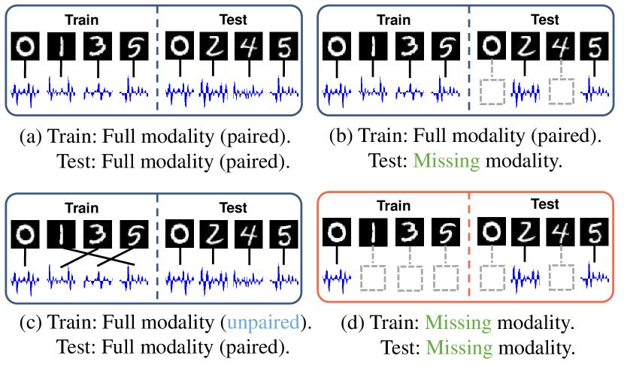
Figure 1
Multimodal learning configurations. (a) Train and test with full and paired modality (Ngiam et al. 2011 ) ; (b) Testing with missing modality (Tsai et al. 2019 ) ; (c) Training with unpaired modality (Shi et al. 2020 ) ; (d) We study the most challenging configurations of severely missing modality in training, testing, or both

Slide 21
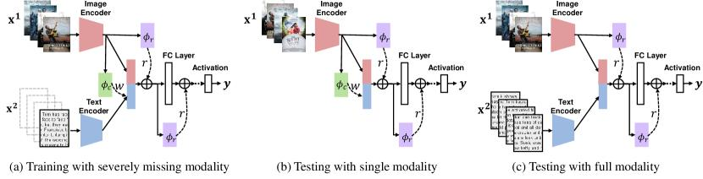
Figure 2
SMIL can uniformly learn from severely missing modality and test with either single or full modality. The reconstruction network $\phi_{c}$ outputs a posterior distribution, from which we sample weight $\omega$ to reconstruct the missing modality using modality priors. The regularization network $\phi_{r}$ also outputs a posterior distribution, from which we sample regularizer $r$ to perturb latent features for smooth embedding. The collaboration ( $\phi_{c}$ and $\phi_{r}$ ) guarantees flexible and efficient learning

Slide 22
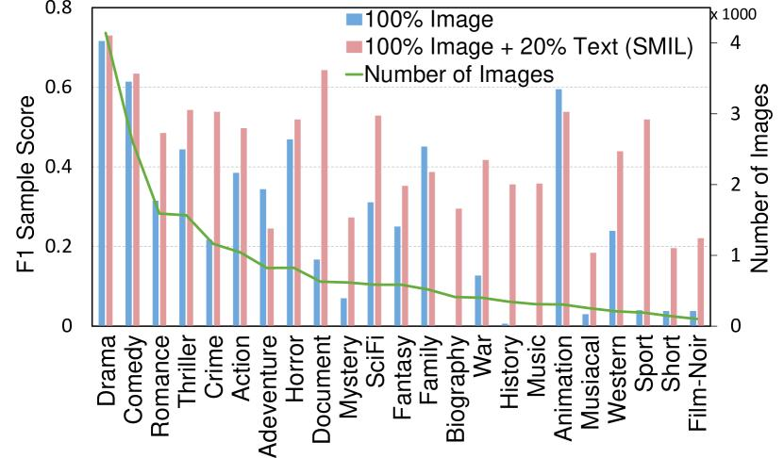
Figure 3
Algorithm 1 Bayesian Meta-Learning Framework.

Slide 23
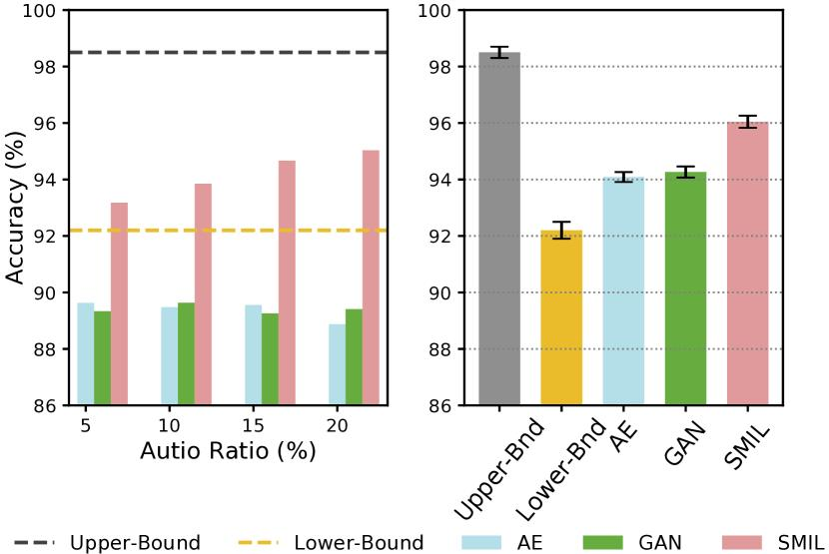
Figure 4
F1 Samples score of each movie genre on the MM-IMDb dataset for the lower-bound baseline ( blue ) and SMIL ( red ). The number of image samples for each movie genre is indicated by the green line

Slide 24
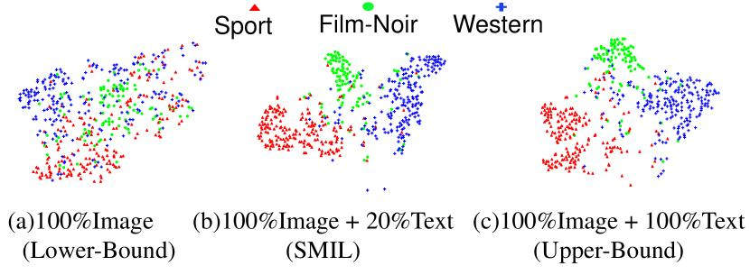
Figure 5
Classification accuracy (%) on avMNIST with two missing patterns. Left : training with 100% Image + $\eta$ % Audio and testing with Image Only. Right : training with 100% Image + $\eta$ % Audio and testing with Image + Audio

