Slide 1
COMPLETE SOFTWARE FRACTION WORKSHEET CREATOR Final Project Phase IV
Prepared by Elementary Engineers:
Olga Sheehan, Sara Hakkoum,
Eric Holm, Ethan Fiero
Framingham State University
28 April 2016

Slide 2
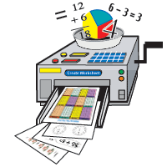
FRACTION WORKSHEET CREATOR
An off-line worksheet generation tool
Help for an elementary school teachers to create a lot of exercises for students to study and practice fractions
Designed by Elementary Engineers, students at Framingham State University
This project is being produced with help from Dr. Andrew Jung.

Slide 3
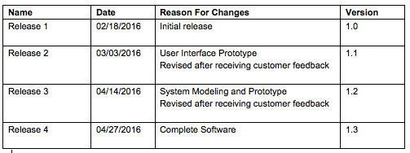
CHANGE HISTORY

Slide 4

PURPOSE OF PROJECT
FWC is a new stand-alone product
Allows teachers and students to create random exercise worksheets to practice operations with fractions.
The fractions worksheets are randomly created and never repeated
The generated worksheets can contain fraction problems of various difficulty levels
FWC will also generate an answer sheet
Free to print, easy to use, and very flexible

Slide 5
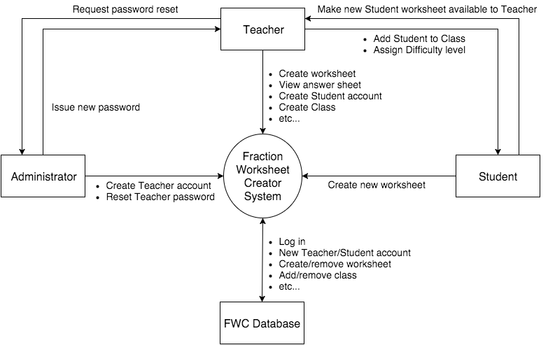
SYSTEM OVERVIEW

Slide 6


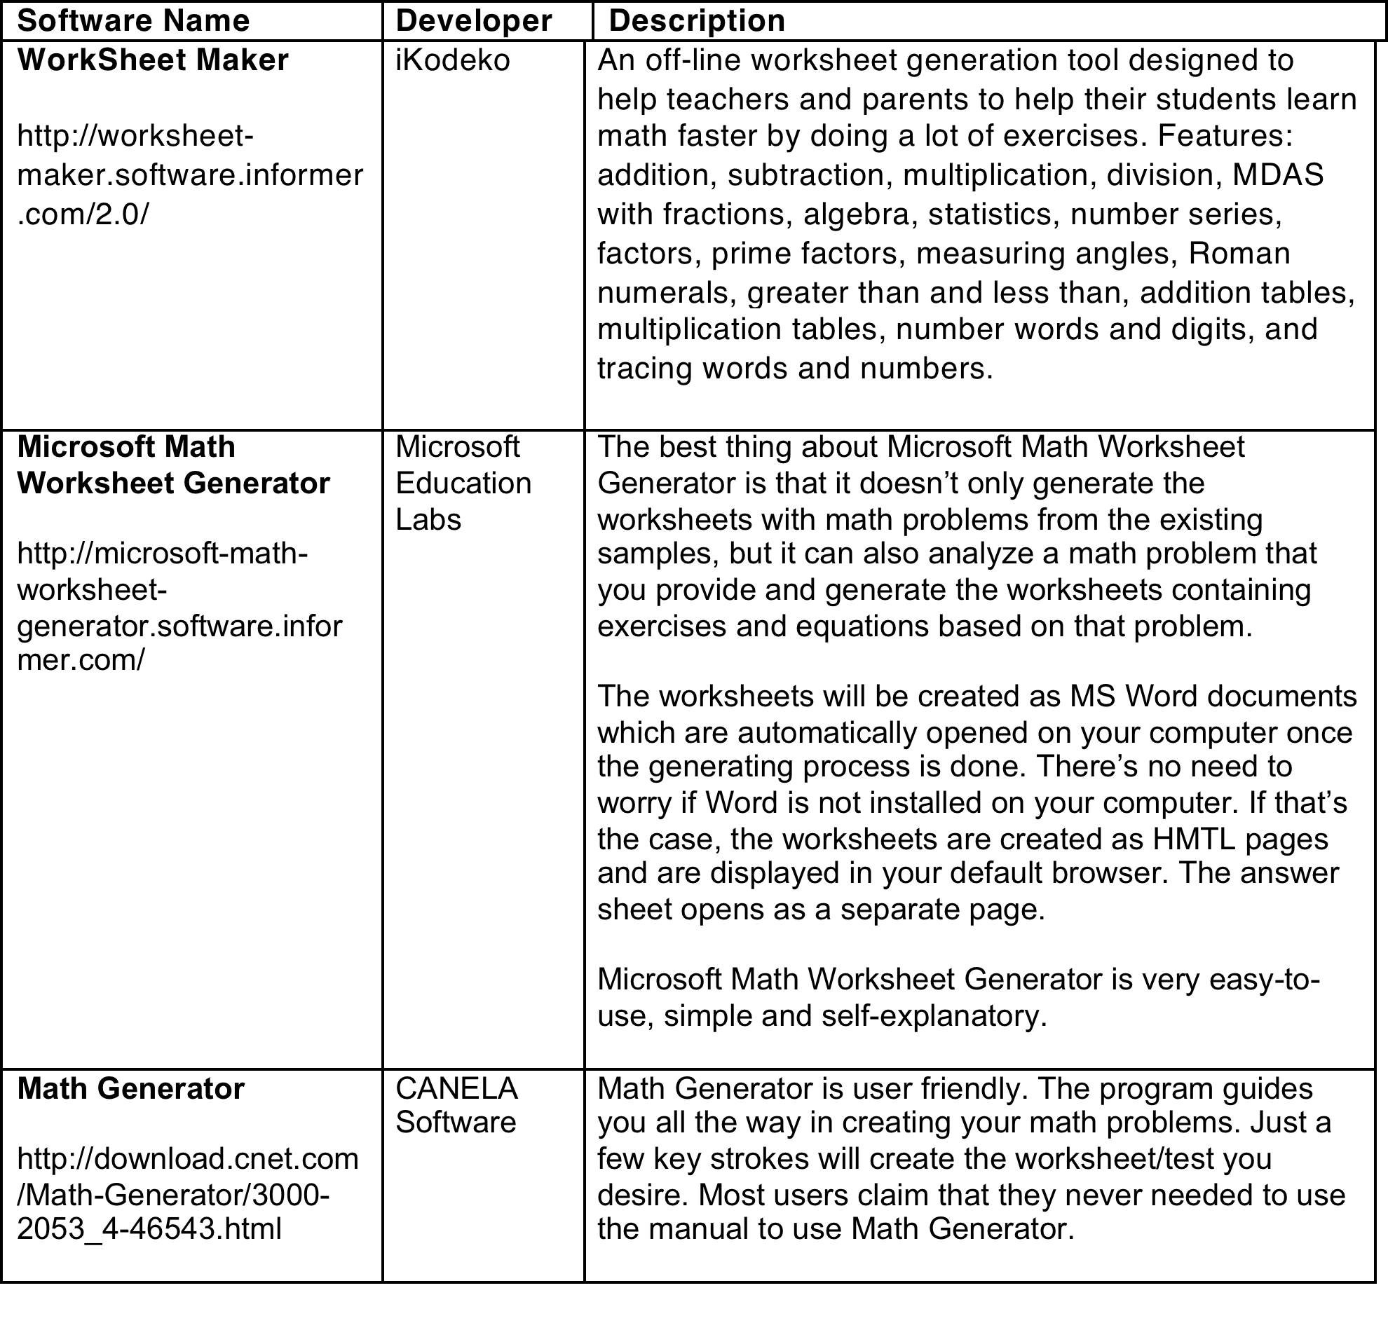
MARKET SEARCH

Slide 7

FWC SOFTWARE ADVANTAGES
Comprehensive
Standalone (do not require a permanent Internet connection)
Worksheet History Feature
Worksheet Different Level of Difficulty
Quick, easy way for creating and printing out worksheets

Slide 8
FEATURE DESCRIPTION
Admin System Features:
Teacher Registration
Teacher Password Reset Teacher System Features
Teacher System Features
Teacher System Access
Teacher Password Reset
Teacher Worksheet Selection
Worksheet Parameter Options
Student Worksheet Review
Student Worksheet Deletion
Class Roster Creation
Student Login Management
Student Difficulty Management
Student System Features:
Student System Access
Student Password Reset
Student Worksheet Option
Admin Account Setup
Graphical User Interface
Help System
Worksheet Difficulty
Worksheet Types
Tutorial Content
Random Exercise Generation
Worksheet Instructions
Search Feature

Slide 9
REQUIREMENTS
Functional Requirements for:
Admin System Features
General System Features
Teacher System Features
Student System Features
Non-Functional Requirements
Software Interfaces
Database Schema
Performance Requirements
Security Requirements
Software Quality Attributes
Business Rules

Slide 10
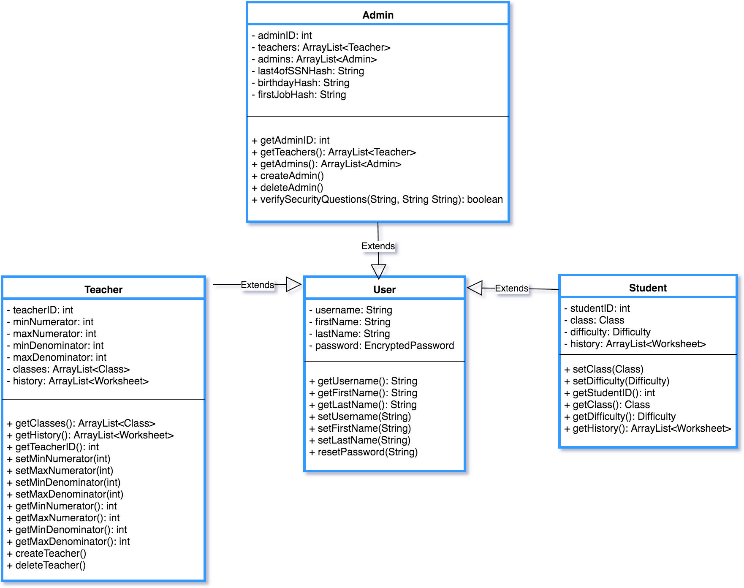
SYSTEM MODEL
Relationship Class Diagram

Slide 11
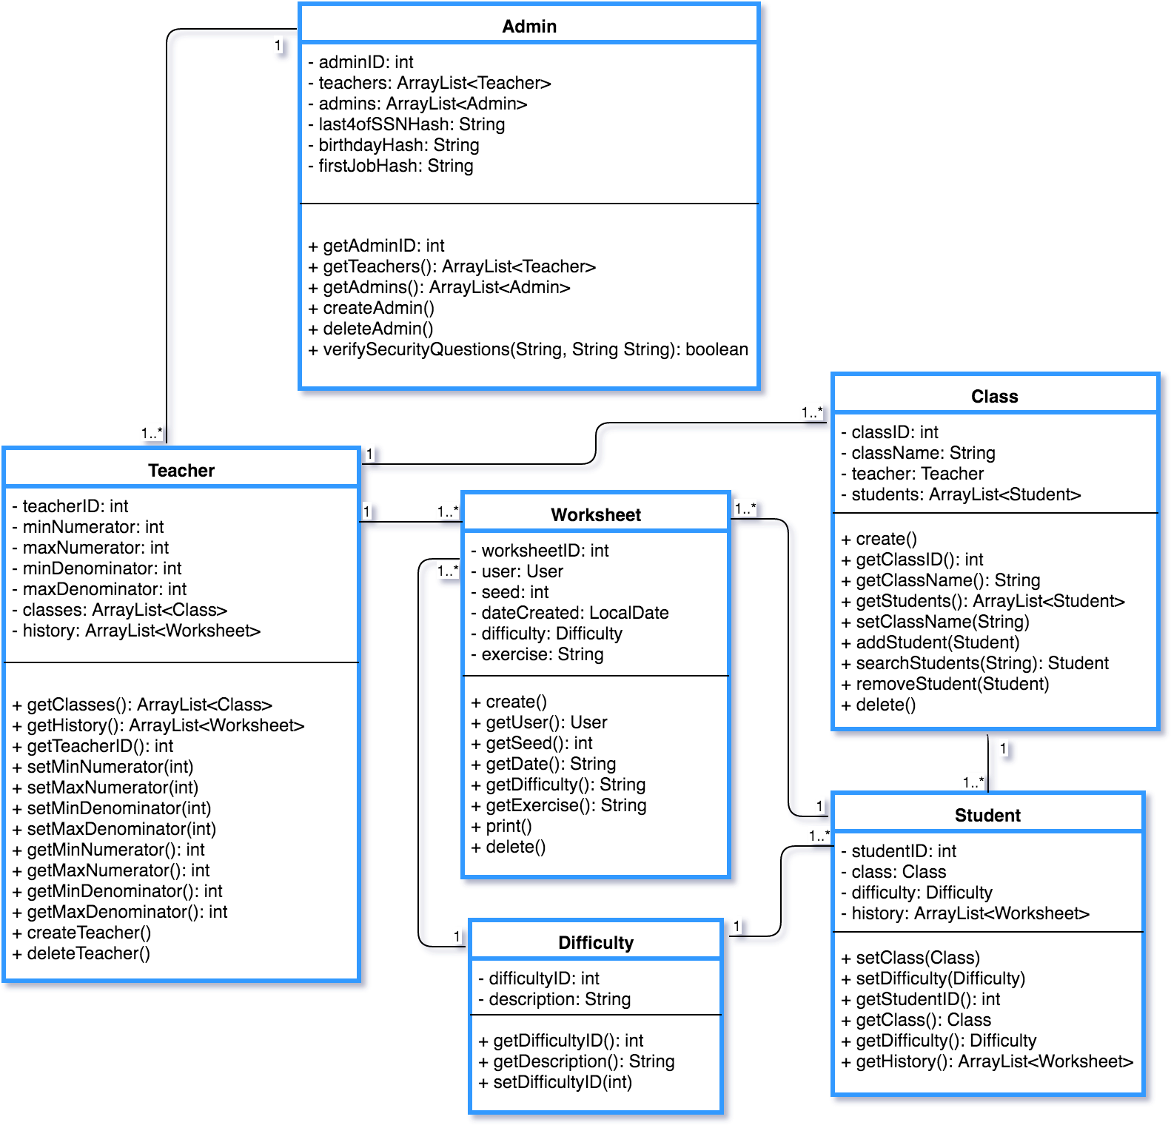
SYSTEM MODEL Cont’d
Relationship Class Diagram

Slide 12
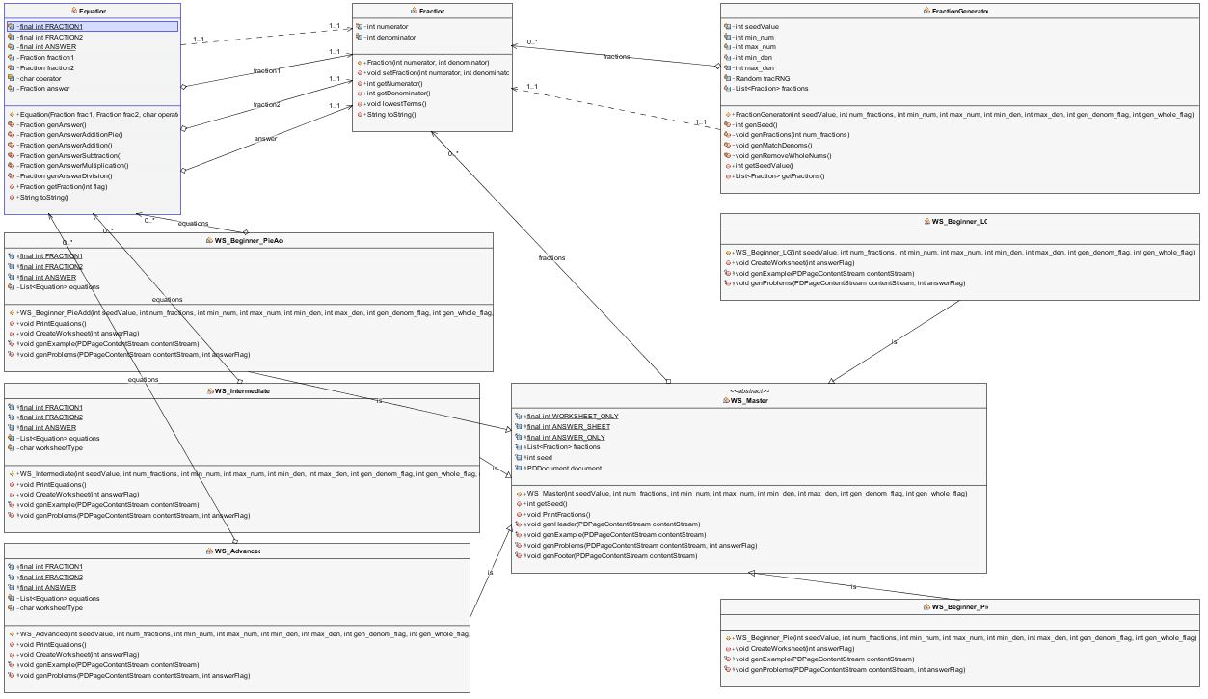
SYSTEM MODEL Cont’d
Relationship Class Diagram

Slide 13


Design Goal
The main goal of the Fraction Worksheet creator (FWC design) is to satisfy and delight the customer to meet all his needs.
Goal to Design:
reliable software system
flexible software system
understandable software system
simple software system.
The main principles of a good design that used in the developing of FWC are flexibility, extensibility and maintainability.

Slide 14
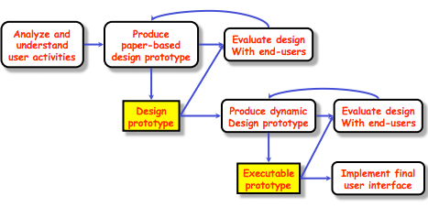
USER INTERFACE
The FWC user interface had following stages of development:
System users often judge a system by its interface
FWC UI should be easy-to–use and be attractive to user.
Users of the FWC without experience can learn to use the system quickly
Interface is consistent wherever possible

Slide 15
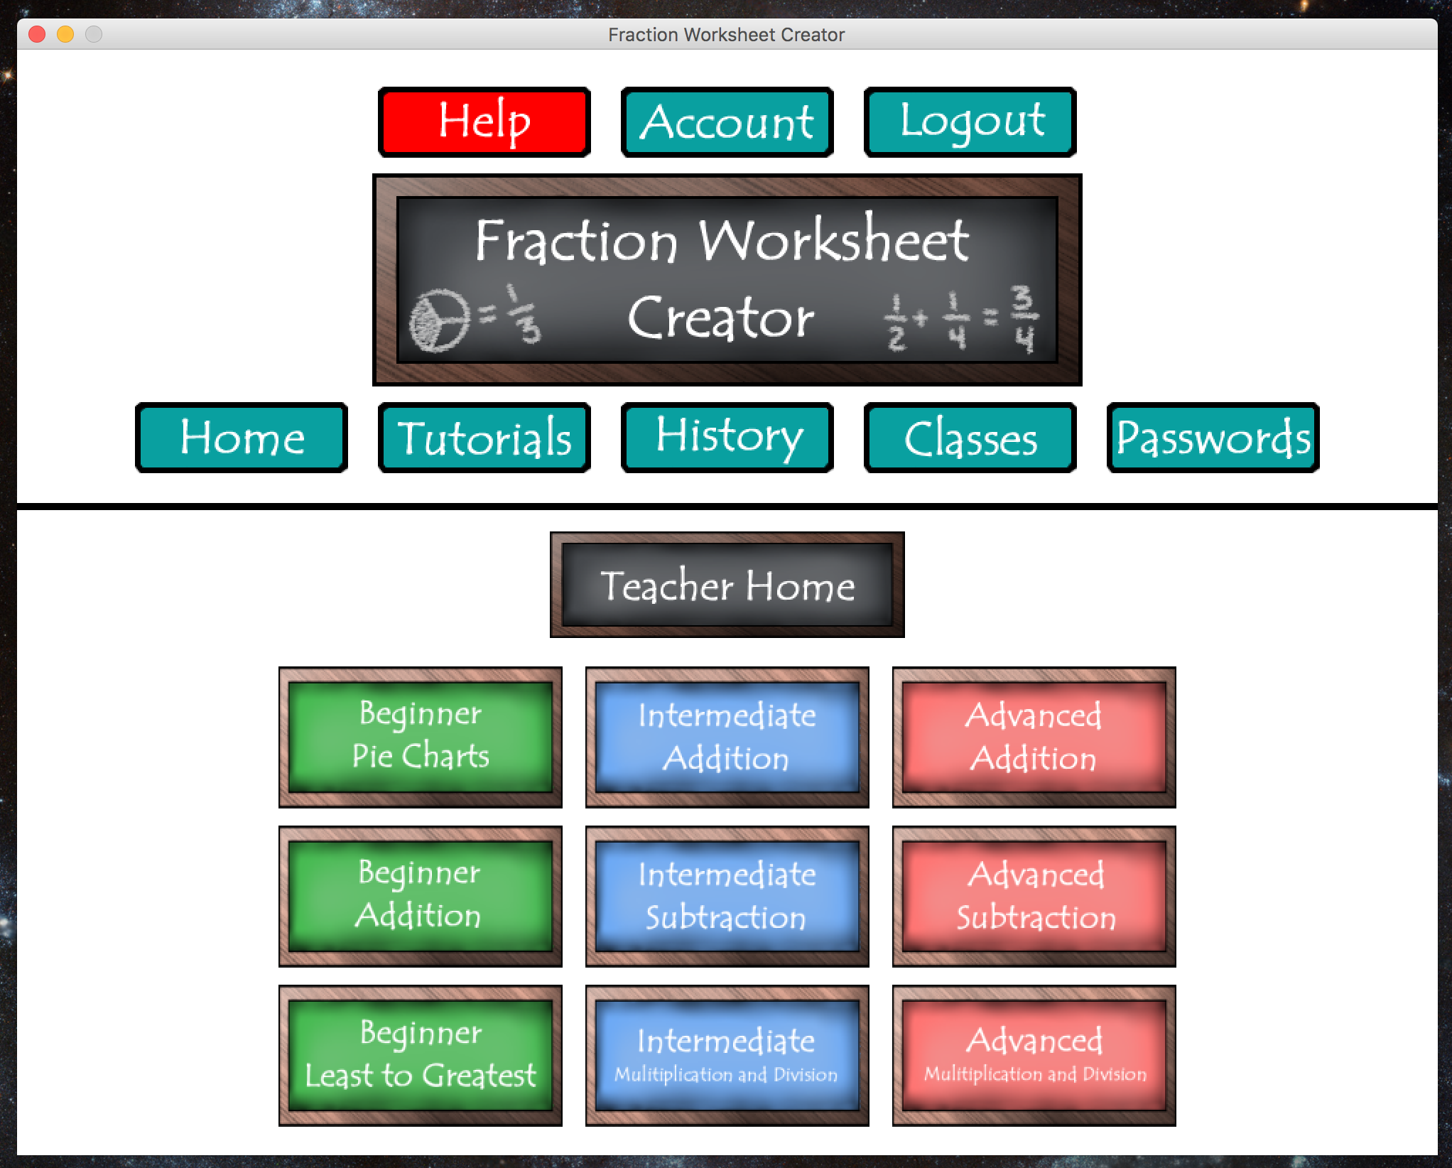
TEACHER HOME PAGE

Slide 16
SYSTEM SERVICE
The FWC system shall provide a help utility within its user interface to aid all users with tasks to perform on the specific page on which the utility is invoked.
The FWC system shall provide video tutorials for Teachers and Students to provide examples and aid for solving the fraction worksheets the FWC creates
The system on which the FWC is installed also has Java installed.
The system on which the FWC is installed also has Adobe Reader installed.
Teachers and Students are able and permitted to save files to the system on which the FWC is installed.
The FWC data does not need to be accessible from a workstation other than the one on which it is originally installed.

Slide 17
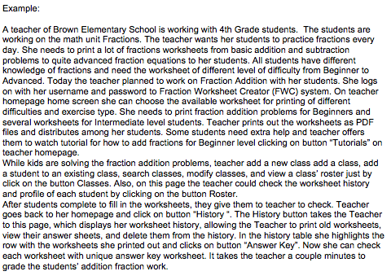
Testing Scenario

Slide 18
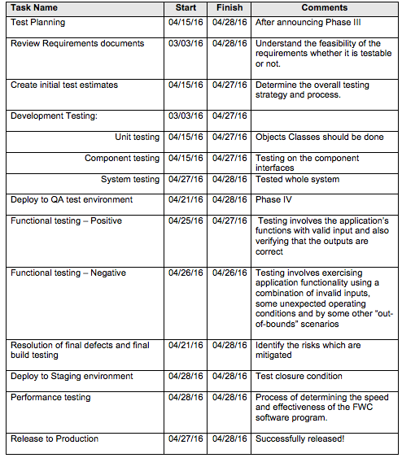

Testing Schedule

Slide 19
Demo

Slide 20

Questions?

