Slide 1
EE 319K
Introduction to Embedded Systems
Lecture 5:Subroutines and Parameter passing,
Pointers, Arrays and Strings,
Functional Debugging
Bard, Erez, Gerstlauer, Valvano, Yerraballi, Telang, Janapa Reddi, Tiwari

Slide 2
Agenda
Recap
  Branches and Arithmetic overflow
    Signed (V) vs. Unsigned (C)
  Control Structures
    if, if-else, while, do-while, for
  Signed: B{LT,GE,GT,LE}; LDRSB, LDRSH Unsigned: B{LO,HS,HI,LS}; LDRB, LDRH
Outline
  Subroutines and Parameter Passing
  Indexed Addressing and Pointers
  Data Structures: Arrays, Strings
  Functional Debugging
Bard, Erez, Gerstlauer, Valvano, Yerraballi, Telang, Janapa Reddi, Tiwari

Slide 3
Registers to pass parameters
High level program
Sets Registers to contain inputs
Calls subroutine
6) Registers contain outputs
Subroutine
3) Sees the inputs in registers
4) Performs the action of the subroutine
5) Places the outputs in registers
Bard, Erez, Gerstlauer, Valvano, Yerraballi, Telang, Janapa Reddi, Tiwari

Slide 4
Stack to pass parameters
High level program
Pushes inputs on the Stack
Calls subroutine
6) Stack contain outputs (pop)
7) Balance stack
Subroutine
3) Sees the inputs on stack (pops)
4) Performs the action of the subroutine
5) Pushes outputs on the stack
Bard, Erez, Gerstlauer, Valvano, Yerraballi, Telang, Janapa Reddi, Tiwari

Slide 5
Assembly Parameter Passing
Parameters passed using registers/stack
Parameter passing need not be done using only registers or only stack
  Some inputs could come in registers and some on stack and outputs could be returned in registers and some on the stack
Calling Convention
  Application Binary Interface (ABI)
  ARM: use registers for first 4 parameters, use stack beyond, return using R0
Keep in mind that you may want your assembly subroutine to someday be callable from C or callable from someone else’s software
Bard, Erez, Gerstlauer, Valvano, Yerraballi, Telang, Janapa Reddi, Tiwari

Slide 6
ARM Arch. Procedure Call Standard (AAPCS)
ABI standard for all ARM architectures
Use registers R0, R1, R2, and R3 to pass the first four input parameters (in order) into any function, C or assembly.
We place the return parameter in Register R0.
Functions can freely modify registers R0–R3 and R12. If a function needs to use R4 through R11, it is necessary to push the current register value onto the stack, use the register, and then pop the old value off the stack before returning.
Bard, Erez, Gerstlauer, Valvano, Yerraballi, Telang, Janapa Reddi, Tiwari

Slide 7
Parameter-Passing: Registers
Caller
;--call a subroutine that
;uses registers for parameter passing
MOV R0,#7
MOV R1,#3
BL Exp
;; R2 becomes 7^3 = 343 (0x157)
Callee
;---------Exp-----------
; Input: R0 and R1 have inputs XX an YY
; Output: R2 has the result XX raised to YY
; Comments: R1 and R2 and non-negative
; Destroys input R1
XX RN 0
YY RN 1
Pow RN 2
Exp
ADDS XX,#0
BEQ Zero
ADDS YY,#0 ; check if YY is zero
BEQ One
MOV pow, #1 ; Initial product is 1
More MUL pow,XX ; multiply product with XX
ADDS YY,#-1 ; Decrement YY
BNE More
B Retn ; Done, so return
Zero MOV pow,#0 ; XX is 0 so result is 0
B Retn
One MOV pow,#1 ; YY is 0 so result is 1
Retn BX LR
Call by value
Suggest changes to make it AAPCS
Return by value
Bard, Erez, Gerstlauer, Valvano, Yerraballi, Telang, Janapa Reddi, Tiwari
Notes:
Not AAPCS because output must be in R0. Fix it by moving R2 to R0 on the last line of subroutine

Slide 8
Parameter-Passing: Stack
Caller
;-------- call a subroutine that
; uses stack for parameter passing
MOV R0,#12
MOV R1,#5
MOV R2,#22
MOV R3,#7
MOV R4,#18
PUSH {R0-R4}
; Stack has 12,5,22,7 and 18
; (with 12 on top)
BL Max5
; Call Max5 to find the maximum
;of the five numbers
POP {R5}
;; R5 has the max element (22)
Callee
;---------Max5-----------
; Input: 5 signed numbers pushed on the stack
; Output: put only the maximum number on the stack
; Comments: The input numbers are removed from stack
numM RN 1 ; current number
max RN 2 ; maximum so far
count RN 0 ; how many elements
Max5
POP {max} ; get top element (top of stack)
; store it in max
MOV count,#4 ; 4 more to go
Again POP {numM} ; get next element
CMP numM,max
BLT Next
MOV max, numM ; new numM is the max
Next ADDS count,#-1 ; one more checked
BNE Again
PUSH {max} ; found max so push it on stack
BX LR
Call by value
Return by value
Flexible style, but not AAPCS
Bard, Erez, Gerstlauer, Valvano, Yerraballi, Telang, Janapa Reddi, Tiwari
Notes:
Not AAPCS because we totally bypassed registers as a means of passing parameters

Slide 9
Parameter-Passing: Stack & Regs
Caller
;------call a subroutine that uses
;both stack and registers for
;parameter passing
MOV R0,#6 ; R0 elem count
MOV R1,#-14
MOV R2,#5
MOV R3,#32
MOV R4,#-7
MOV R5,#0
MOV R6,#-5
PUSH {R4-R6} ; rest on stack
; R0 has element count
; R1-R3 have first 3 elements;
; remaining on Stack
BL MinMax
;; R0 has -14 and R1 has 32
;; upon return
Callee
;---------MinMax-----------
; Input: N numbers reg+stack; N passed in R0
; Output: Return in R0 the min and R1 the max
; Comments: The input numbers are removed from stack
numMM RN 3; hold the current number in numMM
max RN 1 ; hold maximum so far in max
min RN 2
N RN 0 ; how many elements
MinMax
PUSH {R1-R3} ; put all elements on stack
CMP N,#0 ; if N is zero nothing to do
BEQ DoneMM
POP {min} ; pop top and set it
MOV max,min ; as the current min and max
loop ADDS N,#-1 ; decrement and check
BEQ DoneMM
POP {numMM}
CMP numMM,max
BLT Chkmin
MOV max,numMM ; new num is the max
Chkmin CMP numMM,min
BGT NextMM
MOV min,numMM ; new num is the min
NextMM B loop
DoneMM MOV R0,min ; R0 has min
BX LR
Not AAPCS
Notes:
Not AAPCS because we are returning two outputs. Can fix by putting min and max at two consecutive locations in memory and returning the address of the first in R0

Slide 10
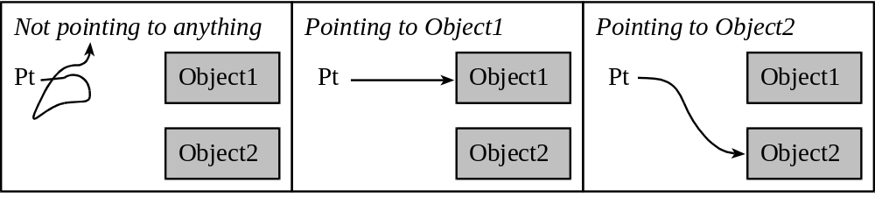
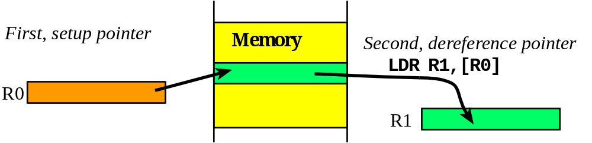
Pointers
Pointers are addresses that refer to objects
  Objects may be data, functions or other pointers
  If a register or memory location contains an address we say it points into memory
Use of indexed addressing mode

Slide 11
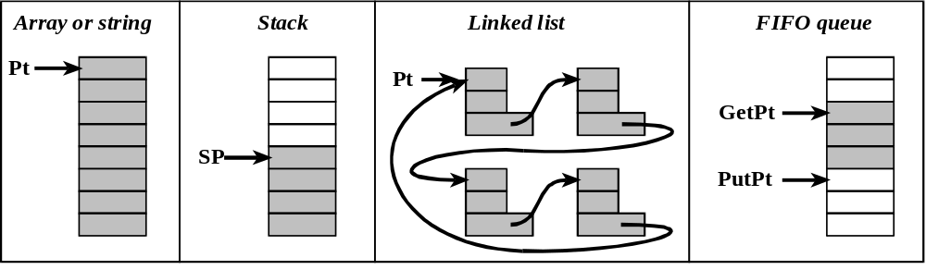
Data Structures
Pointers are the basis for data structures
{
Organization of data
Functions to facilitate access
Data structure
Bard, Erez, Gerstlauer, Valvano, Yerraballi, Telang, Janapa Reddi, Tiwari

Slide 12
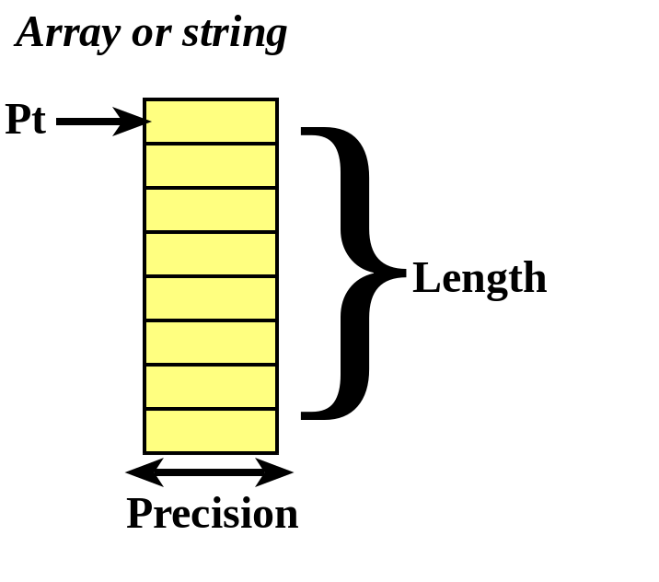
Arrays
Random access
Sequential access
An array
    equal precision and
    allows random access.
The precision is the size of each element. (n)
The length is the number of elements (fixed or variable).
The origin is the index of the first element.
  zero-origin indexing.
{
Data in consecutive memory
Access: Buffer[i]
int32_t Buffer[100]
Bard, Erez, Gerstlauer, Valvano, Yerraballi, Telang, Janapa Reddi, Tiwari

Slide 13
Array Declaration
In assembly
AREA Data
A SPACE 400
AREA |.text|
Prime DCW 1,2,3,5,7,11,13
In C
uint32_t A[100];
const uint16_t Prime[] = {1,2,3,5,7,11,13};
Length of the array?
  One simple mechanism saves the length of the array as the first element
In C:
const int8_t Data[5]={4,0x05,0x06,0x0A,0x09};
const int16_t Powers[6]={5,1,10,100,1000,10000};
const int32_t Filter[5]=
{4,0xAABBCCDD,0x00,0xFFFFFFFF,-0x01}
In assembly:
Data DCB 4,0x05,0x06,0x0A,0x09
Powers DCW 5,1,10,100,1000,10000
Filter DCD 4,0xAABBCCDD, 0x00
DCD 0xFFFFFFFF,-0x01
Split declaration on multiple lines if needed
Bard, Erez, Gerstlauer, Valvano, Yerraballi, Telang, Janapa Reddi, Tiwari
Notes:
With the keyword const the C compiler forces the array to be placed in ROM.

Slide 14
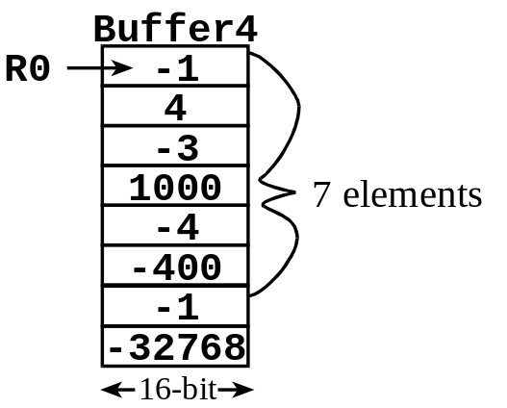
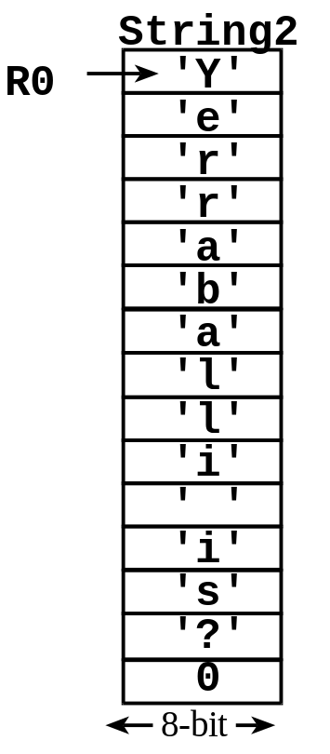
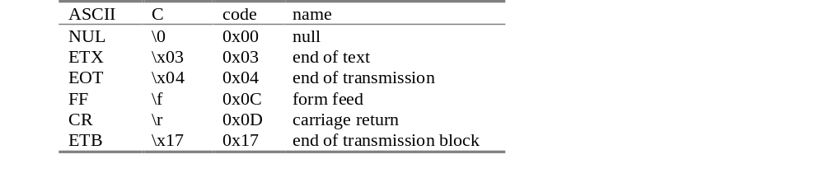
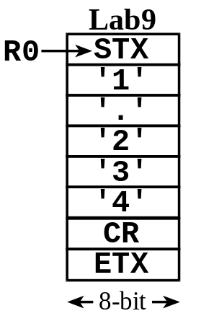
… Arrays
Length of the Array:
  Alternative mechanism stores a special termination code as the last element.
Bard, Erez, Gerstlauer, Valvano, Yerraballi, Telang, Janapa Reddi, Tiwari

Slide 15
Array Access
In general, let n be the precision of a zero-origin indexed array in elements.
  n=1 (8-bit elements)
  n=2 (16-bit elements)
  n=4 (32-bit elements)
If I is the index and
Base is the base address of the array,
then the address of the element at I is
Base+n*I
In C
d = Prime[4];
In assembly
LDR R0,=Prime
LDRH R1,[R0,#8]
Bard, Erez, Gerstlauer, Valvano, Yerraballi, Telang, Janapa Reddi, Tiwari
Notes:
In C, the programmer only gives the index I
The compiler knows about base data type and hence element size n of the array.
Compiler computes the correct offset n*I automatically
In assembly, offset computations need to be done by the programmer

Slide 16
Array Access
Indexed access
  In C
uint32_t i;
sum = 0;
for(i=0; i<7; i++) {
sum += Prime[i];
}
  In assembly
LDR R0,=Prime
MOV R1,#0 ; ofs = 0
MOV R3,#0 ; sum = 0
lp LDRH R2,[R0,R1] ;Prime[i]
ADD R3,R3,R2 ; sum
ADD R1,R1,#2 ; ofs += 2
CMP R1,#14 ; ofs <= 14?
BLO lp
Pointer access
  In C
uint16_t *p;
sum = 0;
for(p = Prime;
p != &Prime[7]; p++){
sum += *p;
}
  In assembly
LDR R0,=Prime ; p = Prime
ADD R1,R0,#14 ; &Prime[7]
MOV R3,#0 ; sum = 0
lp LDRH R2,[R0] ; *p
ADD R3,R3,R2 ; sum += ..
ADD R0,R0,#2 ; p++
CMP R0,R1
BNE lp
uint16_t
Bard, Erez, Gerstlauer, Valvano, Yerraballi, Telang, Janapa Reddi, Tiwari
Notes:
In C, Prime is the same as &Prime (“address of Prime”), where both evaluate to the same result as &(Prime[0]), i.e. the address of the first array element.
In C, additions of integers to pointers are possible. The result of such an expression is again a pointer, where this so-called pointer arithmetic is always relative to the size of the pointer’s base type.
In assembly, the programmer has to ensure that pointers are incremented by the correct number of bytes.

Slide 17
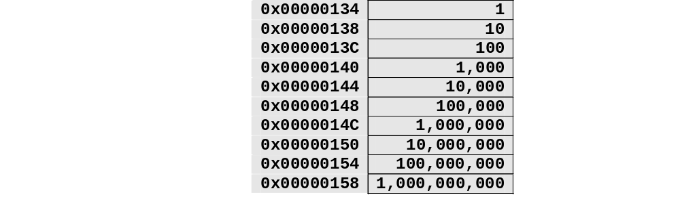
Example 6.2
Statement: Design an exponential function, y = 10^{x}, with a 32-bit output.
Solution: Since the output is less than 4,294,967,295, the input must be between 0 and 9. One simple solution is to employ a constant word array, as shown below. Each element is 32 bits. In assembly, we define a word constant using DCD, making sure in exists in ROM.
const uint32_t Powers[10] =
{1,10,100,1000,10000,100000,1000000,10000000,100000000,1000000000};
Bard, Erez, Gerstlauer, Valvano, Yerraballi, Telang, Janapa Reddi, Tiwari
Notes:
Assembly
AREA |.text|
Scores DCW 75,87,89,92,90
C
const unsigned short Scores[5] = {75.87.89.92.90};
Assembly
AREA data
Grades SPACE 10
C
unsigned short Grades[5];
Assembly
Curve ADD R0,R0,#5
CMP R0,#100
BLS ok
MOV R0,#100
ok BX LR
C
unsigned short Curve(unsigned short in){unsigned short out;
out = in+5;
if(out>100) out=100;
return out;
}
Assembly
LDR R3,=Grades
LDR R1,=Scores
MOV R2,#0
loop LDR R0,[R1,R2]
BL Curve
STR R0,[R3,R2]
ADD R2,#2
CMP R2,#10
BLO loop
C
for(i=0; i<5; i++){
Grades[i] = Curve(Scores[i]);
}

Slide 18
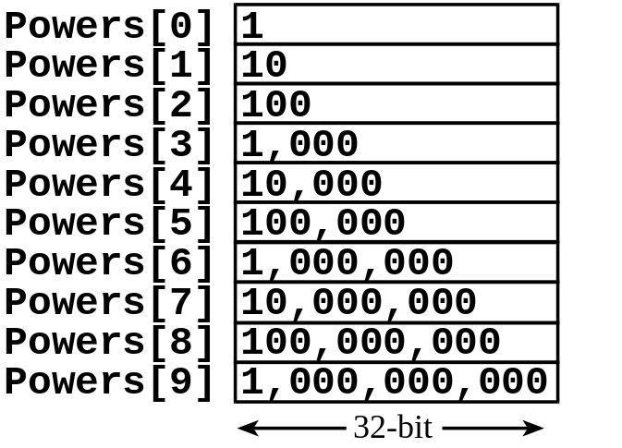
…Solution
C
const uint32_t Powers[10]
={1,10,100,1000,10000,
100000,1000000,10000000,
100000000,1000000000};
uint32_t power(uint32_t x){
return Powers[x];
}
Assembly
AREA |.text|,CODE,READONLY,ALIGN=2
Powers DCD 1, 10, 100, 1000, 10000
DCD 100000, 1000000, 10000000
DCD 100000000, 1000000000
;------power----
; Input: R0=x
; Output: R0=10^x
power LSL R0, R0, #2 ; x = x*4
LDR R1, =Powers ; R1= &Powers
LDR R0, [R1, R0] ; y=Powers[x]
BX LR
Base + Offset
Bard, Erez, Gerstlauer, Valvano, Yerraballi, Telang, Janapa Reddi, Tiwari

Slide 19
Strings
Problem: Write software to output an ASCII string to an output device.
Solution: Because the length of the string may be too long to place all the ASCII characters into the registers at the same time, call by reference parameter passing will be used. With call by reference, a pointer to the string will be passed. The function OutString, will output the string data to the output device.
The function OutChar will be developed later. For now all we need to know is that it outputs a single ASCII character to the serial port.
Bard, Erez, Gerstlauer, Valvano, Yerraballi, Telang, Janapa Reddi, Tiwari

Slide 20
…Solution
Hello DCB "Hello world\n\r",0 ;Input: R0 points to string UART_OutString PUSH {R4, LR} MOV R4, R0 loop LDRB R0, [R4] CMP R0, #0 ;done? BEQ done ;0 sentinel BL UART_OutChar ;print ADD R4, #1 ;next B loop done POP {R4, PC} Start LDR R0,=Hello BL UART_OutString | const uint8_t Hello[]= "Hello world\n\r"; void UART_OutString(uint8_t *pt){ while(*pt){ UART_OutChar(*pt); pt++; } } void main(void){ UART_Init(); UART_OutString("Hello World"); while(1){}; }
Call by reference
Think about how this is insecure. What might happen if a malicious program called this?
Bard, Erez, Gerstlauer, Valvano, Yerraballi, Telang, Janapa Reddi, Tiwari
Notes:
When dealing with strings, it is always good practice to consider maximum possible size, and make sure the string is properly formatted (less than maximum size, and had null-termination)

Slide 21
Functional Debugging
Instrumentation: dump into array without filtering
Assume happy and sad are strategic 8-bit variables.
SIZE EQU 20
HappyBuf SPACE SIZE
SadBuf SPACE SIZE
Cnt SPACE 4
#define SIZE 20
uint8_t HappyBuf[SIZE];
uint8_t SadBuf[SIZE];
uint32_t Cnt;
Cnt will be used to index into the buffers
Cnt must be set to index the first element, before the debugging begins.
LDR R0,=Cnt
MOV R1,#0
STR R1,[R0]
Cnt = 0;
Bard, Erez, Gerstlauer, Valvano, Yerraballi, Telang, Janapa Reddi, Tiwari

Slide 22
… Functional Debugging
The debugging instrument saves the strategic variables happy and sad into respective Buffers
Save
PUSH {R0-R3,LR}
LDR R0,=Cnt ;R0 = &Cnt
LDR R1,[R0] ;R1 = Cnt
CMP R1,#SIZE
BHS done ;full?
LDR R3,=Happy
LDRB R3,[R3] ;R3 is happy
LDR R2,=HappyBuf
STRB R3,[R2,R1] ;save happy
LDR R3,=Sad
LDRB R3,[R3] ;R3 is sad
LDR R2,=SadBuf
STRB R3,[R2,R1] ;save sad
ADD R1,#1
STR R1,[R0] ;save Cnt
done
POP {R0-R3,PC}
void Save(void){
if(Cnt < SIZE){
HappyBuf[Cnt] = happy;
SadBuf[Cnt] = sad;
Cnt++;
}
}
Debugging instruments save/restore all registers
Next, you add BL Save statements at strategic places within the system.
Use the debugger to display the results after program is done
Bard, Erez, Gerstlauer, Valvano, Yerraballi, Telang, Janapa Reddi, Tiwari
Notes:
Discuss nonintrusive, minimally intrusive and highly intrusive
Logic analyzer
Dump data/time into buffer
Printf
Embedded systems (function values, time important)
Instrument Lab 1, does the LED flash at 1ms
Quantify intrusiveness at time to execute (count bus cycles)
Conditional dump

Slide 23
Lab 4 preparation
0) Watch Video 9.1 in ebook chapter 9
http://users.ece.utexas.edu/~valvano/Volume1/E-Book/C9_ArrayFunctionalDebugging.htm
1) Read and watch section 9.5 in the ebook
http://users.ece.utexas.edu/~valvano/Volume1/E-Book/C9_ArrayFunctionalDebugging.htm
2) Watch Videos 10.1 and 10.2. in ebook chapter 10
http://users.ece.utexas.edu/~valvano/Volume1/E-Book/C10_FiniteStateMachines.htm
3) Read textbook sections 4.3 and 4.4, you will use assembly code from book Program 4.7
Bard, Erez, Gerstlauer, Valvano, Yerraballi, Telang, Janapa Reddi, Tiwari

