Slide 1

EXAM TWO REVIEW
3/17/15
Audrey Wittrup & Alex Werntz

Slide 2
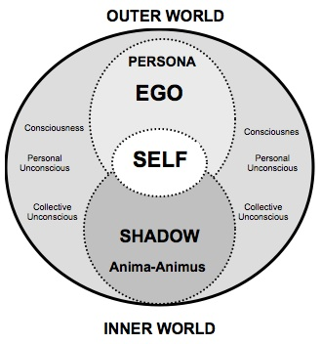
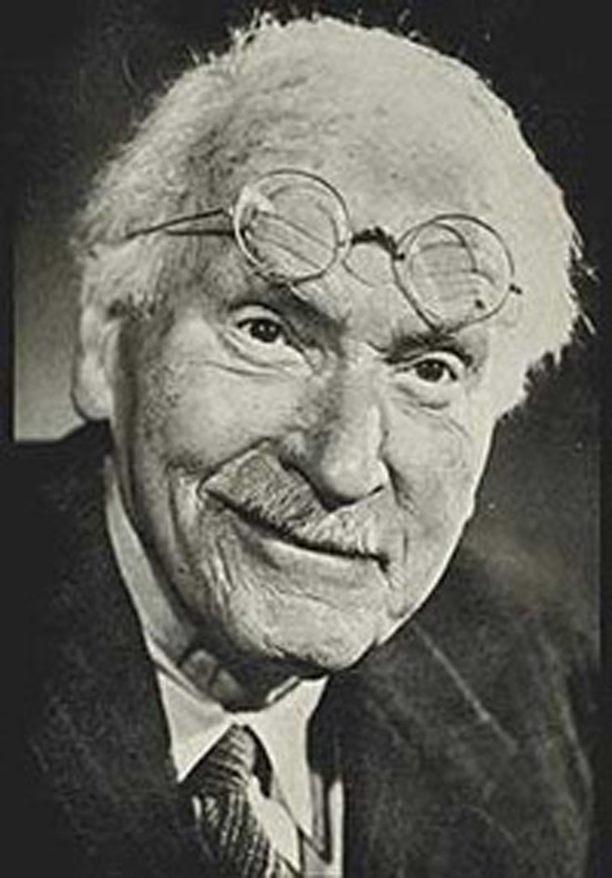
JUNG

Slide 3
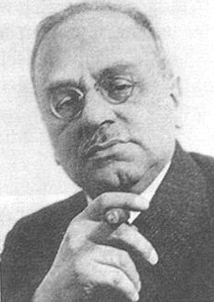
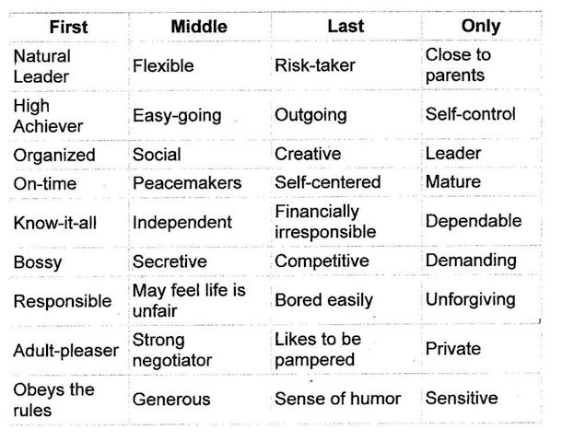
ADLER

Slide 4
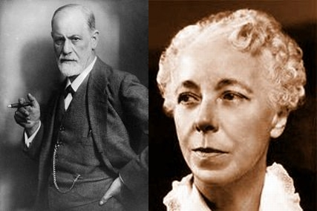
KAREN HORNEY

Slide 5
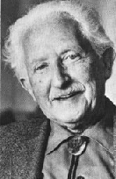
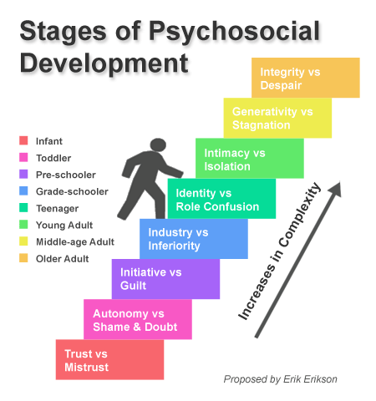
ERIKSON

Slide 6
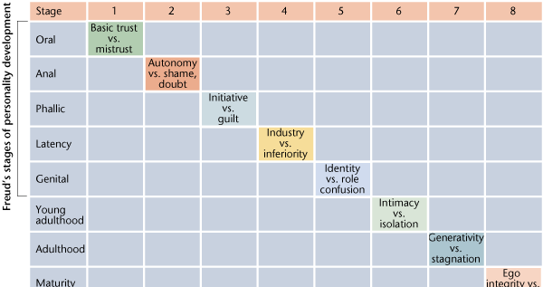

Slide 7
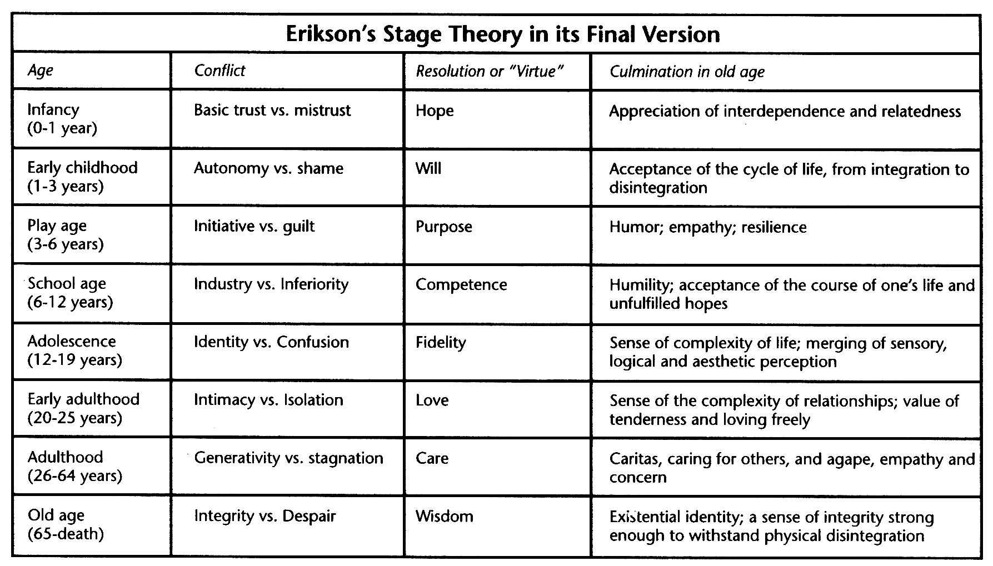
VIRTUES

Slide 8
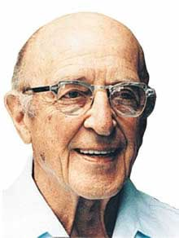
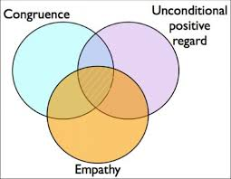
CARL ROGERS

Slide 9
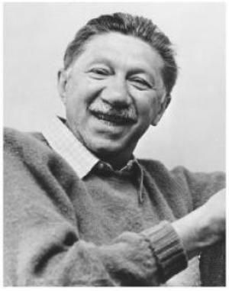
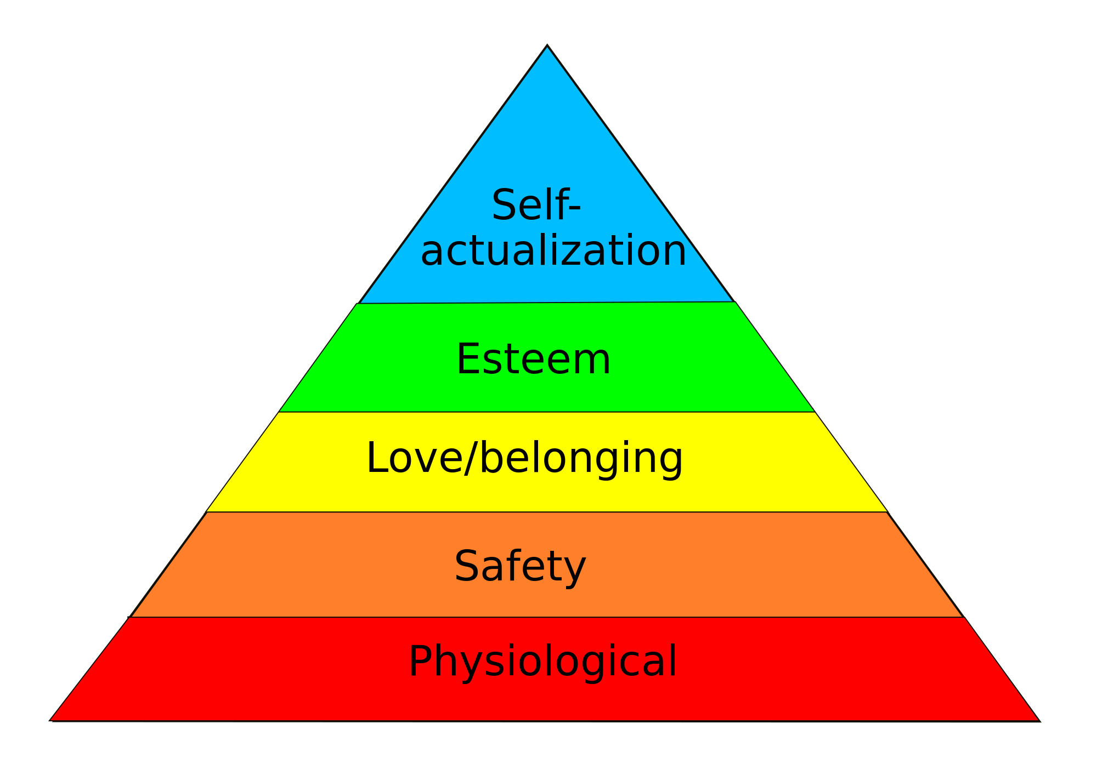
MASLOW

Slide 10
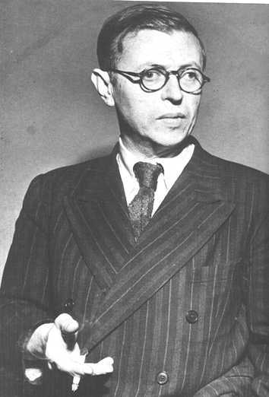

SARTRE

Slide 11
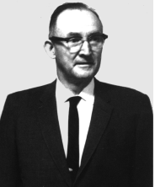
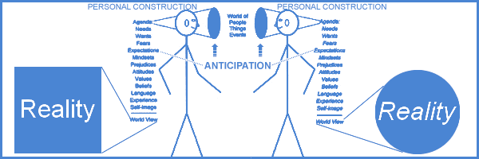
KELLY

Slide 12
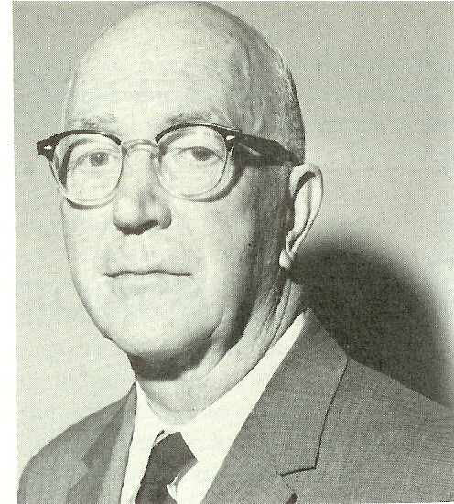
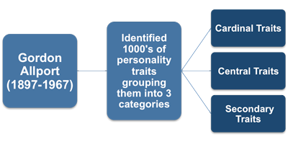
ALLPORT

Slide 13
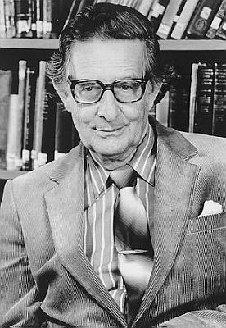
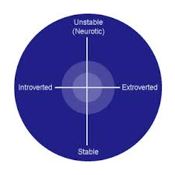
EYSENCK

Slide 14
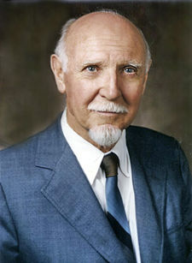
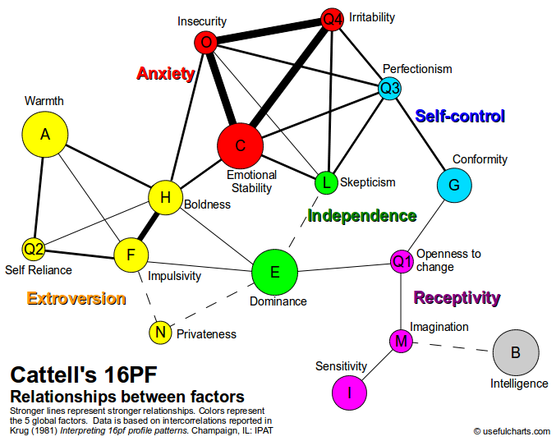
CATTELL

Slide 15

MYERS-BRIGGS TYPE
Four Components:
Sensation
Intuition
Feeling
Thinking

Slide 16
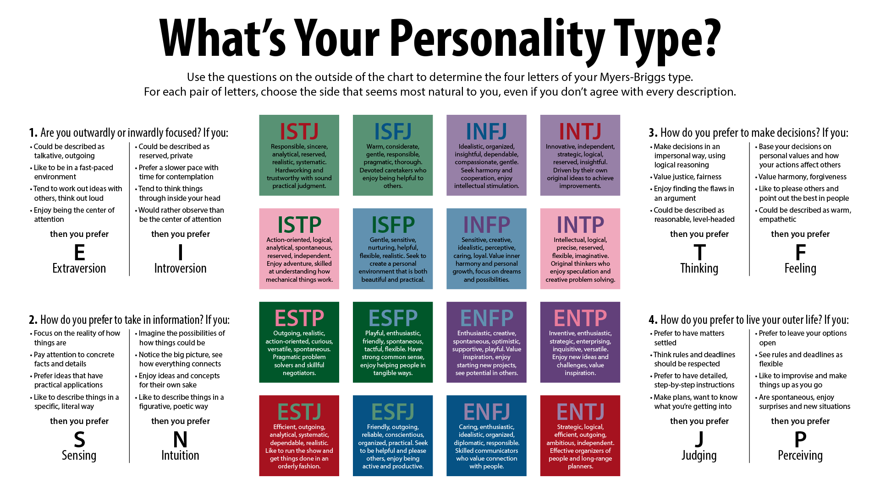

Slide 17
OVERVIEW
PSYCHODYNAMIC:
Jung
Horney
Adler
PHENOMENOLOGICAL:
Sartre
Rogers
Maslow
TRAIT THEORISTS:
Eyesnck
Allport
Cattell

Slide 18
OVERVIEW
You should be able to answer these questions about all of the different theories:
How is therapy approached?
How is the self understood?
How would behaviors be explained? (e.g., acting overly strict and moralistic)
Be ready to APPLY these to scenarios on the exam!

Slide 19
PSYCHODYNAMIC vs. PSYCHOANALYTIC
LESS ATTENTION | MORE ATTENTION
Id and Instincts | Ego and Self
Intrapsychic conflicts and causes | Social interpersonal causes and relationship issues
Earliest childhood | Later developments through the life span
Psychosexual | Social Forces and Positive Strivings; the role of culture

Slide 20
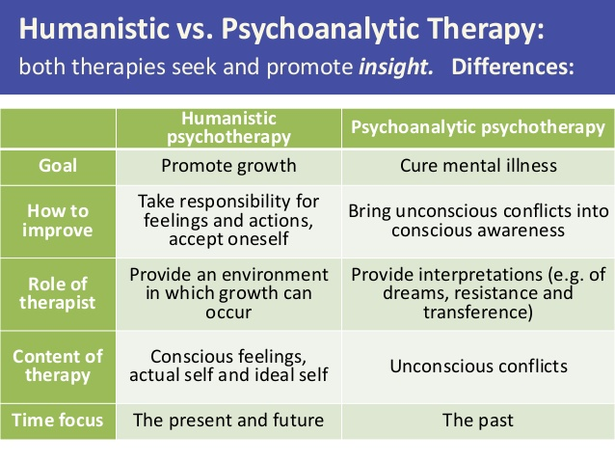

Slide 21
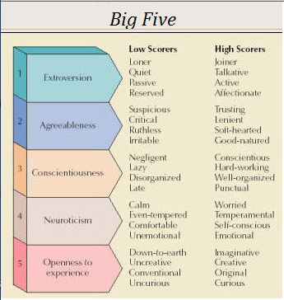
THE BIG 5

Slide 22
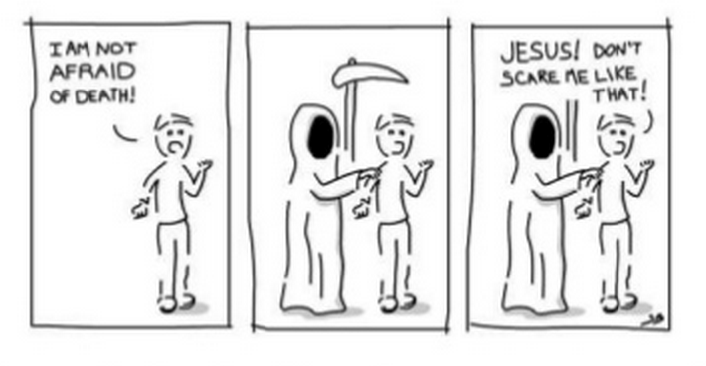
TERROR MANAGEMENT THEORY

Slide 23

OBJECT RELATIONS THEORY

