Slide 1
CS 2102 Discrete Mathematics
David L. Edwards
Rice Hall 502
434-982-2228
dle7pm@virginia.edu

Slide 2
Course Foci
Discrete Mathematics
&
Its Applications

Slide 3
Course Information
See and read syllabus
Web site on Collab
See syllabus for details of semester grading, textbook, contact information, etc.
Textbook:
“Discrete Mathematics With Applications”
Susanna Epp, Fourth (or Third) Edition
Weekly assignments

Slide 4
Grades
Elements of grade:
Ten (or so) weekly assignments 30%
Semester examination 1 20%
Semester examination 2 20%
Final examination 30%
Scores will be available from collab during semester

Slide 5
Assignments
Work with others!
Start by working problems alone
Meet to discuss issues and help each other with understanding
Reconcile answers, turn in (on collab) polished solutions
Material handed in:
Must have on front page the names of people who worked on the assignment as well as computing ids
Must be your best work
See syllabus for details

Slide 6
Examinations
Semester examinations:
TBD
Final examination:
Tuesday, December 9, 2014 9am - 12pm
All exams will be:
Closed book, closed notes, in class.

Slide 7
Rights and Responsibilities
Your rights are:
To have fun!
To receive significant technical information
To have material presented clearly in lectures
To have questions answered satisfactorily in:
Class
Office hours
Electronic mail
To have fun!

Slide 8
Rights and Responsibilities
Your responsibilities are to:
Attend lectures and be attentive during lectures
Arrive and leave lectures in a timely manner—do not disturb class
Ask questions about material you do not understand
Do assignments and complete them on time

Slide 9
Class Rules
Do not arrive late unless you have a special situation.
Be respectful of you classmates and their learning.
Ask lots of questions!
Let the instructor know if you disagree with something.
Help the instructor make this class useful for you!

Slide 10
Ethics
We Take This Very Seriously
If You Engage In Anything Unethical, You Will be Dismissed From The Class

Slide 11
OK, Now Let’s Get To Work

Slide 12
Course Information
First course on discrete mathematics
Outline - concentrate on a few major topics:
Sets and set theory
Propositional logic
Predicate calculus
Notion of proof and various proof techniques
Relations and functions
Graph Theory
Combinatorics
Elementary probability
Finite state machines (If time permits)
But why?

Slide 13
A Big Problem—Algorithms
Algorithm design
Topics include:
Algorithm running time
Numbers of operations
Probabilistic analysis
Important topics in all areas of application:
Network engineering
Software engineering
Application development

Slide 14
A Big Problem—Software
Software development
Topics include:
Specification
Verification
Performance analysis
Important topics in all areas of software:
Operating systems
Systems software
Application software

Slide 15
A Big Problem—Software
Most graduates end up either developing software or managing its development
Software costs increasing as hardware costs decrease
Many software development disasters:
Cost overruns
Late delivery
Reduced or wrong functionality
Non-existent documentation
Non-existent source code
Execution-time failure
Software

Slide 16
Famous Computing Disasters
Mariner Rocket (1962)
Trans-Siberian gas pipeline explosion (1982)
Soviet early warning system false alarm (1983)
Therac-25 radiation therapy malfunction (1985)
Mars climate orbiter (1998)
Love virus (2000)
And many others …

Slide 17
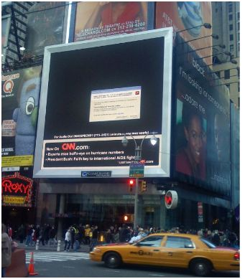
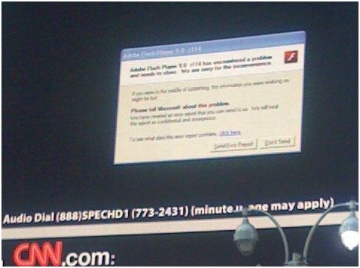
Times Square, December 2nd, 2007
http://www.zoliblog.com/2007/12/02/if-you-crash-crash-big/

Slide 18
http://www.youtube.com/watch?v=kYUrqdUyEpI

Slide 19
A Big Problem—Software
Many failures attributed to software:
Shuttle launch anomaly (first launch)
Social security disaster
Bank of New York government bond trading system failure
Outages of ATT long distance switches (MLK day, 1990)
Death and injury from Therac 25
Ariane V explosion
Mars spacecraft crashed or disabled, including all three rovers
Cost of failure becoming very high:
Financial
Loss of life or loss of equipment
Inconvenience
We Are Talking Serious Money Here

Slide 20
The Software Lifecycle

Slide 21
Specification vs. Implementation
There are many, many techniques
Problem is in two parts:
Correct specification, erroneous implementation
Erroneous specification, correct implementation
Both parts concern us as software engineers
Both parts need attention—why a system fails is not important to the users
Different techniques for the two parts

Slide 22
Software Faults
Find
Introduce
Specification
Design
Implementation
Verify/Test

Slide 23
Mathematics of Software Engineering
In engineering, we gain assurance with mathematics—alternative is ad hoc construction
Examples of mathematics:
Structural analysis - Finite Element method
Aerodynamics - Navier Stokes equation
Electronics - Differential equations
Software engineering:
Discrete mathematics
Often referred to as:
Formal methods or formal techniques

Slide 24
1742
Goldbach’s strong conjecture: Every even integer greater than 2 can be expressed as the sum of two primes (He considered one a prime).
Some think this is an unprovable truth.
Goldbach’s weak conjecture: All odd numbers greater than 7 are the sum of three primes.

Slide 25

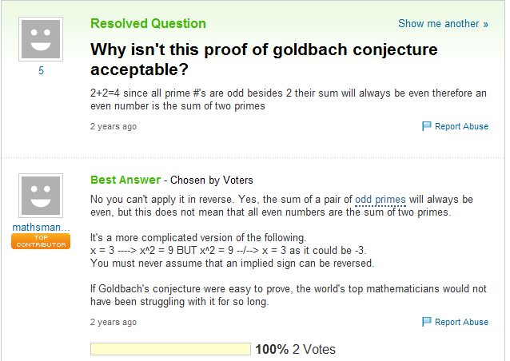
2009
Master the fundamentals

