Slide 1


Title: Visualization and AI for 3D tic-tac-toe
Name: Nan Zhao
Student ID: 201530286
Primary Supervisor: Prof. Boris Konev
Second Supervisor: Prof. Frank Wolter

Slide 2
Content
Project Description
Aims and Objectives
Outputs
Evaluation
Software Demonstration

Slide 3
Project Description
1. A brief explanation of the project
this is a random game of tic-tac-toe, AI firstly starts or player firstly starts in the game, If a player uses two pieces (X and O), AI uses two pieces (Y and W) to play game with a player. If a player uses one piece(X or O), AI uses one piece(Y or W) to play game with a player. Only having the same four pieces become a line from row, column, diagonal will get one score, finally, summing up those scores, getting higher scores will win the game.
In the project, I use the min-max with alpha-beta pruning optimized, because alpha-beta is helpful to find a better location of piece on the board. The time of performed iterations is much less than using only mini-max algorithm.

Slide 4
Project Description
2. The contribution of project makes to the knowledge of others
The game shows the application of minmax algorithm and the visualization, using pygame of the 3D game engine achieves user interface friendly.
Increasing the acknowledge of algorithms and visualization through playing the game of tic-tac-toe.

Slide 5
Project Description
3. The changed content of project compared with my specification and proposed design document
At the beginning, I want to use Unity to complete visualization by using python, I found that Unity usually uses C# programming and not support python, I want to use python in the project. Therefore, I choose to use pygame to achieve visualization and create user interface friendly instead of Unity.

Slide 6
Aims and Objectives
In the project, I finish my idea that AI and player both sides have two pieces respectively to play tic-tac-toe on the 4x4 board.
I also achieved two purposes, the one uses min-max algorithm with alpha-beta pruning optimized, the other is that visualization the cube uses pygame of 3D computer game engine and creates an intuitive user-friendly interface.

Slide 7
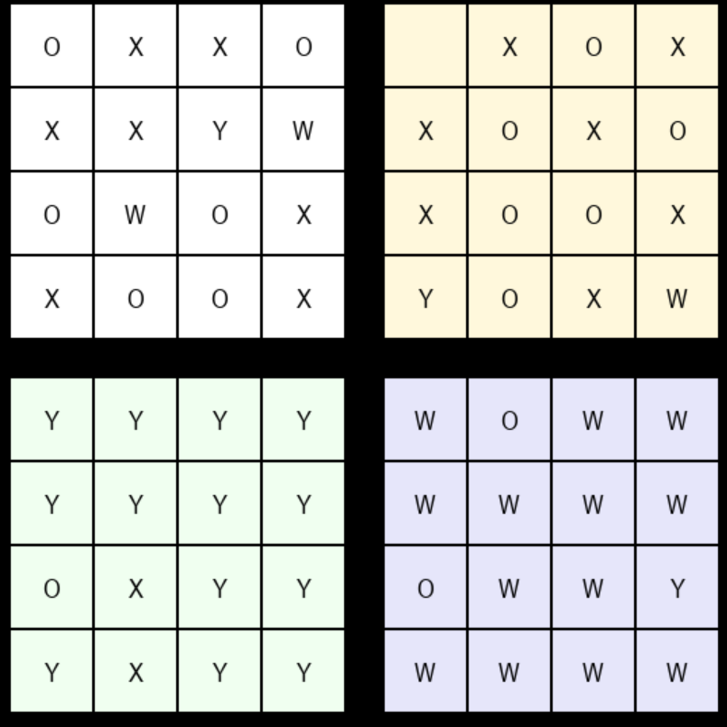
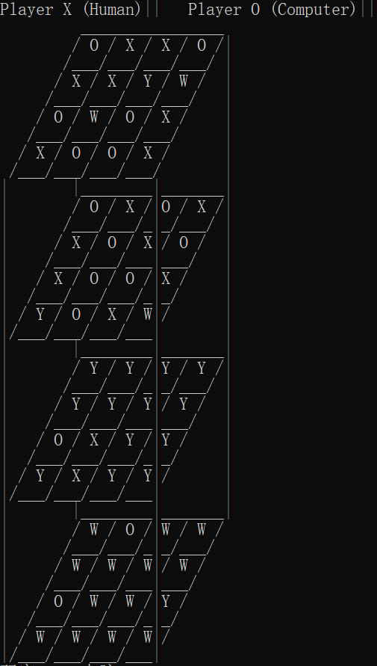
Outputs
The game achieves the 3D cube of 4x4x4 and creat 4x4 board of user interface by using python programming and pygame of 3D game engine. AI always easily wins the game.

Slide 8
Evaluation
achievement | shortfall
Use python program and pygame finish the project | No using Unity to create user interface due to non-compatible python
Visualization 4x4x4 cube
Create user interface friendly on the 4x4 board

Slide 9
Software Demonstration
It takes 2-3 minutes to show the software demonstration.

Slide 10
TAHNK YOU WATCHING

