Slide 1
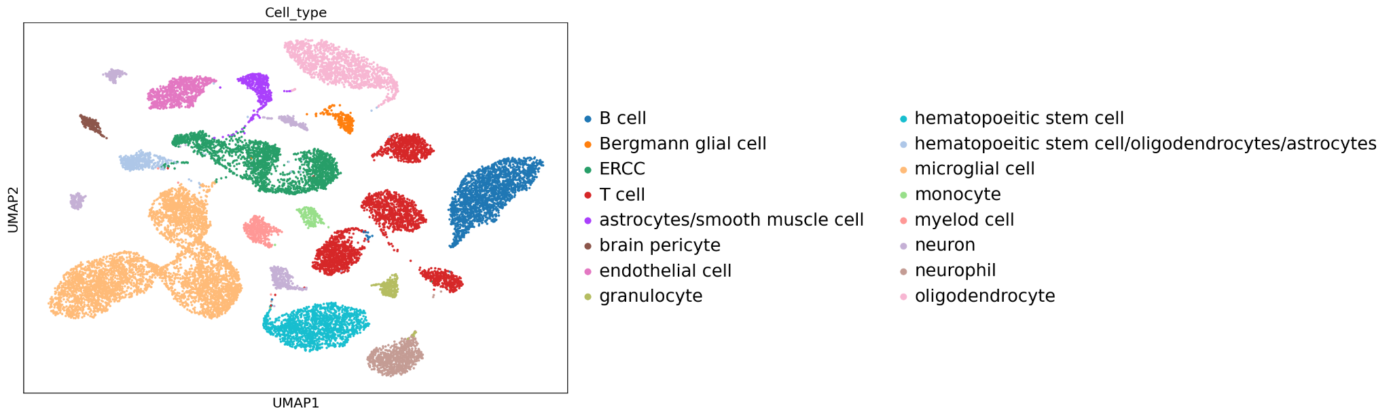
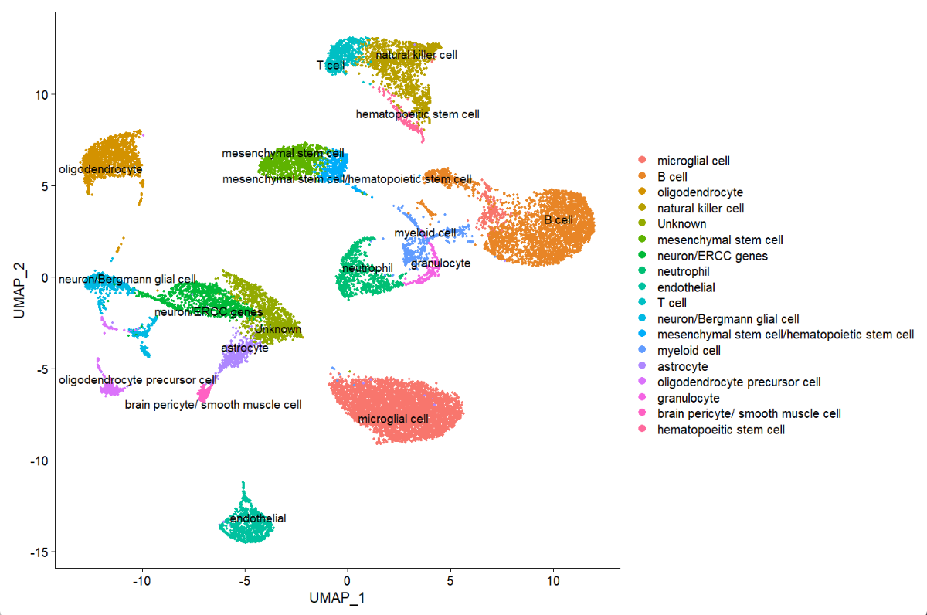
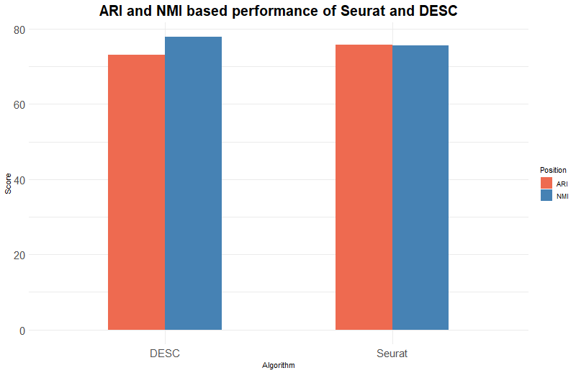
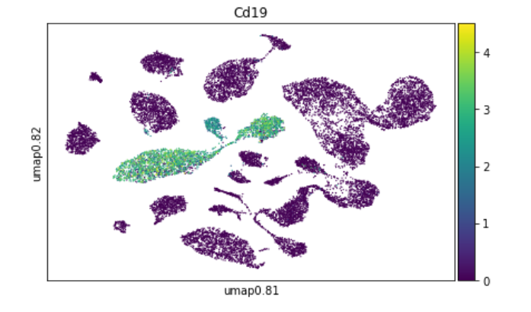
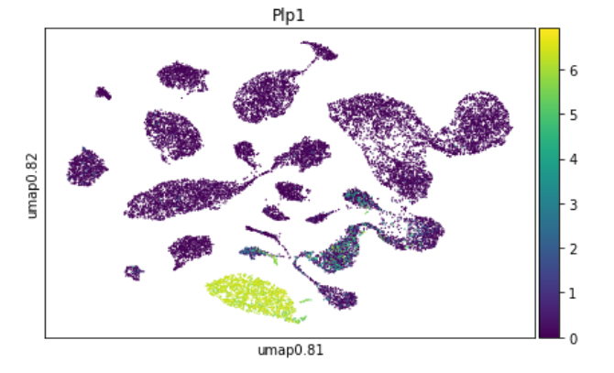
Evaluating Performance of Clustering Algorithms using Single-Cell RNA-Seq Data
Sarah Baalbaki, Sumitra Lele, Sarah Oladejo
Carnegie Mellon University- Computational Biology Department
Abstract
Data Preparation
Results
Efficient computational analyses of scRNA-seq data are required to extract inherent biological information from the huge quantity of information that single-cell RNA-Seq technology presents.
The integration of single-cell RNA-seq data with other machine learning algorithms has facilitated these methods of analysis.
Clustering is an upstream step that affects other downstream analysis, and it is therefore imperative to obtain accurate cluster assignment and number of cell types from scRNA-Seq data.
We plan to compare algorithms that Deep learning to assign the number of cell types.
Data Integration:
Barcode for each cell type in annotations
Integrated gene counts with cell annotations based on the barcodes
Combined data across 5 tissues based on the genes
Data Preprocessing:
Performed basic QC to remove mitochondrial genes
Filtered cells with <200 genes
We removed genes expressed in less than 3 cells
Data Normalization:
Normalized based on log normalization
DESC:
.
SEURAT: COMPARISONS:
MARKER GENES:
Dataset
Algorithms
Recommendations
Our dataset is composed of scRNA-seq data from Smart-seq2 sequencing of FACS sorted cells of 20 organs from 7 mice.
The data contains gene expression information for individual cells within the given cell population.
We choose 5 tissue samples form this dataset, related to immunity:
Spleen
Thymus
Marrow
Brain Neurons
Brain Microglia
We will cluster the genes to correctly identify different cell populations.
SEURAT
DESC
Future work might be more feasible here .
Methodology
DESC:
implute counts dataset
train the dataset
predict cell types
annotate based on expression of marker genes
SEURAT:
find variable features
scale the data
run PCA
find neighbors and find clusters
plot the data in low dimensional space with UMAP
Benchmarking Seurat and DESC using rand index and normalized mutual information
Cd19: B-Cells
Plp1: Hematopoietic stem cell
From our analysis, we see a comparable performance between DESC and SEURAT with both achieving a accuracy greater than 70%.
However, both algorithms differ in their ability to delineate similar cell types such as stem cells (hematopoietic and mesenchymal) and immune cells. For example, DESC was able to cluster the ERCC-spike in transcripts more distinctly than SEURAT
Benchmarking more algorithms and including more datasets will be crucial to draw a conclusion on the strengths and weaknesses of these clustering algorithms
Conclusion and Future Work

