Slide 1
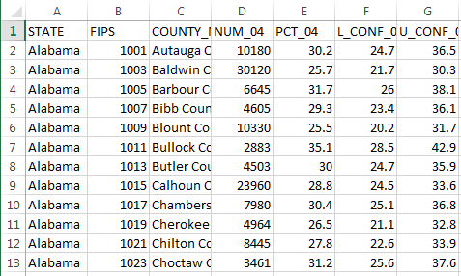
We start with some rows of data
F1 | F2 | F3 | F4 | F5 | F6 | F7 | …

Slide 2
We want to map a specific field…
F1 | F2 | F3 | F4 | F5 | F6 | F7 | …
 |  |  |  | 10
 |  |  |  | 20
 |  |  |  | 40
 |  |  |  | 30
 |  |  |  | -9999
 |  |  |  | 10

Slide 3
We will link it to our map using some ID field…
F1 | F2 | F3 | F4 | F5 | F6 | F7 | …
01 |  |  |  | 10
02 |  |  |  | 20
03 |  |  |  | 40
04
05 |  |  |  | 30
06 |  |  |  | -9999
07 |  |  |  | 10

Slide 4
Our data field may have some cells with no data
F1 | F2 | F3 | F4 | F5 | F6 | F7 | …
01 |  |  |  | 10
02 |  |  |  | 20
03 |  |  |  | 40
04
05 |  |  |  | 30
06 |  |  |  | -9999
07 |  |  |  | 10

Slide 5
Our data field may have some cells with null values (user defined)
F1 | F2 | F3 | F4 | F5 | F6 | F7 | …
01 |  |  |  | 10
02 |  |  |  | 20
03 |  |  |  | 40
04
05 |  |  |  | 30
06 |  |  |  | -9999
07 |  |  |  | 10

Slide 6
So, when we ‘bin’ we may not want to use all rows of data (remove null and no-data easily) – filter phase 1 to clean up data
F1 | F2 | F3 | F4 | F5 | F6 | F7 | …
01 |  |  |  | 10
02 |  |  |  | 20
03 |  |  |  | 40
04
05 |  |  |  | 30
06 |  |  |  | -9999
07 |  |  |  | 10
F1 | F2 | F3 | F4 | F5 | F6 | F7 | …
01 |  |  |  | 10
02 |  |  |  | 20
03 |  |  |  | 40
05 |  |  |  | 30
07 |  |  |  | 10

Slide 7
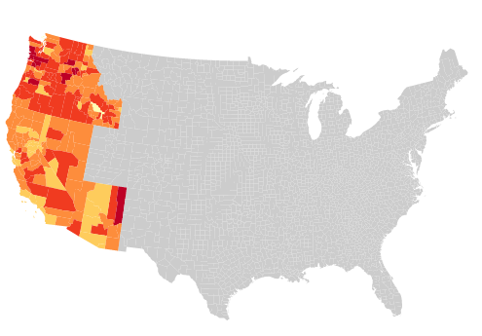

Which should give us something like this:
Map data without null (-9999), without no data (empty cells)
All marks visible, but rows filtered out are given a default color encoding
Binning is done only on ‘valid’ data (null, no data removed)
Color encoding is based on bins on ‘valid’ data
Not very pretty printed bin ranges:

Slide 8
But…sometimes the data is also filtered to remove other attributes
Remove rows with defined characteristics, e.g., with ID of 07
F1 | F2 | F3 | F4 | F5 | F6 | F7 | …
01 |  |  |  | 10
02 |  |  |  | 20
03 |  |  |  | 40
04
05 |  |  |  | 30
06 |  |  |  | -9999
07 |  |  |  | 10
F1 | F2 | F3 | F4 | F5 | F6 | F7 | …
01 |  |  |  | 10
02 |  |  |  | 20
03 |  |  |  | 40
05 |  |  |  | 30

Slide 9
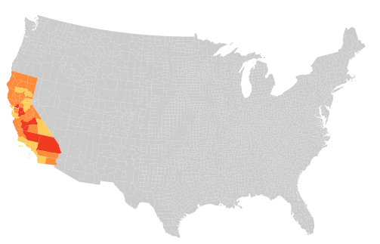
If a ‘global’ set of (statistically defined) bins is used, treat the filtered data as ‘no data’
Bin definition is the same, but the data is filtered to just California
In this example, filtered out data is encoded to match ‘no data’ and ‘null’

Slide 10
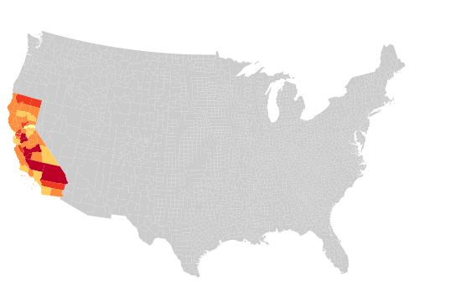

If a ‘local’ set of (statistically defined) bins is used, re-create the bins based on the filtered data
Bin definition changes to reflect only values in the non-filtered out data

Slide 12
When we might encode? Global vs. local.
Encoding based on ‘Global’ bin (use all valid values)
Encoding based on ‘Global’ (all valid values) or ‘Local’ bin (only remaining values)
Filter
Filter
General data cleaning to remove null and no data values
User filtering to remove rows to narrow to data of interest

