Slide 1
TEAM IDK
Team Lead: Sarah Headley
Giang Bui
Tony Moua

Slide 2
Trivia Maze Overview
Ask for Players name
Prompt user for a size user wants for maze
Prompt user for door they would like to go through
Once door is chosen
Question pops up
User answers
Get it right move on, get it wrong that door is locked
Once door is open they stay open
Can always retrace your path back
Win = reach the end of the maze(bottom right corner of maze)
Lose = all doors that lead to the end of maze are locked

Slide 3
Individual Task
Sarah
Admin
Set up Object
Questions

Slide 4
Individual Task
Giang
Transverse- lock-up
Move
Skip option

Slide 5
Individual Task
Tony
Set up DB
Get Questions and Answers
Validate User Input

Slide 6
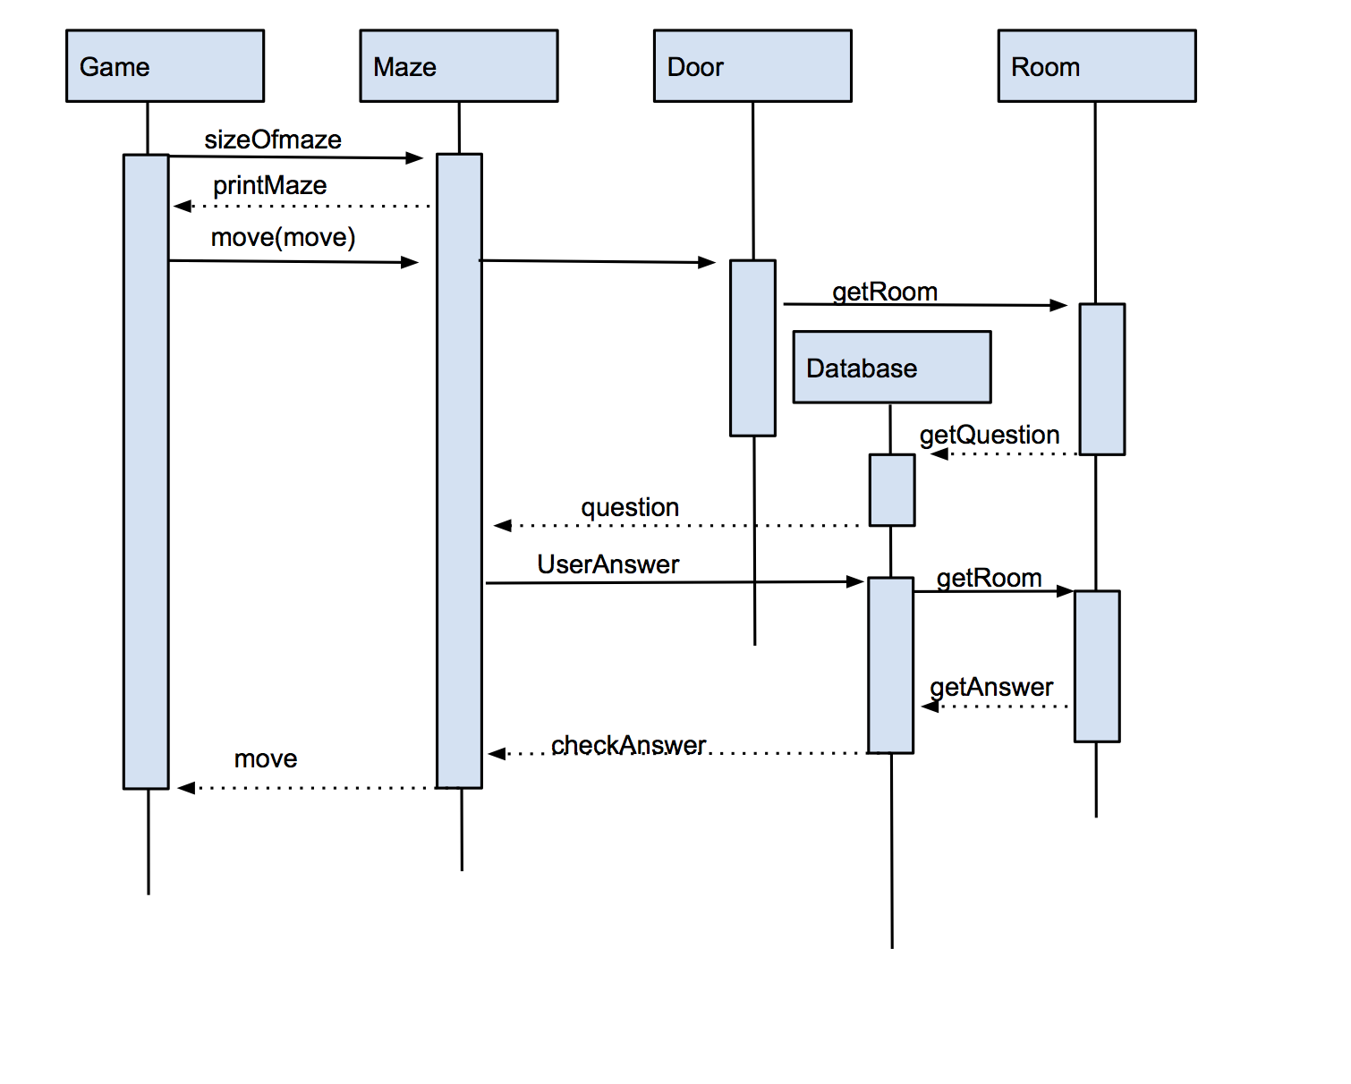
Sequence Diagram

Slide 7
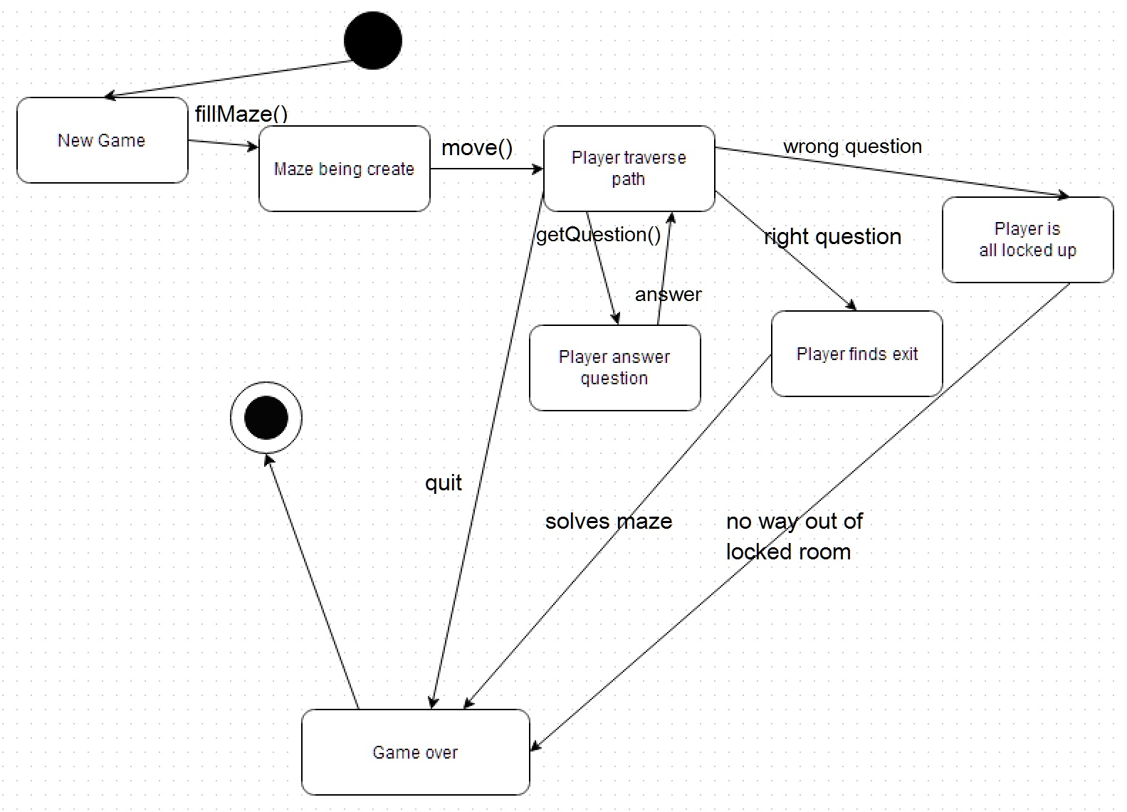
State Diagram

Slide 8
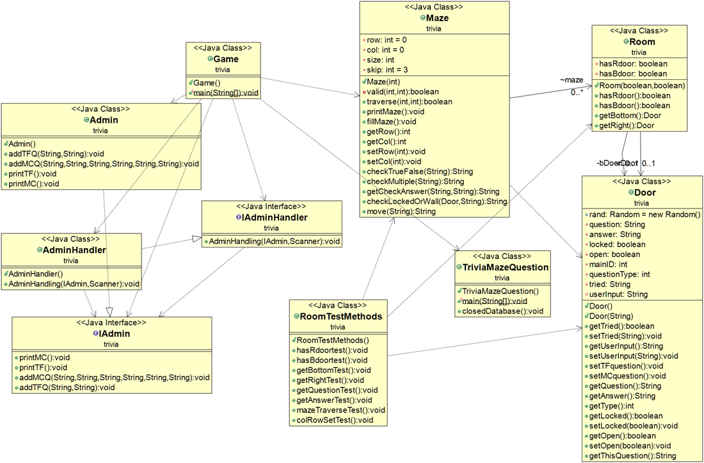
UML Diagram

Slide 9
Questions?

