Slide 1
Occupational Employment and Wage Statistics
Sarah Parker
DA 11

Slide 2
What is the Occupational Employment and Wage Statistics (OEWS) Program?
According to the Bureau of Labor Statistics, the OEWS program produces employment and wage statistics annually for approximately 830 occupations.
These estimates are available for:
The nation as a whole
Individual states
Metropolitan or nonmetropolitan areas
Specific industries
Some states, such as Tennessee, are responsible for
gathering this data for the Bureau of Labor Statistics.

Slide 3
Have you ever seen the most boring statistics of your entire life and thought to yourself, “Hey, who collected the data for this?!”

Slide 4


Slide 5
Project Motivations
My motivation for this project was two-fold:
1. I currently collect this data for the Tennessee Department of Labor.
2. As a student of Nashville Software School, I have been personally interested in the current job market for myself, my loved ones, and my classmates.

Slide 6
01
National OEWS Data

Slide 7

02
California: An OEWS Case Study

Slide 8


03
Application Demographics

Slide 9
ABOUT US!
Here you could give a brief description of the topic you want to talk about. For example, if you want to talk about Mercury, you could say that it’s the smallest planet in the entire Solar System

Slide 10
TABLE OF CONTENTS
01
Project
02
Report
03
Team
04
Mockup
You could describe the topic of the section here
You could describe the topic of the section here
You could describe the topic of the section here
You could describe the topic of the section here

Slide 11
PICK A SIDE!
Mercury
Venus
Mercury is the closest planet to the Sun and the smallest one in the Solar System—it’s only a bit larger than the Moon
Venus has a beautiful name and is the second planet from the Sun. It’s terribly hot and has a very poisonous atmosphere

Slide 12
YOU MAY NEED THREE COLUMNS
Mars
Jupiter
Saturn
Despite being red, Mars is a cold place, not hot
It’s a gas giant and the biggest planet
Yes, this is the ringed planet. It’s a gas giant

Slide 13

A PICTURE IS WORTH
A THOUSAND WORDS

Slide 14

THANK YOU!

Slide 15
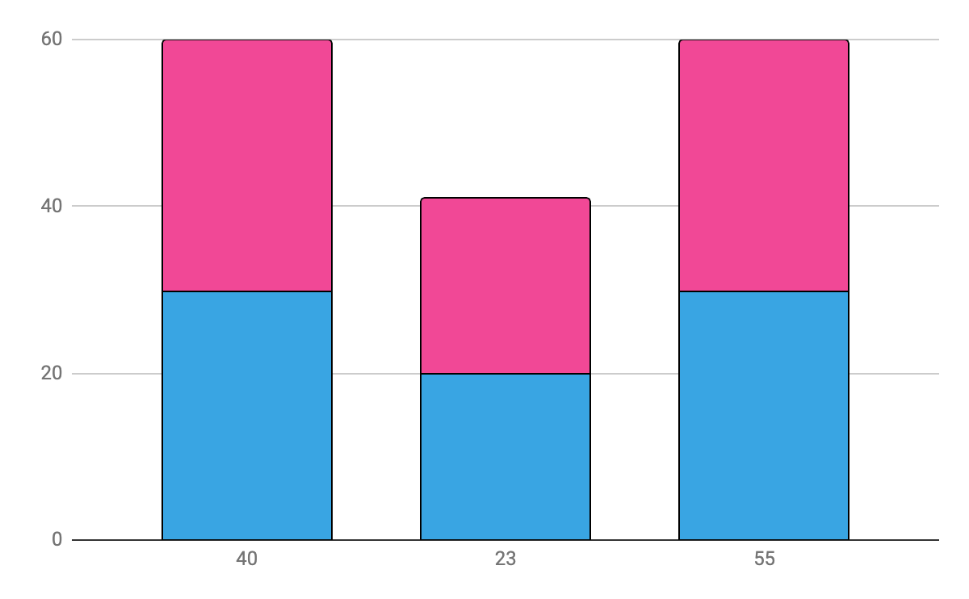
THIS IS A GRAPH
Mercury
Jupiter
Mercury is the closest planet to the Sun
It’s the biggest planet in the Solar System
Follow the link in the graph to modify its data and then paste the new one here. For more info, click here

Slide 16
REVIEWING CONCEPTS
Mercury
Venus
Mars
Jupiter
Saturn
Neptune
It’s the closest planet to the Sun
Venus has a beautiful name, but it’s hot
Despite being red, it’s a cold place
Jupiter is the biggest planet of them all
Saturn is the ringed planet and a gas giant
Neptune is the farthest planet from the Sun

Slide 17
THIS IS AN INFOGRAPHIC
Neptune
Venus
Mars
80%
60%
30%
Neptune is the farthest planet from the Sun
Venus has a beautiful name, but it’s hot
Despite being red, it’s a cold place

Slide 18
THIS IS A MAP
Mercury
Jupiter
Saturn
Mercury is the closest planet to the Sun
It’s the biggest planet in the Solar System
Saturn is the ringed planet and a gas giant

Slide 19
THIS IS A TIMELINE
Mars
Jupiter
Mercury
Venus
1
3
Despite being
red, Mars is a
very cold place
Jupiter is the biggest planet in the Solar System
2
4
Mercury is the closest planet to the Sun and the smallest
Venus has a beautiful name, but it’s even hotter than Mercury

Slide 20
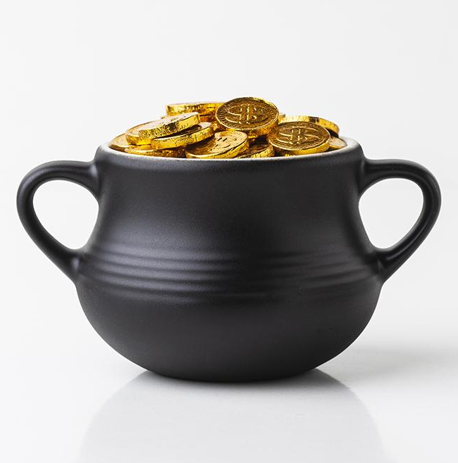
SUMMARY POINTS
Venus
Mars
Mercury
Saturn
Venus has a beautiful name, but it’s very hot
Mars is actually a cold place. It’s full of iron dust
Mercury is the closest planet to the Sun
Saturn is composed of hydrogen and helium

Slide 21
3,987,000
Big numbers catch your audience’s attention

Slide 22
333,000,000
24h 37m 23s
386,000 km
Earths is the Sun’s mass
It’s Jupiter’s rotation period
It’s the distance between the Earth and the Moon

Slide 23
IF YOU NEED A DIAGRAM
1
Mercury is the smallest planet
Mercury
Planets
Jupiter
2
It’s the biggest planet of all
Venus
3
Venus has a beautiful name

Slide 24
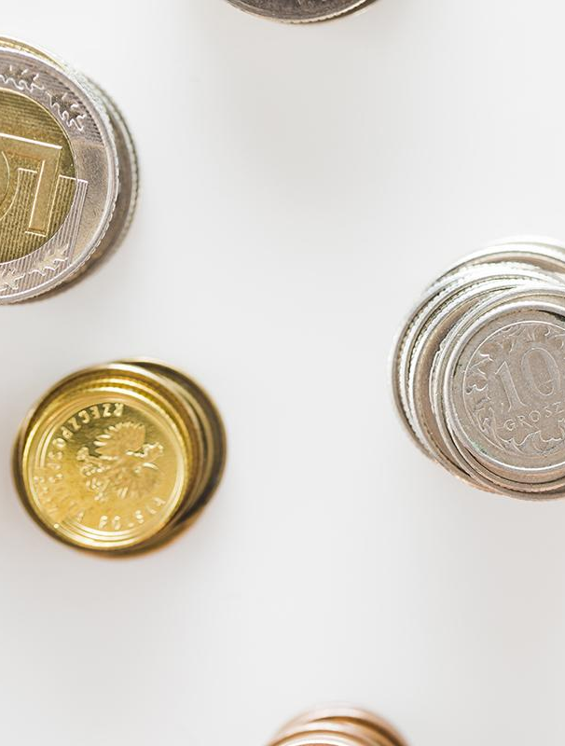
IMPORTANT LISTS
Here you can list your reference websites or publications
Here you can list your reference websites or publications
Here you can list your reference websites or publications
Here you can list your reference websites or publications

Slide 25
DO’S AND DON’TS
Here you can describe what the user should do
Here you can describe what the user should do
Here you can describe what the user should do
Here you can describe what the user shouldn’t do
Here you can describe what the user shouldn’t do
Here you can describe what the user shouldn’t do

Slide 26
SOURCES

