Slide 1
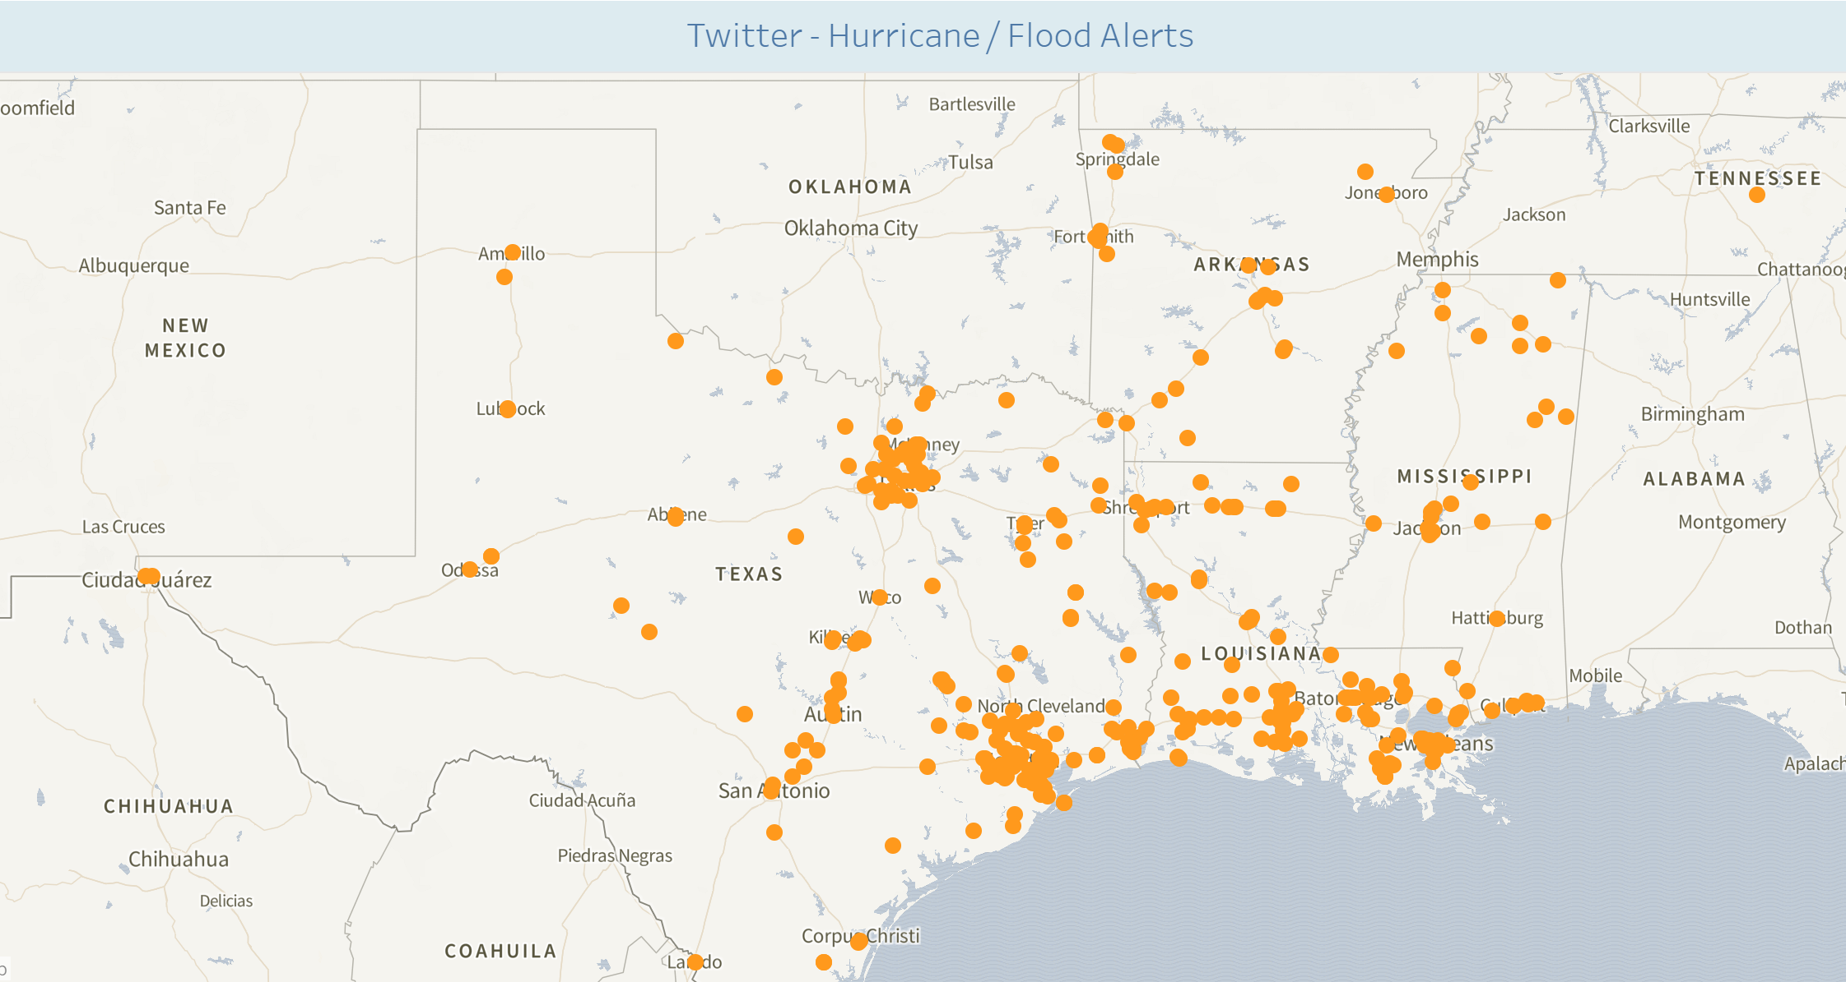
August 26th

Slide 2
This is a standard GIF… should work on any device
Aug 19 – Aug 26th
(I can have Aug 27th tmrw)
**Now that I see this… I can add the date in big font on the bottom right as the days change (if a GIF works)

