Slide 1

Intro to Botany Fall 2018 Intro to R programming and moss growth statistics lab

Slide 2

What is R?
“Many users think of R as a statistics system. We prefer to think of it of an environment within which statistical techniques are implemented.”
https://www.r-project.org/about.html

Slide 3
What is R?
The implementation of statistics techniques has prodigious uses…
“Base R” runs a lot of stats and makes graphics.
People write R packages to accomplish a lot of other tasks.
“A package bundles together code, data, documentation, and tests, and is easy to share with others.”
http://r-pkgs.had.co.nz/intro.html

Slide 4
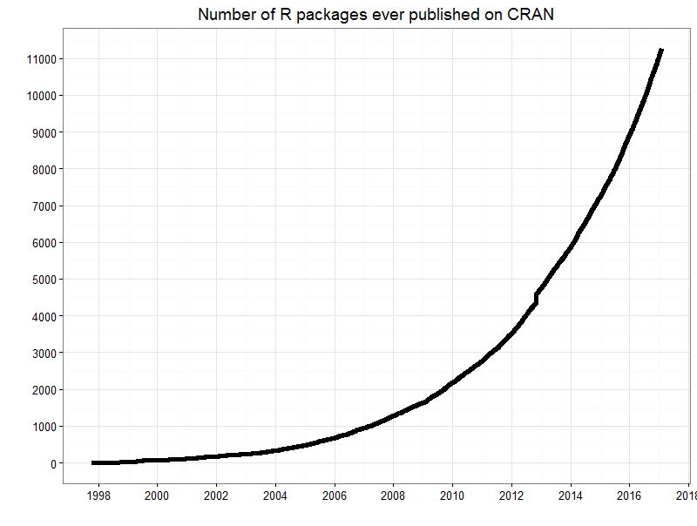
Over 10,000 R packages published!!!!
R first appeared in August 1993
http://blog.revolutionanalytics.com/2017/01/cran-10000.html

Slide 5
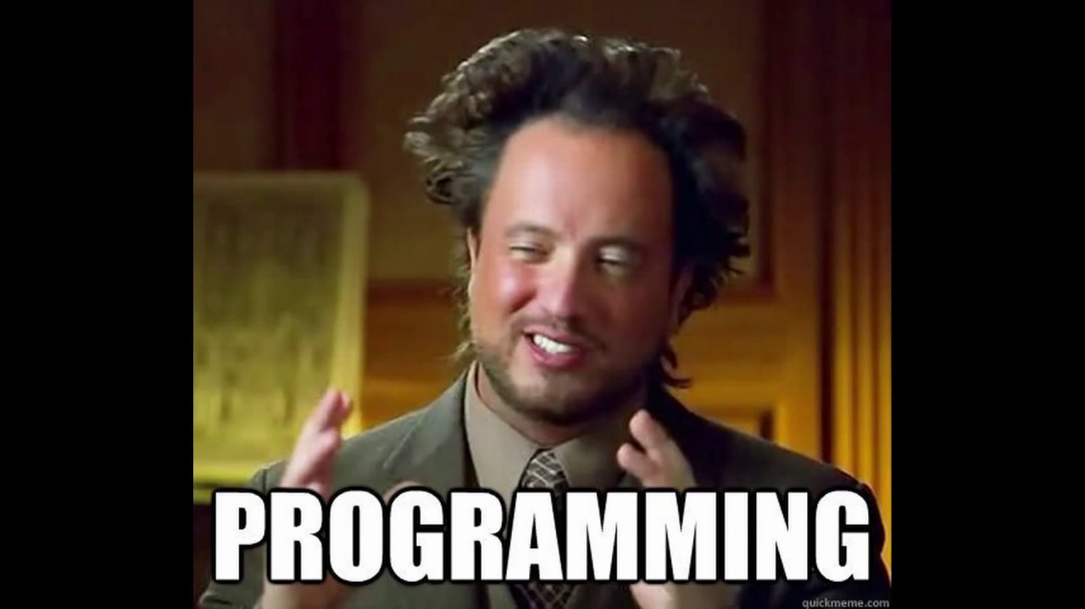
“Those are cool facts Sarah, but how is R useful to me?”

Slide 6
“Those are cool facts Sarah, but how is R useful to me?”
How many of you anticipate a career where you’ll have to run some statistics?

Slide 7
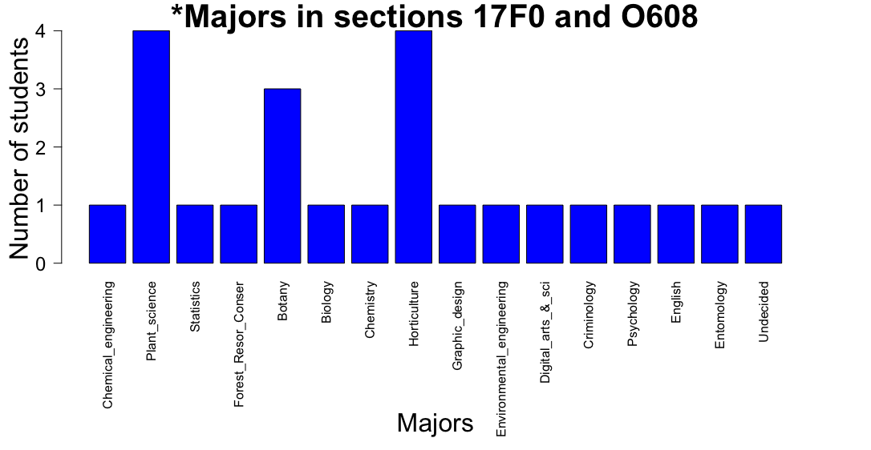
*graph made in R

Slide 8
Graphic design & Digital arts:
magick: Advanced Graphics and Image-Processing in R
Psychologists:
Package QuantPsyc: “These are basic operations covered in a multivariate course in most Doctoral level Psychology programs. These functions will also likely be useful in other domains (e.g., sociology, business management,
medicine).”
Chemical engineering & Chemistry:
Package chemCal: Calibration Functions for Analytical Chemistry

Slide 9
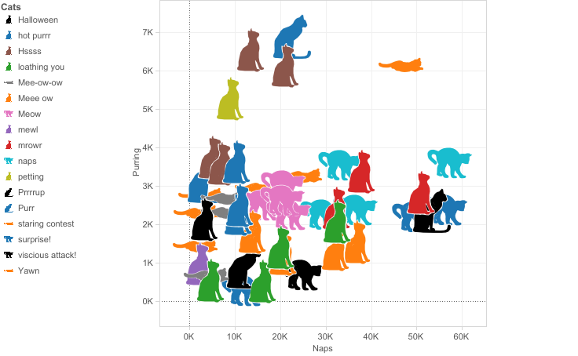
There are also fun R packages
Like Catterplots!

Slide 10
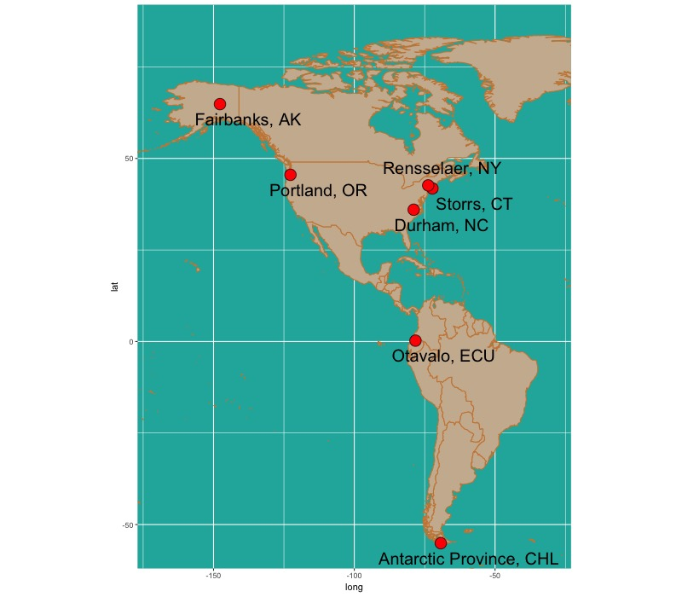
You can make maps!

Slide 11
You can make (relatively) easy graphics!

Slide 12
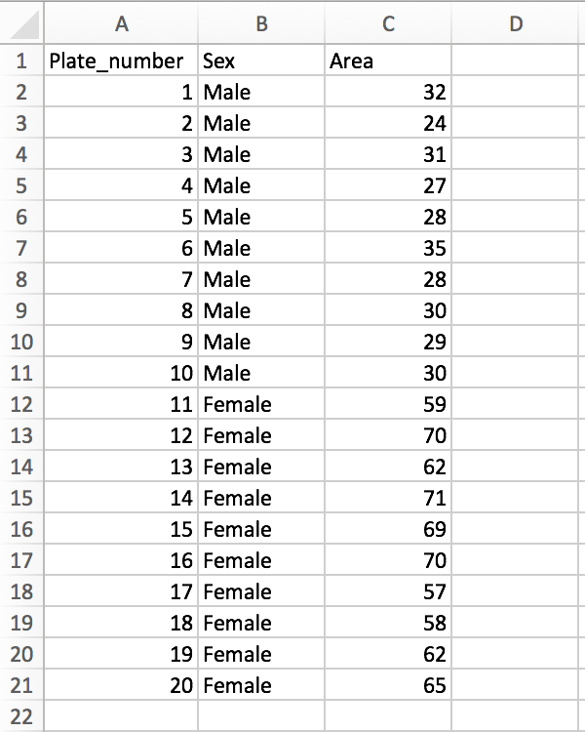
You can subset really big datasets!
subset

Slide 13
One of my favorite things about R: it’s open source
That means it’s freely available to you.
And you can Google just about any problem and find your answer.
(I Googled how to make this graph)

Slide 14
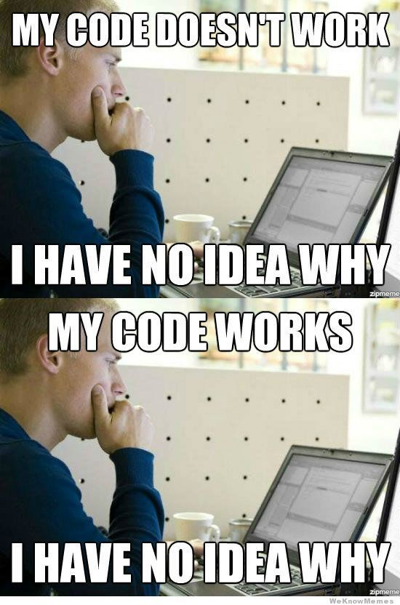
Downside to R (and other programming languages): it can be hard to learn

Slide 15
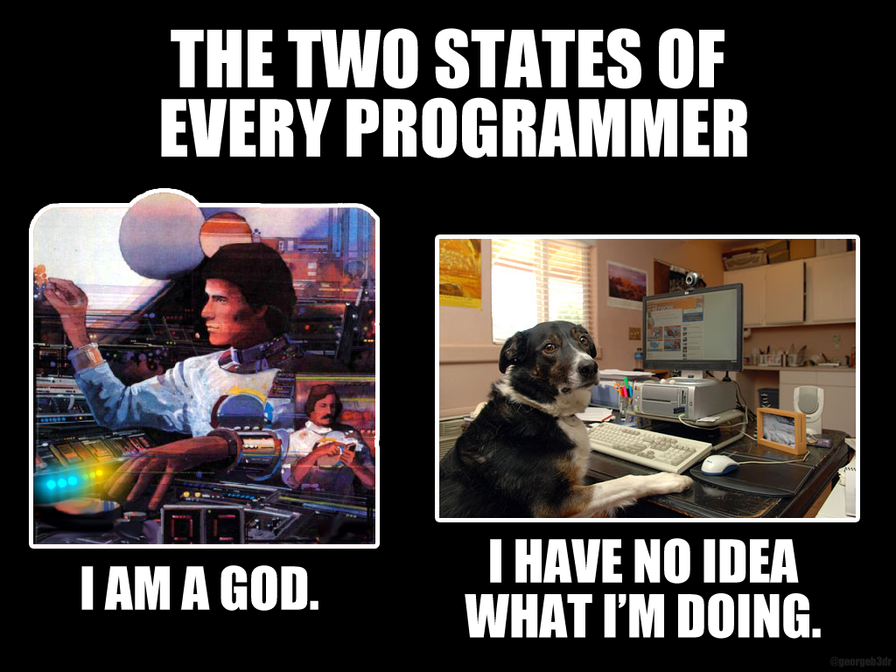

Slide 16
“When learning R (or any other new task) it’s okay to start small: aim for improvement not perfection”
– Dr. Meghan Duffy
University of Michigan
Quote from:
https://dynamicecology.wordpress.com/2018/10/30/when-learning-r-or-any-other-new-task-its-okay-to-start-small/

Slide 17
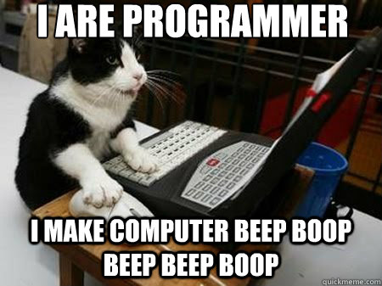
For a further introduction to R programming
https://rforcats.net

Slide 18
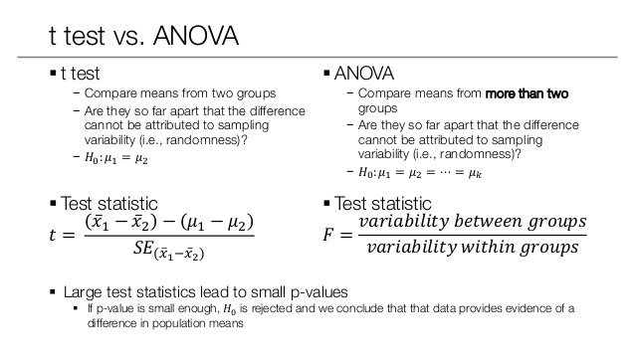
What kind of data analysis:
Depending on your experimental design, you’ll run either a t-test or ANOVA (and Tukey’s test)

Slide 19
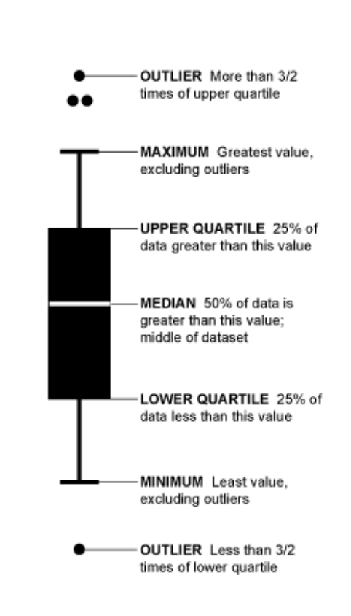
Graph data using boxplots
http://www.r-graph-gallery.com/portfolio/boxplot/

