Slide 1
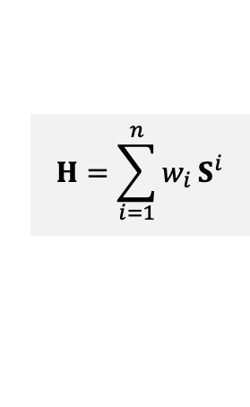
Literature Data
Expert Survey to Rank Covariate Importance
Identify (n) relevant Covariates and their suitable range
Expert Data
Rasters for each covariates (R)
Use AHP to assign covariate weights (w)
Assign suitable values for each covariate (S)
Methods
Basic
Smoothed
Jagged
Calculate Habitat Suitability Index (H)
$$H=\sum_{i=1}^{n}{w_{i}}S^{i}$$

