Slide 1
Sultana Kowser
011141116

Slide 2
NOMAO data set
NOMAO collects data about place from many sources.
Deduplication consist in detecting what data rate % to the same place.
Instances in the data set compare 2 spots.

Slide 3
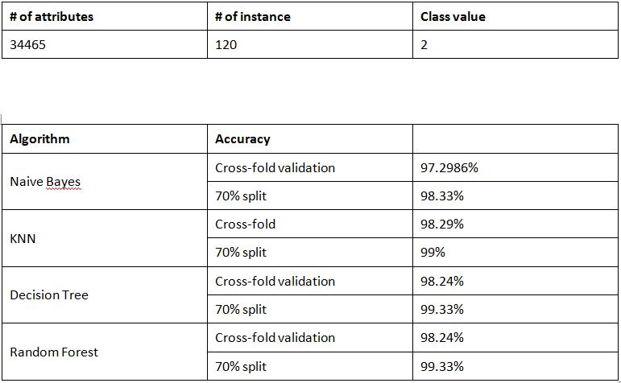

Slide 4
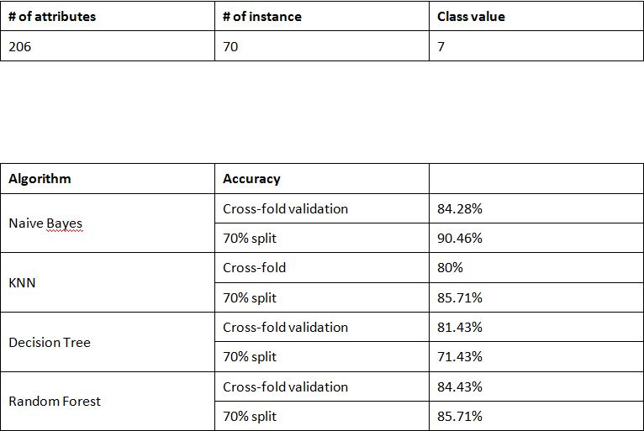
SCADI data set

