Slide 1
Digging Deeper into Javascript
Sajid Rabbani
Senior Software Engineer
Nascenia

Slide 2
Client Side Validation
Validate element of a form
Saves time & bandwidth
Gives more option to point out the problem
Triggered upon submission of form
Can validate pattern like email, phone number

Slide 3
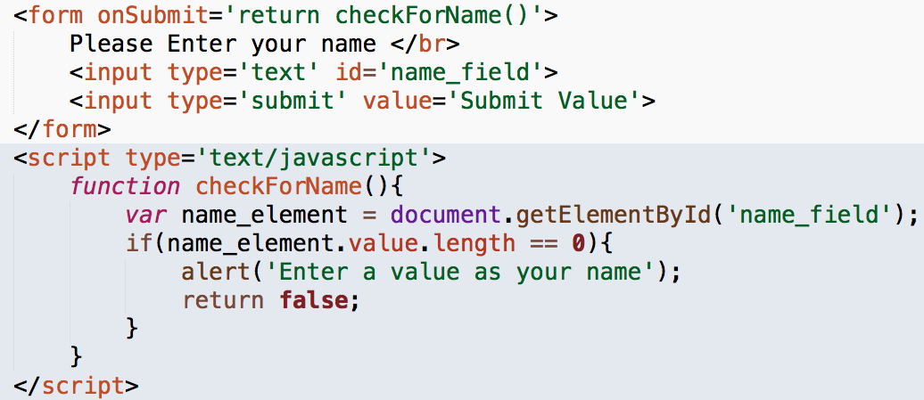
Form Validation: Text Fields

Slide 4
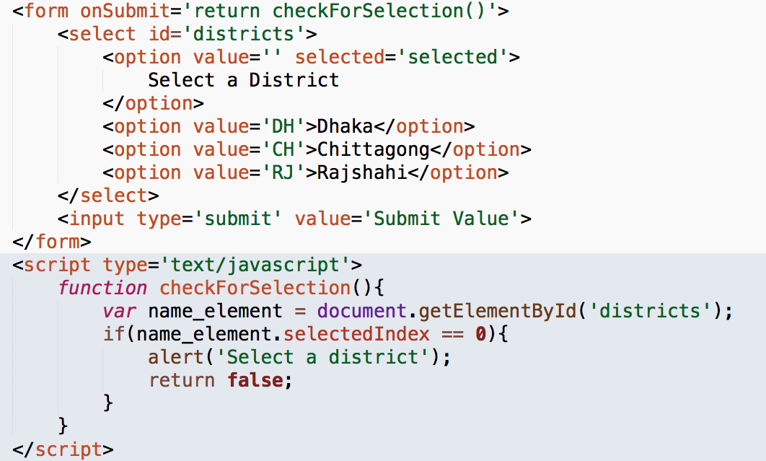
Form Validation: Drop Downs

Slide 5
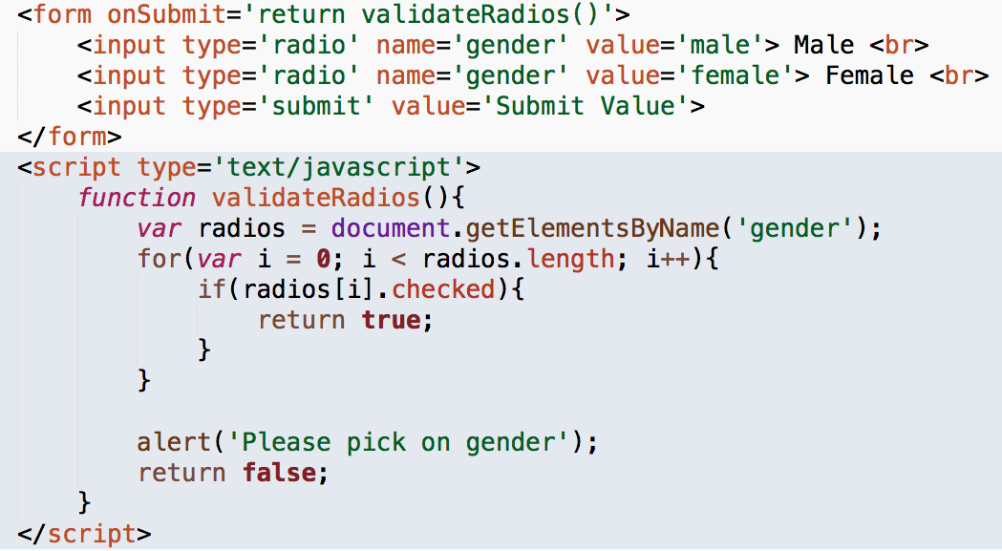
Form Validation: Radio Buttons

Slide 6
Regular Expression
Sequence of characters
Define a search pattern
Used for pattern matching with strings
Example: [A-Za-z0-9]+

Slide 7
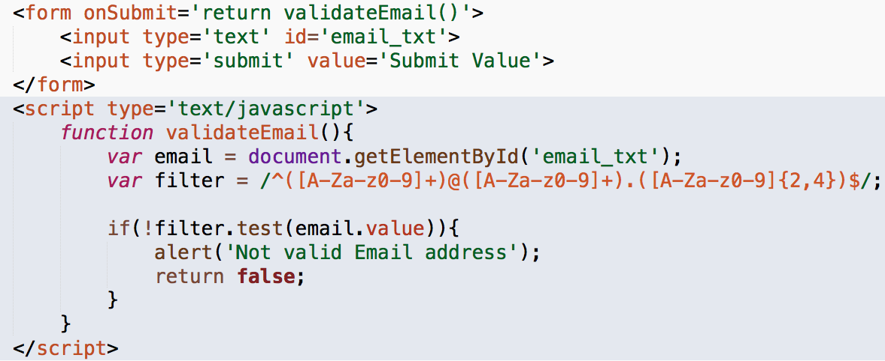
Form Validation: Regular Expression

Slide 8
The DOM
DOM – Document Object Model
An organization chart
Document is the first level
Under the document html is the second level
Head & body are the third level

Slide 9
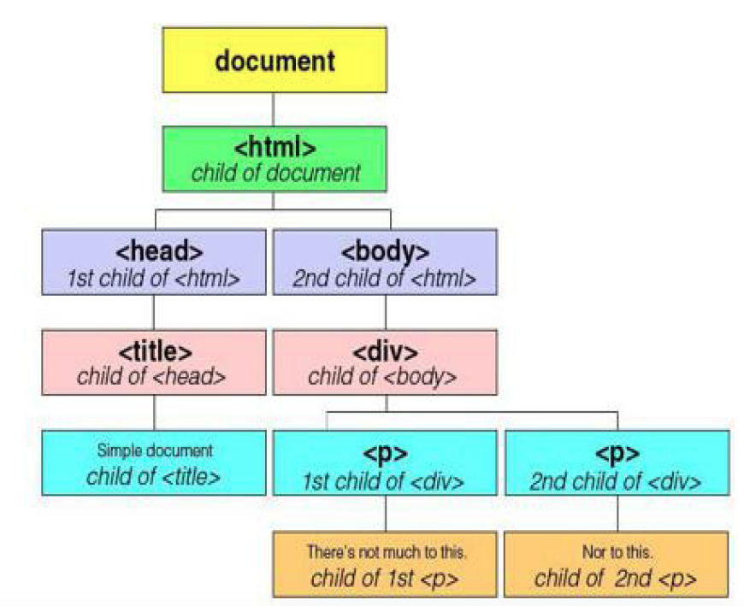
The DOM

Slide 10
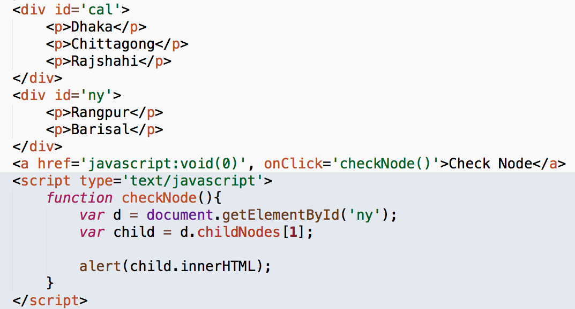
Accessing Child Nodes

Slide 11
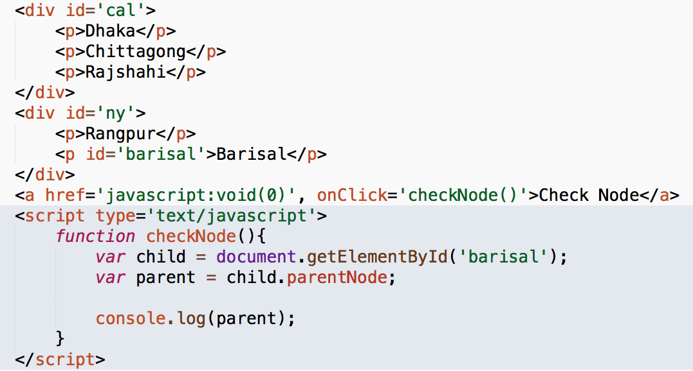
Finding the Parent

Slide 12
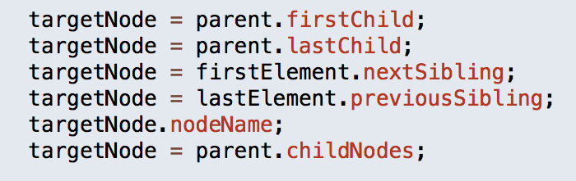
Some more properties

